Slide 1



Primary Care Buprenorphine Basics
Jonathan Robbins MD,MS
Adapted from Dan Hoover, MD
Eleasa Sokolski, MD

Slide 2
Disclosures
no disclosures.

Slide 3
Learning Objectives
Review the challenges of starting buprenorphine in patients using fentanyl.
Understand the rationale behind different buprenorphine initiation strategies.
Learn to counsel patients on buprenorphine administration techniques.

Slide 4
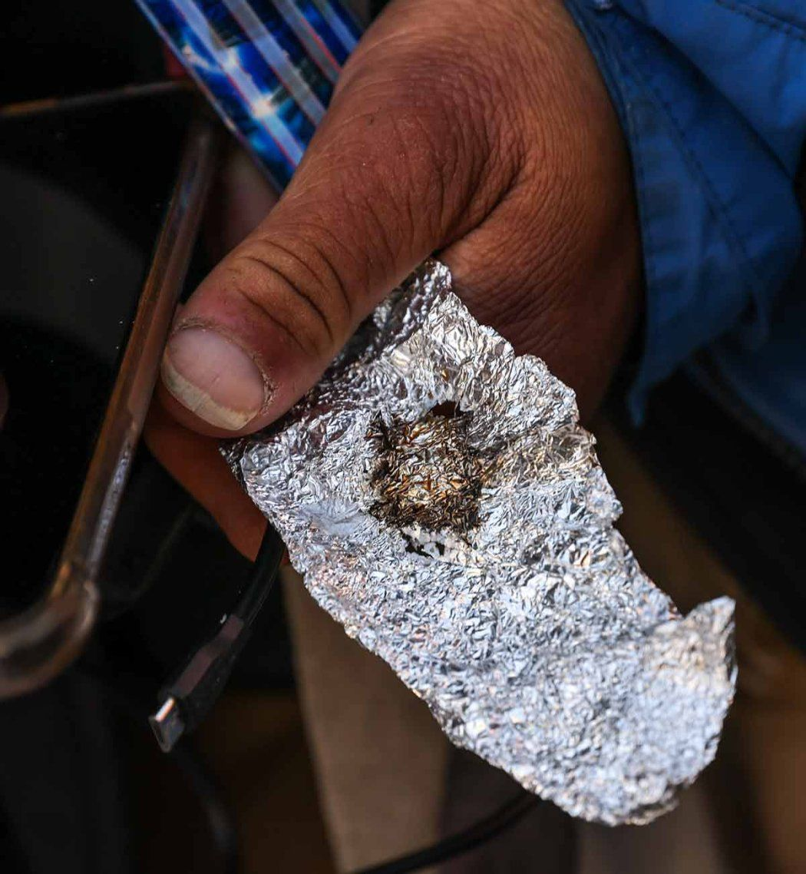
38 year-old man “Jim” chronic use of smoked fentanyl / methamphetamine, unstable housing, recent overdose, presents for primary care follow-up.

Slide 5
How to Start - First Office Visit
Confirm diagnosis of opioid use disorder (DSM-V)
History & physical exam
Labs +/- Urine Drug Screen
Vaccines
Harm Reduction (or, at least naloxone)
Warm hand off to behavioral health + peer support
Notes:
https://www.ncbi.nlm.nih.gov/books/NBK64245/pdf/Bookshelf_NBK64245.pdf

Slide 6
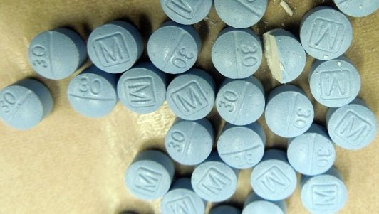
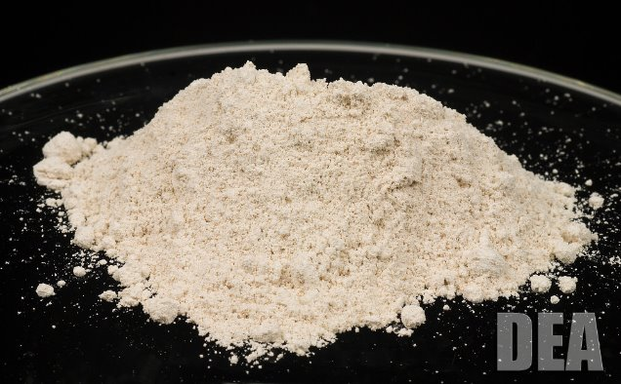
Fentanyl
50-100X more potent than heroin ​
Short acting but highly lipophilic ​
$0.5-2 per pill

Slide 7
Iatrogenic "Precipitated" Opioid Withdrawal
Lipophilicity of fentanyl complicates traditional buprenorphine initiation.​
High rates of iatrogenic severe withdrawal with starting buprenorphine within 24-48 hours of last fentanyl use.
Varshneya. J Addict Med. 2022

Slide 8
Starting Buprenorphine in the Fentanyl Era​
Low Dose Starts | High Dose Starts
Start small doses while continuing fentanyl | Give big dose of buprenorphine up front
Buprenorphine slowly replaces fentanyl at the mu-opioid receptor​ | Quickly occupy the most mu-opioid receptors with buprenorphine​
Lower risk for precipitated withdrawal | Higher risk for precipitated withdrawal​
Takes time to complete – can be sped up but still at least 3-4 days | Can be completed in 1 day, patients will not need to continue fentanyl use

Slide 9
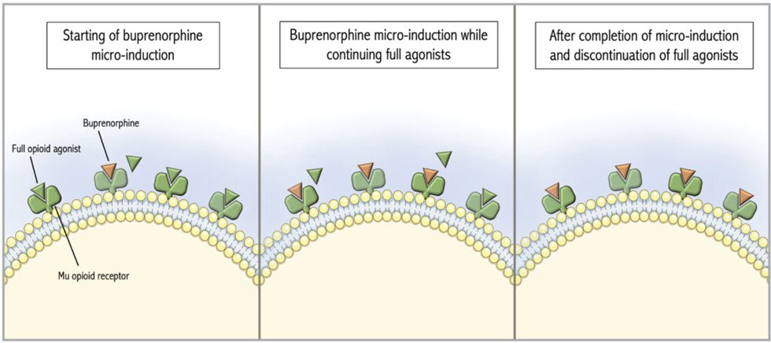
Low-dose "Micro" Initiation ​
South, The Hospitalist. 2022
Notes:
https://www.the-hospitalist.org/hospitalist/article/33560/clinical-guidelines/beyond-the-basics-how-should-we-manage-acute-pain-in-hospitalized-patients-with-oud/

Slide 10
Example Low-Dose Protocol
Day ​ | Buprenorphine ​ | Full-agonist Opioid ​
1​ | 0.5mg every 6 hours x4 doses​ | Continue​
2​ | 1mg every 6 hours x4 doses ​ | Continue​
3​ | 2mg every 6 hours x4 doses ​ | Continue​
4​ | 8mg in morning + additional 4-8mg q2hr doses up to 24-32mg ​ | Stop ​
In the hospital can prescribe full-agonist opioids
Outpatient- must continue to use non-prescribed opioids to prevent withdrawal

Slide 11
High-Dose Start
Wait as long as possible to start, at least 24 hours from last use of fentanyl ​​(but ideally 48-72hr)
Take 8-16mg of buprenorphine, may take additional 8mg every 1-2 hours to max 32mg
Herring, JAMA, 2021​​
CA Bridge Buprenorphine Self-Start

Slide 12
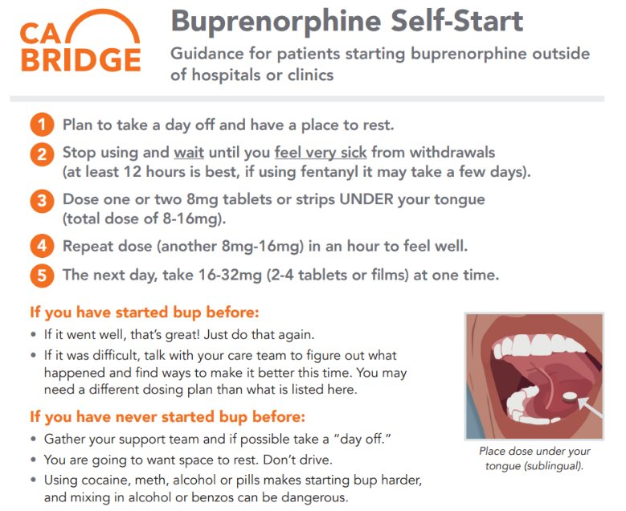

Slide 13
Consider Adding Adjuncts
Adjunctive Medication | Dose | Indication
Clonidine | 0.1mg-0.2mg three times daily as needed | Sweating, anxiety, restlessness, insomnia
Gabapentin | 300mg every 8 hours as needed | Anxiety, restlessness, insomnia
Acetaminophen | 500mg-1000mg every 6 hours as needed | Mild to moderate pain
Melatonin | 3mg at bedtime as needed | Insomnia
Tizanidine | 2mg-4mg every 6 hours as needed | Muscle spasms
Loperamide | 2mg every 6 hours as needed | Diarrhea
Hyoscyamine | 0.125mg every 6 hours as needed | Abdominal cramping
Hydroxyzine | 25mg-50mg every 6 hours as needed | Anxiety
Ondansetron | 4mg every 8 hours as needed | Nausea

Slide 14
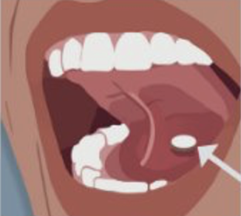
Counseling for Administration of Bup
Avoid nicotine for 30 minutes before taking buprenorphine
Only dissolve 2 tabs or films at a time
Allow 5-10 minutes to dissolve – spit out residue to reduce risk for nausea
Wash mouth out (swish and spit) to reduce risk for dental carries

Slide 15
Low-Barrier Buprenorphine
Accepting same-day walk-ins.​
Not turning patients away who are late for their appointments.​
Non-punitive approach to opioids or substance use.​
Providing access to buprenorphine; freedom to decline counseling, etc.
Kapadia. J Gen Intern Med. 2021

Slide 16
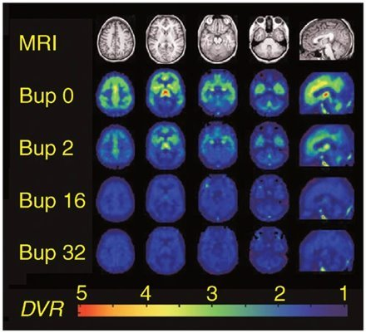
Dose Limits – Can I go up to 32mg?
24mg dose limit is based on data from before the fentanyl era ​
The opioid receptor has 85-92% occupancy at 16mg daily and 94-98% occupancy at 32mg daily ​
Higher receptor occupancy is associated with reduced withdrawal symptoms and cravings​
A subset of patients do better at 32mg daily (at least during stabilization phase)!
Grande. J Addict Med. 2023
Greenwald, Neuropsychopharmacology, 2003

Slide 17
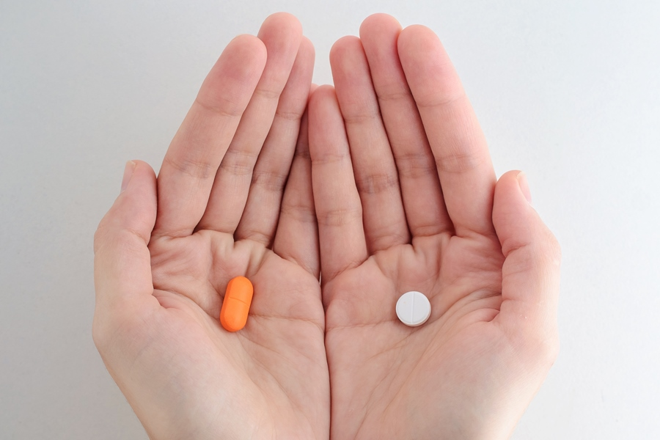
Buprenorphine (Subutex) vs Buprenorphine-Naloxone (Suboxone)
When used sublingually, naloxone is minimally absorbed.
Primarily a deterrent to block the effect of buprenorphine if a tablet is injected.
Some patients may have side effects with the combination product (headache, nausea)
Blazes, Front Psychiatry, 2020

Slide 18
One week follow-up
Jim is now taking buprenorphine SL 8 mg TID. He has ongoing cravings and has minimally reduced his smoked fentanyl use.
Speech is tangential and pressured.

Slide 19
Meth Use
LAI bup
Sublocade 300 mg
or
Brixadi 128 mg
Contingency Management
and
Olanzapine 2.5 – 5 mg BID prn delusions, anxiety

Slide 20
OHSU Clinical Advice Line
Free, real-time advising for your care of Oregonians
Call (503) 494-4567 Mon-Fri, 8 am-5 pm and ask for Addiction Medicine. Responsibility for treatment and diagnostic decisions remains with you, the treating provider, when an OHSU physician is providing advice to you.
Notes:
Dan

Slide 21
Thank You
Jonathan Robbins, MD
Division of General Internal Medicine
Section of Addiction Medicine
robbijon@ohsu.edu

