Slide 1
Vaccines 101 for Parents & Caregivers
Notes:
This presentation is designed to share basic information about vaccines with parents and caregivers.
To add your own photos to this slide:
1) Click the “Insert” button above.
2) Click on the “Pictures” button and select “This Device.”
3) A pop-up box with access to the folders on your computer will open. Look for the image you’d like to add.
4) Once you select the image, it should come up on the slide. Use your mouse to move and place the image.

Slide 2
Your Presenter
HEADSHOT HERE
Title
Organization
Email Address
Notes:
[Introduce yourself and any co-presenters if applicable]
To add your headshot to this slide:
1) Click the “Insert” button above.
2) Click on the “Pictures” button and select “This Device.”
3) A pop-up box with access to the folders on your computer will open. Look for the image you’d like to add.
4) Once you select the image, it should come up on the slide. Use your mouse to move and place the image over the “HEADSHOT HERE” place holder. That’s it!

Slide 3
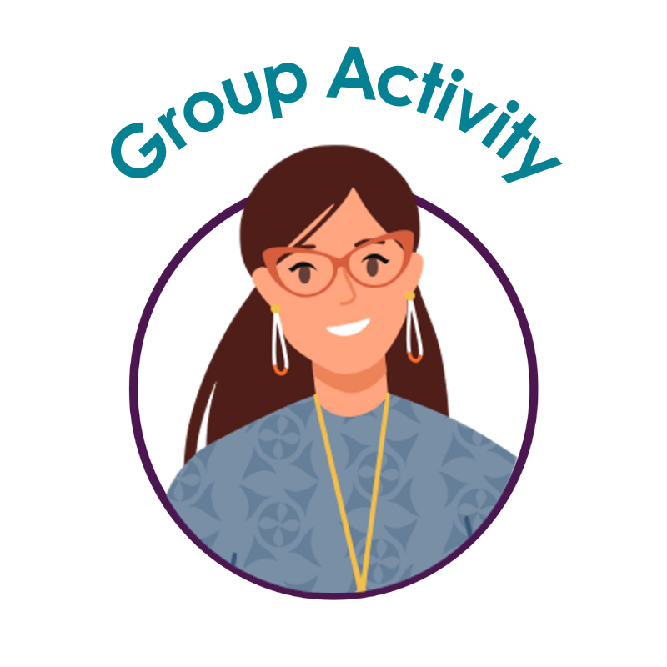
Introductions
Share your:
Name
Pronouns
Tribal Nation(s)
Community Roles
Notes:
Now, let’s take a moment to introduce ourselves. Please share your name, pronouns, your tribal affiliation, and your roles in the community. I'll call on someone, and after you've finished introducing yourself, call on someone else.

Slide 4

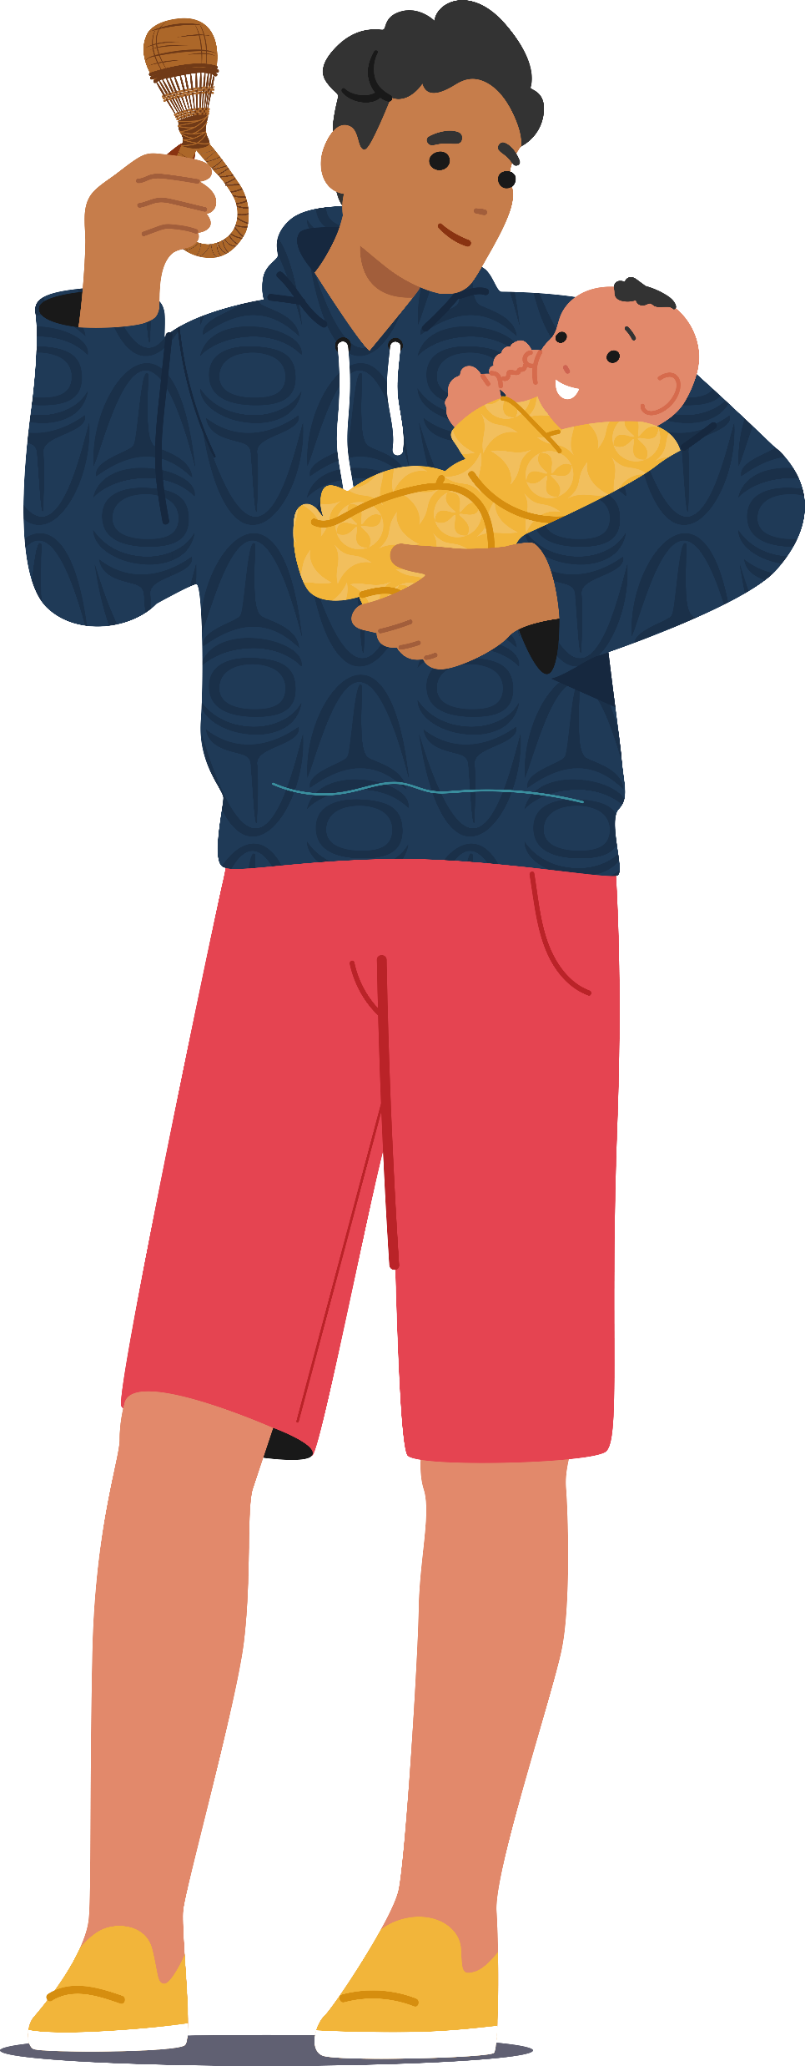
Agenda
Our history
How vaccines work
Child vaccine schedule
Vaccine safety
Common questions
Good places to get information
Notes:
During this presentation, we will discuss our history and how certain diseases impacted our ancestors. We will also talk about how vaccines work, the child vaccine schedule and why it’s important. Then, we will share information about vaccine safety and answer some common questions. Lastly, we will highlight a few good sources of information you can check out if you have questions.

Slide 5
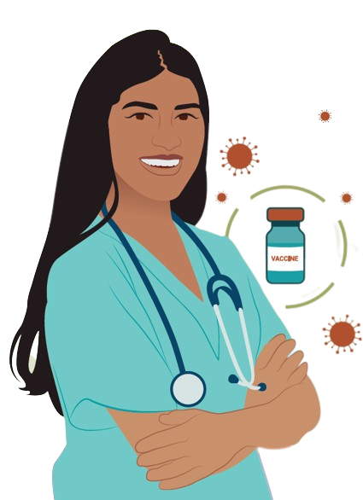
Handout
Questions for My Doctor:
Write down your questions
Bring handout to your next appointment
Notes:
Before we get started, I’m going to quickly pass out a handout called “Questions for My Doctor”. If you have questions that come up during the presentation today, write them down. If we don’t get to them, you can bring the handout to your doctor or your child’s doctor at your next appointment.
Note to presenter: The “Questions for My Doctor” handout can be found here XX

Slide 6
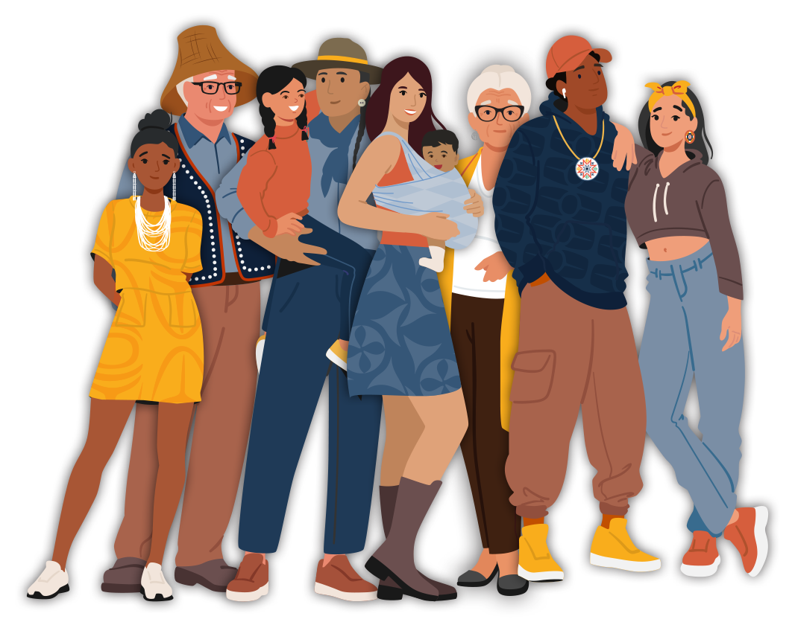
Vaccines are a hot topic!
Notes:
Today, vaccines are a hot topic! If you’re a parent or caregiver, you’ve probably heard it’s important to get your kids vaccinated. After all, vaccines protect kids from many dangerous diseases – like measles, polio, and certain types of cancer.

Slide 7
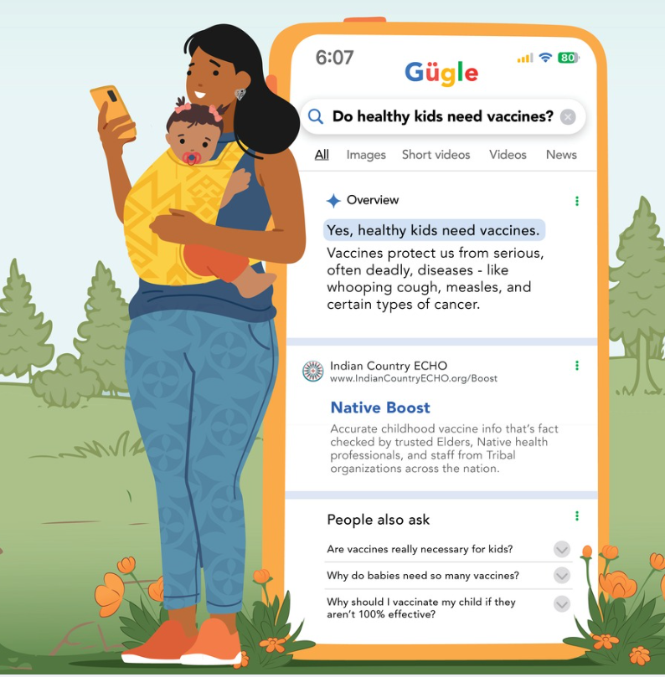
Vaccine Misinformation
Conflicting information about vaccines:
On social media
Online
Talking with other parents
Notes:
But recently there’s been a lot of misinformation circulating about vaccines. If you've spent any time scrolling on social media, googling information online, or talking with other parents, you've likely come across conflicting information about vaccines.

Slide 8
Group Discussion
Question:
What are some reasons people here are hesitant to get their kids vaccinated?
Notes:
We know that not everyone is confident in vaccines. What are some common reasons people here are hesitant to get their kids vaccinated? Let’s break up into small groups of 2-3 people. Then take 5 minutes to discuss. Afterward, we will come together as a large group and share what we’ve discussed.
A word cloud can be imbedded in the slides:
Participants’ responses will appear on the screen as they submit them. You can create a word cloud using PollEverywhere.com/Word-Cloud.

Slide 9
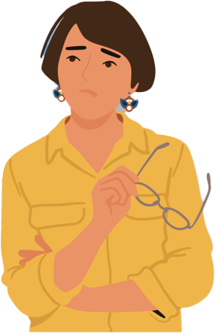
Reasons for Vaccine Hesitancy
Common reasons:
Misinformation
Pressure from family & friends
Concerned about vaccine safety
Not sure where to get quality information about vaccines
Notes:
Thank you all for sharing your ideas! Some common reasons Native parents and caregivers say they are hesitant is that they’ve heard misinformation about vaccines, they feel pressure from family or friends not to vaccinate, and they are concerned about the safety of vaccines. Some parents say they are not sure where they can get reliable information about vaccines.

Slide 10
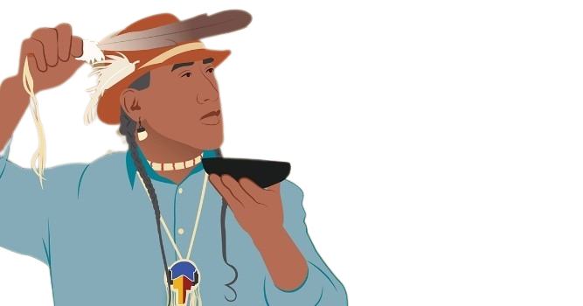
Reasons for Vaccine Hesitancy
Poor treatment by:
Medical community
Federal government
Notes:
Also, as we know, some fears about vaccines come from a long history of poor treatment by the medical community and the federal government. This history impacts how some Native parents and caregivers view vaccines today. It’s understandable if sometimes you feel worried about vaccines, especially given our history.

Slide 11
Why We Weigh the Facts About Vaccines
We all want the best for our kids!
Notes:
Even though we might have certain fears or hesitations, today, many of us understand that we need to weigh the facts about vaccines, so we can make informed decisions that help our kids stay healthy.

Slide 12

“There is so much misinformation out there. I would urge our relatives to arm themselves with updated knowledge about vaccines, their safety, and their effectiveness.”
Dr. Jeffrey Henderson, MD, MPH, Lakota & Cheyenne River Sioux Tribe, President and CEO of the Black Hills Center for American Indian Health
Notes:
As many of our Native doctors express, including Dr. Jeffrey Henderson, there is so much misinformation out there. It’s important that our relatives arm themselves with updated knowledge about vaccines, their safety, and effectiveness.

Slide 13
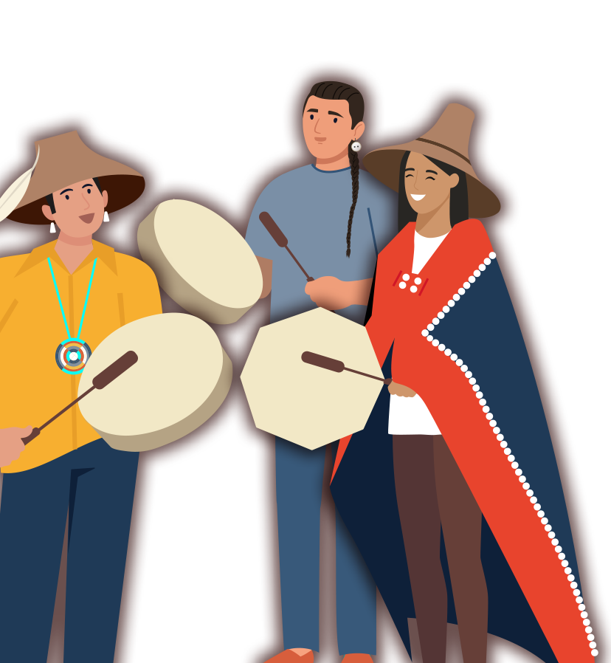
Our Ancestors’ Experiences
Notes:
As we being to weigh the facts today, it’s important to remember our ancestors’ experiences.

Slide 14
Group Discussion
Question:
What information about “diseases of the past” (like polio) have your relatives shared with you?
How did these diseases impact families here?
Notes:
What information about “diseases of the past” (like polio) have your relatives shared with you? How did these diseases impact families here? Let’s break up into small groups of 2-3 people. Then take 5 minutes to discuss. Afterward, we will come together as a large group and share what we’ve discussed.
A word cloud can be imbedded in the slides:
Participants’ responses will appear on the screen as they submit them. You can create a word cloud using PollEverywhere.com/Word-Cloud.

Slide 15
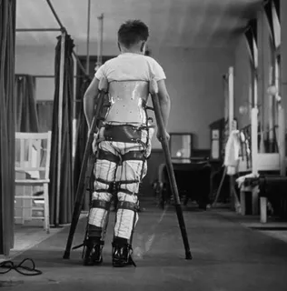
Polio
Generations ago:
Polio was feared
Kids were often paralyzed (their muscles stopped working)
Source: George Konig/Keystone Features/Getty Images
Notes:
Generations ago, polio was one of the most feared childhood diseases. Kids were often paralyzed from polio – meaning that polio caused their muscles to stop working - either for a short while or for the rest of their lives.

Slide 16
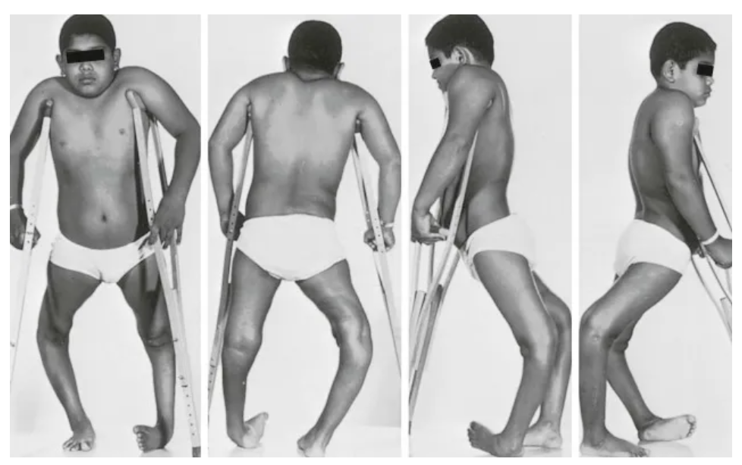
Polio
By late 1940s:
Polio was disabling more than 35,000 Americans
Source: https://musculoskeletalkey.com/poliomyelitis/
Notes:
By the late 1940s, polio was disabling more than 35,000 Americans each year. Because polio causes certain muscles to stop working, it was common to see children and adults with curved and underdeveloped leg bones and spines. As you can imagine, this could be very painful.
Source: https://www.history.com/articles/vaccines-diseases-forgotten

Slide 17
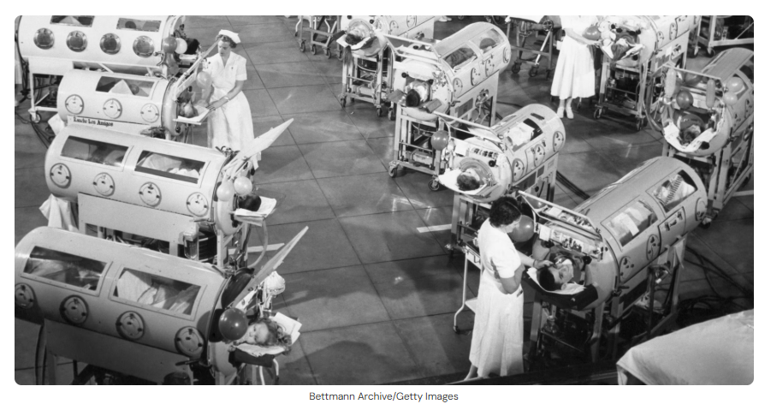
Polio
When breathing muscles stopped working:
Needed “iron lung”
In 1952:
3,000+ people died
Notes:
When kid’s breathing muscles stopped working from polio, they needed to be placed in breathing machines called iron lungs. Here is a picture of several children in a hospital polio ward in Los Angeles in 1952. They are in iron lungs. In 1952, over 3,000 people in the U.S. died from polio.

Slide 18
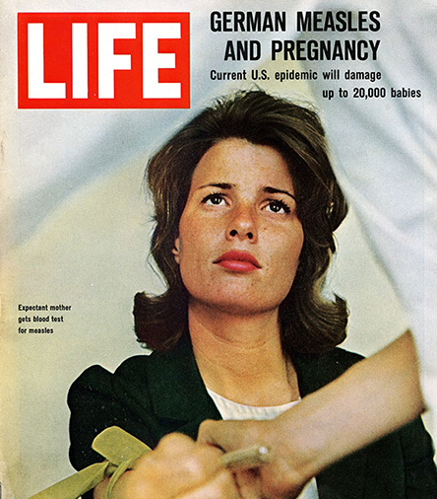
Rubella (German Measles)
Pregnant people:
Had miscarriages
Gave birth to babies with disabilities
Source: National Institutes of Health
Notes:
Polio is just one of the diseases our ancestors were familiar with. In the past, pregnant people who got rubella (German measles) had miscarriages or gave birth to babies with disabilities. Before childhood vaccines were available for rubella, many people suffered.

Slide 19

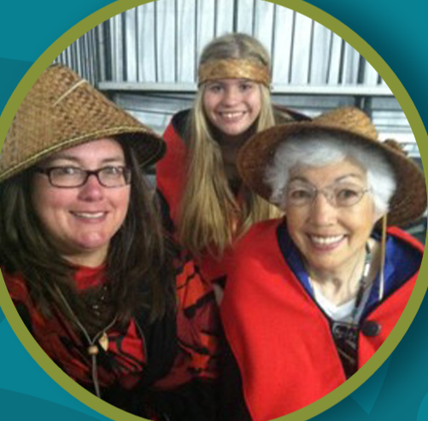
“My great grandma lost multiple children to the flu. Before we had the flu shot, it was common for people to get very sick or die from the flu.”
– Tam Lutz | Lummi Nation Tribal Elder
Notes:
And many of our relatives here died from flu. In this quote, Tam Lutz, a Lummi Nation Tribal Elder, shares her thoughts. She says “my great grandma lost multiple children to the flu. Before we had the flu shot, it was common for people to get very sick or die from the flu.”
Note to presenter: Take this opportunity to share your own stories related to the dangers of “diseases of the past” if you have them.

Slide 20
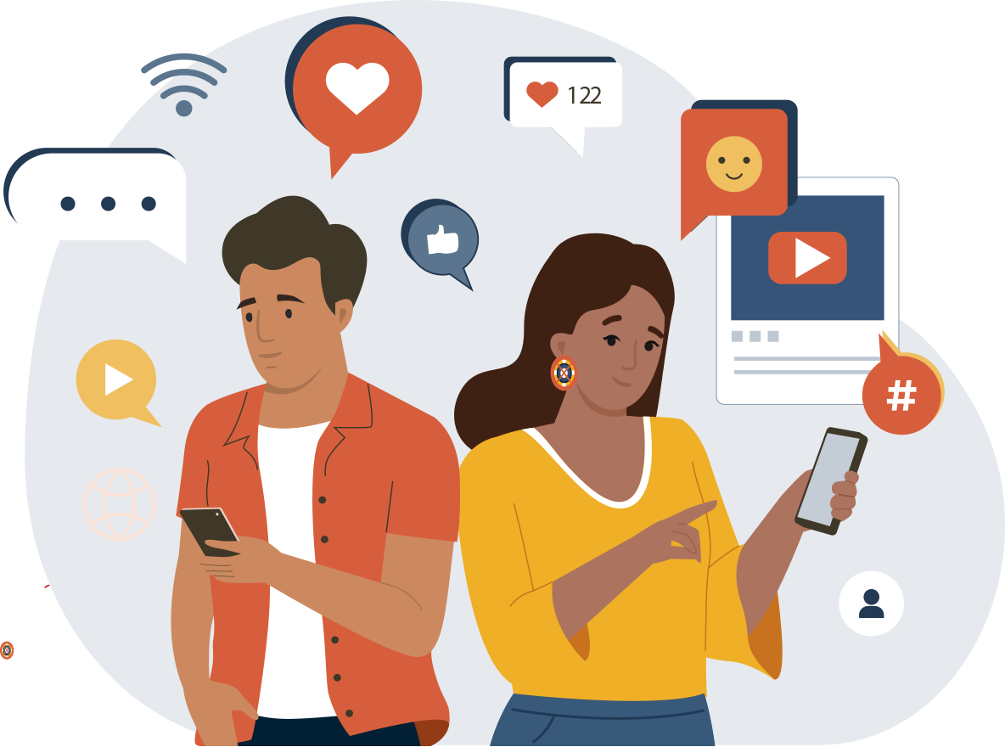
It can be easy to forget…
We haven’t seen these diseases because:
Vaccines worked so well
But these diseases are still serious if kids don’t get vaccinated against them!
Notes:
Today, most of us have never seen many of these dangerous diseases that our ancestors were familiar with. This is because vaccines have worked so well. Due to this, it can be easy to forget how serious some diseases – like polio, measles, and flu - still are. It can also be easy to buy into inaccurate information we hear about vaccines. But these diseases are still very serious and can harm kids if they don’t get vaccinated.

Slide 21
The Facts About Vaccines
Notes:
That’s why it’s important for us to educate ourselves and learn the facts about vaccines. That’s what the next part of this presentation is about.

Slide 22
How Vaccines Work
Vaccines teach our warrior cells (antibodies):
How to see & fight diseases
Notes:
Vaccines teach our warrior cells – or antibodies – how to see and fight diseases. That’s how vaccines protect kids. For example, once your child is vaccinated against polio, if they ever come across polio virus in the future, their body will know how to recognize it and fight it.

Slide 23
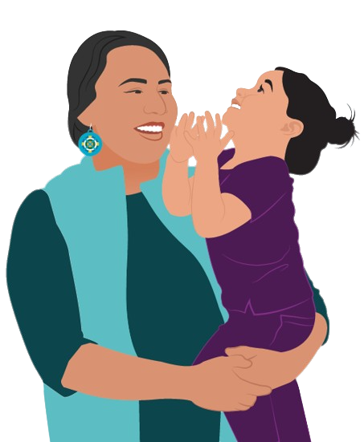
Even Healthy Kids Need Vaccines
Our warrior cells need to learn how to fight diseases.
Without this knowledge, they can’t protect us!
Notes:
Even healthy kids and kids that live a traditional lifestyle need vaccines. Our warrior cells must be taught how to fight certain serious diseases, like cancer, polio, rubella, and flu. Without this knowledge, they cannot protect us.
Note to presenter: The HPV vaccine protects people from 6 types of cancer!

Slide 24
Vaccines Keep Kids Healthy
Vaccines’ SUPERPOWER
=
Protect us from
serious sickness
Notes:
Vaccines keep kids healthy. Vaccines’ superpower is that they protect us from serious sickness.

Slide 25
Vaccines Keep Kids Healthy
Kids who get yearly COVID vaccine are:
90% less likely to get COVID
Notes:
For example, kids who get the yearly COVID vaccine booster are about 90% less likely to get COVID. That’s great!

Slide 26
Vaccines Keep Kids Healthy
Kids who get yearly COVID vaccine are:
90% less likely to get COVID
HUGE BENEFIT: If kids do get sick,
it will be mild (not life changing)
Notes:
But a HUGE benefit of the vaccine is that if your child gets sick, their symptoms will likely be mild if they have any at all. So, if they get COVID, they will likely not end up in the hospital or worse…

Slide 27
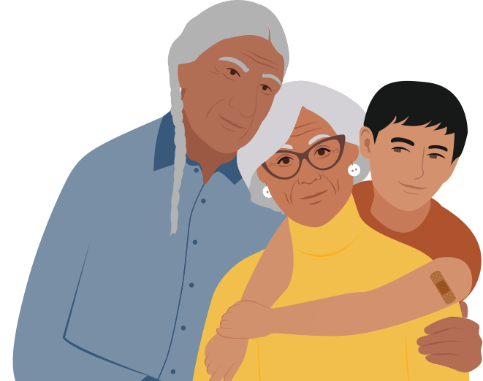
Community Protection
Notes:
Also, getting ourselves and our kids vaccinated protect the community. When our kids are vaccinated, it’s less likely that they will get sick. They are also less likely to spread illness to others who are more vulnerable - like Elders, young babies, and people with certain health conditions.

Slide 28
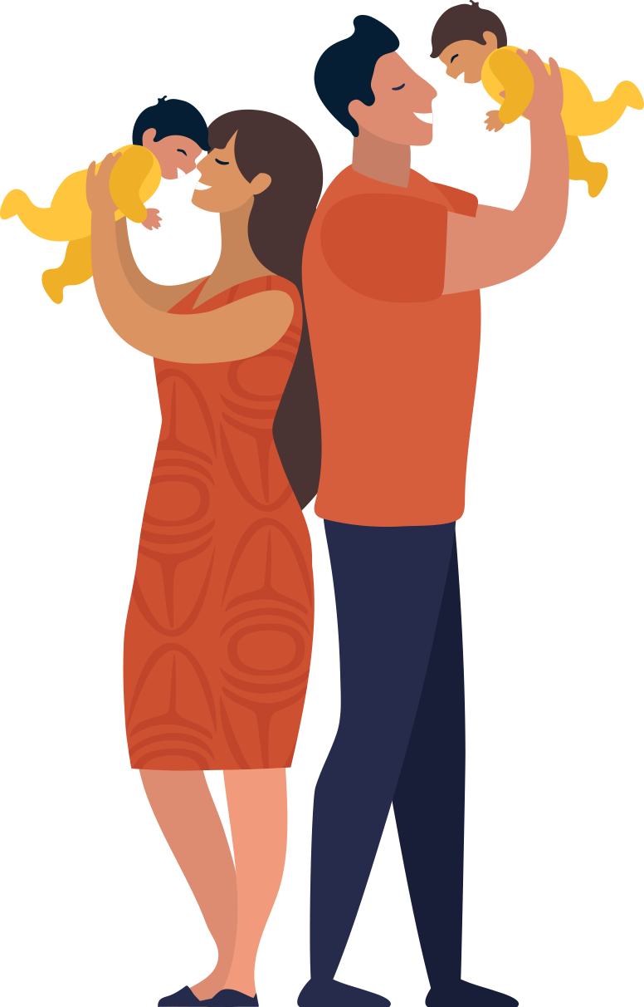
We Give Our Kids Early Protection
We pass our warrior cells to our baby during:
Pregnancy
Breast/chestfeeding
Notes:
Something many people don’t know if that, we give our kids early protection. During pregnancy our bodies pass warrior cells to our baby. This also happens during breast/chestfeeding.

Slide 29
We Give Our Kids Early Protection
We pass our warrior cells to our baby during:
Pregnancy
Breast/chestfeeding
This protection fades soon!
Notes:
However, this early protection starts to fade soon.

Slide 30
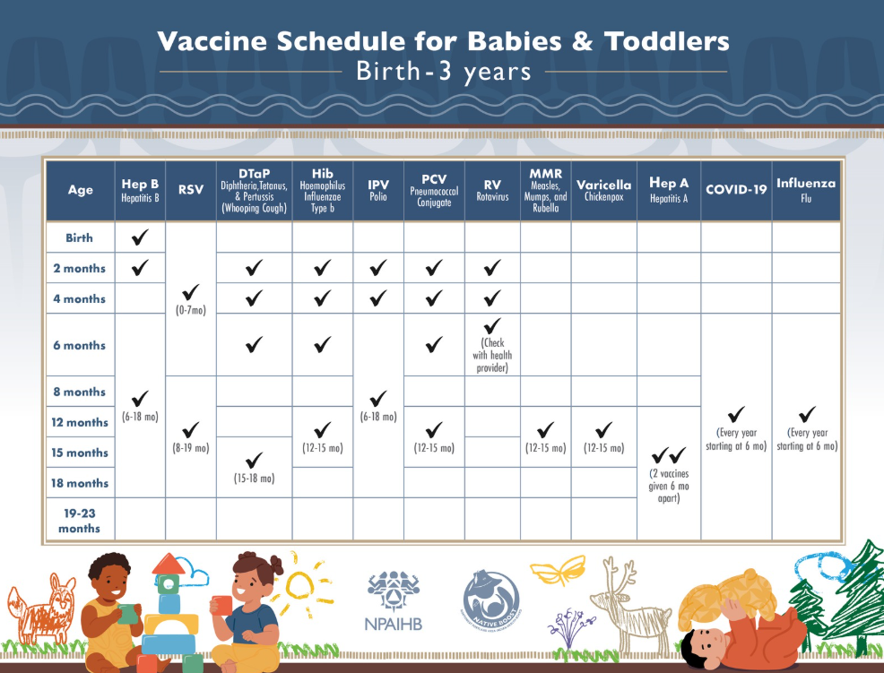
Child Vaccine Schedule
It’s built to:
Protect your child before they contact life-threatening diseases
Notes:
That’s why vaccinating your child according to the child vaccine schedule is very important. The child vaccine schedule is built to protect your child before they come in contact with life-threatening diseases.

Slide 31
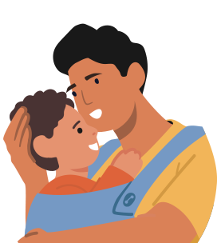
Vaccines Are Safe
Vaccines go through many safety tests before being approved:
Many Native people and Tribes volunteer to help
Notes:
Vaccines are safe and effective for everyone – including Native kids. Vaccines go through many rounds of safety tests (which include thousands of volunteers) before being approved. During testing many Native people and Tribes volunteer to help.

Slide 32
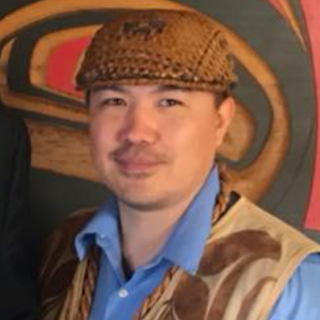
“Tribes and Native people have helped at every step in fighting against diseases through doing things like participating in vaccine trials. At Lummi Nation we participated in the Novavax vaccine trials. We are proud to have participated in this effort, but more importantly we are proud of our people.”
– Nick Lewis| Lummi Nation Tribal Leader
Notes:
This is true of Tribes and Native people all over Indian Country. Like, Nick Lewis, a former Lummi Nation Tribal Leader said: “Tribes and Native people have helped at every step in fighting against diseases through doing things like participating in vaccine trials. At Lummi Nation we participated in the Novavax vaccine trials. We are proud to have participated in this effort, but more importantly we are proud of our people.”
Note to presenter: Take this opportunity to share your own stories related to Tribal Nations participating in vaccine testing if you have them.

Slide 33
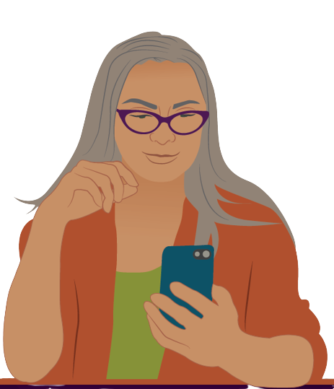
Vaccine Monitoring
Everyday people share how the vaccine made them feel
Monitoring helps to quickly identify any vaccine risks and take action
Notes:
Making sure a vaccine is safe doesn't stop after vaccine approval. Once a vaccine is approved, everyday people who got the vaccine can share how it made them feel. We all have the power to contribute in this way.
The purpose of this kind of monitoring is to identify any possible vaccine risks quickly and take action.

Slide 34
Mild Side Effects
Result from:
Effort as vaccine teaches warrior cells to fight
Examples:
Fever
Muscle aches
Redness/ swelling
Notes:
Something to know is that sometimes as a vaccine teaches your child’s warrior cells how to fight a disease, the effort may cause mild side effects – like fever, muscle aches, or soreness, redness, and swelling where the vaccine was given.

Slide 35
Mild Side Effects
Are normal:
Last 1-2 days
Are a good sign:
Your child’s body is preparing to protect them
Notes:
Mild vaccine side effects are normal and should only last a few days. Mild side effects are a good sign that your child’s body is preparing to protect them. Serious reactions to vaccines are extremely rare. People are more likely to get hit by lightning than have a severe allergic reaction to any vaccine.

Slide 36
Getting Multiple Vaccines is Safe for Babies & Children
Notes:
Based on solid research we know that getting several vaccines at the same time is safe for kids and babies. It also reduces the number of clinic visits for you and your family. Some worry that multiple vaccines will “overload” their child’s body. But the truth is that a common cold puts a greater burden on your child’s warrior cells.

Slide 37
Getting Multiple Vaccines Makes Sense
Notes:
Getting several vaccines at once also makes sense…

Slide 38
Getting Multiple Vaccines Makes Sense
Notes:
Consider this – Let’s say the child vaccine schedule recommends your child get three vaccines at once.

Slide 39
Getting Multiple Vaccines Makes Sense
3 Vaccines Spread Out
Many days of mild side effects!
Notes:
If you choose to “spread out” their vaccines and your child only gets only one vaccine at a time, they may experience many days of mild vaccine side effects, like fever or muscle aches.

Slide 40
Getting Multiple Vaccines Makes Sense
3 Vaccines Spread Out
VS
3 Vaccines at Once
Many days of side effects!
Only 1-2 days of side effects
Notes:
Verses if they get all 3 vaccines at once, they might only feel uncomfortable for 1-2 days.

Slide 41
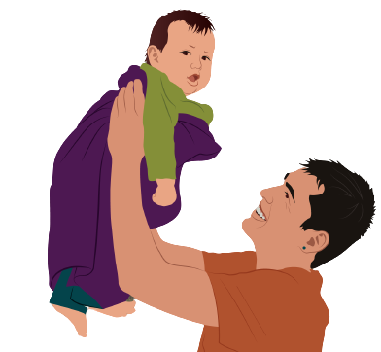
Vaccines Don’t Cause Autism
Good research has found:
Zero evidence linking vaccines to autism
Notes:
Something to also know is that vaccines do not cause autism. Researchers investigated and found zero evidence linking vaccines to autism. Like we talked about vaccines are incredibly safe because of how many steps they go through to get approved, and they are carefully watched even after they are approved.

Slide 42
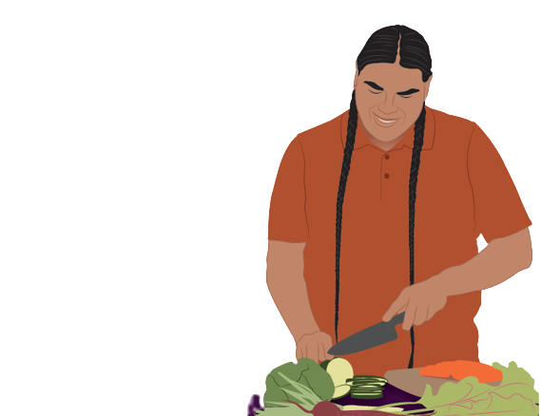
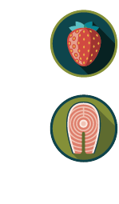
Vaccine Ingredients
Vaccines contain natural ingredients – including sugars and proteins
Sugar
Sugar is found in fruits & vegetables.
Proteins
Proteins can be plant & animal-based.
Notes:
Vaccines contain natural ingredients common in food we eat, like sugars and proteins. After vaccines prepare your child’s warrior cells to fight disease, they leave their body.
Note to presenter: If someone asks how the vaccine leaves your body, respond with “once the vaccine ingredients provide instructions to your warrior cells, the vaccine is cleared from your body the same way other ‘wastes’ may be cleared from your body – through urination and sweat.”

Slide 43
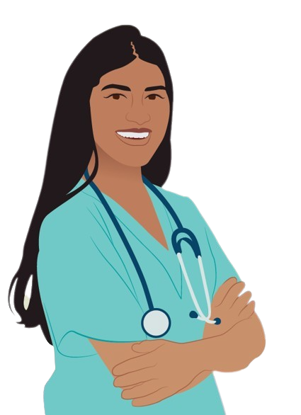
Catching Up
If your child is behind on their vaccines:
They can still catch up
But… delaying, missing, or spreading out vaccines:
Puts them at risk for getting sick!
Notes:
If your child is behind on their vaccinations, they can still catch up. However, unless it’s recommended by your doctor, delaying, missing, or “spreading out” vaccines only puts them – and others - at risk for getting seriously sick.

Slide 44
Vaccines Keep Kids Safe
Notes:
As parents, we have enough to worry about. Don’t let vaccines be one of them. Keep your children safe by making sure they get all their recommended vaccines.

Slide 45
Vaccines Keep Kids Safe
Mild vaccine side effects:
Go away quickly
Serious impacts of getting a dangerous disease can:
Last a lifetime!
Source: George Konig/Keystone Features/Getty Images
Notes:
Remember, mild vaccine side effects, like fever and muscle aches, go away relatively quickly. But the serious impacts of getting a harmful disease in childhood can last a lifetime. Don’t forget our ancestor’s experiences. Disease of the past will come back if our kids are not vaccinated.

Slide 46
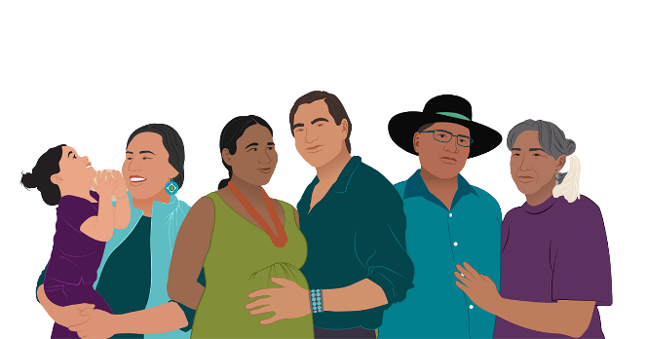
Remember…
Our kids and communities
deserve to be healthy
Notes:
Our ancestors worked hard to protect our communities from dangerous diseases. Vaccines are an answer to their prayers. And our kids and communities deserve to be healthy. So, consider talking with your health provider about what vaccines your child needs and when.

Slide 47


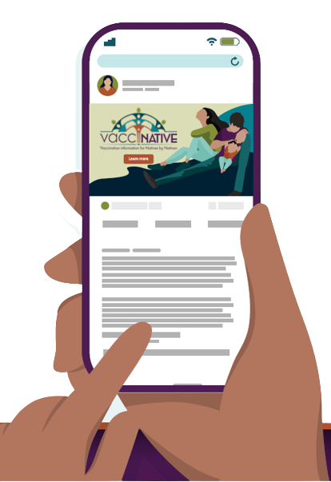
Good Sources of Information
IndianCountryECHO.org/Vaccines
Notes:
If you have questions after today’s presentation, learn more by visiting Native Boost and VacciNative. Native Boost has accurate childhood vaccine information for parents and caregivers and VacciNative offers good vaccine information for adults. Both Native Boost’s and VacciNative’s materials have been fact checked by trusted Elders, Native health professionals, and staff from Tribal organizations across the nation.

Slide 48
Handout Reminder…
Questions for My Doctor:
Write down your questions
Bring handout to your child’s next appointment
Notes:
Finally, before we get going, remember the “Questions for My Doctor” handout that I passed out earlier. If you have questions about vaccines that we didn’t get to today, consider using this handout to start a conversation with your doctor or your child’s doctor at your next visit… Ok, thank you so much for participating today!

