Slide 1
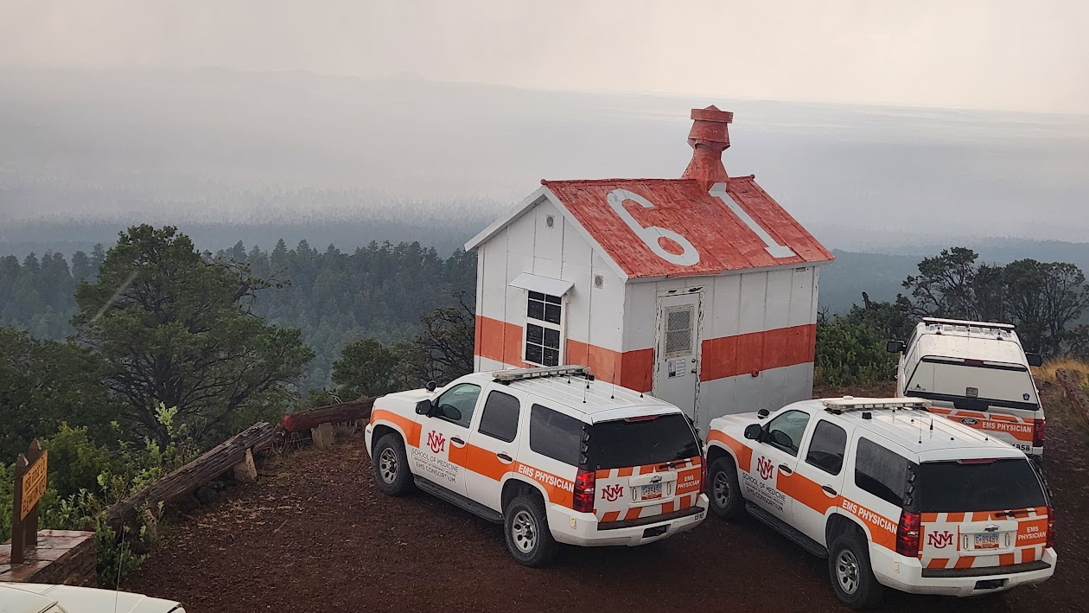
Termination of Resuscitation
What To Do When There’s Nothing Else To Do
Bart Grabman, MD University of New Mexico EMS Fellow February 3, 2026

Slide 2
I have no disclosures or conflicts of interest related to this presentation

Slide 3
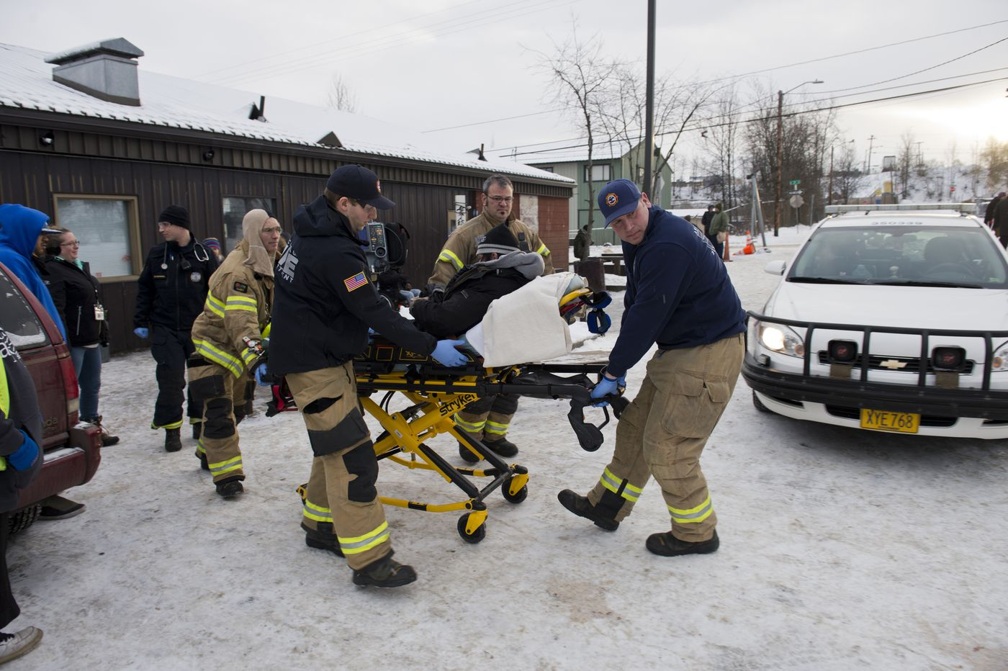
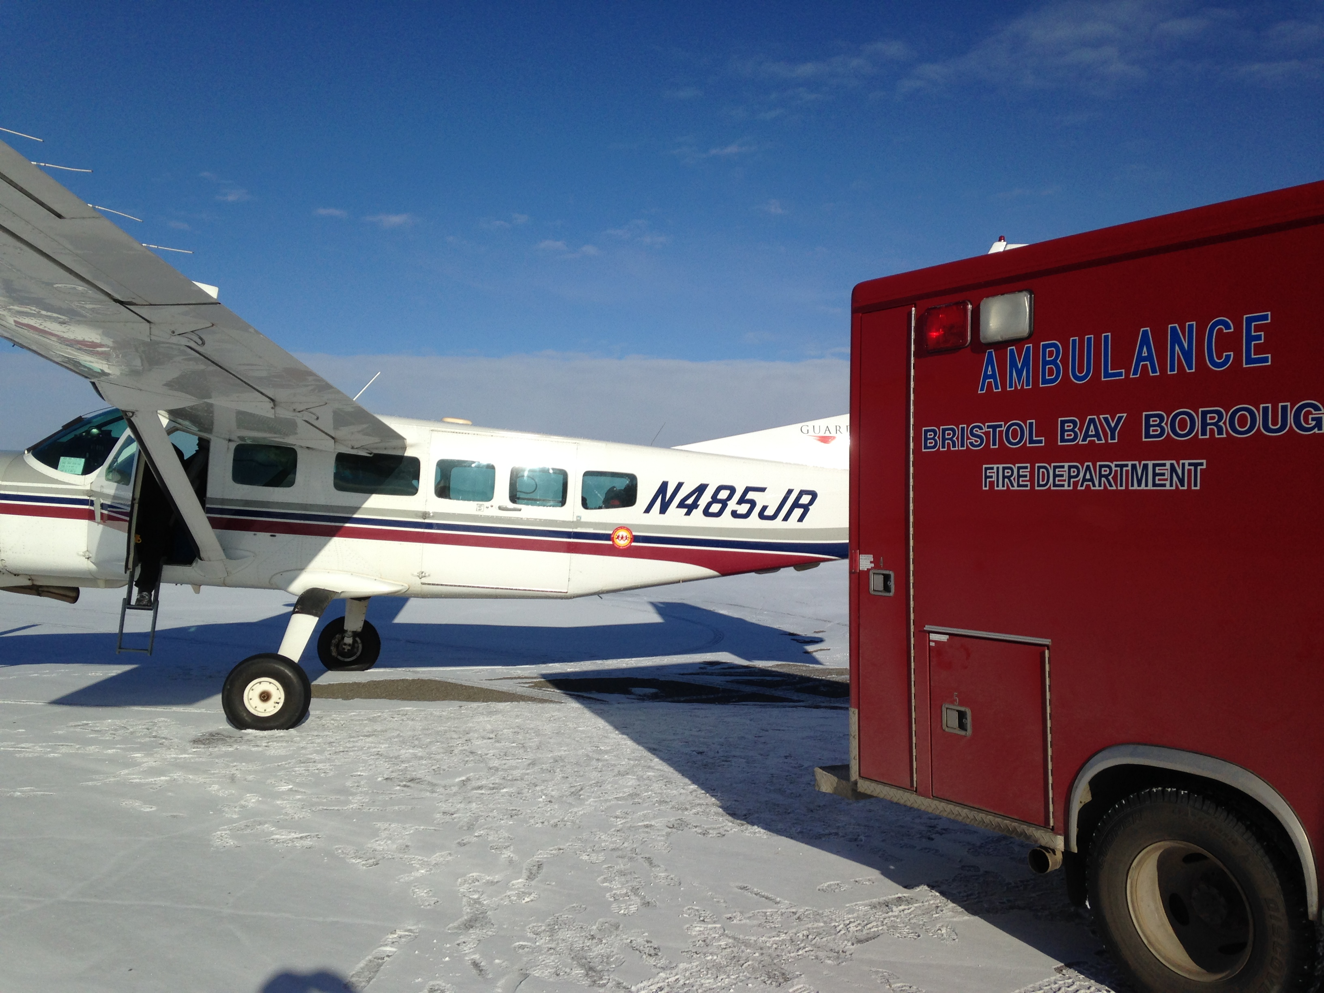
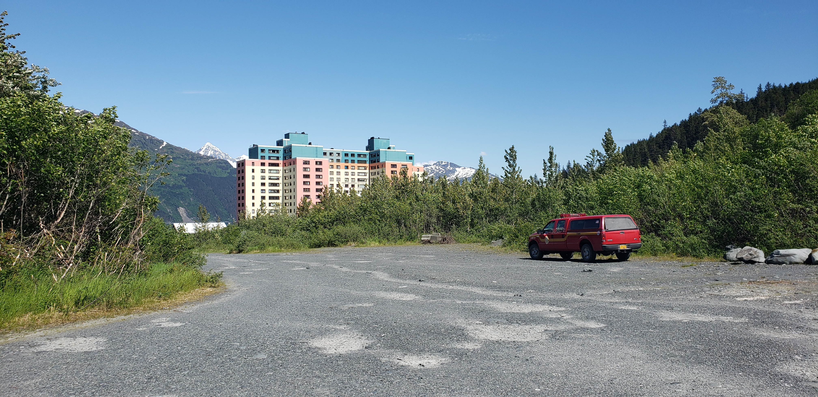
Notes:
I have lived and worked in multiple communities throughout the US, and worked in a large, urban fire department (Anchorage Fire Department) that had 300+ EMTs and paramedics, full-time staff, and help was always minutes away if requested. I also worked in very small, rural departments, including Whittier, Alaska, where the minimum transport time was 2 hours by road, and Bristol Bay Borough in southwest Alaska, where the minimum transport was about 1.5 hours by plane, if we could get a plane in, depending on whether. The point is that the lessons I have learned and the skills I will discuss are applicable, regardless of where you work – whether in a large urban area or a tiny, volunteer agency with very long response and transport times.

Slide 4
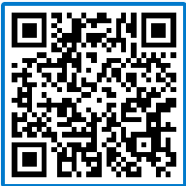
Scan the QR Code with your phone or device to participate in (optional) polling later in the presentation

Slide 5
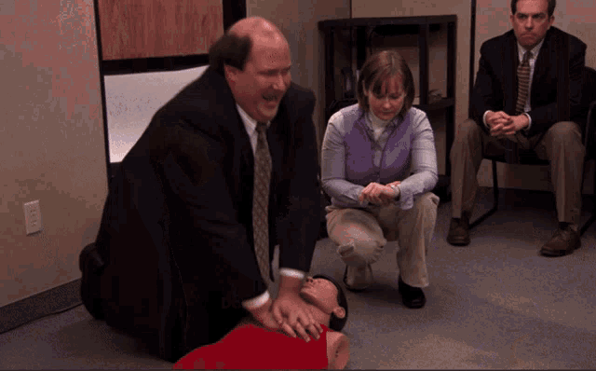
Notes:
Hopefully, we’re a little better at CPR than Kevin from the Office.

Slide 6
Cardiac Arrest Dispatches
About 1,000 out-of-hospital cardiac arrests every day in the US
About 5-10% survive
Vast majority die on scene or are not transported
Notes:
Lets look at some national data: In the US, somewhere around 350,000-400,000 cardiac arrests occur outside of the hospital every year, or roughly 1,000 per day. If we look at all the data in the US, the numbers vary a little bit, but estimates suggest that about 5-10% of these patients will survive to hospital discharge. Unfortunately, the vast majority of these patients will die. In New Mexico, and in many agencies, many of these patients will die on scene and are not transported to the hospital. This will vary significantly based on local protocols and jurisdictions, and may vary depending on direction from your agency or medical director.

Slide 7
In Our System…
8,036 Calls for EMS Service
185 Dispatched Cardiac Arrests
35 Deceased after CPR
94 Decreased with no CPR
17 transported to hospital alive
Notes:
I looked at data in the Albuquerque Metro area between January 1-Feb 1, 2026, just to get some representative data. In our area, there were around 8,000 calls for service for EMS. Of those, about 2%, or 185, were dispatched or upgraded to a cardiac arrest, based on the 911 call taker’s interpretation and understanding of the phone call.
Many of those 185 were not in arrest – for example, they may have had strokes but were breathing, or other medical issues, such as overdoses, syncopal episodes, or similar medical issues.
However, of those 185, 35 were declared dead on scene after resuscitation was attempted. 94 were declared dead on scene, and no resuscitation efforts were attempted – this may be because they had advance directives, or they were unfortunately beyond help. In all of our data, 17 patients were transported to the hospital – and we have a protocol that we generally do not transport with ongoing CPR, except for rare or unusual circumstances. For example, in someone with refractory ventricular fibrillation, who may be a candidate for ECMO (or heart/lung bypass), they might be transported with ongoing CPR.

Slide 8
13%
Of confirmed cardiac arrests in our system were transported to the hospital…
…and about 2/3 of those patients will likely die in the hospital.
Notes:
So, in our system, only 13% of patients who had confirmed cardiac arrests were transported to the hospital. We know from large, national research, that most of the patients that are transported to the hospital will die in the hospital, and only around 1/3 will be discharged alive.

Slide 9
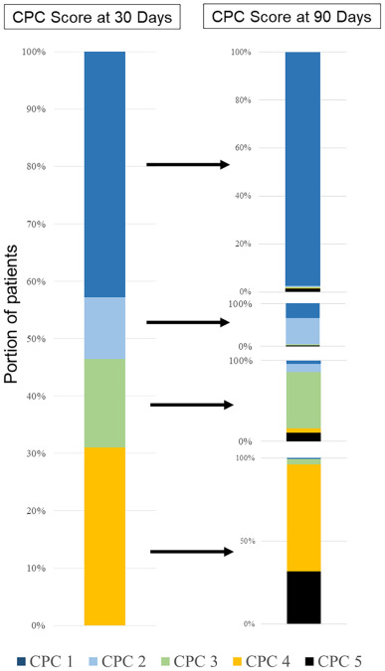
How Do They Do?
About 50-70% will die in the hospital
If they survive to discharge, most are not the same as before
Notes:
The more important question, in my mind, is how do patients do once they are admitted to the hospital? We know we can do a great job in the field, and I feel like it’s a definite win if we get the person to the hospital alive and with a pulse. But, from several large studies, we know that about 50-65% or more of the patients that have an out-of-hospital cardiac arrest and ultimately make it to the hospital with a pulse will die in the hospital. There was a large study that looked at how patients do if they survive and are discharged from the hospital, and are still alive 30 days later. We use a scoring system to determine their level of function – the blue bars here represent ‘Normal’ or ‘Good’ function – I think of this as being able to get up in the morning, make and enjoy a cup of coffee, and be able to function fairly independently.
The green bar represents severe disability – these survivors need significant help, and may need around-the-clock care, but can still communicate and understand the world around them.
The Yellow bar represents a persistent vegetative state – someone who may be dependent on a ventilator, may need artificial nutrition through a feeding tube, and cannot communicate.
This study showed that, if patients get discharged from the hospital after a cardiac arrest, only about 50% will have a ‘Normal’ or ‘Good’ recovery. The others area likely to need around-the-clock care if they survive.

Slide 10
The Vast Majority Of Patients Die, even if they have
Fast response times
Short transport times
Plenty of personnel available
A big hospital nearby
Notes:
And again, these data are generally in urban systems. These are systems that have short response times. These are in systems that are close to a hospital. They likely have plenty of personnel available – and multiple paramedics on scene, plus plenty of non-paramedics to do other interventions. This is, obviously, very different from many of the rural or remote areas in which we work.

Slide 11

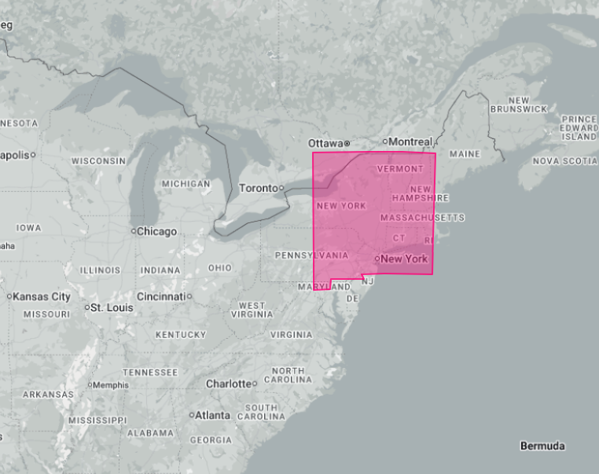
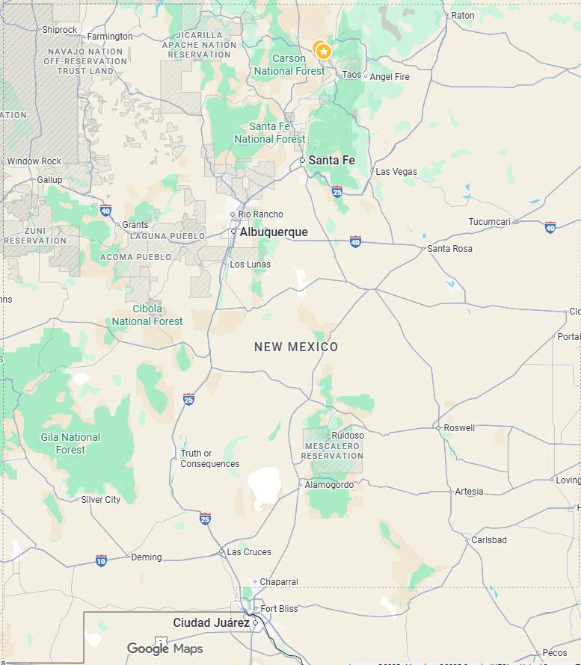
Notes:
As you all know, when you work and live in rural areas like New Mexico, this is rarely your practice environment. Here’s New Mexico laid over the East Coast – think about how many large hospitals we have that have a cardiologist available on-call 24/7, compared to the entire state of New York, Massachusetts, half of Pennsylvania, and several other states.
We know that care is more challenging in New Mexico, and patients do worse because of these challenges, even if our EMTs, paramedics, fire departments, and other first responders are excellent.

Slide 12
Does It Matter?
Most of our patients in rural areas will die
Most of our families are not ready for or expecting death
Many families experience lasting guilt, flashbacks, or symptoms of PTSD
Notes:
The question I always ask if – does it matter? The big takeaways for me are:
1.) Most of our patients that live in rural areas that suffer an out-of-hospital cardiac arrest will die.
2.) Like everywhere else, most of the families or loved ones are not ready for death.
3.) We know from research that many families experience ongoing symptoms of guilt – perhaps that they didn’t do enough, or didn’t call early enough, or didn’t do CPR well enough. They had flashbacks, and many have ongoing symptoms of PTSD.

Slide 13
Scan the QR Code with your phone or device to participate in (optional) poll

Slide 14
18-year-old girl is found unresponsive by her father in her bedroom at home. She was last seen about 30 minutes ago.
Family is sobbing and in the bedroom when you arrive
She has no pulse, and you start CPR. Empty prescription pill bottles are in the room. You suspect an overdose. Your AED says “no shock advised.”
Notes:
Feedback from group

Slide 15
Would you let the family stay in the room during your resuscitation attempt?
Notes:
Feedback from group

Slide 16
What things would you worry about if family stays to watch the resuscitation?
Notes:
Feedback from group

Slide 17
Potential concerns
Scene safety
Increased stress on crews
Mistakes being witnessed / Legal Concerns
Others?
Notes:
Solicit feedback from groups. These may be some of the potential concerns that come up when we think of reasons of why not to let families watch or be involved in the resuscitation. Some of these are very valid.

Slide 18
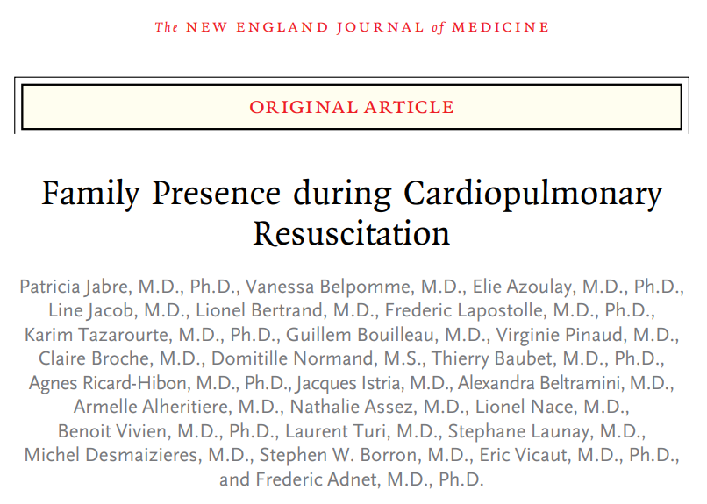
Notes:
This was a very large, well-done study that looked specifically at how families responded – and how paramedics and EMTs felt – when families were allowed to watch out-of-hospital resuscitations. This was done in France, so it’s a little different, but I think the study is still very well done, valid, and has some very important takeaway points.

Slide 19
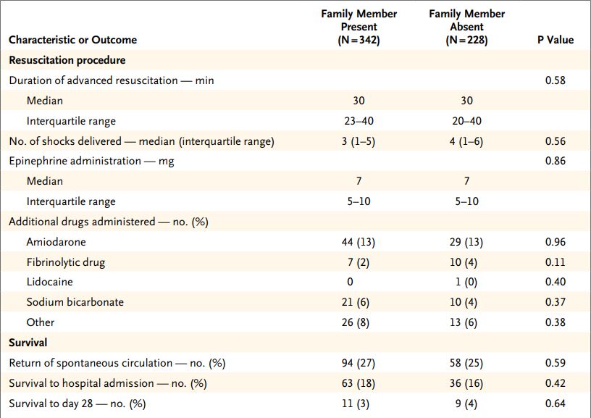
Notes:
In this study, researchers looked at outcomes of pre-hospital cardiac arrests. Families were either explicitly offered to stay and watch the resuscitation attempts, including CPR, airway management, and medication administration, or were not offered to stay and watch.
They compared data from the actual resuscitation attempt, as well as other factors, when the patient’s family member was watching and not watching.
They found that there was no statistical difference in the length of their resuscitation if family was present and watching.
They also found that there was no statistical difference in patient outcomes – roughly the same percent of patients got pulses back whether family was watching or not – 27% regained pulses when family was present, while 25% got pulses back when family was not watching. There were also similar findings for the number of patients that ultimately survived and were discharged from the hospital.

Slide 20
Families Did Better When Watching CPR
14% lower rates of PTSD-symptoms
8% lower rates of anxiety
9% lower rates of depression
13% lower rates of getting prescribed anti-depressants
No lawsuits / legal concerns
Notes:
Overall, families did better when they were allowed to watch the resuscitation. They were interviewed weeks to months later, and, amongst families that were allowed to watch the resuscitation, they had lower rates of PTSD, anxiety, depression, and much lower rates of getting prescribed antidepressants, compared to families that were not allowed to watch. There were no lawsuits or legal concerns arising in either group in this study.

Slide 21
What are some reasons that family should be told to leave during the resuscitation?
Notes:
Feedback from group

Slide 22
Are there times when family should definitely NOT be allowed to watch/stay in the room?
Notes:
Feedback from group

Slide 23
Reasons NOT to Allow Family?
Legitimate safety concerns
Significant intoxication?
Truly no space available
Potential homicide?
Notes:
This is not to say that a family should be allowed to stay and watch a resuscitation every time. There are plenty of legitimate reasons to have family leave the area or be escorted outside. If there are legitimate safety concerns – such as if a family member is physically threatening or interfering with resuscitation, obviously they need to be removed. Someone who is intoxicated may be allowed to stay sometimes – but if they are posing a threat, or if you’re worried that they are going to become a threat to safety or hinder your resuscitation in some way, they need to leave.
If you are in a very small space and there is no physical space for family, I try to take them outside of the physical space to a place where they may be able to watch, if they want. Sometimes this means stepping outside of the room and allowing them to watch through a doorway or something similar. Finally, if you’re worried this is a crime scene and there is concern they may contaminate the scene or evidence, nobody should be allowed in except for responders and law enforcement.

Slide 24
Best Practices During Resuscitation
If possible, assign one person to talk to family (“Family Contact”)
If multiple family members are present, try to identify the “decision-maker”
Ask for the patient’s name (and preferred name), and the family’s name and relationship
Notes:
We all understand that these situations are complex, dynamic, and that there is no single framework that will work for every resuscitation. However, there are some general recommendations and practices that I have found to be particularly helpful when I am on scene on a cardiac arrest.
I also recognize that not all of these may be possible all of the time.
If possible when you arrive on scene, assign one responder to talk to family. Introduce yourself, and ask for the family’s name and relationship to the patient.

Slide 25
Family Contact Role
Ensure safe working space
Explain what is happening
Gather information
Explain why we are not going to “load and go”
Notes:
If I’m on scene, I try to take the family contact role, and allow others on scene to perform resuscitation and interventions.
This role doesn’t need to be the senior person, or supervisor. It can be an EMT, a volunteer or, sometimes, a paramedic – it will depend on who is on scene. But, I like to establish this role in advance – ideally before the call has even been dispatched! You can have this discussion, and other similar discussions, at trainings, around the station, or on the way to a call if needed. Obviously, this will be dynamic and may need to change depending on the circumstances. In general, if you can assign one person to this take, their role should be to have a “global view” of the situation. They can help explain to the family what we are doing in real-time, and why. They can get more medical history from family, which allows other responders to focus on CPR, airway, and medications, if appropriate. I also like to explain to families that we are “bringing the hospital to them.” Many families are confused when we don’t load-and-go – and we know from lots of research that doing CPR while in an ambulance leads to more injuries for responders, worse CPR for patients, and is more dangerous for everyone – and it does not improve patient outcomes.

Slide 26
Family Contact Role
Consider asking about advanced directives or prior wishes
Update family with “I hope” and “I worry” statements “I hope her heart starts working again on its own, but I worry that the medicines aren’t working.”
Notes:
When appropriate, I ask if they have ever talked about what they would want if their heart stopped. I avoid terms like DNR/DNI and “advanced directives,” as these can be confusing for families at times. Asking in plain language, “Has Jim ever talked about what he would want if he wasn’t breathing?” gives more opportunity for family to stop and think about the topic, and may more helpful than simply asking if he has signed a form. I also like to use “I hope” and “I worry” statements – I think this helps frame the conversation better. As the medical clinician on scene, you saying that you hope something will happen expresses your efforts and dedication to continuing the resuscitation. But, we know that most of these patients will die, and stating that you worry that it’s not getting better helps better prepare families early in the resuscitation that the patient may not survive, and may help “soften the blow.”

Slide 27
Recommended Words/Phrases
Life Support: Creates a sense of the severity of the situation
Use patient’s name: Creates a more sense of caring
Use Plain Language: “We are going to put a breathing tube in to help her breathe” instead of “she is being intubated.”
Notes:
I use the term “Life support.” I think this conveys a sense of how severe the situation is, in addition to framing for family that the patient is not alive without our efforts. Sometimes, patients have expressed a desire to not be on life support, or something similar, and this helps with the conversation regarding family or patient wishes, if appropriate. I use the patient’s name as much as possible. “Unfortunately, Jim’s heart still isn’t working on its own” feels more personal and caring than saying “His heart still isn’t working.” Finally, we often times get caught in a trap of using language that is too complicated, especially when families are stressed and not thinking clearly. Saying that “we are giving medicine to him” is better than “we are pushing epinephrine through his IO,” because health literacy, in general, is very low and people likely will not understand what that means.

Slide 28
Recommended Words/Phrases
“Unfortunately, she has died” Avoids confusion and provides clarity.
Notes:
If you are going to terminate resuscitation, please use the term ‘dead’ or ‘died.’
This helps avoid confusion and gives clarity and finality. I remember one of my paramedic instructors said he told a family that the patient “had gone to a better place” – the family assumed that meant that he was in the living room instead of the bathroom (where he was initially).

Slide 29

Notes:
Hopefully we’re doing slightly better at breaking the bad news than this…

Slide 30

Got ROSC?
Notes:
If you get ROSC, make sure you do things in the proper order – first, you should celebrate! But probably keep it to internal celebrations, and save the high-fives until you’re back at the station.

Slide 31
13%
Remember this slide?
Of confirmed cardiac arrests in our system were transported to the hospital…
…and about 2/3 of those patients will likely die in the hospital.
Notes:
But… remember this slide? Most of the patients that get transported to the hospital will still die before they are discharged, and those that are discharged are, statistically, unlikely to have a good neurological function when they leave the hospital.

Slide 32
Got ROSC?
“She is still very sick and still on life support. She is not breathing on her own, and we are breathing for her with the breathing tube. Her heart is pumping again, but I worry it may stop again. They will be able to give you more information at the hospital, but it’s still possible she may die today.”
Notes:
I 100% believe that it is my job as the doctor to tell the family if the patient has died, if they get to the hospital. If you transport someone who has achieved ROSC, though, family may have a belief that “everything will be OK.” There are several studies that have shown that non-medically trained individuals have a false belief that patients will often have excellent outcomes if they get ROSC – just think of all the movies and TV shows that depict people being fine after having a cardiac arrest. If you can prep family with a statement like this, it can go a long way to making the conversation in the ER much easier for me. Families deserve to understand what is going on, what may happen, and to have the same information we have. We can do this by being honest with them about outcomes – while not sharing specific data or percentages.

Slide 33
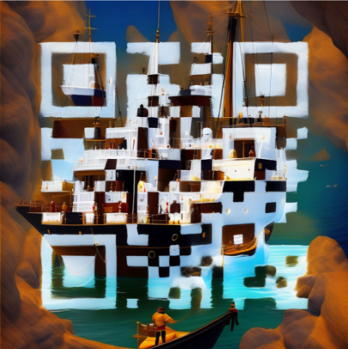
Next Steps?
Free online class with several videos, and several cases that can be used with crews or independently
Includes special circumstances, including pediatric patients, and children present on scenes of family members
Notes:
If you’re interested in learning more and using a free resource online, this is an excellent website with free training videos, including case scenarios that can be used at the station (or individually) to get better at this process and these conversations. These are hard to implement – but so are lots of things that we do. We should not avoid hard conversations, simply because they are hard, and our patients and their families deserve it.

Slide 34
“I am not here for me, I am here for we, And we are here for them.”
Notes:
This was the internal motto of the Anchorage Fire Department, where I used to work. “I am not here for me, I am here for we. And we are here for them.” We all got into EMS and Fire to help. Whether it’s helping individual patients, to help our neighbors, or our communities, this is a motto I try to live by every day to help remind me of why I got into EMS.
I am not here for me. I choose to do this job and to go to work to help others. Firstly, I think that by helping ourselves, by being here for “we,” fire and EMS personnel improve our longevity in a stressful, emotionally challenging field that too often leads to burnout amongst EMS clinicians. We know that EMTs and paramedics have high rates of substance abuse and depression, and by dealing with death and guilt, these feelings can compound. By being here we each other, or by being here for “we,” EMS can help support each other in these stressful times.
Most of all, fire and EMS must remember that we are here for them – the public. When people call and ask for help, we must be the ones to help care for our friends, neighbors, and communities.
Unfortunately, in cardiac arrest, too often the “them” includes the patient and their loved ones. The caring must not stop when we stop doing CPR.

Slide 35
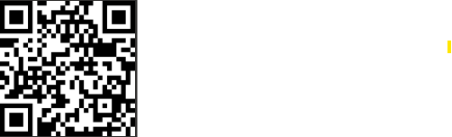
Scan for CE Credit
E-mail for Questions
Bart Grabman, MD BGrabman@salud.unm.edu

