Slide 1
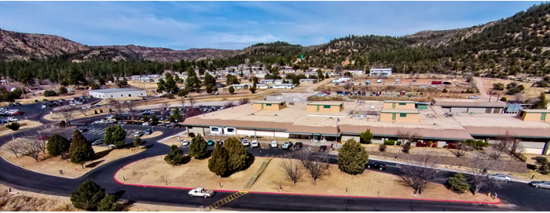
Building a Bridge Clinic Joseph Mega, MD MPH Emergency and Addiction Medicine Physician Whiteriver Indian Health Service Hospital Whiteriver, Arizona
December 16, 2025

Slide 2
The contents do not represent the views of the Indian Health Service or the United States Government
This material is the result of work supported with resources and the use of facilities at the Whiteriver Indian Hospital, located in the Phoenix Area of the Indian Health Service.
I have no disclosures

Slide 3
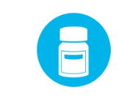


What is a Bridge Clinic?
Low-Barrier Treatment
Immediate Connection to Care
Meeting Patients Where They are At

Slide 4
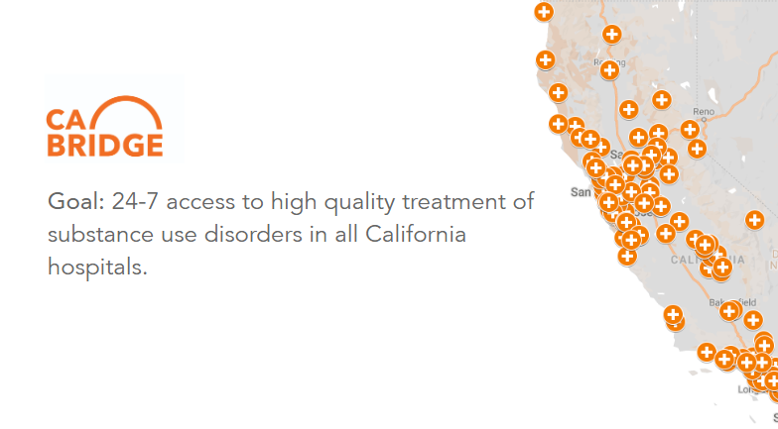

Slide 5
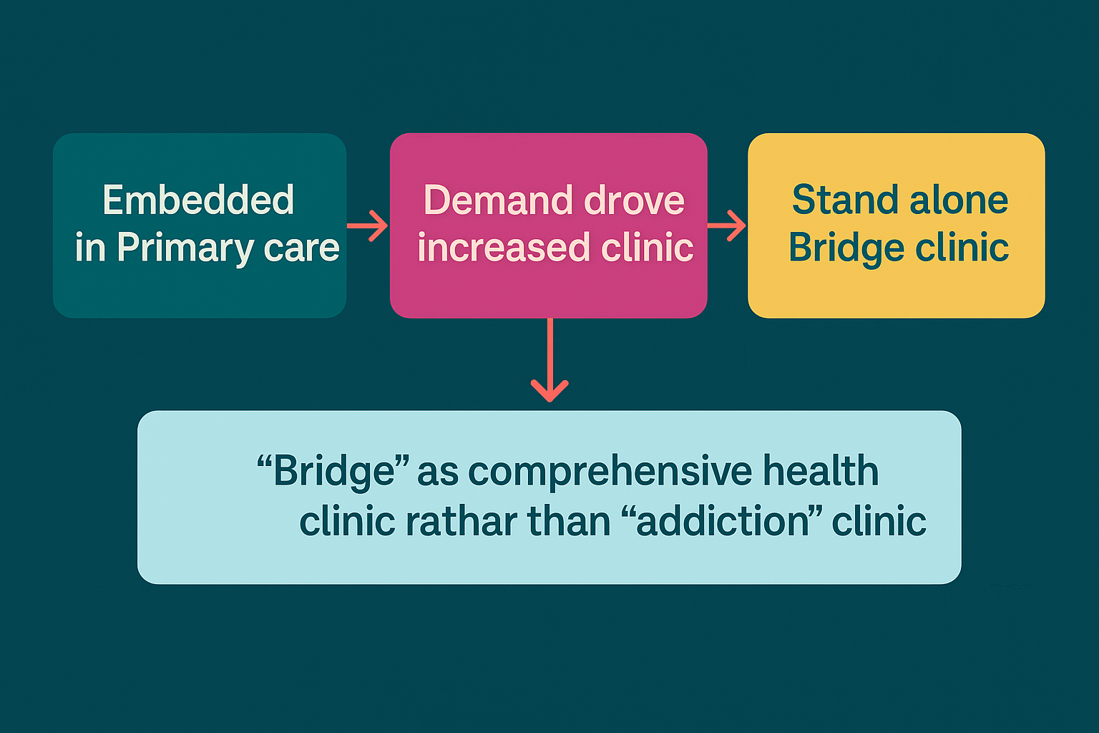

Slide 6
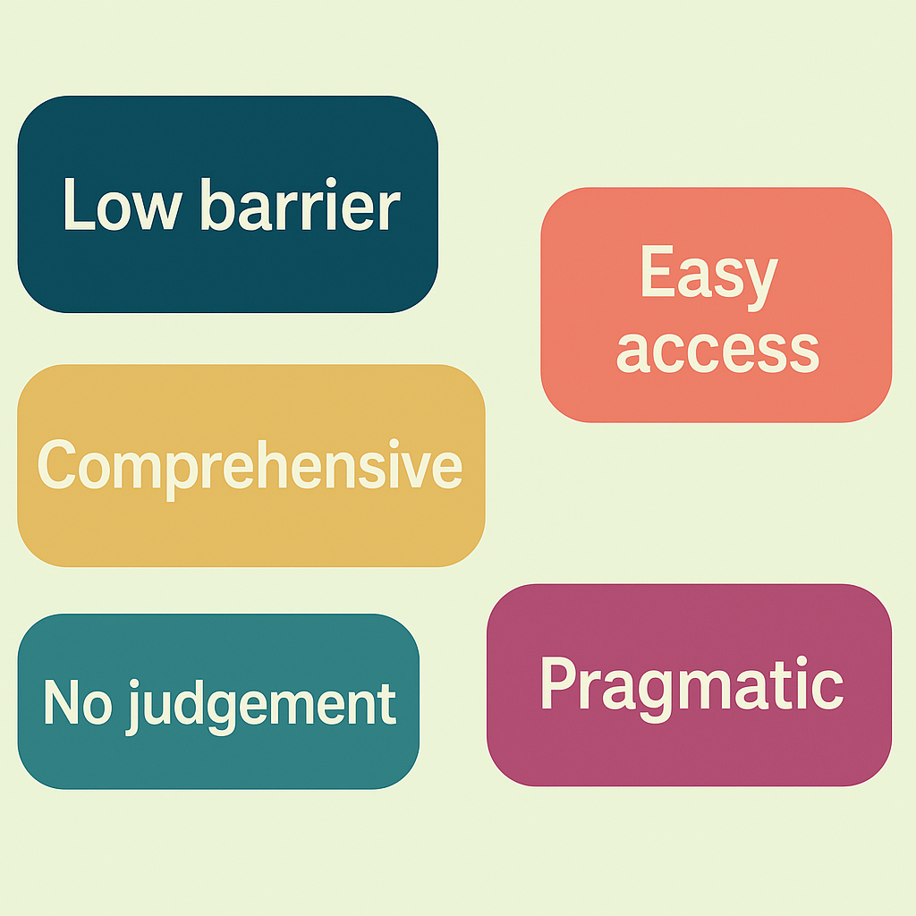

Whiteriver Bridge Model and Philosophy

Slide 7
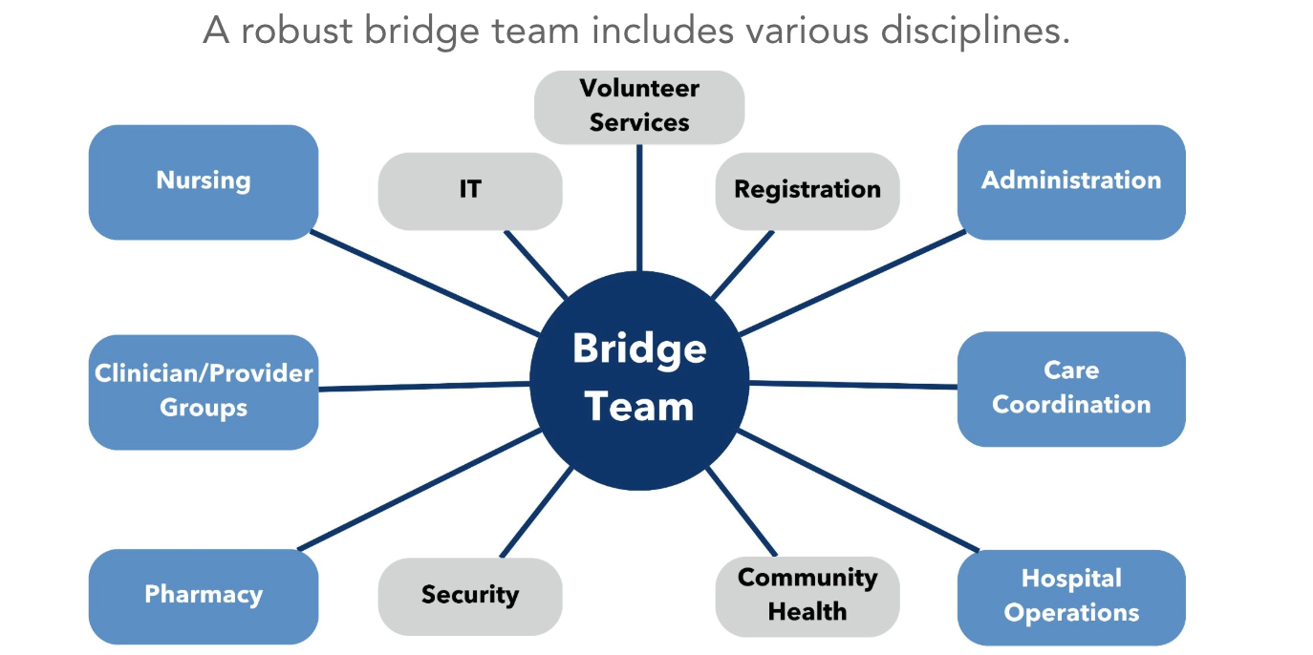

Slide 8
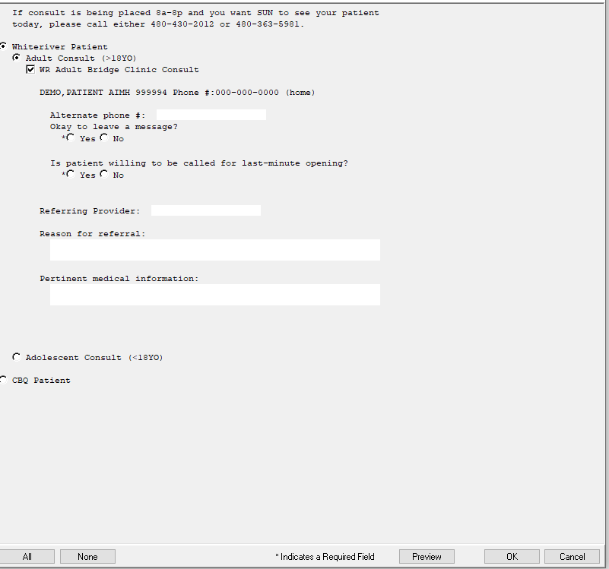

Referral Process
Electronic Health Record Referral
2. Substance Use Navigator (SUN) Direct scheduling
3. Walk-in

Slide 9

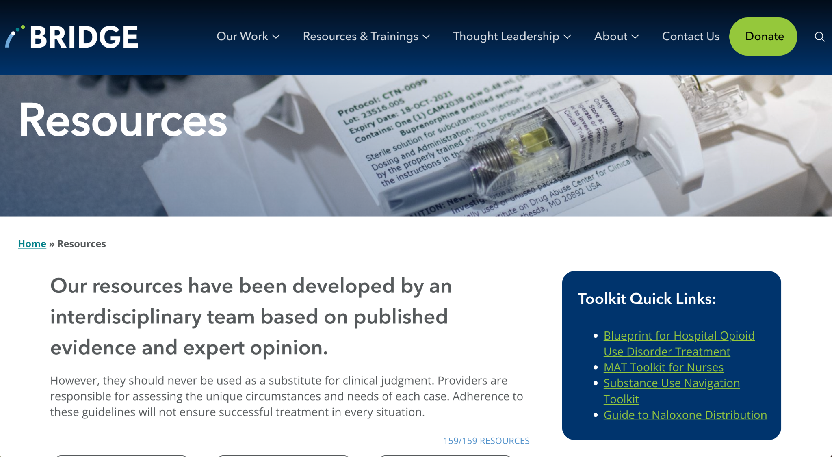
Staffing
What do you need to run the clinic?
Education
https://bridgetotreatment.org/tools/resources/
Consistency

Slide 10
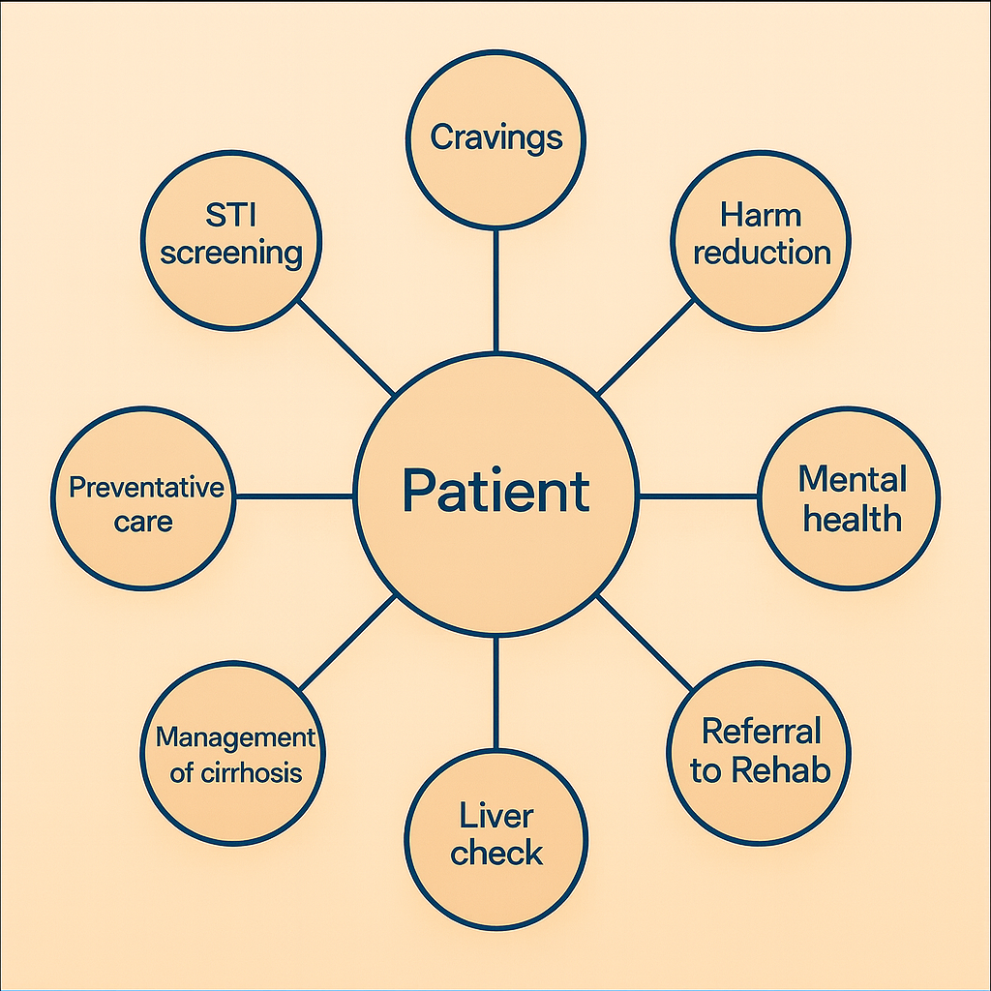
What Happens at a Bridge Visit

Slide 11
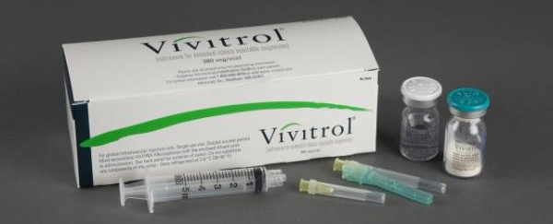
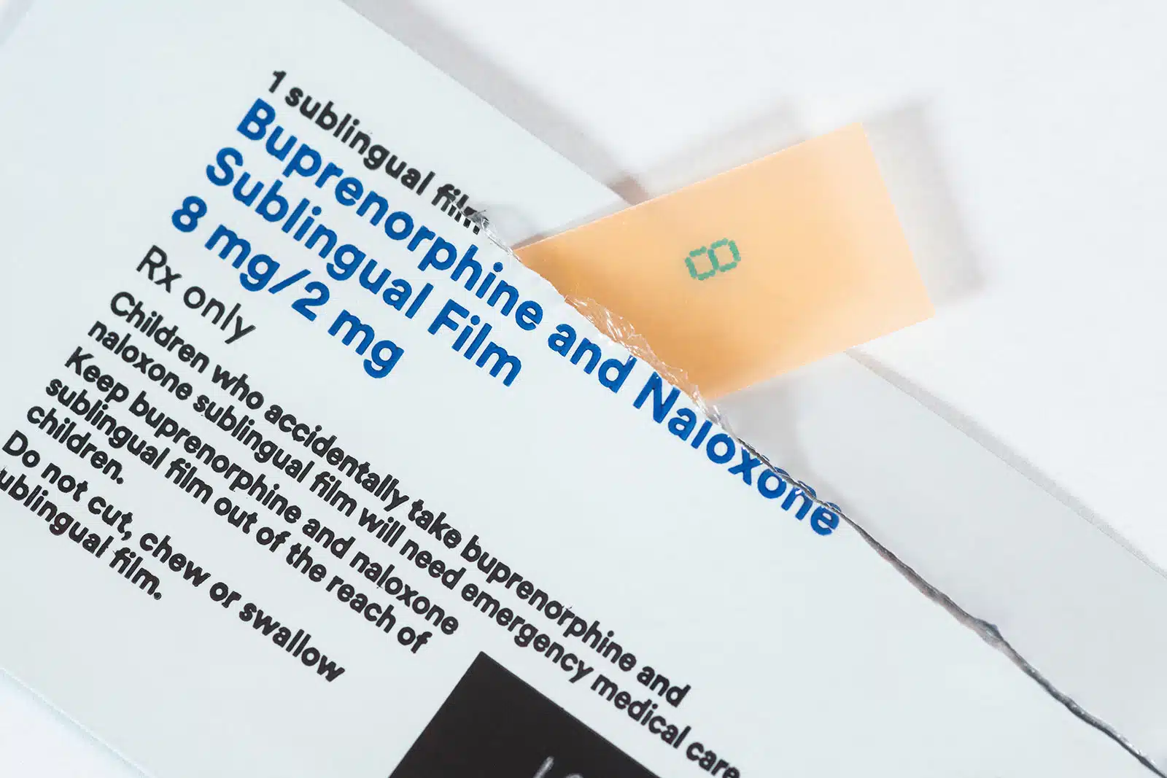
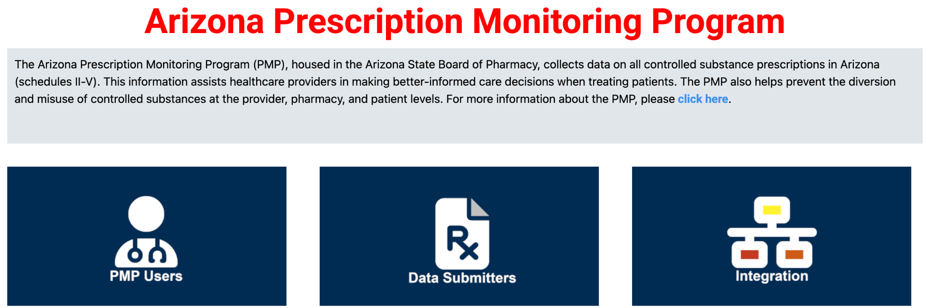
Pharmacy Role

Slide 12
Bridge Evolution at Whiteriver
Embedded in Primary Care clinic
Demand warranted increased clinic scheduling
Added SUNs through grant funding then permanent positions*
Added additional providers
Increasing involvement of stakeholders

Slide 13
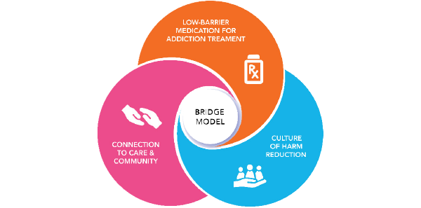
Addition of Substance Use Navigators

Slide 14
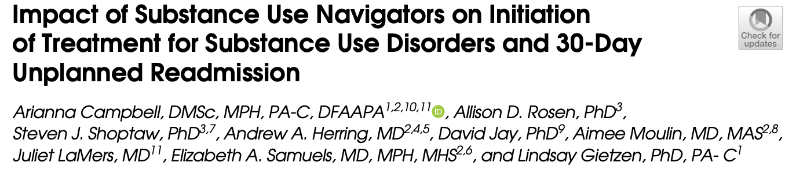
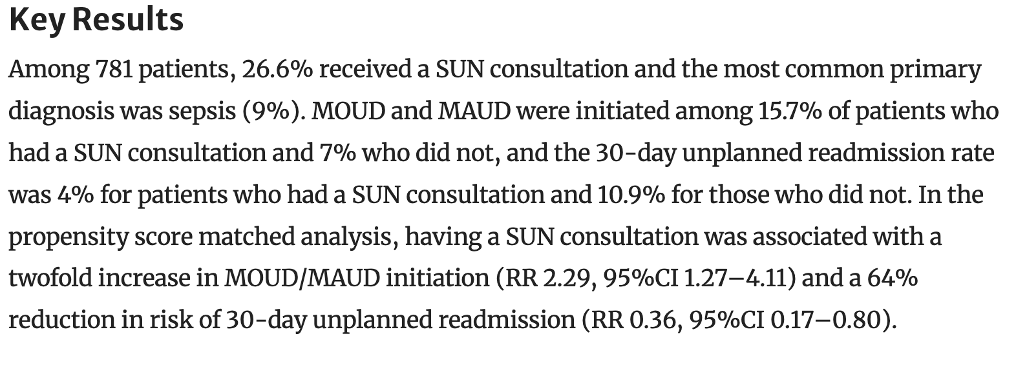
SUNs Make a Difference
SUN involvement associated with a two-fold increase in MOUD/MAUD initiation and a 64% reduction in 30 day unplanned readmission

Slide 15
Billing for Sustainability
ED MAT HCPCS code G2213: Initiation of medication for the treatment of opioid use disorder in the emergency department setting, including assessment, referral to ongoing care, and arranging access to supportive services.
SBIRT code G0396: Alcohol and/or substance abuse structured screening and brief intervention services; 15 to 30 minutes
Code G0397: Alcohol and/or substance abuse structured screening and brief intervention services; greater than 30 minutes
Slide courtesy of CA Bridge

Slide 16
Metrics/Measures of Success
Bridge Show Rates
Patients seen and screened by SUNs
Referrals to residential treatment
ED encounters given Medication Assisted Treatement with a follow up
Patient reported satisfaction
Decreasing leaving against medical advice (AMA)

Slide 17
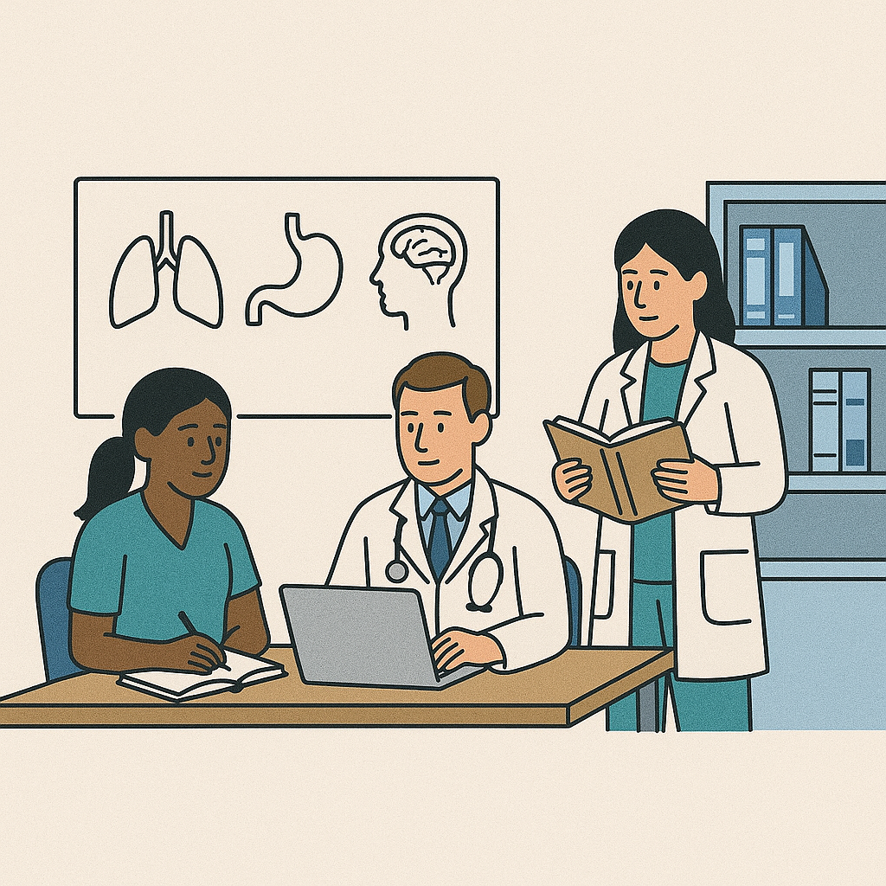
Ongoing Education

Slide 18
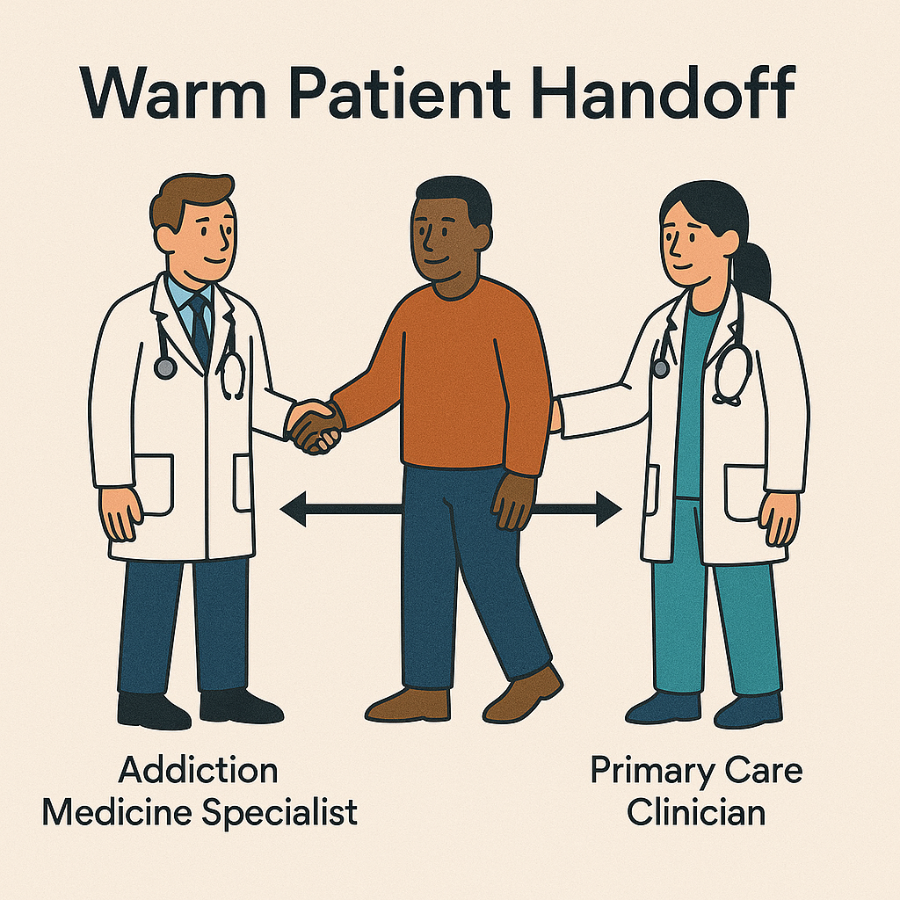
Transitions of Care

Slide 19
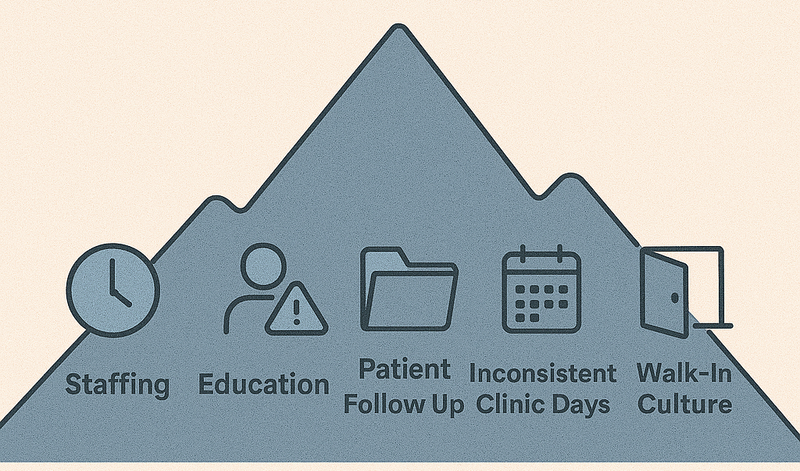
Challenges

Slide 20
Future Goals
Hire more SUNs
Dedicated Bridge clinic staff
Patient incentives
Contingency Management program
Increased collaboration with local recovery/638 programs
Increase clinic show rates
Improve outreach efforts

Slide 21
Questions?

Slide 22
Image Credits
Slide 1: https://www.ihs.gov/Phoenix/healthcarefacilities/whiteriver/
Slide 3: National Bridge Expansion Project; https://bridgetotreatment.org/addiction-treatment/national-bridge/
Slide 4: CA Bridge; https://bridgetotreatment.org/addiction-treatment/ca-bridge/
Slide 6: Open AI. (2025); Chat GPT (Nov 29 version). https://chat.openai.com
Slide 7: National Bridge Expansion Project; https://bridgetotreatment.org/addiction-treatment/national-bridge/
Slide 8: Open AI. (2025); Chat GPT (Nov 29 version). https://chat.openai.com
Slide 9: 1: Open AI. (2025); Chat GPT (Nov 29 version). https://chat.openai.com, 2: National Bridge Expansion Project; https://bridgetotreatment.org/addiction-treatment/national-bridge/
Slide 11: 1. www.drugs.com; 2. ACEP Now; https://www.acepnow.com/article/prehospital-buprenorphine-is-a-powerful-tool-in-the-opioid-crisis-fight/. 3. Arizona Prescription Drug Monitoring Program; https://pharmacypmp.az.gov/
Slide 13: ACEP Now; https://www.acepnow.com/article/one-way-you-can-help-patients-who-abuse-drugs/
Slide 17, 18, 19: Open AI. (2025); Chat GPT (Nov 29 version). https://chat.openai.com

Slide 23
Citations
Campbell, A., Rosen, A.D., Shoptaw, S.J. et al. Impact of Substance Use Navigators on Initiation of Treatment for Substance Use Disorders and 30-Day Unplanned Readmission. J GEN INTERN MED (2025). https://doi.org/10.1007/s11606-025-09902-y

