Slide 1
Approaches to Opioid Withdrawal
emRIC ECHO
19 May 2025
Caroline Kaigh MD
Cooper University Healthcare

Slide 2
Disclosures
I have no financial disclosures.

Slide 3

Notes:
I will be using the term opioid because it is the larger category and includes both opiates (naturally occurring) and synthetic drugs
Most of the drug supply in my area of the US is synthetic fentanyl

Slide 4

Opioid Tolerance and Dependence
Respiratory depression
Euphoria
Dose
Tolerance
Analgesia
Withdrawal
Dependence
Opioid naive
Opioid tolerance/dependence
Notes:
Tolerance: A neurobiological adaptation in which the brain accommodates to an abnormally high level of a drug. Results in a need for increasingly higher doses to obtain the same result.
Dependence: A neurobiological adaptation in which absence of the substance causes a state of withdrawal
Withdrawal: Physical or cognitive symptoms that occur after chronic use of a drug is reduced or stopped
Opioid naïve patient – doses can cause response along range of opioid effects (analgesia → euphoria → respiratory depression)
With repeated dosing, you see shift of response: higher dose required to reach even lowest opioid effect of analgesia (this is development of tolerance)
Then dependence develops and you get withdrawal unless receiving continued/higher doses
Harder and harder to achieve analgesia much less euphoria or respiratory depression

Slide 5



Opioid withdrawal
Notes:
Signs and symptoms include diaphoresis & temperature instability, nausea/vomiting/diarrhea/abdominal cramping, mydriasis, piloerection, muscle aches, restlessness, anxiety, irritability, dysphoria

Slide 6

COWS
Notes:
COWS – in MDCalc
Pulse, sweating, restlessness, pupil size, bone/joint aches, runny nose/tearing, GI upset, yawning, anxiety/irritability, piloerection

Slide 7

Notes:
The approach we use to treat withdrawal should be informed by the patient’s goals and ultimate treatment destination – where is this patient going? Options for dispo may be limited from ED but still useful to have this conversation. Really important to learn about the resources in your community. Is there a methadone clinic? Is there anyone prescribing bup or doing Vivitrol?
Harm reduction
Is control of withdrawal a bridge to MOUD? If so, which one? If not, what is our goal?

Slide 8
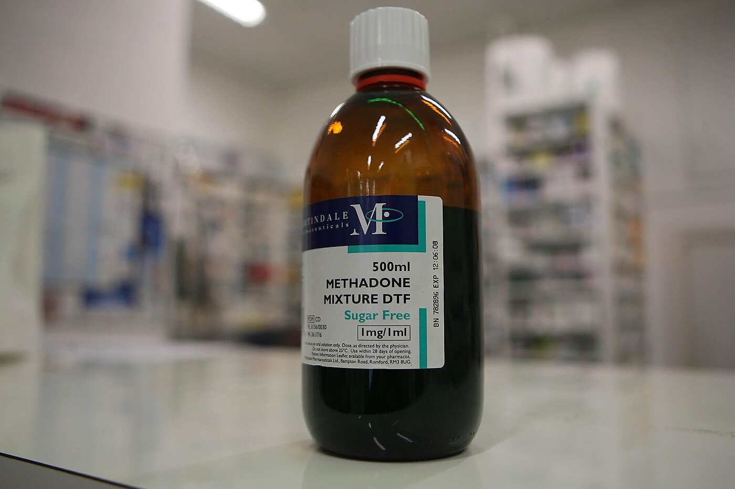
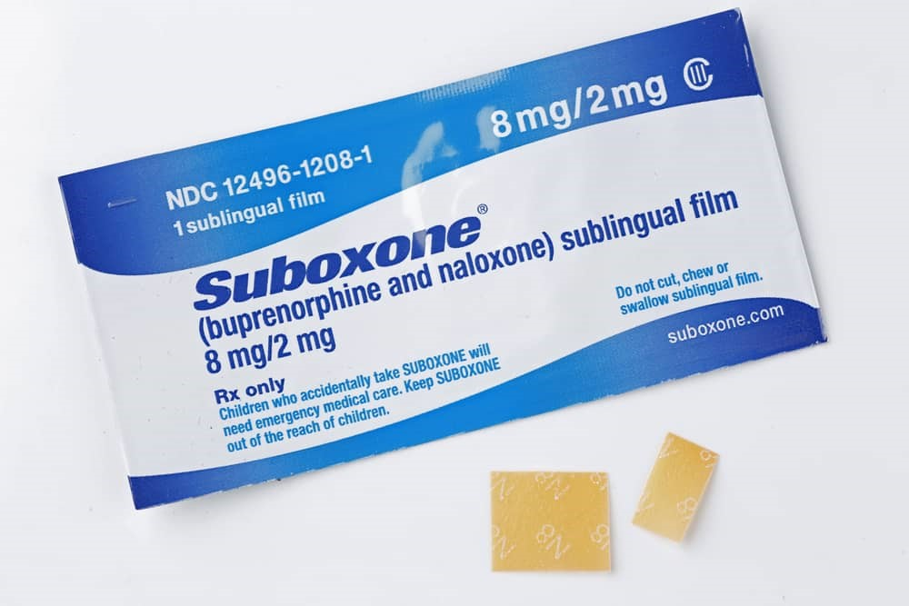
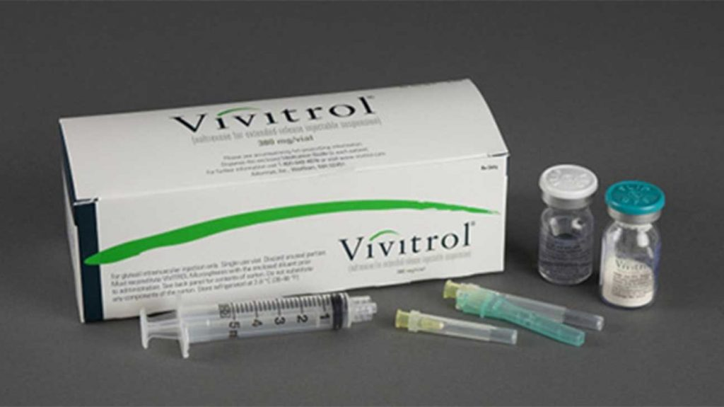
Notes:
3 medications are FDA approved for treatment of OUD
Methadone – full agonist
Buprenorphine – partial agonist
Vivitrol – antagonist

Slide 9
Full agonists:
Heroin
Morphine
Fentanyl
Methadone
Opioid effect
Respiratory depression
Partial agonist
Buprenorphine
Naltrexone
Dose
Notes:
Precipitated withdrawal occurs when you accidentally drop a patient from full agonism to partial agonism

Slide 10
Case #1
51 year old man presents to the ED in obvious withdrawal
He has been using heroin daily for many years and wants to stop
Each time he has tried to stop, his withdrawal symptoms have become so bad that he has returned to use.
Notes:
Hard to start Vivitrol
No methadone clinics nearby
Buprenorphine!
Most important thing to remember: do not cause precipitated withdrawal
Discuss traditional, micro, and macro inductions
Used to require X-waiver, no longer the case, if you have a DEA you can prescribe
Patients do need follow-up; there are monthly options available

Slide 11
Case #2
26 year old woman presents to the ED for broken ankle
She is visiting from the city and fell while hiking
Will need surgery
While you are setting up transportation to the nearest hospital with ortho, she begins vomiting and tells you she has been buying Percocet every day for the past 2 years
Notes:
She is coming from the city and will be going back there – you find out the city has a methadone clinic!
Per federal guidelines, start with 30 mg, then can give additional 10 mg
Check an EKG prior to dosing for QTc
Multiple protocols for rapid titration inpatient, can discuss more

Slide 12
Case #3
47 year old man brought in by EMS after being “found down,” clearly intoxicated
You provide resuscitation & supportive care, and after several hours, he wakes up and tells you that he has been using both alcohol and heroin. He is starting to have heroin withdrawal symptoms.
He wants to go to rehab
Notes:
Vivitrol requires 7 to 10 days of no opioids whatsoever prior to initiation
Can be a great option with co-occurring AUD because it treats that as well
Symptom control: clonidine, anti-emetics, benzos, loperamide, dicyclomine, anti-psychotics, etc.
Inpatient rehab on its own does not have good evidence for treating OUD, but coupled with MOUD can be highly effective
Naltrexone also available PO

Slide 13
Case #4
32 year old woman presents to the ED for a large abscess that requires incision and drainage.
Due to combination of her feeling sick, long transport time, and ED wait time, she begins having opioid withdrawal symptoms.
She tells you she is not ready to stop using drugs
Notes:
Using full agonists for opioid withdrawal symptoms is a bit of a gray area. Methadone is definitely approved but has limitations – in this context, biggest problem is dose limit.
Inpatient, definitely okay to use full agonists.
My personal approach: use either methadone or short-acting agonists until patient’s dispo is clear. If they need admission, I am comfortable using long-acting agonists. If not, short-acting is the safer choice.
Of note, patients with OUD have hyperalgesia as well as increased tolerance, so even if you are dosing for pain, you will need higher than typical doses.
Cannot treat pain until withdrawal is controlled.
In this case: would use some combination of full agonists to treat withdrawal, treat pain, stabilize her.
Patients who plan to return to use are at high risk for fatal overdose if they lose tolerance. One benefit of using full agonists is that it helps preserve tolerance and therefore protects from overdose.

Slide 14
Conclusions
There are many ways to approach opioid withdrawal.
Treatment strategies should be guided by the patient’s goals, the local setting and resources, and the applicable laws and regulations.
OUD is a highly treatable disease

Slide 15

Kaigh-Caroline1@cooperhealth.edu
Notes:
Please email me if questions come up in the future – I am happy to help!

