Slide 1
Back to basics
The vitals machine broke
And other physical exam findings

Slide 2
A few definitions
Assessment: the full thing with the patient from Primary survey through exam
Primary Survey: our initial assessment for life threats and to establish general impression
History: includes what the patient verbally tells us +/- what we learn from bystanders etc
Exam: the physical exam we do- touching the patient and finding stuff
Vitals: blood pressure, pulse, respiratory rate, oxygen saturation
Notes:
These are not very technical definitions

Slide 3
Last time: Review
Why our structured assessment matters, how we think, the patient history

Slide 4

Why we teach it and do it this way
Structure/scaffold
If you do it the same way…
Don’t forget things
You don’t miss things
Develop pattern recognition
Avoid bias like premature closure, anchoring, availability

Slide 5


During our Assessment
Type 1
Type 2
Visual clues
Do the same things
Patterned questions
Vitals
Exam
Treatments based on patterns
Answers to questions don’t match visual clues
Vitals don’t match primary impression
History provides unfamiliar information
Exam yields unexpected findings

Slide 6
What is cognitive bias/error
Anchoring: the tendency to be overly influenced by the first piece of information that we hear or see
Confirmation: clinicians selectively accept clinical data that support a desired hypothesis and ignore data that do not
Availability: clinicians choose the first thing that comes to their mind (often because it is the most common or most recently seen)
Early Closure: jumping to and holding on to a presumptive diagnosis (possibly abandoning additional questions/exam)

Slide 7
What we teach in school
Scene safe/BSI
Primary survey
OPQRST/SAMPLE
“Focused” exam
Treatment plan

Slide 8
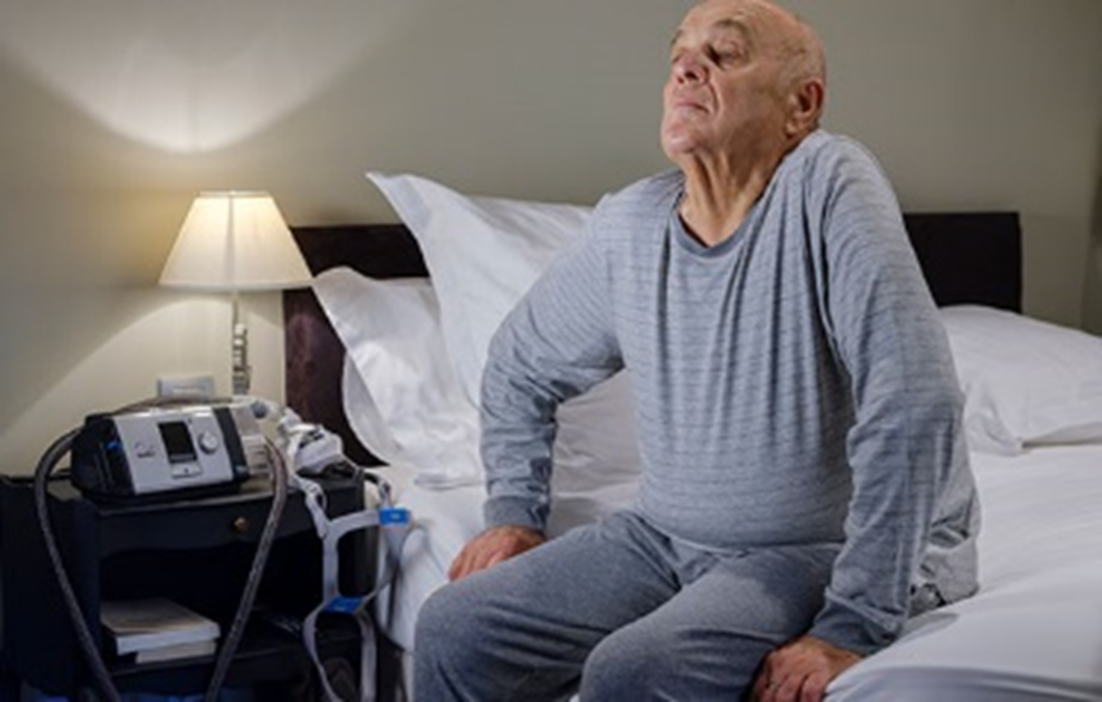

Primary survey
Clinician handshake and type 1 thinking

Slide 9

History
What is going on + why might it be happening
Doors we open

Slide 10
Examples since last month?

Slide 11
Vital signs are Vital
But have their own limitations

Slide 12
What we are including:
Blood pressure
Heart Rate
Respiratory rate
O2 sat
Temp

Slide 13
The importance of the vital signs
Objective markers
Opportunity to avoid bias
Change over time

Slide 14
The challenge with vital signs
Interpretation in context of patients
Bad usually = Bad
Good doesn’t always = Good

Slide 15
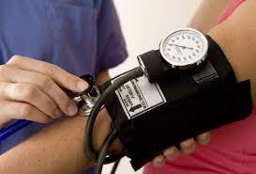
The first blood pressure should be Manual*
Its faster
You touch the patient
You pay attention and register the number
How does an automated blood pressure cuff work?
Mean Arterial Pressure = (2xDBP + SBP)/3
Risk for inaccurate SBP

Slide 16

Pulse
You already kind of know
Monitor 4 or 12 lead
Monitor pulse Ox
Trends?

Slide 17
Respiratory rate
Are they tachypneic?

Slide 18
O2 sat
Cold
Poor perfusion
Remember the cliff

Slide 19

Temporal thermometers are random number generators
High is usually right
Recent hat on
Standing outside in the sun
Everything makes it falsely normal
It is a data point only

Slide 20
Exam
Why does my patient have these symptoms, extension of the history

Slide 21
Disciplined observation
General
Face stuff
Airway
Breathing effort
Basic neuro
Bleeding/deformities

Slide 22
Check out what the patient told you…
You just asked a lot of questions
You have a number of things that could be going on (differential diagnosis)
Now see what you find
Look
Listen
Palpate

Slide 23
The risk of the exam…
What if I don’t know what some finding means?

Slide 24
Focused exam based on complaint
Dizzy, weak, headache, etc= Neuro exam
Painful parts= look at and palpate what hurts (even feet)
Think about system “above and below”
Abdominal complaints= pulmonary and lower extremity exam
Neck = mouth/posterior oropharynx and chest

Slide 25
Other stuff
Glucose, EKG, Capnography

Slide 26
Wrap up

Slide 27
We have covered
Primary survey
OPQRST/SAMPLE
Exam
Vitals

