Slide 1
Helping people with diabetes thrive with
Time in Range

Slide 2
Audree Hall
Digital Campaign Manager,
The Time in Range Coalition
Notes:
Intro - My name is Audree Hall and I’m the digital Campaign Manager for TIRC. While I’m not a doctor, I’ve lived with T1D for almost 16 years now—which makes me a bit of a lived expert!

Slide 3
The Time in Range Coalition
Notes:
Now, who is the TIRC?

Slide 4
The diaTribe Foundation
Not for profit, founded by Kelly Close, that is dedicated to improving the lives of people with diabetes and advocating for action.
Learn - www.diatribe.org
Stigma - www.dstigmatize.org
Time in Range - www.TimeinRange.org
Notes:
The TIRC is a part of diaTribe

Slide 5
Time in Range Coalition
The Time in Range Coalition is an effort to engage the diabetes ecosystem, including nonprofits, professional societies, industry, and patient advocates, to drive awareness and adoption of time in range (TIR), as well as time above range (TAR) and time below range (TBR), as the primary glucose metric for daily management, complemented by HbA1c, in diabetes care as critical tools to improve the care of people with diabetes.

Slide 6
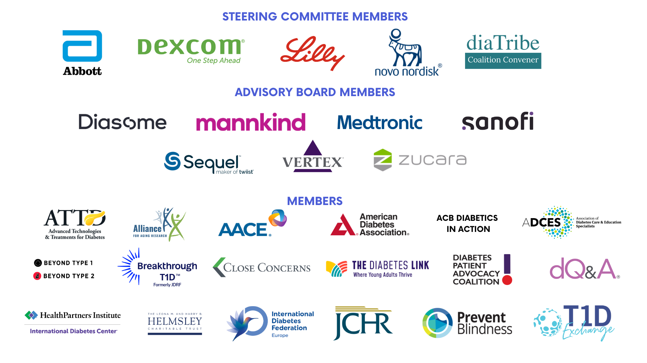
Notes:
The TIRC is made up of some seriously impressive groups in the diabetes space, etc etc

Slide 7
Before we start…
Please keep this in mind. “Resistance” to care has foundational reasons. Indigenous peoples have gone through generations of trauma from outsiders. Patience, understanding, and a change is perspective is vital when introducing diabetes technology.
Taking care of yourself and your body is honoring those who have allowed you to be here. Diabetes care is a ritual in itself.

Slide 8
CGM Metrics

Slide 9
What glucose metrics can CGMs offer?
Time in range
Average Glucose
Standard Deviation
GMI
Patterns
AGP Report

Slide 10
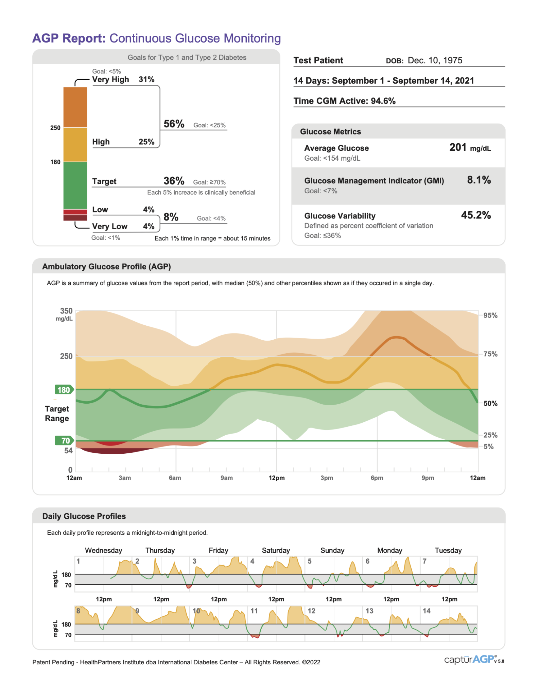
What is an AGP report?
An AGP report is a standardized, single-page report that includes glucose statistics like time in range, a summary glucose profile, and daily glucose graphs. It converts blood glucose readings from a CGM device into a detailed picture, allowing you to quickly visualize the time you spend above and below your target range.
The report is based on at least seven days of CGM data, with 14 days of data (or more) considered ideal.

Slide 11
What can the AGP report tell you?

Slide 12
Time in Range
Notes:
A big part of that is time in range!

Slide 13
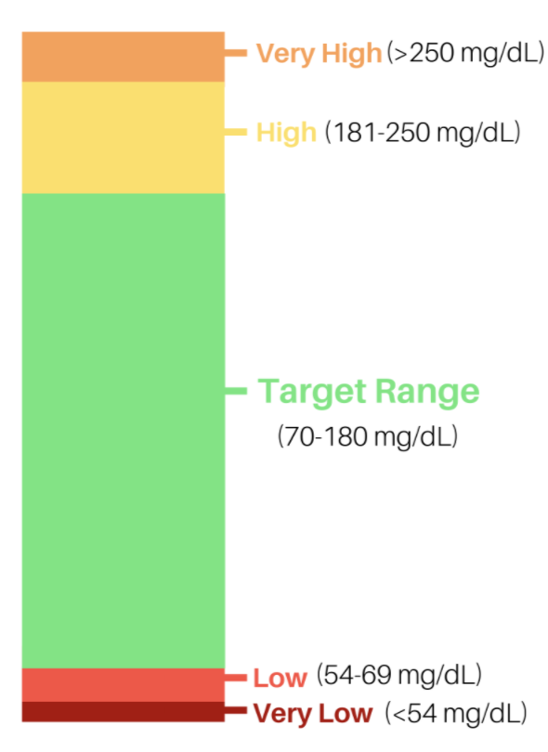
Time in Range
Very High (>250 mg/dL)
High (181-250 mg/dL)
Time in Ranges
Target Range
70-180 mg/dL
Low (54-69 mg/dL)
Very Low (< 54 mg/dL)
Notes:
We recognize that not everyone is familiar with Time in range, so a quick recap…. ALL of those numbers from the continuous glucose monitors – get channeled into something like this… You want to spend as much of your time as possible in the green range… as little as possible in the red… and this information is available on your phone, computer, - anywhere apps are available…
In 2019, an international panel of diabetes experts set these recommendation for people with type 1 and type 2 diabetes. These experts, with their research and knowledge determined that people with diabetes should be working towards 70% OR MORE of time spent in the green “IN RANGE” target and less then 4% of time spend BELOW Range (the red areas)
TIR is an actionable metric that captures the percent of time that someone’s glucose is between 70 and 180 mg/dl.
TIR, along with time below range (TBR) and time above range (TAR), as measured by a continuous glucose monitor (CGM), shows daily fluctuations in glucose and the amount of time spent high or low across several days.
This information can be more useful and actionable than A1C, which only provides the average blood glucose and nothing about glucose variability.
Knowing TIR and TBR helps to focus necessary action on both the part of PWDs as well as they healthcare teams to improve glucose management – by giving them the power to make informed decisions.

Slide 14
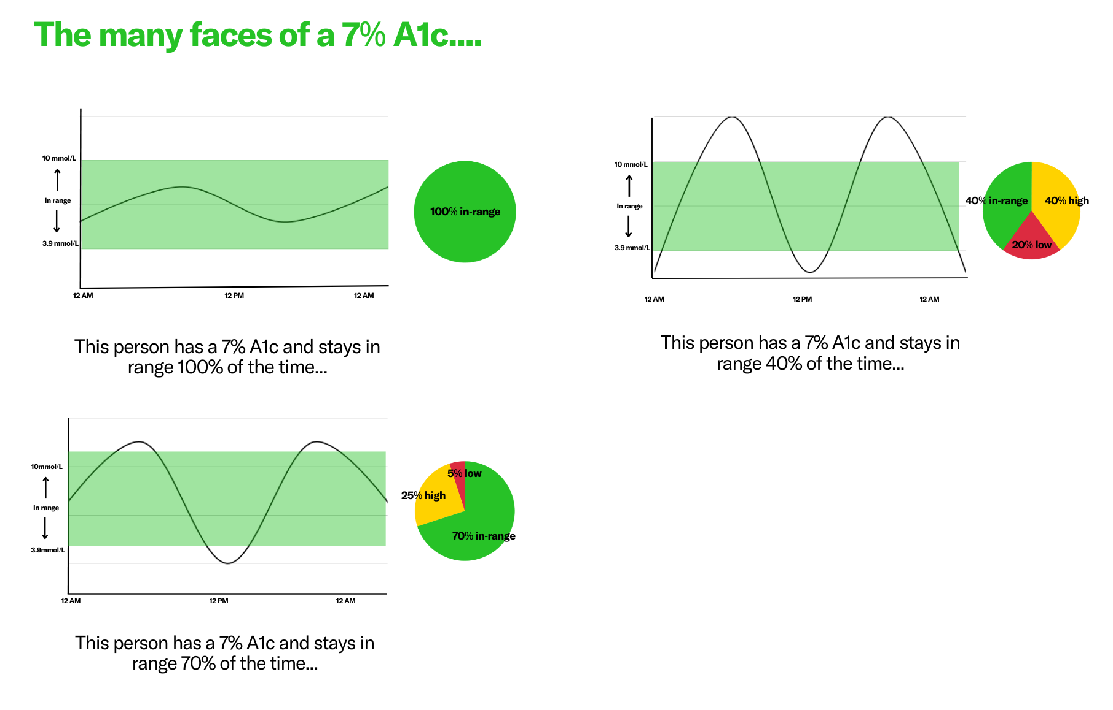
Notes:
And TIR fills in the gaps of the A1c… Because A1c isn’t perfect…

Slide 15
Measurable benefits of TIR
Time in range and diabetes complications:
Research shows that TIR can be a more accurate indicator for risk of long-term diabetes complications^{1,2}
Time in range and mental health:
Preliminary evidence suggests increased TIR is associated with better mood; less anger and negative affect^{3,4}
Time in range and quality of life:
Studies show using CGM and it’s metrics can help improve quality of life for people with diabetes^{5,6}
Time in range and glycemic control:
Studies show that using a CGM and its metrics can actually lower A1C and improve glycemic control^{7–9}
Notes:
TIR has multiple measurable benefits
TIR, along with time below range (TBR) and time above range (TAR), is typically measured by a continuous glucose monitor (CGM), shows daily fluctuations in glucose and the amount of time spent high or low across several days.
TIR can and SHOULD be used by both patients and health care professionals to optimize outcomes.
I can tell you, I have left providers who didn’t understand, use or incorporate this data into my management. I don’t stab myself with metal every 10 days and wear this device because it completes my outfit. I wear to help me and my team understand what’s happening and where we can improve my management.

Slide 16
Standards of Care for Diabetes (ADA)
TIR is associated with the risk of microvascular complications and can be used for assessment of glycemic control.
Assess glycemic status using a 14-day CGM assessment of TIR and GMI or A1c for use in clinical management and followed remotely
CGM should be offered for anyone with diabetes.

Slide 17
Dexcom Stelo and Abbott Rio
CGMs have just become a lot more accessible.
Dexcom’s Stelo and Abbott’s Rio is are “OTC” CGM sensors designed for people with Type 2 diabetes not on insulin—no prescription or insurance required.
Stelo is $99 for a month supply, $89 if you get a monthly subscription at https://www.stelo.com/en-us.
We expect Rio to come to market soon.

Slide 18
How can you take action with time in range?
Time in range allows you to see the totality of a person’s diabetes management in one glance. You can see if they’re running high or low, and then dive deeper to make changes needed.
Utilizing time in range gives you a data-driven starting place, saving time during appointments and helping you and those in your care feel more empowered.
More empowerment = less diabetes distress.

Slide 19
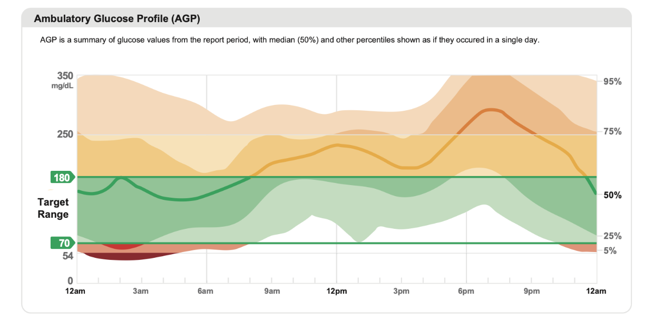
Ambulatory Glucose Profile
Notes:
A big part of that is time in range!

Slide 20
How to read the AGP
Solid line: the median of all the readings. Half of your glucose values are above the middle line, and half are below.
Darker shading: 50% of your glucose values lie in this area
Lighter shading: 90% of your glucose values lie in this area
Green: this is the time spent in your target glucose range (usually between 70 and 180 mg/dL)
Yellow: this is the time spent in a high glucose range (between 180 and 250 mg/dL)
Orange: this area near the top of the graph is time spent in a very high glucose range (above 250 mg/dL)
Red: this area near the bottom is time spent in a low glucose range (between 70 and 54 mg/dL)
Dark red: this area at the bottom of the graph is time spent in a very low glucose range (below 54 mg/dL)

Slide 21
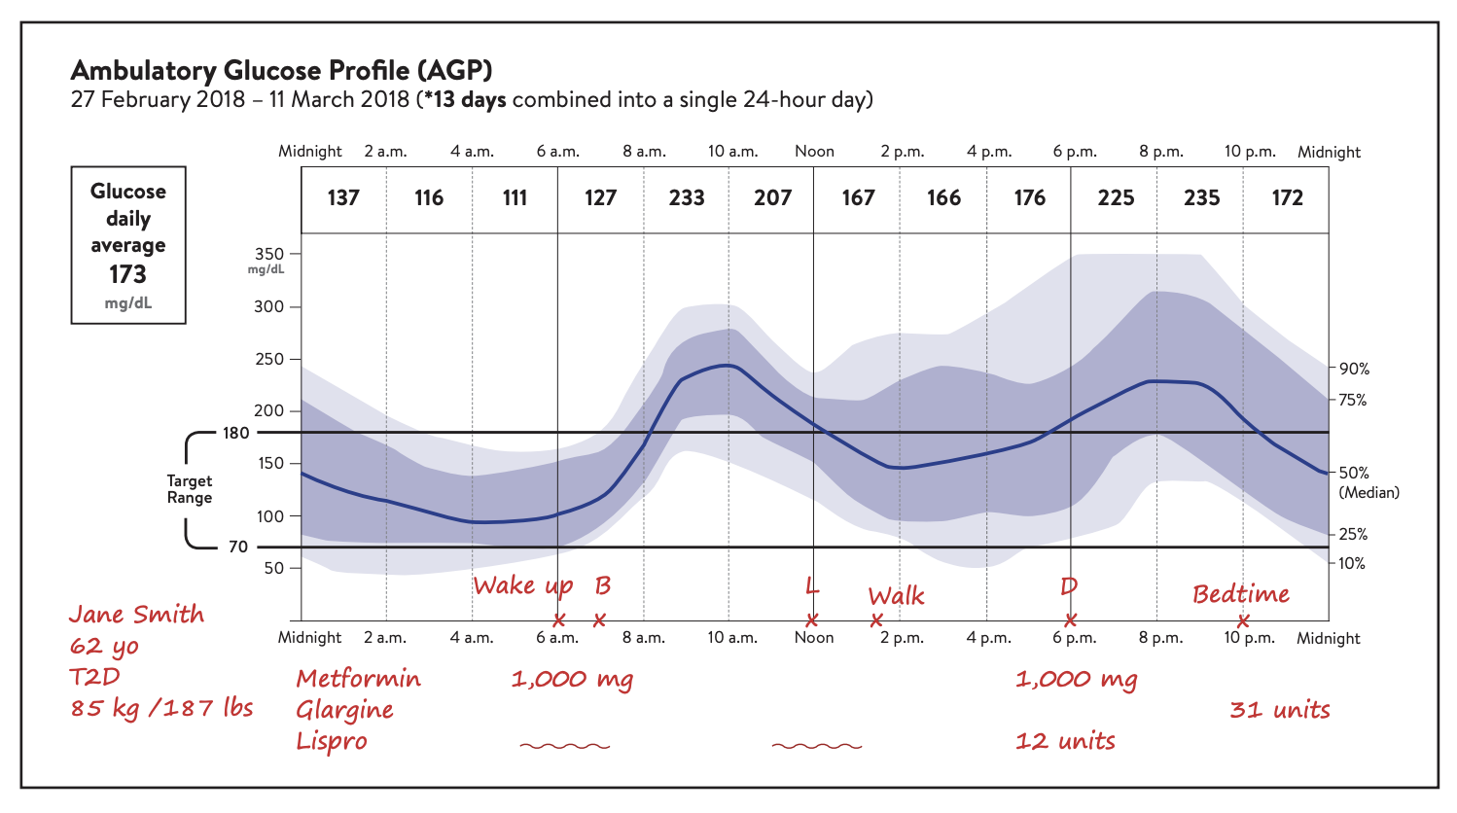
What can the AGP identify?
Patterns.
Patterns of hypo- and hyperglycemia
Glucose variability
Factors that affect glucose
Notes:
You can see on this chart that the AGP report shows that Jane is often seeing a post-meal spike after dinner, sometimes spiking all the way to 350.

Slide 22
How can you take action with the AGP?
Review factors that affect AGP, look for patterns of low and high glucose levels on AGP, identity wide variability patterns, and use that data to make an action plan with those in your care.
For example, if we look back at Jane’s data, we can see she has a higher spike than wanted after dinner. You can work to make changes to insulin, exercise, or diet based on this diet—everyone’s management plan can be individualized based on their needs and what’s realistic to them.

Slide 23
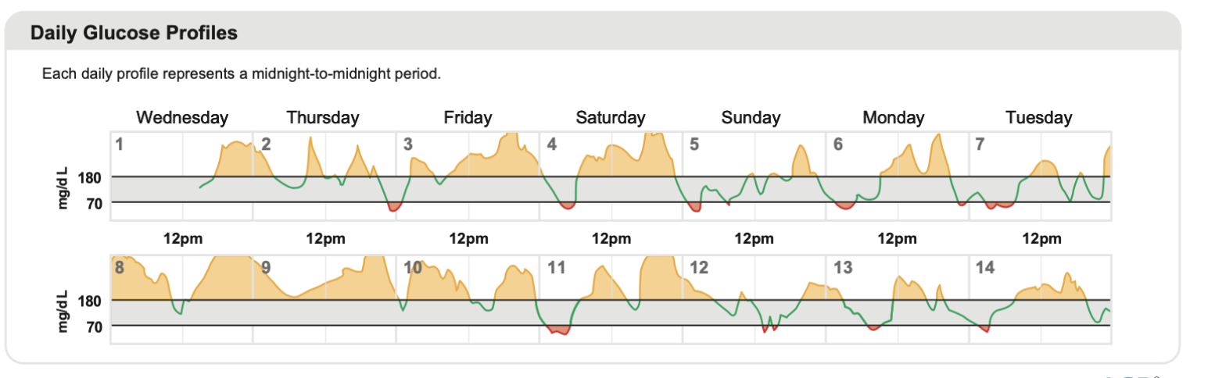
Other AGP data:
Average glucose: All glucose values added together, divided by number of readings
GMI (glucose management indicator): Calculated from average glucose for at least 12 days of data; is not the same as A1c, but can help estimate your future lab A1c
Glucose Variability: How far apart (wide) glucose values are; ideally a low number equal to or less than 36% [percent coefficient of variation]
Daily Glucose Profiles: Each box is a single day's glucose pattern
Notes:
Average glucose can be helpful bc even if you’re in range 80% of the time, you can see if you’re sitter closer tot he top or bottom of that range. GMI is helpful to compare to A1C. Glucose variability is huge—this can show you how high and low people are going, if they’re swinging and riding a rollercoaster. For example—my TIR was around 70% but I was spiking high and crashing low for short periods of time. Daily glucose profiles are great for pinpointing events—look at the “good” days and try to replicate

Slide 24
How does this help diabetes distress?

Slide 25
A1C: The scarlet letter
How would you feel if you had to wear a sticker for 3 months straight that said “I did a bad job”?
That’s what A1C can feel like to people with diabetes.
When talking to people with diabetes about CGM and time in range, it’s important to keep this thought in mind. A combination of intentional language, a focus on the positive, accessible resources, and supportive staff can help you empower those in your care to thrive with time in range. And most importantly—leave your
assumptions at the door.
Notes:
When talking to PWD about TIR, language matters! A big part of PWD and their fear/avoidance of looking at their blood sugar is because they don’t want it to define them. Time in range can take that pressure away. The ADA 2024 SOC says CGM is everyone!

Slide 26
CGM/TIR + diabetes distress
Data has shown that receiving reviewing CGM reports including time in range can not only improve hypoglycemic confidence and overall well-being, helped to improve A1C, but it can reduce diabetes distress as well.
In elderly populations on multiple daily injections, the introduction of CGM did not lead to additional diabetes distress.
Notes:
TIR has multiple measurable benefits
TIR, along with time below range (TBR) and time above range (TAR), is typically measured by a continuous glucose monitor (CGM), shows daily fluctuations in glucose and the amount of time spent high or low across several days.
TIR can and SHOULD be used by both patients and health care professionals to optimize outcomes.
I can tell you, I have left providers who didn’t understand, use or incorporate this data into my management. I don’t stab myself with metal every 10 days and wear this device because it completes my outfit. I wear to help me and my team understand what’s happening and where we can improve my management.

Slide 27
CGM/TIR + diabetes distress
While diabetes tech provides immense benefits, it can also be connected to diabetes distress.
Burnout from constant monitoring, the thought of being “watched” and judged by HCPs, and and obsession with numbers that can lead to disordered eating are very real issues.
CGM breaks are OKAY. Starting on a CGM for only 2 weeks a month can help ease the transition and start the process encouraging healthier behaviors.
Notes:
When talking to PWD about TIR, language matters! A big part of PWD and their fear/avoidance of looking at their blood sugar is because they don’t want it to define them. Time in range can take that pressure away. The ADA 2024 SOC says CGM is everyone!

Slide 28
Language Matters
Language around diabetes management to avoid:
Discipline
Regiment
“Good” or “Bad”
Compliance
Control(led)
Alarming
Lifestyle change
Language around diabetes management to include:
Active, specific language (checking glucose, taking insulin)
Management
Above/below your range
Personalization
Optimizing/adjusting
Choices/decisions
Check out dStigmatize’s language guide here.
Notes:
Before we get started, we need to lay the foundation of every conversation you have with a person in your care. Language matters. The first column is not empowering, it’s not exciting, and it puts all of the blame on the PWD. When people feel like they’re doing something wrong and are being judged, that leaves no room for excitement about what they could do.

Slide 29
Talking points
Time in range helps put the power in your hands.
Time in range gives you the entire picture—A1C can’t tell you how different rituals, foods, hormones, or emotions affect you.
Time in range can give you data to better understand your glucose —it can provide less frustration and confusion.
Increasing time in range can improve sleep, decrease complications, and help you feel better now. Decreasing complications allow you to be there for your community for longer.
A1C has actually shown to be less accurate for people of color with diabetes
Notes:
Most conversations around TIR center around these main talking points—these can be the basis for convincing PWD to try time in range.

Slide 30
Patterns and Positivity
Time in range can identify patterns and help give a more positive outlook to people living with diabetes through more data—but the thought of constantly being monitored can be stressful for people with diabetes. Here’s how you can frame some of the positives on time in range!
Notes:
Time in

Slide 31
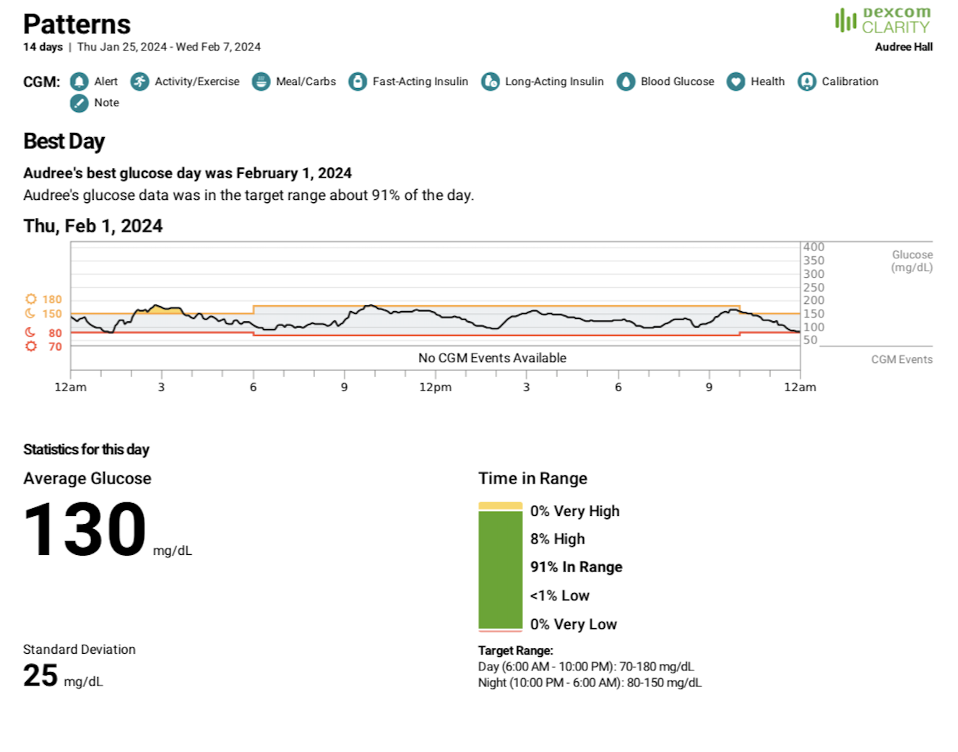
Patterns and Positivity
Notes:
CGM and time in range allows your HCP to see all of your glucose data over the past week, month, or 3 months = We can work together to identify what you’re doing when your glucose is in range and try to replicate it in scenarios where you find yourself out of range (time in range lets you focus on what they’re doing RIGHT.

Slide 32
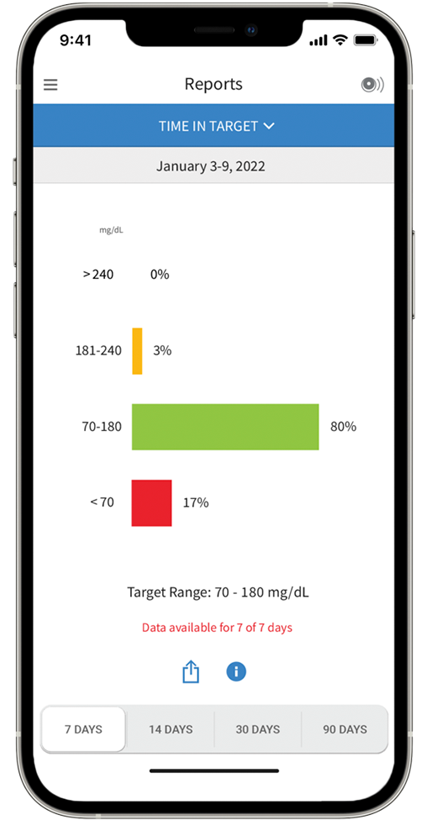
Patterns and Positivity
The target range can differ depending on the person with diabetes.
Notes:
The goal is to stay in range 70% of the day = We can tailor your time in range goal to what feels realistic and helpful for you. (Smaller, more accessible goals encourages people to meet them.) Pregnancy, older adults with hypo risk, etc.

Slide 33
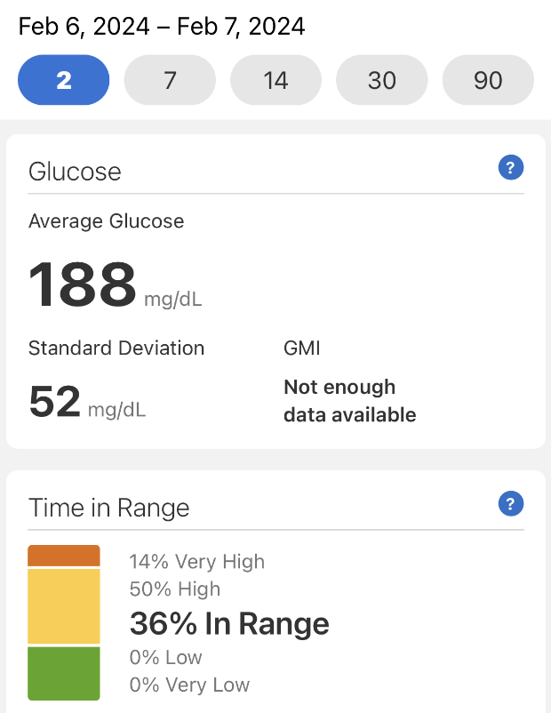
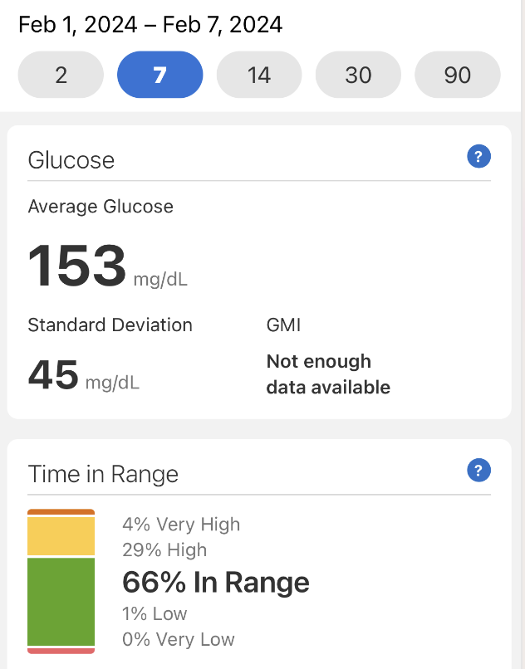
Patterns and Positivity cont.
1 day (or 2 days..or a week) doesn’t define you!
Notes:
Time in range tells you the percentage of each day you’re in range = Everyday is a new day when you use time in range. Instead of your A1C hanging over your head every 3 months, you can start each day fresh. 1 rough day—even a rough week, doesn’t define you.

Slide 34
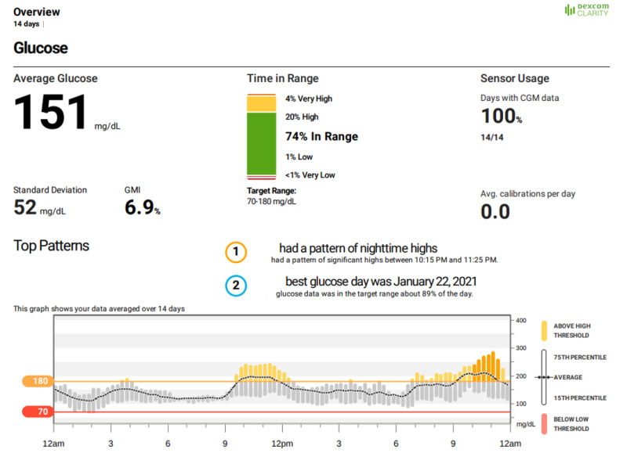
Patterns and Positivity cont.
Notes:
Time in range can show fluctuations in your glucose levels due to hormones, etc. = It can be really frustrating when your glucose is going up and down and you have no idea why. Time in range can help you understand those patterns and figure out if you need to do something a little different during your period, etc.

Slide 35
Unraveling the mystery…
“I’ve been having a lot of lows, but my A1C is still 7%. I guess I’m fine?”
“I feel like I’m riding a rollercoaster. I’m high and low all the time, but my A1C is fine, so I guess it’s not a problem”
“I am running higher than I’d like to, but my A1C isn’t that bad, so it’s probably fine”
How can you acknowledge these concerns while bringing up time in range?
Notes:
These are all things I have said in my head—and I guarantee you, things that other PWD have said, but aloud to you when they get their A1C results. Say you’re in the office, and someone says one of these to you. How would you talk to them about using time in range?

Slide 36
Time in range goals
While the suggested TIR goal is 70%, the beauty of time in range is its ability to be individualized to every person with diabetes. If a numerical goal isn’t empowering to someone in your care, try thinking about goals in a different way. It could look like…
Using time in range to honor your body and those who made it possible for you to be here
Using time in range to figure out what food makes me spike or drop
Using time in range to figure out what time of day it’s best for me exercise
Using time in range to figure out how I should manage my diabetes while I’m on my period
Using time in range to help me feel less stressed about where my glucose is going
Notes:
Most conversations around TIR center around these main talking points—these can be the basis for convincing PWD to try time in range.

Slide 37
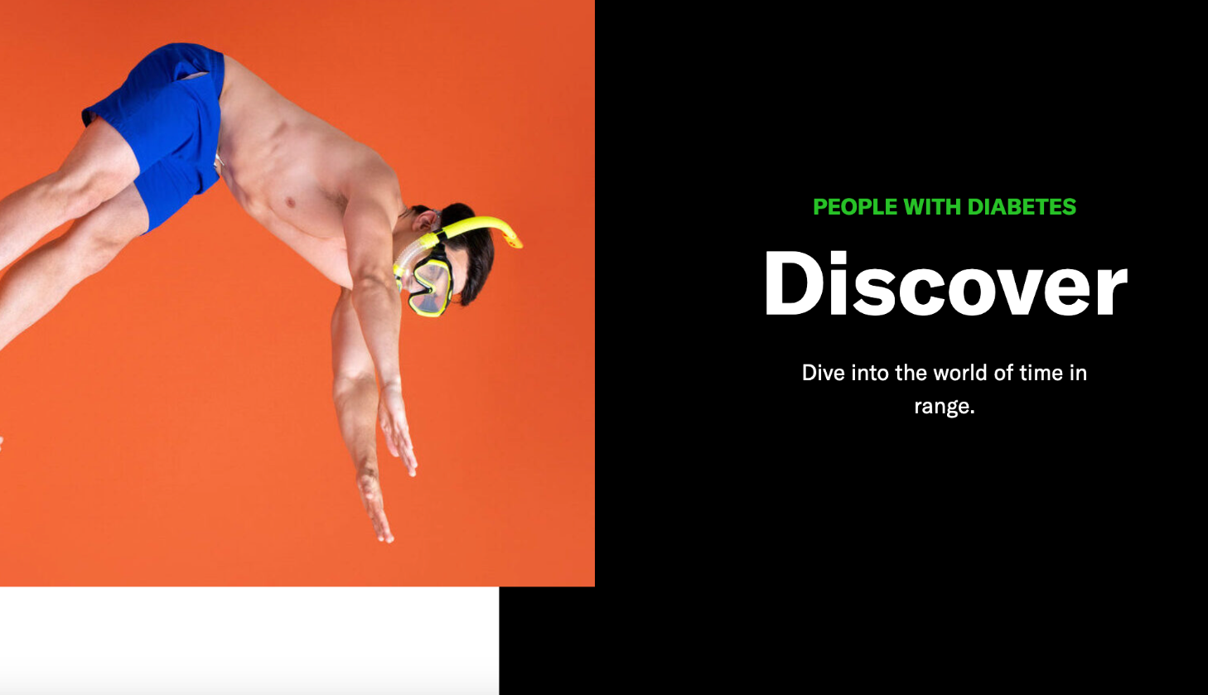
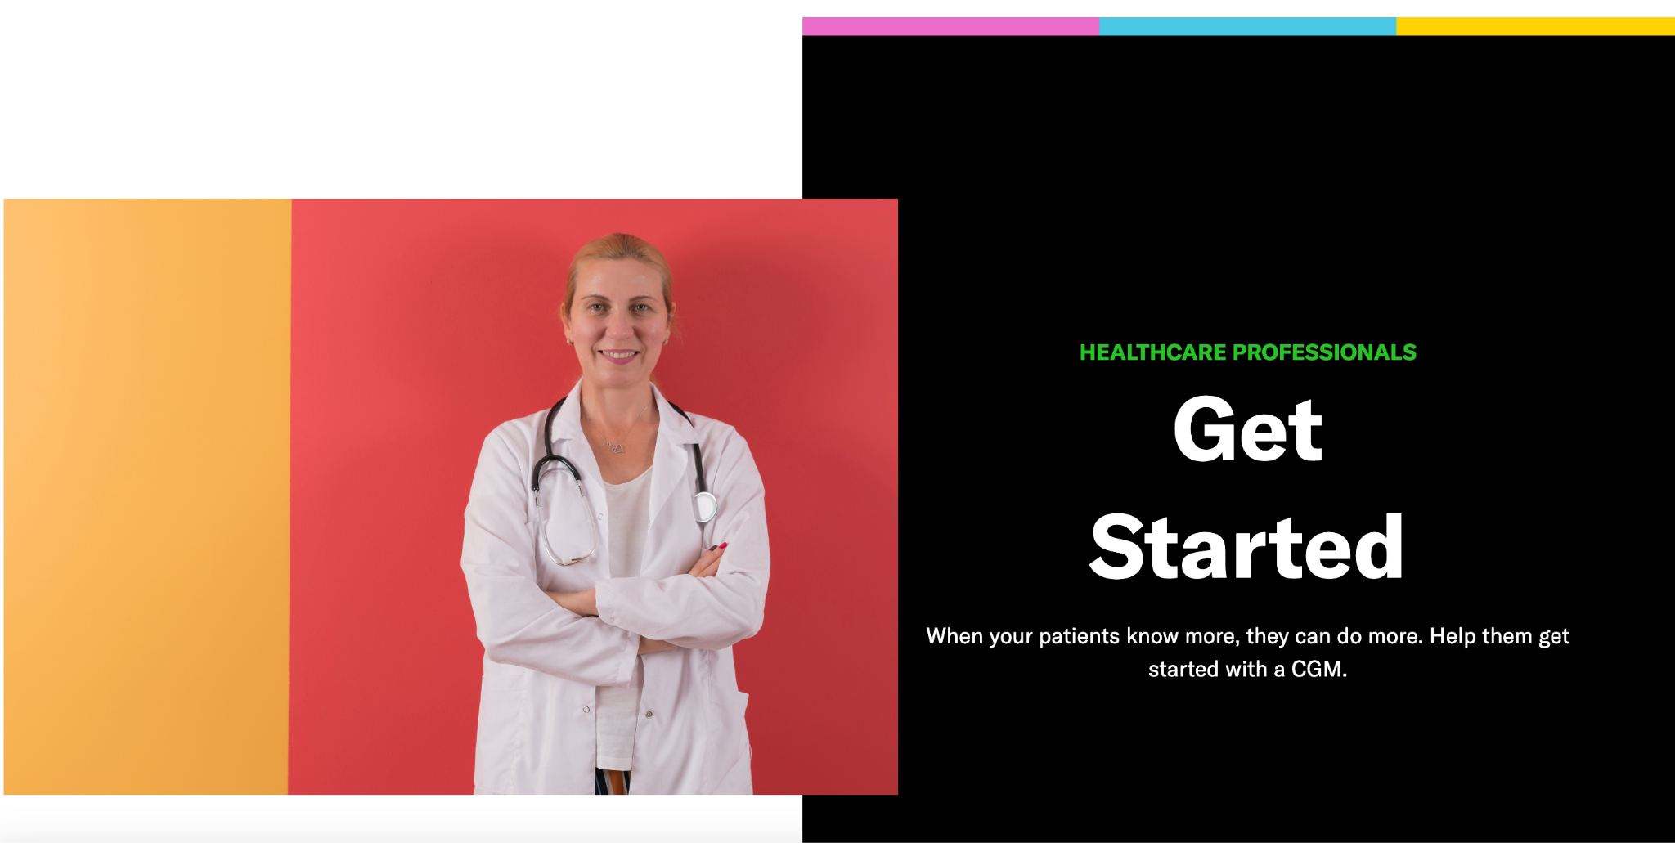
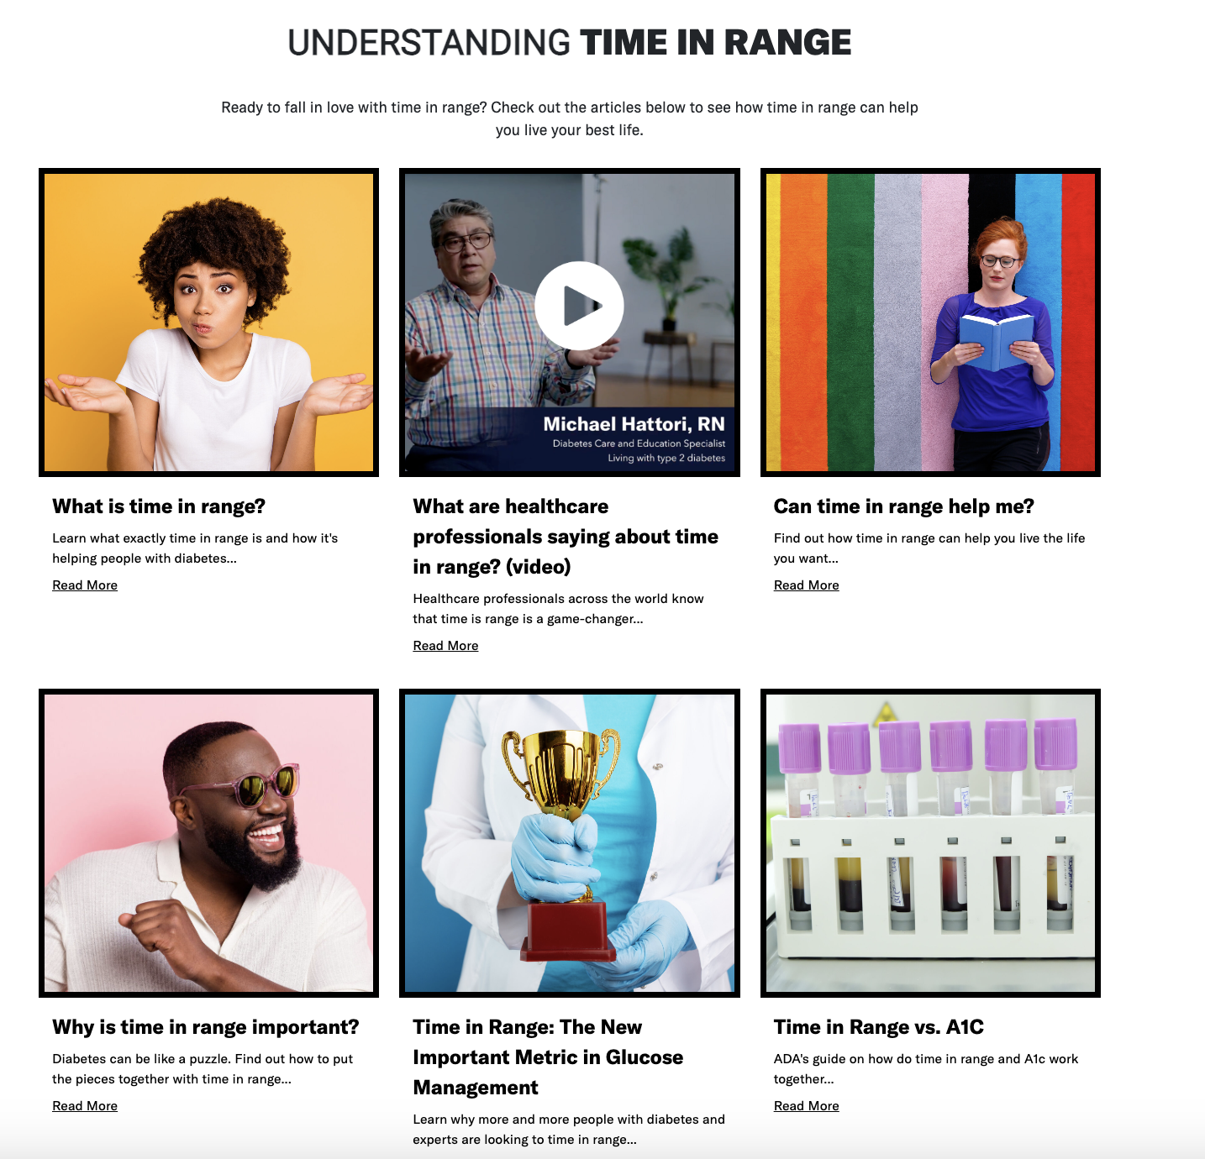
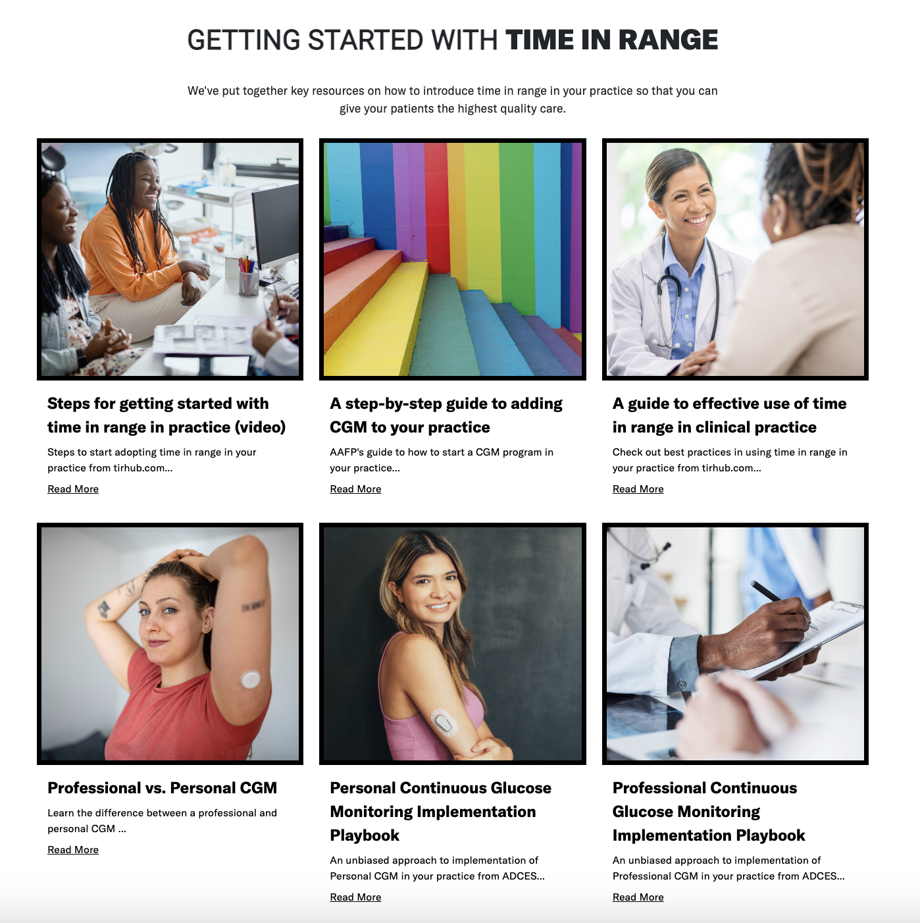
Timeinrange.org
Resources for people with diabetes and healthcare professionals—including step by steps on how to integrate CGM into practice and workflow, latest research, and more.

Slide 38
How can timeinrange.org help?
Timeinrange.org was created for people with diabetes by people with diabetes to help navigate each person’s individual time in range journey. Resources include:
Time in range basics
Video and text testimonials from people living with diabetes
Resources on how to get started—from CGM guides and FAQs to time in range app guides, it provides accessible , step-by-step guides
Information on how time in range helps your overall health (kidney, mental health, etc.)
Information for people who already use time in range—like how to increase your time in range, CGM tips and tricks, and more
Diabetes tech self care kit….coming soon!
Notes:
Timeinrange.org also has downloadable posters and information for people with diabetes that you can print and keep in your office.

Slide 39
Q+A

Slide 40
Thank you!

Slide 41
References
Beck RW. The Association of Time in Range and Diabetic Complications: The Evidence Is Strong. Diabetes Technol Ther. 2023;25(6):375-377. doi:10.1089/dia.2023.0141
Yapanis M, James S, Craig ME, O’Neal D, Ekinci EI. Complications of Diabetes and Metrics of Glycemic Management Derived From Continuous Glucose Monitoring. J Clin Endocrinol Metab. 2022;107(6):e2221-e2236. doi:10.1210/clinem/dgac034
Ehrmann D, Priesterroth L, Schmitt A, Kulzer B, Hermanns N. Associations of Time in Range and Other Continuous Glucose Monitoring-Derived Metrics With Well-Being and Patient-Reported Outcomes: Overview and Trends. Diabetes Spectr. 2021;34(2):149-155. doi:10.2337/ds20-0096
Polonsky WH, Fortmann AL. The influence of time in range on daily mood in adults with type 1 diabetes. Journal of Diabetes and its Complications. 2020;34(12):107746. doi:10.1016/j.jdiacomp.2020.107746
Gilbert TR, Noar A, Blalock O, Polonsky WH. Change in Hemoglobin A1c and Quality of Life with Real-Time Continuous Glucose Monitoring Use by People with Insulin-Treated Diabetes in the Landmark Study. Diabetes Technol Ther. 2021;23(S1):S35-S39. doi:10.1089/dia.2020.0666
Polonsky WH, Soriano EC, Fortmann AL. The Role of Retrospective Data Review in the Personal Use of Real-Time Continuous Glucose Monitoring: Perceived Impact on Quality of Life and Health Outcomes. Diabetes Technol Ther. 2022;24(7):492-501. doi:10.1089/dia.2021.0526
Maiorino MI, Signoriello S, Maio A, et al. Effects of Continuous Glucose Monitoring on Metrics of Glycemic Control in Diabetes: A Systematic Review With Meta-analysis of Randomized Controlled Trials. Diabetes Care. 2020;43(5):1146-1156. doi:10.2337/dc19-1459
Jancev M, Vissers TACM, Visseren FLJ, et al. Continuous glucose monitoring in adults with type 2 diabetes: a systematic review and meta-analysis. Diabetologia. 2024;67(5):798-810. doi:10.1007/s00125-024-06107-6
Reaven PD, Newell M, Rivas S, Zhou X, Norman GJ, Zhou JJ. Initiation of Continuous Glucose Monitoring Is Linked to Improved Glycemic Control and Fewer Clinical Events in Type 1 and Type 2 Diabetes in the Veterans Health Administration. Diabetes Care. 2023;46(4):854-863. doi:10.2337/dc22-2189

