Slide 1
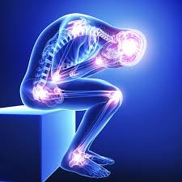
Prescribing Buprenorphine for Chronic Pain
Anchorage Syndemic Training, September 2024
Sarah Spencer, DO, FASAM

Slide 2
Learning Objectives
Identify patients with chronic pain that could benefit from switching from chronic full opioid agonist therapy to buprenorphine
Explore dosing and formulation options for buprenorphine for pain, including off label use
Review initiation strategies for SL buprenorphine

Slide 3

Financial Disclosures
I have no financial conflicts of interest to disclose
I am currently employed by the Ninilchik Traditional Council
I work as a treatment consultant for the Opioid Response Network in Alaska, ANTHC, as well as for other non-profit agencies.

Slide 4
Opioids for Chronic Pain?
The evidence is not good…
There is little evidence for the benefits of chronic opioid therapy and I am not recommend initiating patients on buprenorphine or any opioid agonist for chronic pain (other than for palliative purposes)
The use of buprenorphine for chronic pain as discussed in this presentation is in patients already chronically dependent on full opioids agonists and represents a form of harm reduction and may be off label

Slide 5
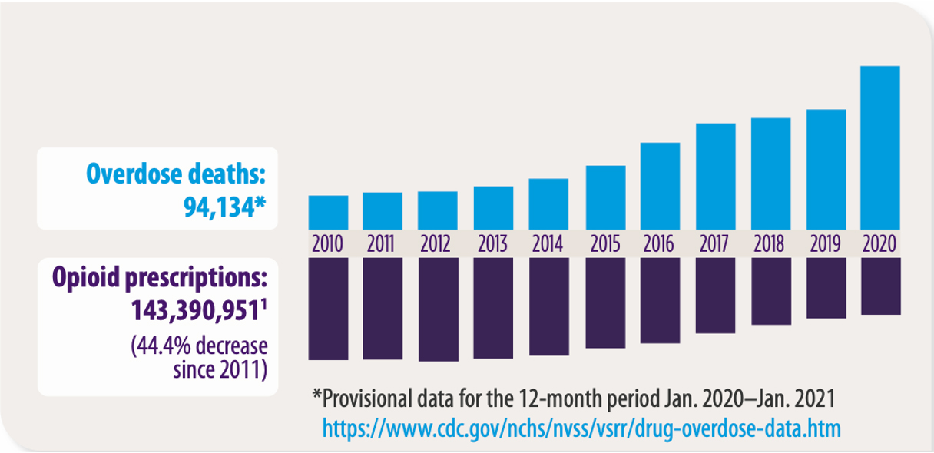
REDUCTIONS IN OPIOID PRESCRIBING HAVE NOT LED TO REDUCTIONS IN OVERDOSE DEATHS
SOURCE: https://www.ama-assn.org/delivering-care/overdose-epidemic/physicians-progress-toward-ending-nation-s-drug-overdose-epidemic
Notes:
SPEAKER NOTES
Despite a reduction in opioid prescribing, opioid overdose deaths continue to rise. In 2020, an average of 44 people in the U.S, died per day from an overdose involving opioids. Prescription opioids were involved in 18% of all opioid overdose deaths that year, which is a 16% increase from 2019-2020 (CDC: https://www.cdc.gov/drugoverdose/deaths/prescription/maps.html). As of 2020, there are still pockets of the U.S. where prescribed opioids are influencing the number of deaths (CDC, 2021. U.S. Opioid Dispensing Rate Map. Retrieved from https://www.cdc.gov/drugoverdose/rxrate-maps/index.html). In other words, we are not done with this problem. States with prescriptions dispensed at 64.1 to 82.9 per 100 persons are Kentucky, Tennessee, Arkansas, Mississippi, Louisiana, and Alabama (CDC). [Speaker to note: If you are in any of these states, be sensitive to the audience, as they are all personally and professionally impacted by prescription opioid overdose deaths. We are not using education as a means to “call out” states, but want to help the audience with tools to help reduce these rates.]
Let’s walk through this histogram. The blue bars on the top show the number of overdose deaths in the U.S. from 2010 to 2020. The purple bars on the bottom show the number of opioid prescriptions in the U.S. over the same period. While the prescribing level has gone down, the number of overdose deaths has continued to rise at an alarming rate. The next slide will help explain why.
An additional important point to make here: Opioid use disorder has a strong relationship with suicide as compared with other SUDs. Reference: Bohnert, A., & Ilgen, M. Understanding Links among Opioid Use, Overdose, and Suicide. NEJM 2019; 380:71-79. doi: 10.1056/NEJMra1802148
References:
Demidenko, M, Dobscha, S, Morasco, B, Meath, T, Ilgen, M, & Lovejoy, T. Suicidal ideation and suicidal self-directed violence following clinician-initiated prescription opioid discontinuation among long-term opioid users. General Hospital Psychiatry. 47 (2017) 29-35. https://www.ncbi.nlm.nih.gov/pubmed/28807135. Among patients with a substance use disorder and matched controls, there are high rates of suicide ideation and self-directed violence following opioid discontinuation, suggesting that these “high-risk” patients may require close monitoring and risk prevention.
Bohnert, A, Ilgen, M, Louzon, S, McCarthy, J, & Katz, I. Substance use disorders and the risk of suicide mortality among men and women in the US Veterans Health Administration. Society for the Study of Addiction. 16 March 2017. doi: 10.1111/add.13774
Oquendo, M, & Volkow, N. Suicide: A silent contributor to opioid-overdose deaths. NEJM. 26 April 2018; 378:1567-1569. doi: 10.1056/NEJMp1801417
The percentage of opioid overdose deaths that were suicides is not well documented. But an OUD more than doubled the risk of suicide among women and increased the risk among men by 30%. It is important to screen for suicide risk in patients treated for chronic pain.

Slide 6
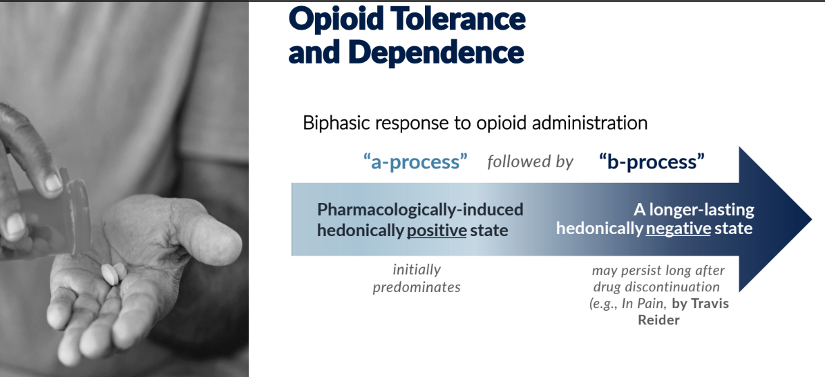
The body is continuously seeking homeostasis
Mark Sullivan, MD, PhD ASAM 2024

Slide 7
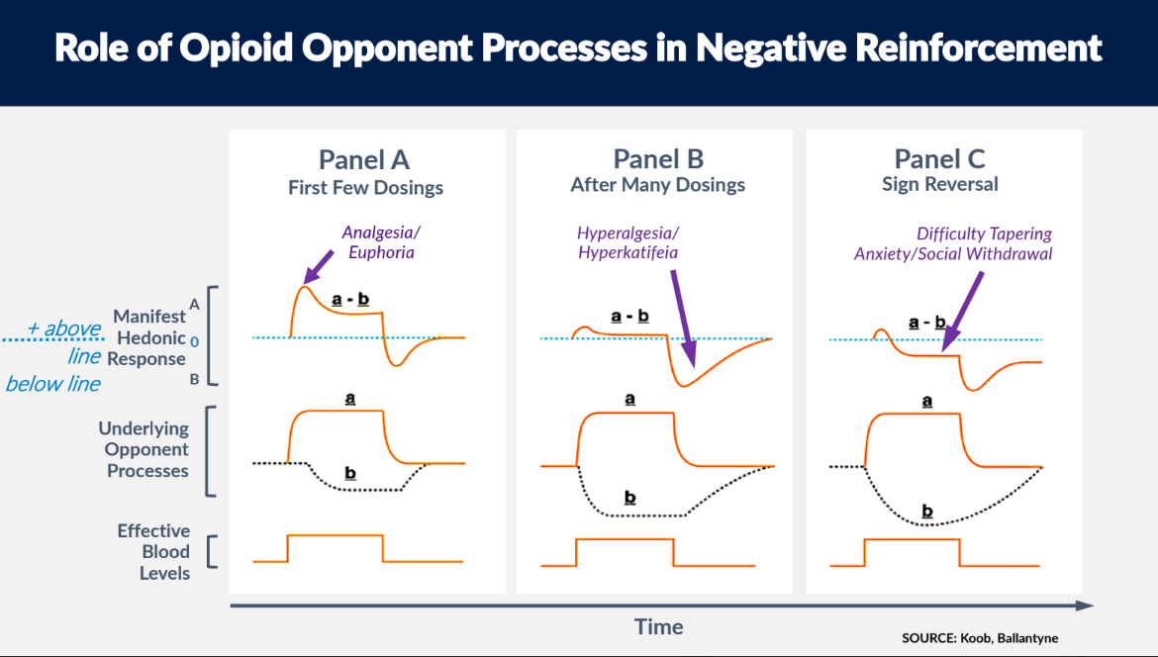
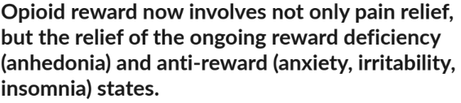
Mark Sullivan, MD, PhD ASAM 2024

Slide 8
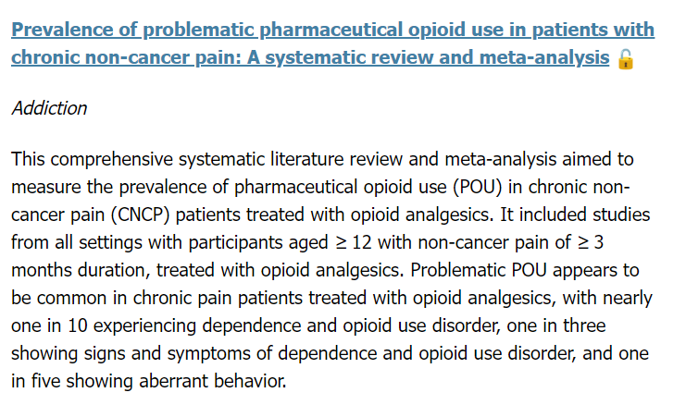
https://onlinelibrary.wiley.com/doi/10.1111/add.16616?asam.org=

Slide 9
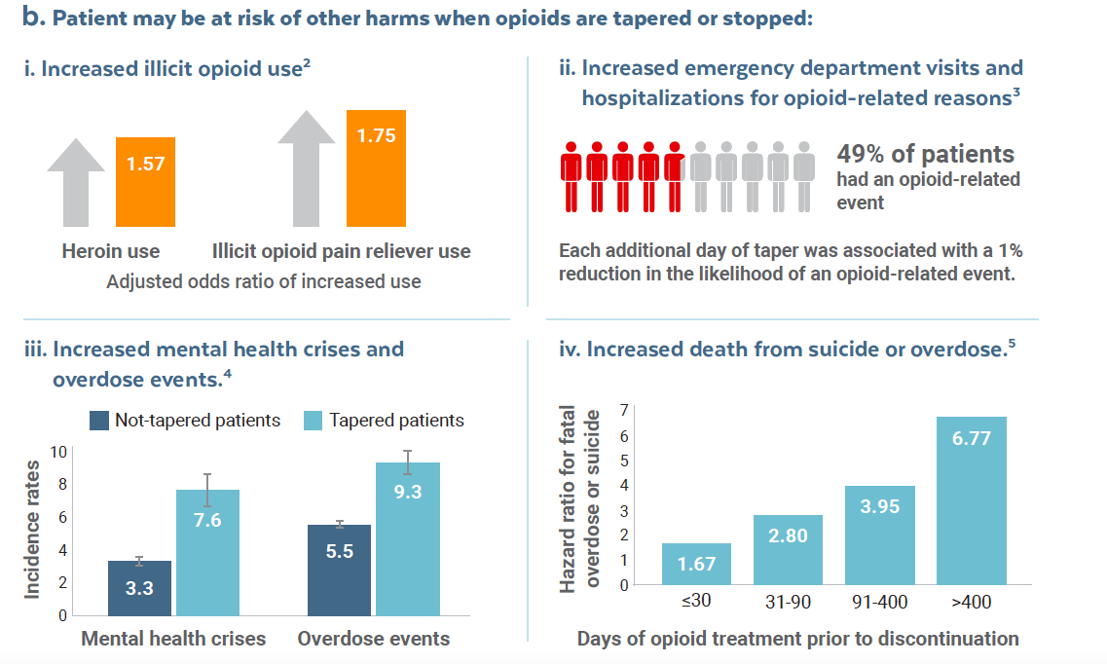
Ajay et al, 2010, Substance Abuse, Coffin et al, 2020, PLOS One, Agnoli et al, 2022, JAMA, Oliva et al, 2020, BMJ

Slide 10
CDC 2023 Opioid Guidelines
Under Recommendation #5
“Emerging evidence suggests that patients for whom risks of continued high-dose opioid use outweigh benefits but who are unable to taper and who do not meet criteria for opioid use disorder might benefit from transition to buprenorphine. Buprenorphine is a partial agonist opioid that can treat pain and opioid use disorder and has other properties that might be helpful, including less respiratory depression and overdose risk than other opioids”

Slide 11
Management of Opioid Misuse That Does Not Meet Criteria for Opioid Use Disorder (Recommendation 12)
Clinicians can have challenges distinguishing between opioid misuse behaviors without opioid use disorder and mild or moderate opioid use disorder (352). For patients with opioid misuse that does not meet criteria for opioid use disorder (e.g., taking opioids in larger amounts than intended without meeting other criteria for opioid use disorder), clinicians should reassess the patient’s pain, ensure that therapies for pain management have been optimized (see Recommendation 2), discuss with patients, and carefully weigh benefits and risks of continuing opioids at the current dosage (see Recommendation 5). For patients who choose to but are unable to taper, clinicians can reassess for opioid use disorder and offer buprenorphine treatment or refer for buprenorphine or methadone treatment if criteria for opioid use disorder are met. Even without a diagnosis of opioid use disorder, transitioning to buprenorphine for pain also can be considered because of reduced risk for overdose with buprenorphine compared with risk associated with full agonist opioids (see Recommendation 5).

Slide 12

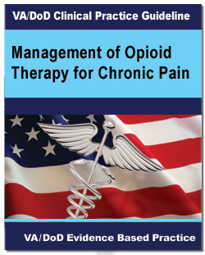
VA 2022 Guidelines
For patients receiving daily opioids for the treatment of chronic pain, we suggest the use of buprenorphine instead of full agonist opioids due to lower risk of overdose and misuse.
https://www.healthquality.va.gov/guidelines/Pain/cot/VADoDOpioidsCPGProviderSummary.pdf

Slide 13
Buprenorphine for Pain = Risk Reduction
Buprenorphine can be used for chronic noncancer pain and could be preferable to other options in patients with higher risks of toxicity (eg, elderly patients, patients with COPD, OSA, CVD, renal and hepatic dysfunction)
Strongly consider transitioning patients on chronic full opioid agonists to buprenorphine to reduce opioid related risks
https://www.hhs.gov/opioids/sites/default/files/2019-10/Dosage_Reduction_Discontinuation.pdf

Slide 14
Which patients on chronic opioid therapy may benefit from being transitioned to buprenorphine?
Patients who find that protracted opioid withdrawal symptoms/pain are unbearable when attempting an opioid taper
Patients at high risk for opioid/sedative related morbidity or mortality on their current pharmacotherapy
Patients with opioid induced hyperalgesia??? Or other current opioid induced side effects (depression, cognitive impairment, somnolence)
Patients with opioid use disorder

Slide 15
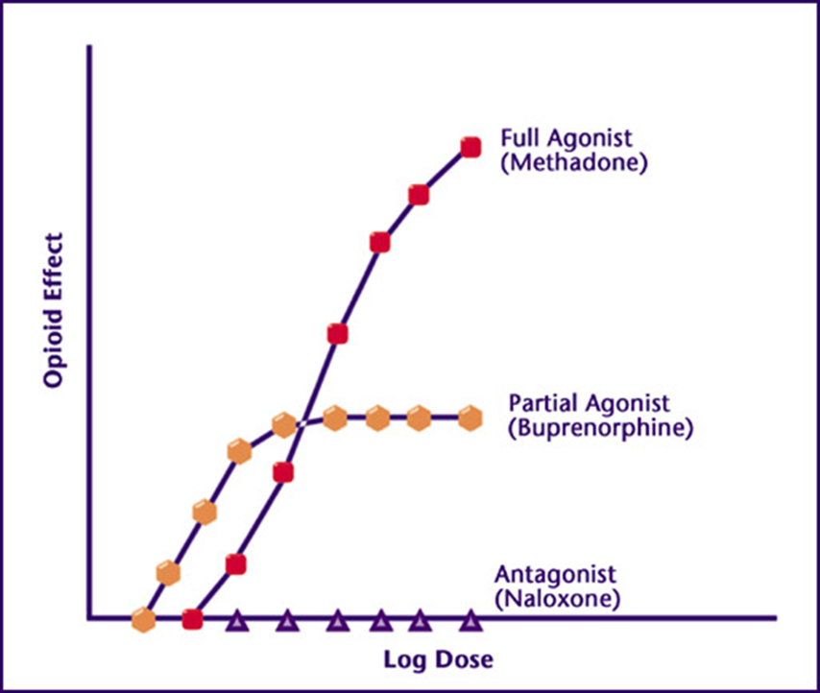
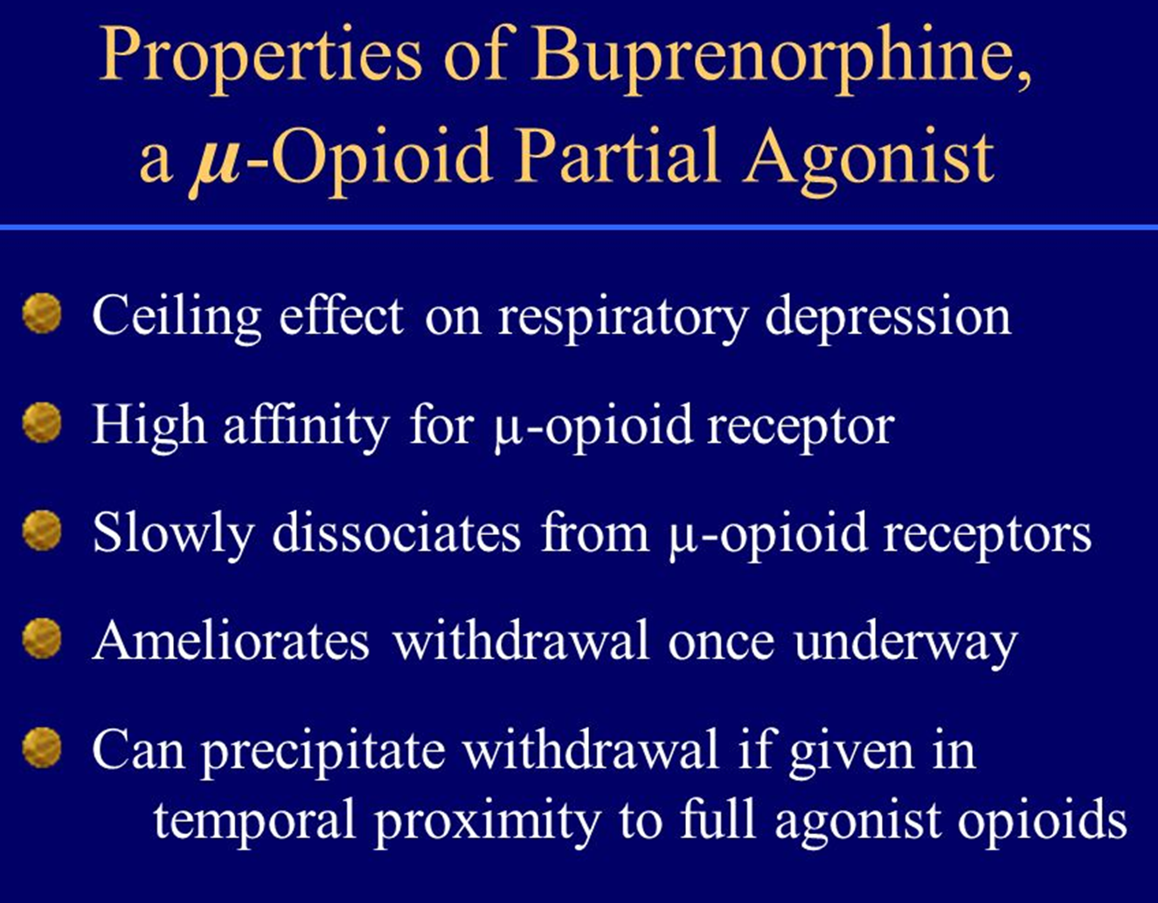

Slide 16
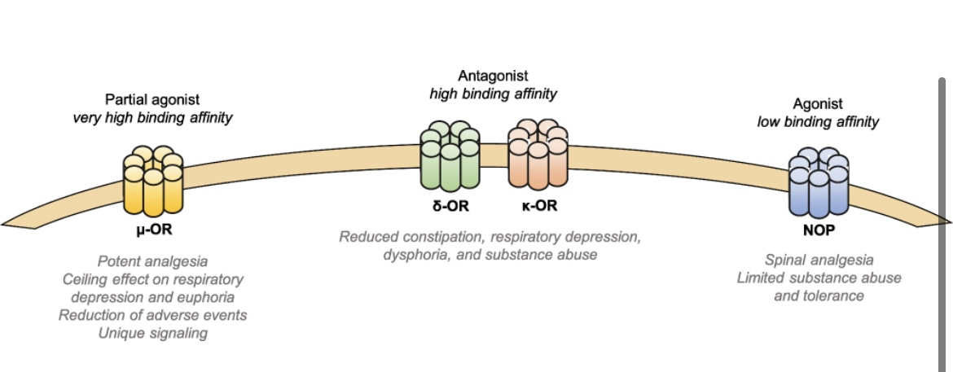
Antagonist effect at the Kappa receptor likely related to antidepressant effect
https://link.springer.com/article/10.1007/s40122-019-00143-6

Slide 17
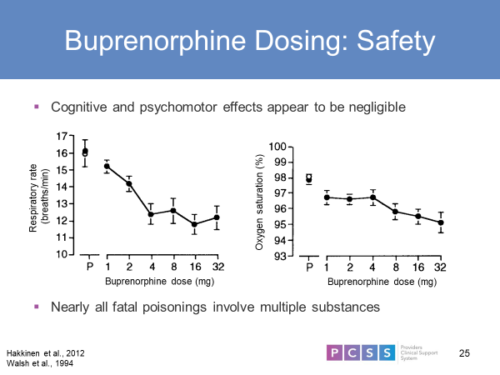
Minimal respiratory depression
even in opioid naïve patients

Slide 18
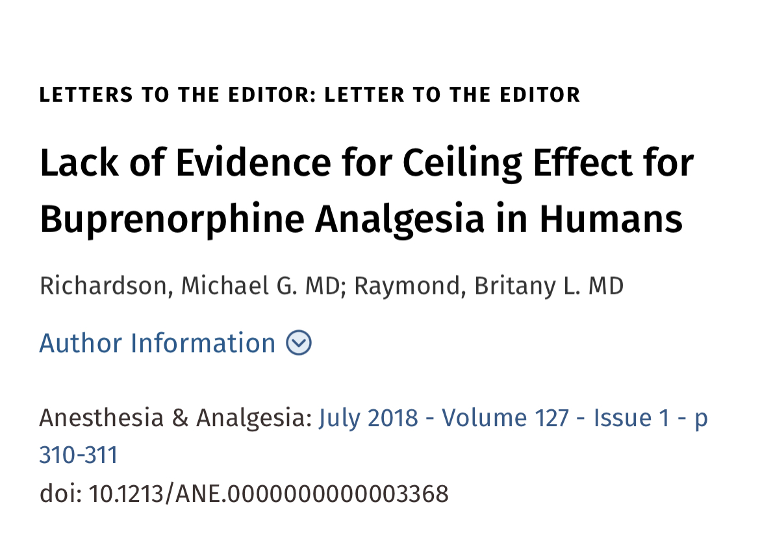

Slide 19
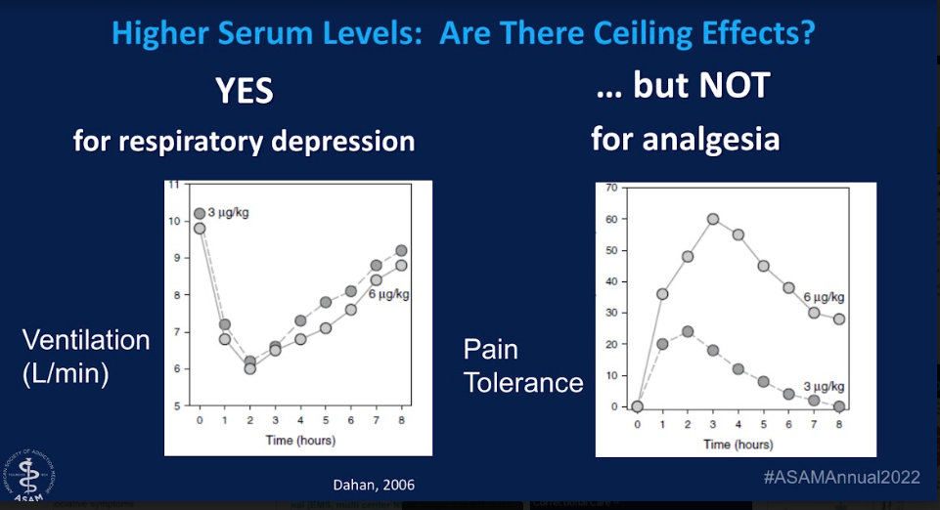

Slide 20
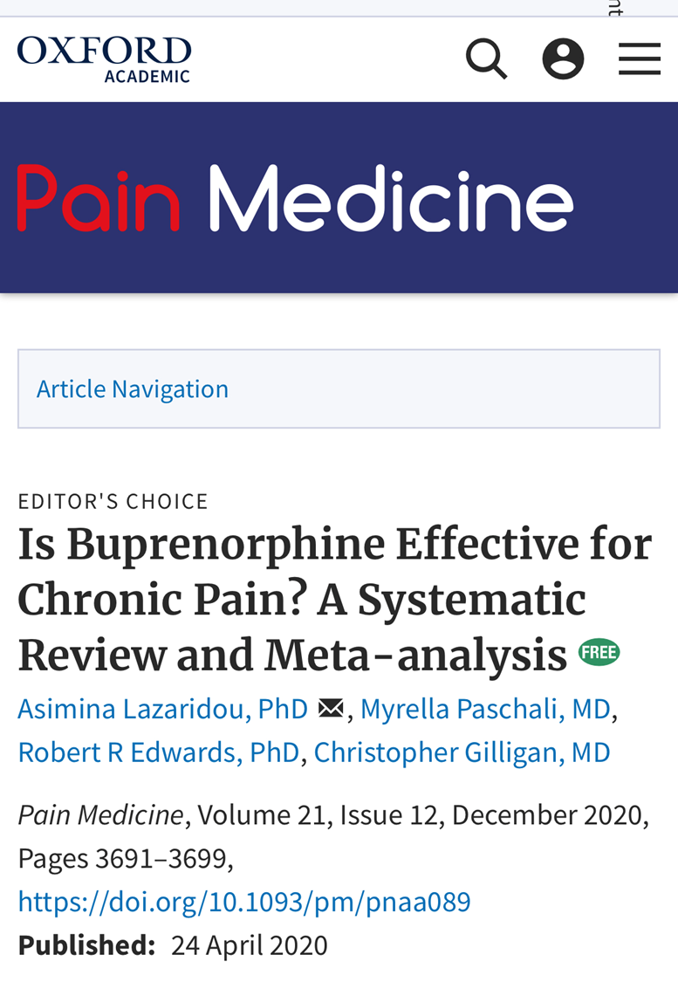
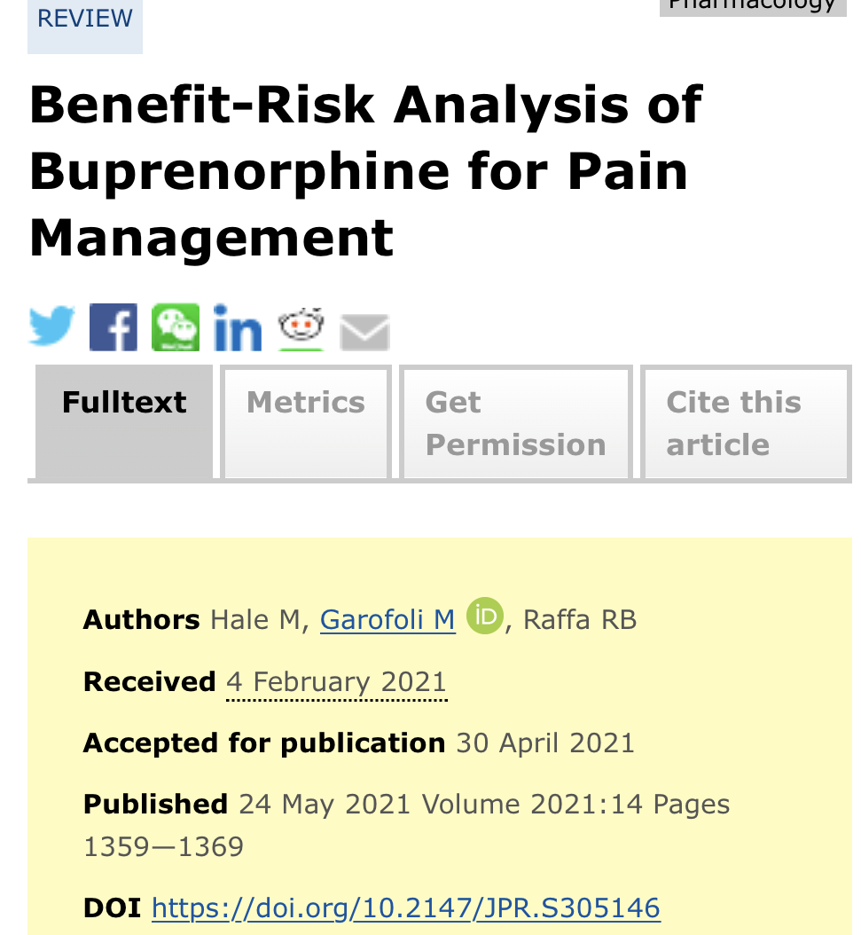
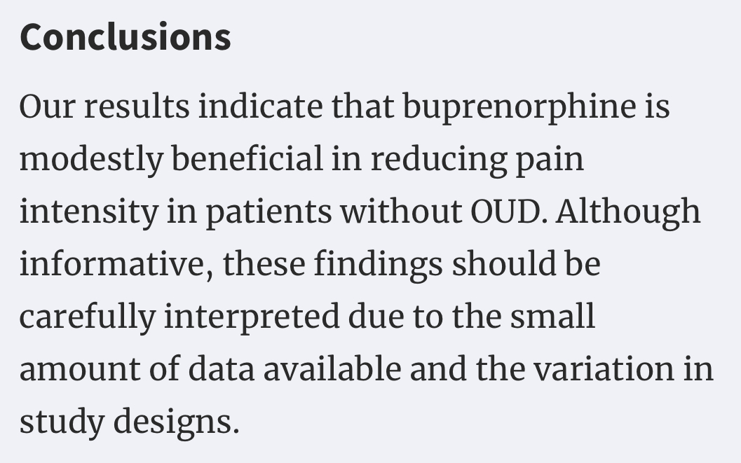

Slide 21
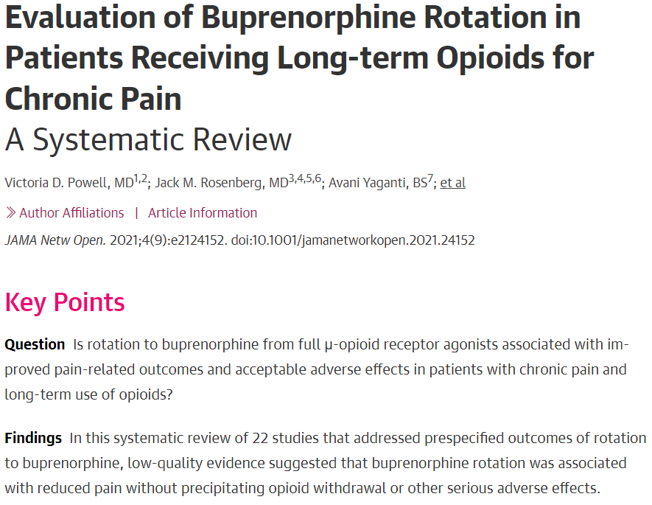

Slide 22
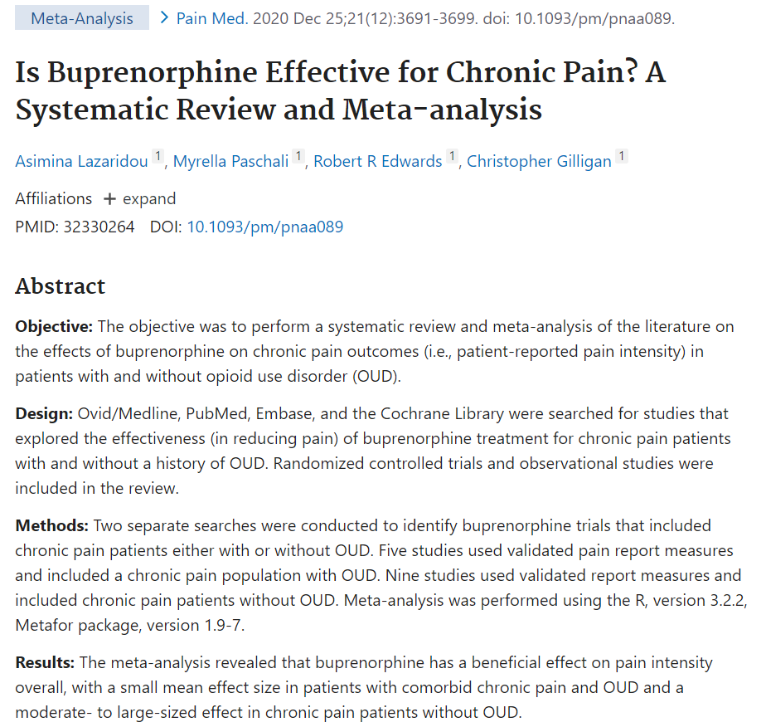

Slide 23
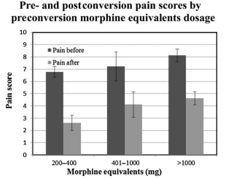
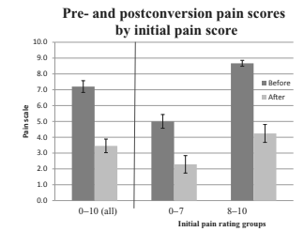
Conversion from high-dose full-opioid agonists to SLBUP
reduces pain scores and improves quality of life
for chronic pain patients
35 patients, ave 550 MME, converted to 2–20 mg (mean 8 mg) of buprenorphine, followed for 6 months.
Patients converting off higher opioid doses enjoyed a greater average improvement in quality of life score.
https://doi.org/10.1111/pme.12520

Slide 24
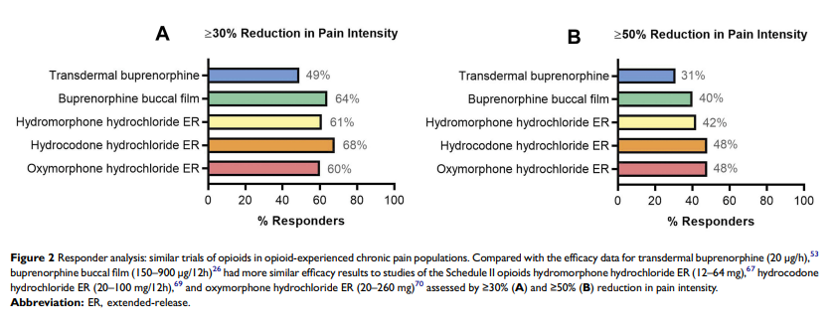
https://www.tandfonline.com/doi/pdf/10.2147/JPR.S231948

Slide 25
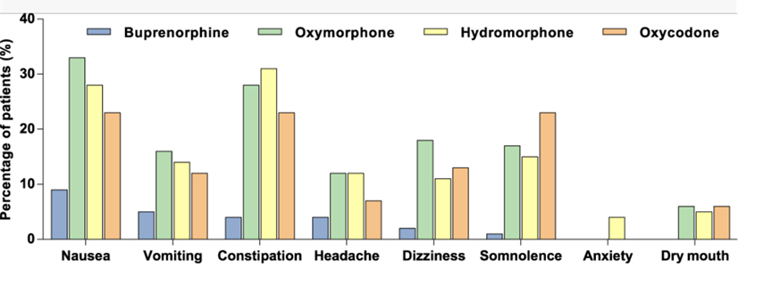
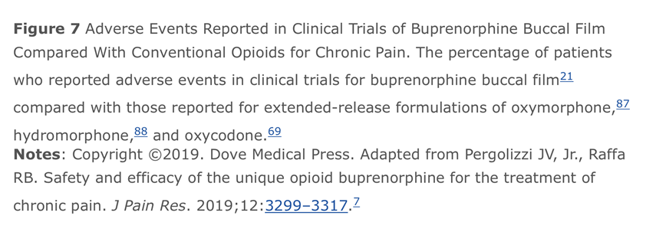
https://www.tandfonline.com/doi/pdf/10.2147/JPR.S231948

Slide 26
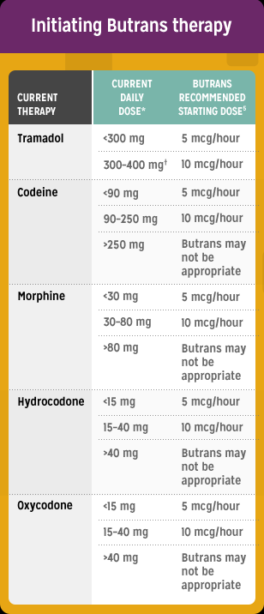
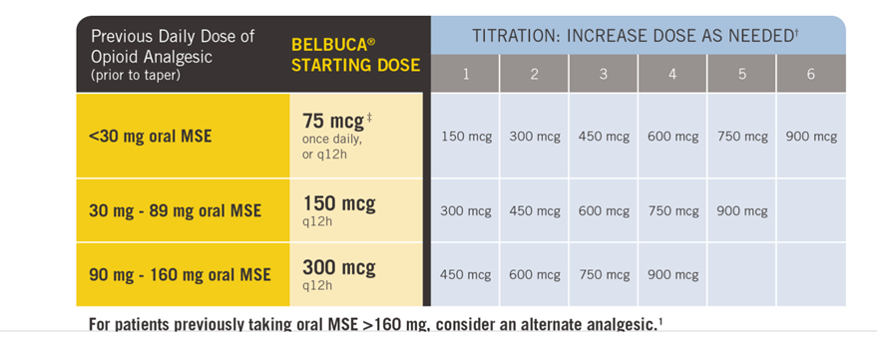
FDA approved forms of BUP for chronic pain
Prior Total Daily Dose of Opioid Between 30 mg to 80 mg MME per Day: Taper the patient’s current around-the-clock opioids for up to 7 days to no more than 30 MME per day before beginning treatment with BUTRANS.
Consider off label use of sublingual buprenorphine or bup/naloxone for patients with higher levels of tolerance whose pain is uncontrolled, or when cost is a barrier

Slide 27
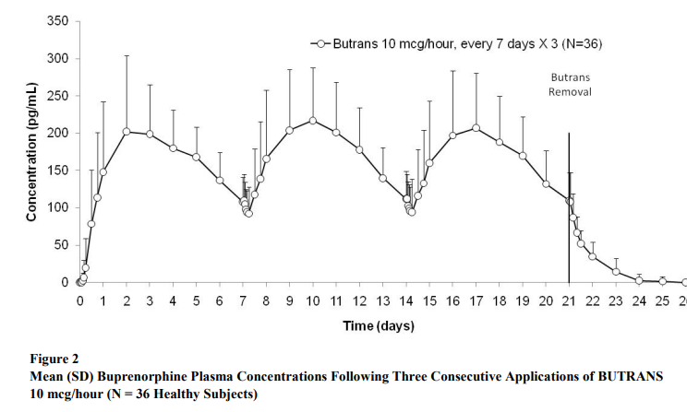
Peak serum BUP levels 0.2 ng/ml
https://www.accessdata.fda.gov/drugsatfda_docs/label/2014/021306s015s019lbl.pdf

Slide 28
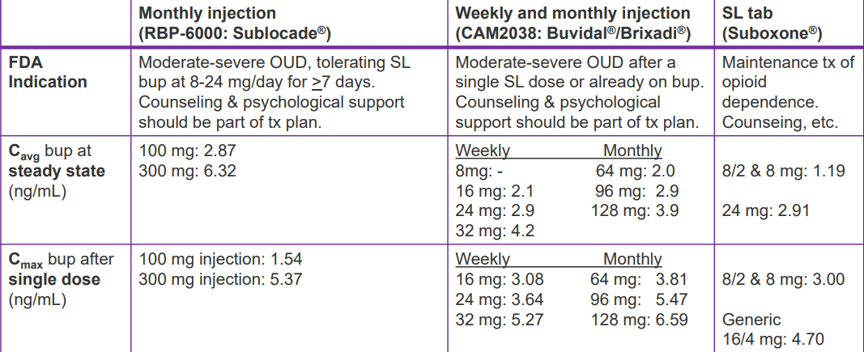

Slide 29
BUPRENORPHINE FORMULATIONS
Formulation | Transdermal patch | Buccal film | SL tab or film
Max Strength | 20 mcg/hr (0.5mg/day) | 900mg bid (1.8mg/day) | 2mg or 8mg tid (24mg)
FDA approved for pain | Yes | Yes | No
Transition from max MME | <30-80 | <160 | No Max
Price per month | $900 | $1,200 | $30-$300
Abuse Deterrent form available | Inherent in formulation | No | Yes Rx combo product with nlx

Slide 30
Advantages of SL buprenorphine films
Can be cut to easily adjust dosage (to make 0.5 mg from 2mg film)
Abuse deterrent formulation
Generic and widely available
Easy to count and transport (individually wrapped)

Slide 31
Although it is legal to prescribe sublingual buprenorphine off label for pain, not all insurances cover this medication (it’s more expensive than regular opioids).
Some insurances only cover buprenorphine patch (Butrans – covered by Medicaid) or buccal film (Belbucca), these formulations are low-dose and appropriate for patients with lower levels of opioid tolerance
Chronic pain patients with higher levels of tolerance (>50-100 MME) may need SL buprenorphine tablets or film, also allows for prn dosing. Combo products (with naloxone) have lower diversion and abuse risk and may be suitable to use in patients with pain, slightly higher incidence of nausea.
(ASAM 2020 guidelines and HHS Guide for Clinicians on the Appropriate Dosage Reduction or Discontinuation of Long-Term Opioid Analgesics 2019)

Slide 32
Insurance will usually cover SLBUP for Pain
with PA indicating medical necessity
Example: Patient with multiple comorbidities on high dose chronic opioids, needing to change/taper for safety concerns (at risk for respiratory suppression) or side effects, but unable to tolerate opioid taper, buprenorphine can reduce overdose risk.
(ASAM 2020 guidelines and HHS Guide for Clinicians on the Appropriate Dosage Reduction or Discontinuation of Long-Term Opioid Analgesics 2019)

Slide 33
Another diagnosis option for patients who are opioid dependent without OUD and have not tolerated taper due to withdrawal symptoms and wish to switch to sublingual buprenorphine for safer pain management/ taper, but not covered by insurance, is to give them this diagnosis:
F11.20/F11.23 Opioid dependence/ with withdrawal
(Physiologic only without opioid use disorder)
(Not this one → F11.10/F11.9 Opioid use Disorder)
Only with informed consent from the patient that they understand this will be on their chart, and ability to
make it clear on the chart that they do NOT have OUD

Slide 34
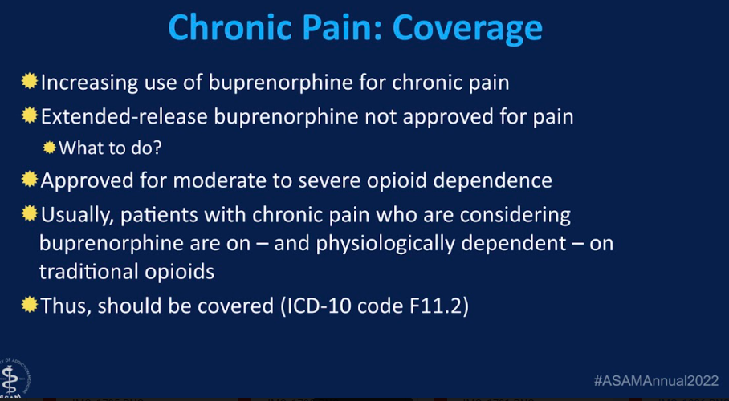
OF XRBUP (SUBLOCADE)

Slide 35
Calculating Buprenorphine dose
There is no verified MME or conversion factor for buprenorphine
(some sources online suggest 1 mg SLBUP= 20-30MME, not linear)
Dosing/therapeutic effect is not linear
If insurance covers transdermal/buccal, and patient on less than 50-100 MME then start there and follow manufacturers instructions
If insurance does not cover FDA approved forms or patient on >100-150 MME then start with 2 mg films that can be quartered, prescribe only 1-2 days and be ready to rapidly escalate dosage as high as needed to achieve therapeutic effect (5 days to achieve steady state), insurance will rarely cover more than 24 mg/day

Slide 36
Starting Buprenorphine

Slide 37
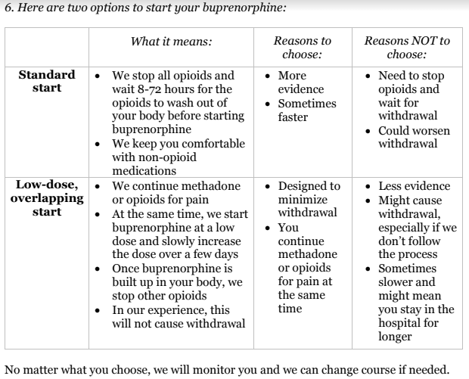
Buprenorphine Initiation Strategies

Slide 38
Precipitated Withdrawal
Precipitated withdrawal can occur due to replacement of high dose full opioid receptor agonist (heroin, fentanyl, or morphine) with a low-med dose of partial agonist that binds with a higher affinity (Buprenorphine).
Typically occurs 30-60 mins after first SLBUP dose
Rapid onset of severe opiate withdrawal symptoms
Avoid by ensuring adequate withdrawal before first dose (COWS > 12; Fentanyl may require higher COWS score)
Treated symptomatically and by rapidly giving higher doses of SLBUP

Slide 39
At home withdrawal assessment
Wait 12-24 hours after last opioid dose
Wait until you have at least 4 WD sxs
Rhinorrhea, sweating, tearing, N/V/D, abd cramping, myalgias, goosebumps, restlessness, yawning, anxiety
Wait until you can’t wait anymore!

Slide 40
Common Rx at First Visit for COT→ SLBUP switch
Buprenorphine/naloxone 2/0.5 mg tab or film, SL as directed up to 3 per day, dispense 6
Ondansetron 4-8 mg ODT SL tid prn, disp #12
Clonidine 0.1 mg, 1-2 tid prn restlessness and sweating, disp #30
Naloxone nasal spray kit (refill X3)
Consider Trazodone 100 mg qhs for insomnia, Tizanidine 4mg qid for spasms, ibuprofen 800 tid for pain, Imodium 2 qid for diarrhea, hydroxyzine 50 mg tid for anxiety

Slide 41
Sublingual Buprenorphine Traditional Start
Wait until in moderate WD (12-24 hrs since last dose)
Patients taking <90 MME: start with 0.5 mg SL (1/4 of 2mg film) Repeat 0.5 mg every 1-2 hours as needed until withdrawal and pain controlled up to 6 mg on day 1
Patients taking >90 MME: Start with 2-4 mg (1/4-1/2 of 8mg film) (and repeat 2-4 dose prn until effect, max 16 mg on day 1)
On days 2-5 provide frequent phone/nurse/telemed check-ins and rapidly adjust dose as needed (e.g. switch to 8 mg films)

Slide 42
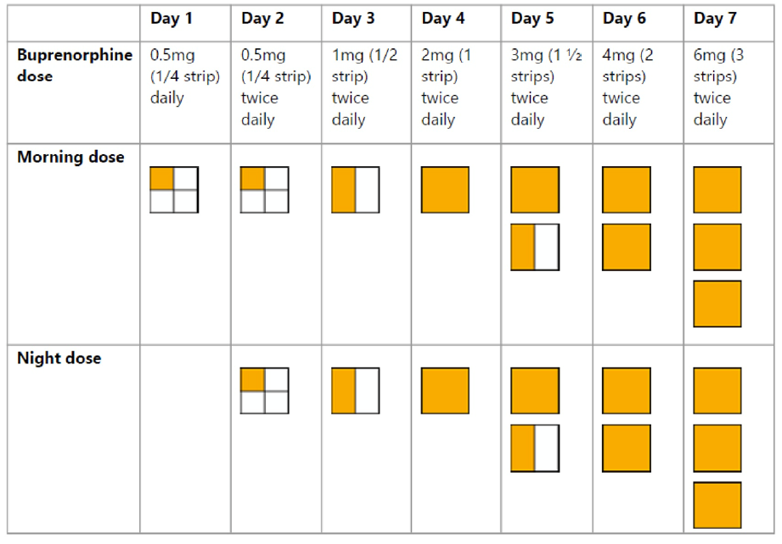
Low-Dose Overlapping Start (High MME, Methadone or fear of withdrawal)
Continue to use full agonist on days 1-6
No minimum or max BUP dose, stop increase if feeling over-medicated
Stop using the full agonist on day 7 (or sooner if feeling overly sedated)

Slide 43
Dosing Frequency
Buprenorphine has a slow dissociation rate from the mu opioid receptor, which gives rise to its prolonged suppression of opioid withdrawal and blockade of exogenous opioids (24-48 hours).
Once daily dosing for control of drug cravings and withdrawal
Most patients prefer BID-TID
Relatively short analgesic duration(6 hours)
BID-QID dosing for pain control

Slide 44

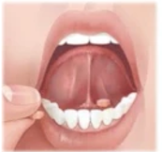
Dosing instructions
Wet mouth first, avoid smoking before dose
Dissolve under tongue for 15-20 mins (tabs or films)
No talking, eating, drinking, smoking
Spit out excess saliva (swallowing can increase nausea)
Rinse and spit after finished
Peak effect in 1-2 hours

Slide 45
Maintenance dosing
5 days required to reach steady-state
Weekly visits until pain, dose, W/D and side-effects stable
Monitor and refill as you would for any other COT
May provide prn doses for breakthrough/acute exacerbations
Can increase to 24-32+ mg/day prn acute pain/surgery
Consider specialty consultation for perioperative pain control advice in people taking 8+ mg/day

Slide 46
Resources for BUP in Chronic Pain
Buprenorphine for Chronic Pain: A Safer Alternative to Traditional Opioids https://www.ncbi.nlm.nih.gov/pmc/articles/PMC8567798/
Benefit-Risk Analysis of Buprenorphine for Pain Management https://www.dovepress.com/benefit-risk-analysis-of-buprenorphine-for-pain-management-peer-reviewed-fulltext-article-JPR
Buprenorphine for OUD and Chronic Pain WA State Webinar Slides https://wmc.wa.gov/buprenorphine-oud-and-chronic-pain
Pain Management Webinar Series 2024 - Buprenorphine in the Treatment of Chronic Pain (CME June 11,2024) https://ce.mayo.edu/pain-medicine/content/pain-management-webinar-series-2024-buprenorphine-treatment-chronic-pain

Slide 47

Contact FMI
Sarah Spencer DO, FASAM
Ninilchik Community Clinic
907-299-7460
sarahspencerak@gmail.com

