Slide 1
ID Updates
Leslie Stewart, MD
7/18/2024

Slide 2
Outline
COVID
Avian flu
Mpox
ACIP meeting updates from June 2024

Slide 3
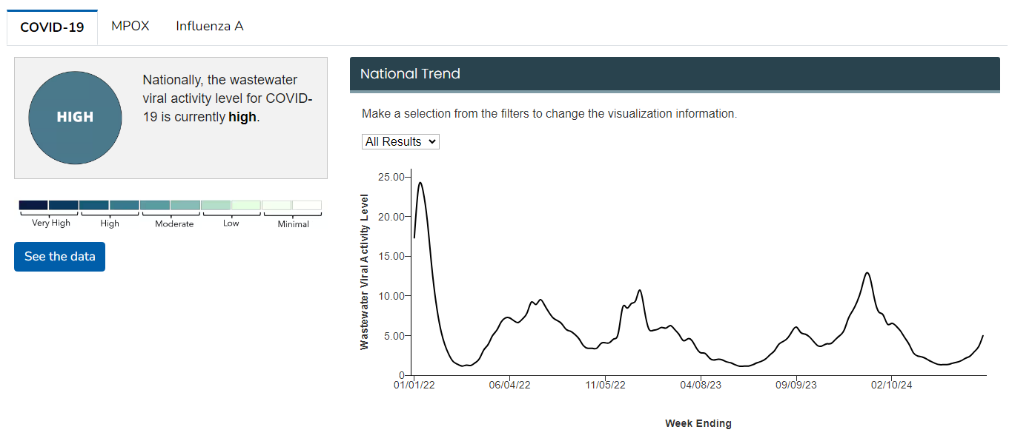
COVID
FliRT strains (Omicron subvariant): KP.3, LB.1

Slide 4
COVID
ACIP recommends 2024-2025 COVID-19 vaccines as authorized or approved by FDA in persons ≥6 months of age.
All COVID-19 vaccines are expected to be available to ship mid-August to late-September.

Slide 5
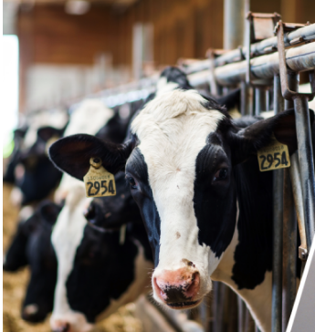
Avian influenza (H5N1)
Origin of outbreak ongoing, has been in dairy herds, chicken farms
4 human cases during this outbreak
Symptoms have included conjunctivitis or mild respiratory symptoms
No human-to-human transmission
No recommendation for livestock workers to be vaccinated against avian flu
All meat and pasteurized dairy products remain safe according to USDA/FDA
Current diagnostics should detect H5N1 viruses
No known markers of resistance to FDA approved antiviral drugs
Current public health risk is low
Picture: https://www.fda.gov/food/alerts-advisories-safety-information/updates-highly-pathogenic-avian-influenza-hpai

Slide 6
Mpox
Continued Mpox activity, most cases in unvaccinated or who have only had 1 Jynneos vaccine
Tecovirimat (TPOXX)
Available mostly through NIH’s STOMP trial or CDC’s EA-IND protocol
May also have still at local health departments, I.H.S. supply channels
https://emergency.cdc.gov/coca/ppt/2024/062724_slides.pdf

Slide 7
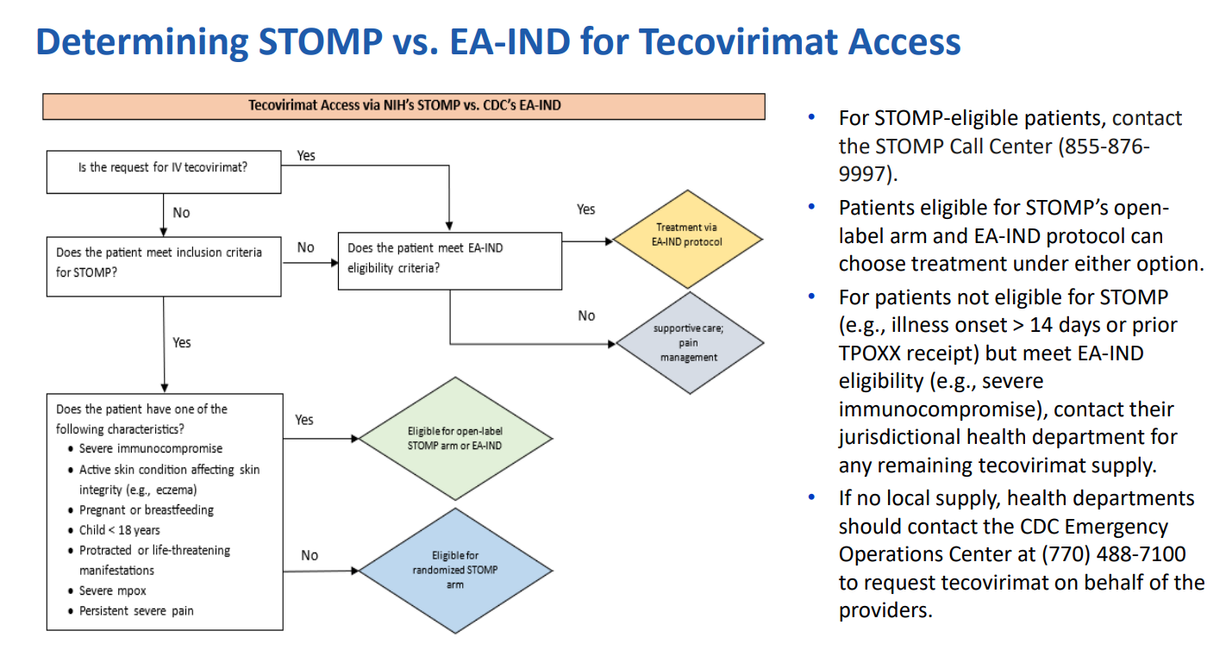
https://emergency.cdc.gov/coca/ppt/2024/062724_slides.pdf

Slide 8
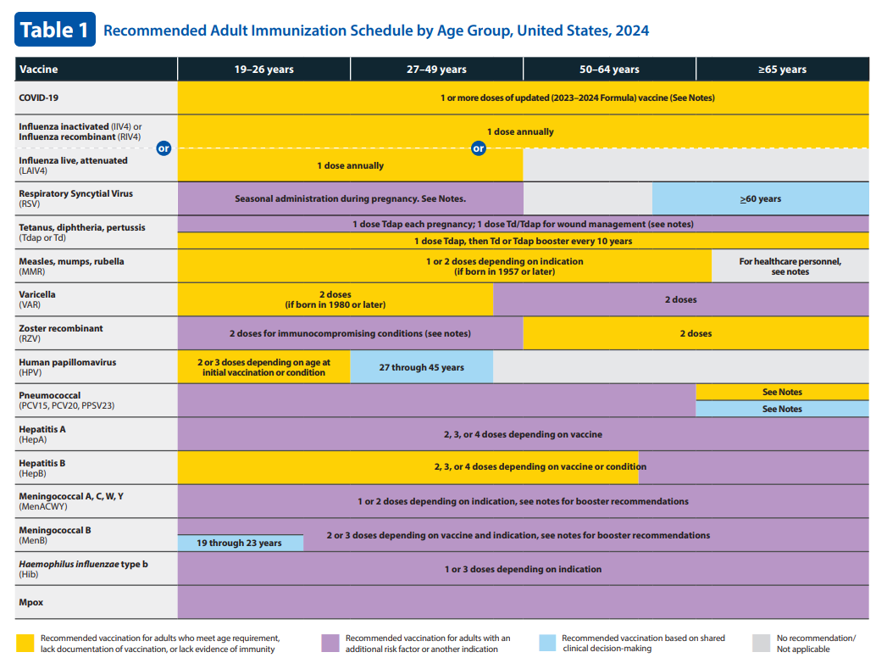
-Persons who are gay, bisexual, and other MSM, transgender or nonbinary people who in the past 6 months have had:
At least 1 new STI
≥1 sex partner
Sex at commercial sex venue
Sex in association with a large public event in a geographic area where Mpox transmission is occurring
-Persons who are sexual partners of the persons described above
-Persons who anticipate experiencing any of the situations described above
-Not recommended for those who have had Mpox
-No booster recommended
https://www.cdc.gov/vaccines/schedules/downloads/adult/adult-combined-schedule.pdf

Slide 9
Other Vaccine Updates: ACIP June 2024

Slide 10
RSV vaccine for non-pregnant adults
Old Recommendation
Adults age 60 years or older can receive 1 dose RSV vaccine (Arexvy® or Abrysvo™) based on shared clinical decision-making
New Recommendations
Adults 75 years of age and older receive a single dose of RSV vaccine
Adults 60–74 years of age and older who are at increased risk of severe RSV disease receive a single dose of RSV vaccine
CDC will publish Clinical Considerations that describe chronic medical conditions and other risk factors for severe RSV disease for use in this risk-based recommendation.
RSV vaccination is recommended as a single lifetime dose only. Persons who have already received RSV vaccination are NOT recommended to receive another dose.
Available vaccines
Abrysvo (Pfizer)
Also recommended for pregnant people
Arexvy (GSK)
(also FDA approved for age 50+)
MRESVIA (Moderna): mRNA vaccine just approved by FDA

Slide 11
Flu
Recommended for 6 months and older
ACIP recommends high-dose inactivated (HD-IIV3) and adjuvanted inactivated (aIIV3) influenza vaccines as acceptable options for solid organ transplant recipients aged 18 through 64 years who are on immunosuppressive medication regimens, without a preference over other age-appropriate IIV3s or RIV3.

Slide 12
Pneumococcal
21-valent pneumococcal conjugate vaccine (PCV21)
Approved by FDA 6/2024 for age ≥ 18
ACIP recommends PCV21 as an option for adults who currently have a recommendation to receive a dose of PCV
PCV21 is not replacing PCV20

Slide 13
DTaP-IPV-Hib-HepB (Vaxelis®) Vaccine
DTaP-IPV-Hib-HepB (Vaxelis®) should be included with PRP-OMP (PedvaxHIB®) in the preferential recommendation for American Indian and Alaska Native infants based on the Haemophilus influenzae type b (Hib) component

