Slide 1
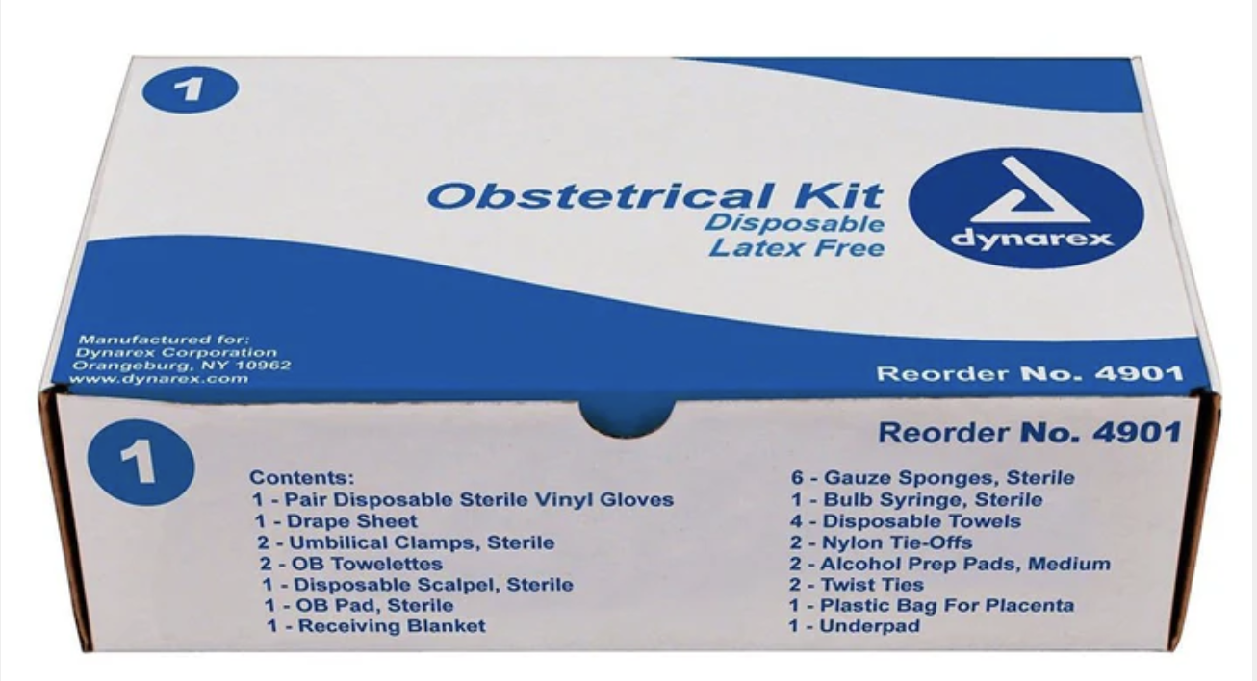
Out-of-Hospital Childbirth and its Potential
Complications
Jenna M. B. White, MD, FAEMS

Slide 2
This Talk
Vaginal delivery that progresses unimpeded and results in spontaneous delivery of the fetus
Fetal malpresentations
  Breech presentation
  Umbilical cord prolapse
Stuck baby
  Shoulder dystocia
Maternal delivery complications
  Postpartum hemorrhage
  Preeclampsia
  Eclampsia

Slide 3


A Word on Body Autonomy for Birthing Patients and the Idea of Birth Justice

Slide 4
A Review of “Normal”
Vertex cephalic presentation
95% of singleton pregnancies

Slide 5
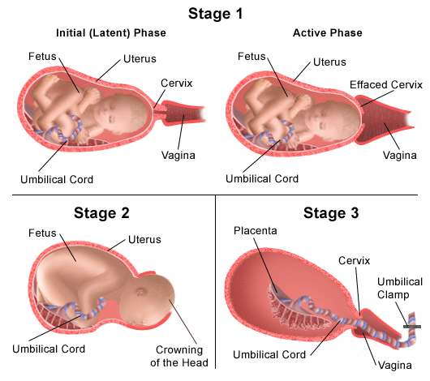
Stages of Birth

Slide 6
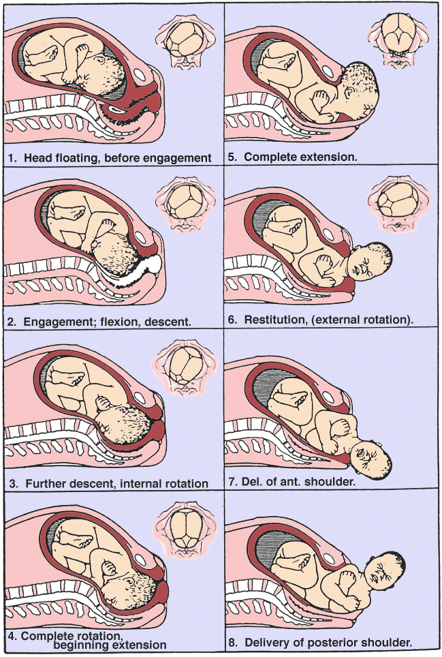
Cardinal Movements of Labor

Slide 7

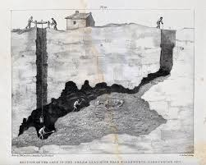
Cardinal Movements of Labor

Slide 8
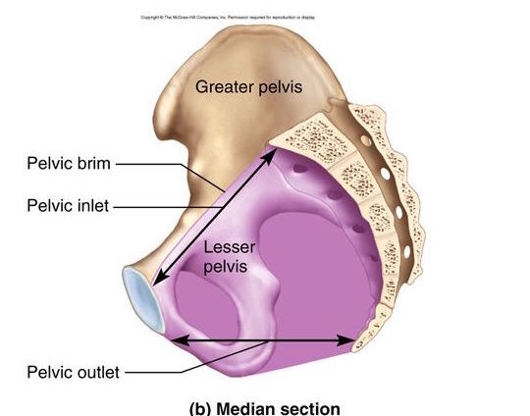
Pelvic Shape

Slide 9
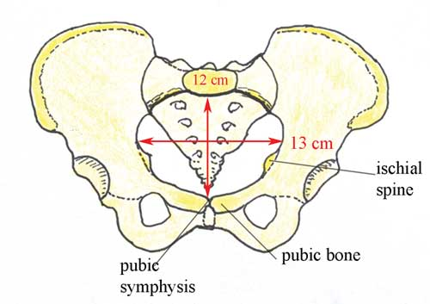
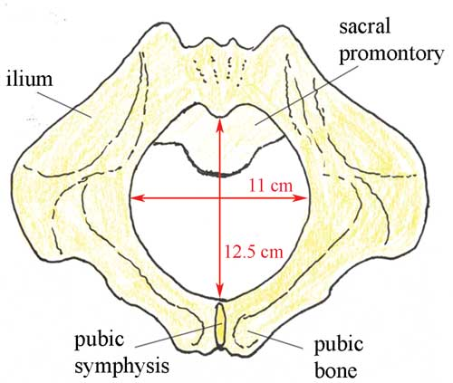
Pelvic Shape
Pelvic Inlet
Pelvic Outlet

Slide 10
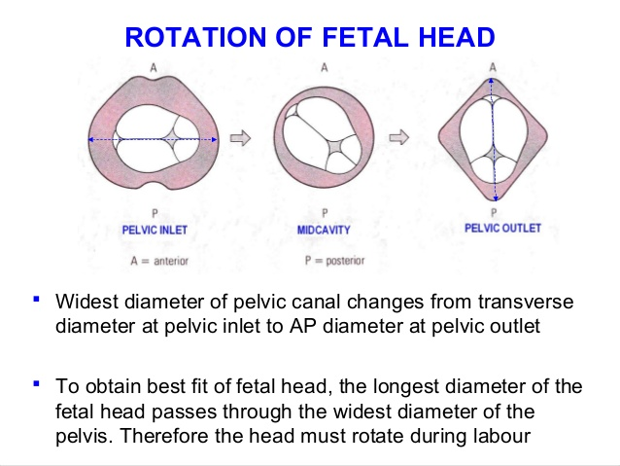
Rotation of Fetal Head

Slide 11
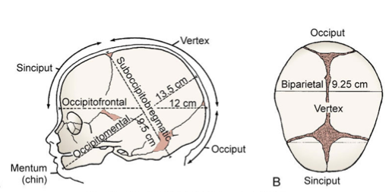
Baby Skull Dimensions

Slide 12
Baby Skull Dimensions

Slide 13
Cardinal Movements of Labor
Pelvic Inlet →
Flexion of Head→
Pelvic Outlet→

Slide 14
Cephalic Presentation
By engaging the head at the pelvic inlet in the transverse orientation, the infant utilizes the widest passageway to begin descent
By flexing the head as resistance is met from the pelvic floor and cervix, the infant’s head orients so that the smallest diameter of the skull will pass through the cervix
The infant rotates into anterior-posterior position as it approaches the pelvic outlet because A-P diameter is widest here

Slide 15
Cardinal Movements of Labor
Pelvic Inlet →
←Restitution;
bi-acromial
diameter aligns into
A-P position
Flexion of Head→
Pelvic Outlet→

Slide 16
Breech Delivery

Slide 17
Breech Delivery
Any fetal presentation in which head is aftercoming of the fetal buttocks

Slide 18
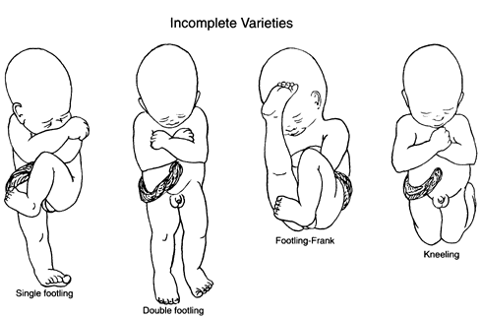
Breech Delivery

Slide 19
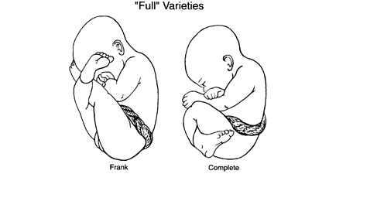
Breech Delivery

Slide 20
Breech Delivery
Problematic because fetal head is the largest structure that must pass through the cervix and birth canal
When fetal head does not present first, this raises the possibility of fetal head entrapment within the cervix that does not dilate sufficiently to allow passage of the head through it
  Pressure on cervix from fetal head is what causes it to dilate
  If fetal head is not presenting part, then cervix may not have enough pressure applied from buttocks, etc. to dilate enough to allow the head out

Slide 21
Breech Delivery
If head becomes entrapped, umbilical cord becomes compressed
  No blood flow from the placenta (still in uterus) to baby (mostly out)
  Fetal hypoxia

Slide 22
Breech Delivery
Vaginal delivery of breech presentation uncommon
  Maneuvers to turn the baby before baby is engaged in pelvis
  Elective C-section if persistent breech presentation at term
Vaginal breech delivery in the field is high risk for baby and mother, and is scary for everyone!

Slide 23
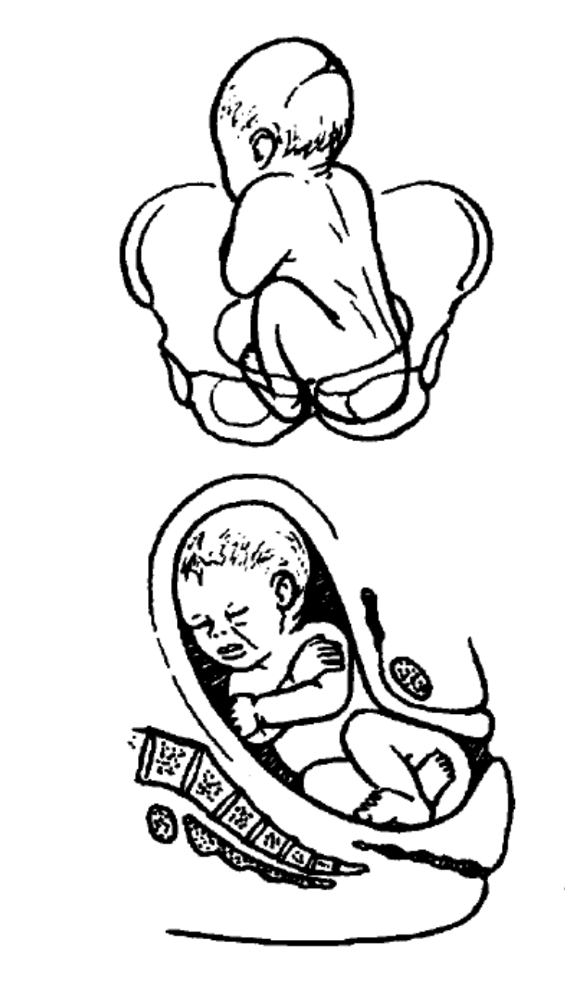
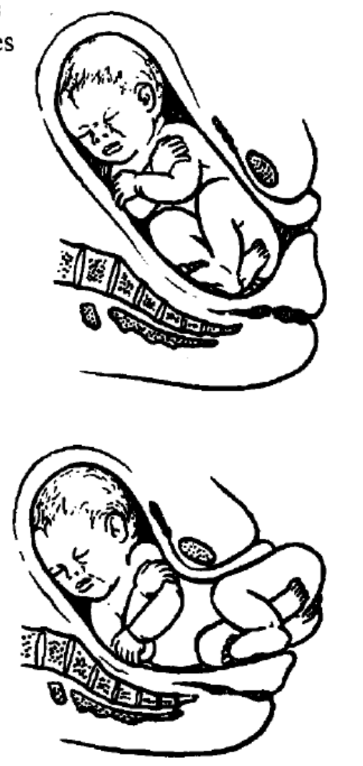
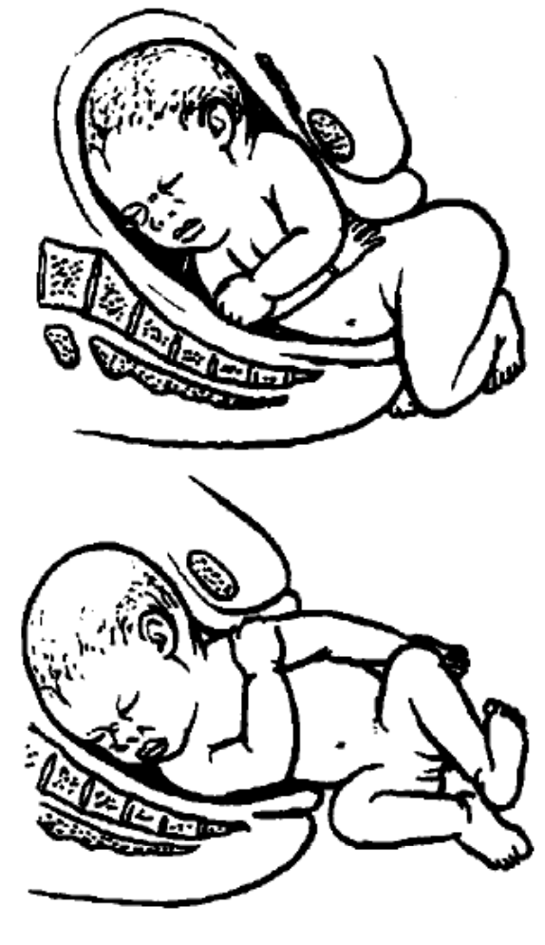
Engagement and Descent of the Breech Fetus

Slide 24
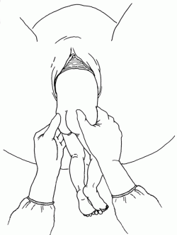
Breech Delivery
A breech infant whose delivery is imminent will usually spontaneously deliver buttocks, and legs will usually quickly follow
Once fetal pelvis has been delivered, grasp sacrum/hips with a towel
Do not grasp abdomen – risk damage to abdominal organs

Slide 25
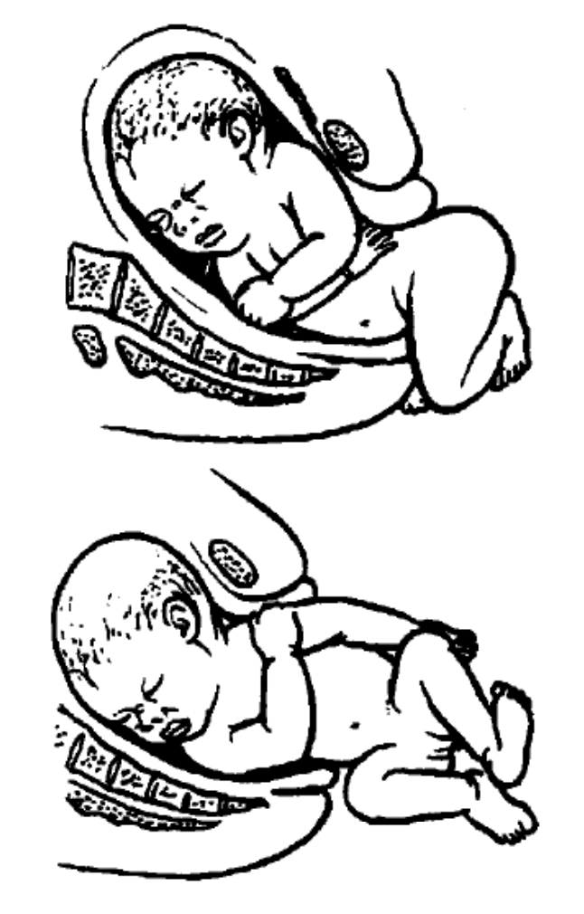
Breech Delivery
Once fetal trunk is delivered, fetus will rotate 90 degrees to facilitate delivery of shoulders (biacromial diameter) though the pelvic outlet in the A-P diameter
Can assist with rotation of fetus if necessary
Grasp front arm in antecubital fossa and assist out of vagina

Slide 26
Breech Delivery
Repeat for delivery of the posterior (back) arm
If challenging, can rotate fetus 180 degrees so the posterior arm becomes anterior

Slide 27
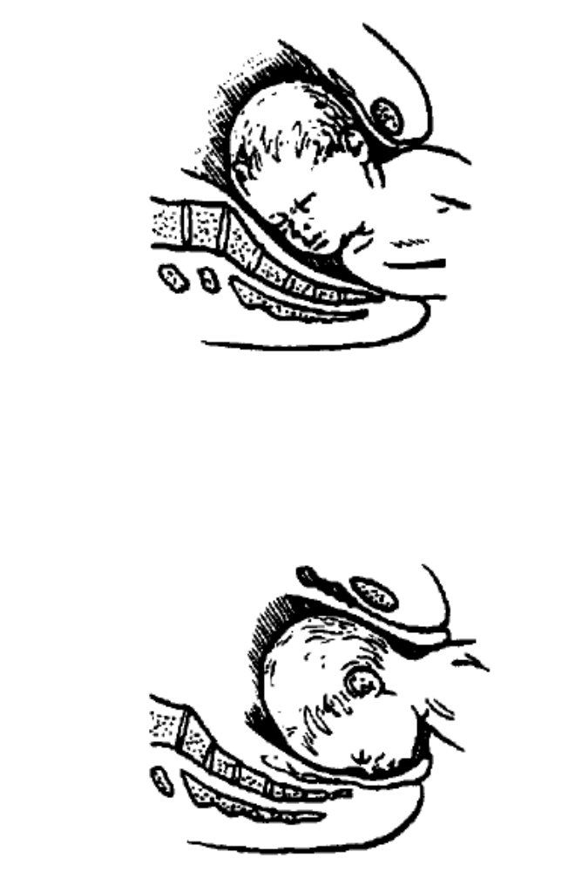
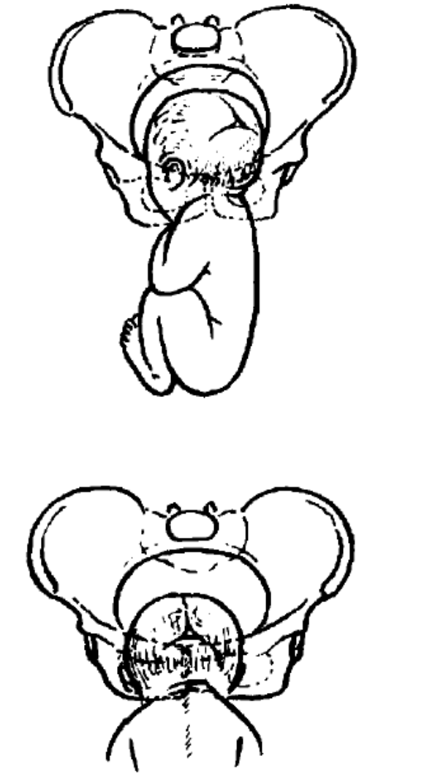
Breech Delivery
Head rotates so face is towards sacrum as the occiput becomes hinged underneath the pubic symphysis
Tricky part!

Slide 28
Breech Delivery
Fetal head not only has to fit through the cervix (which has hopefully dilated enough for this to occur) but also has to negotiate the pelvic outlet (widest diameter is A-P) without the propulsive force of the uterine contractions on the aftercoming body and the resistance of the pelvic floor tissues promoting flexion of the head

Slide 29
Breech Delivery
Fetal head not only has to fit through the cervix (which has hopefully dilated enough for this to occur) but also has to negotiate the pelvic outlet (widest diameter is A-P) without the propulsive force of the uterine contractions on the aftercoming body and the resistance of the pelvic floor tissues promoting flexion of the head

Slide 30
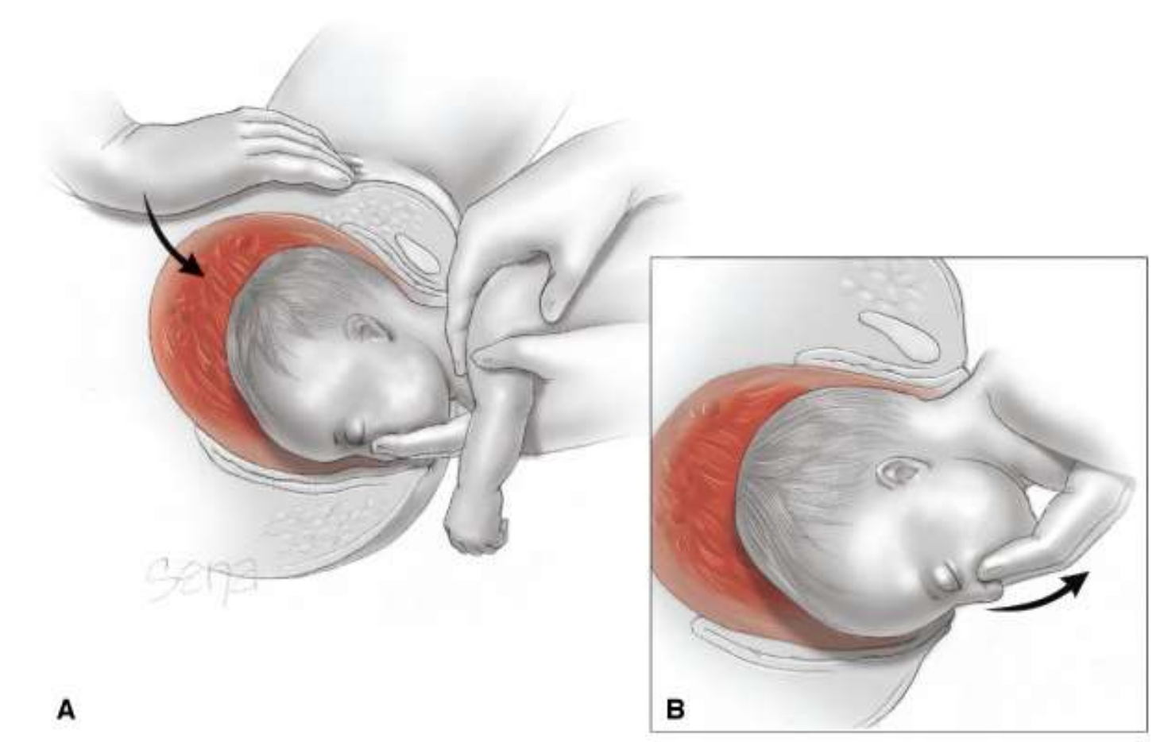
Mariceau Maneuver
How we flex the head

Slide 31
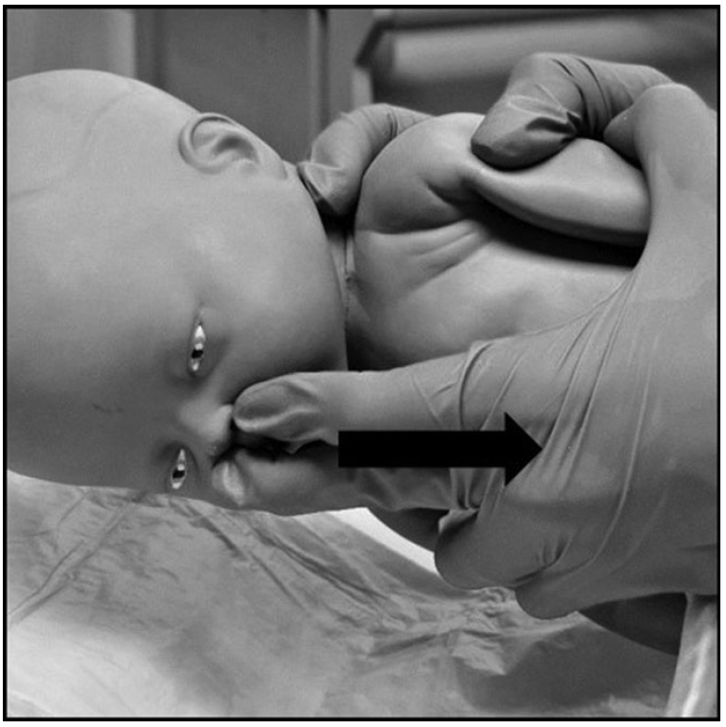
Mariceau Maneuver
Two fingers on fetal maxilla to pull the fetal neck into flexion
Brings the suboccipito-bregmatic diameter into most favorable positioning to fit through the pelvic outlet in A-P orientation

Slide 32
Mariceau Maneuver
Additional provider applying suprapubic pressure
Coach mother to push…HARD!
Emergent transpor to OB-capable facility
Early notification of receiving hospital

Slide 33
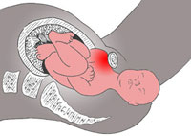
Shoulder Dystocia

Slide 34
Shoulder Dystocia
Impaction of anterior shoulder onto the pubic symphysis, preventing further delivery of the infant
Risk to the fetus because of umbilical cord compression
  Birth asphyxia
  Neonatal encephalopathy
  Fetal death
  Brachial plexus injuries

Slide 35

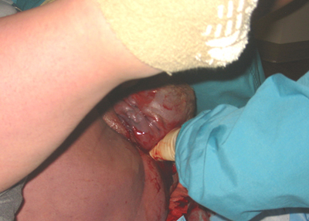
Turtle Sign

Slide 36

Code Shoulder!

Slide 37

Calm Down!

Slide 38

Calm Down!
You have time to execute maneuvers in a calm, organized, safe, manner
Avoid panic
Announce the situation
Give clear directions to helpers
Think 1 step ahead
Notes:
Cord gas pH noted to be lower in many instances of shoulder dystocia, although not felt to be clinically significant as often no difference in Apgar score or measured fetal outcomes
Another study revealed that majority of neonates with brain injury after shoulder dystocia had head-to-body delivery times of greater than 4 minutes
“Safe” time interval between delivery of the fetal head and ultimate delivery of the infant is unknown

Slide 39
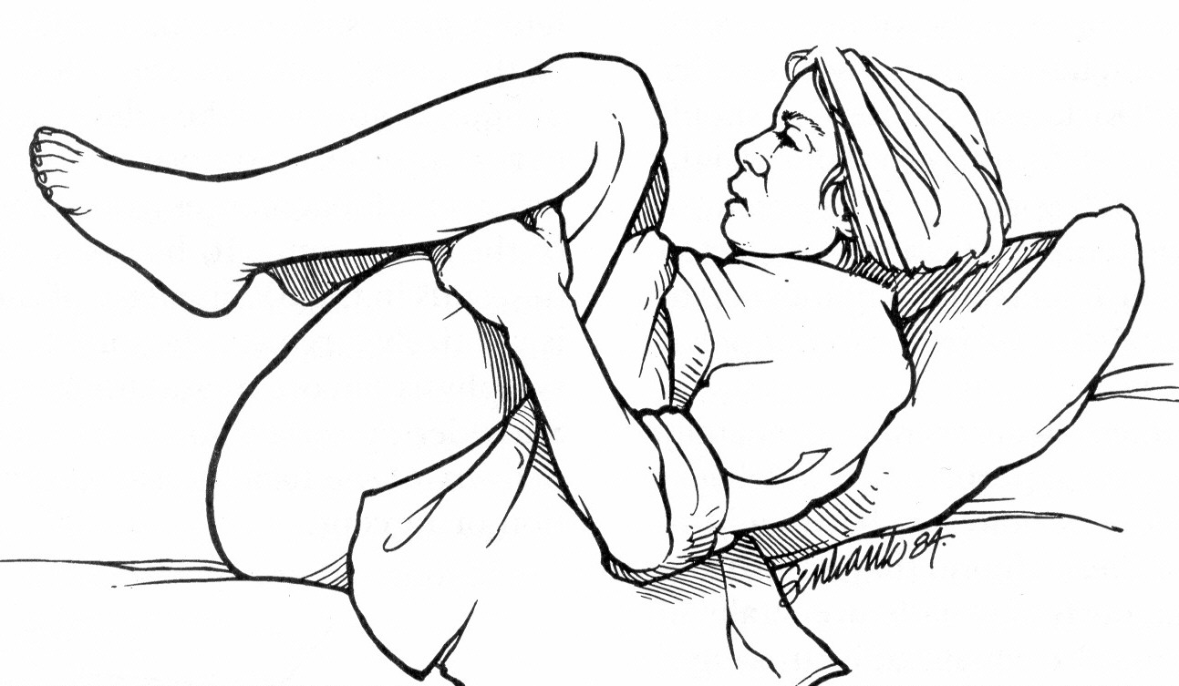
McRoberts Position

Slide 40
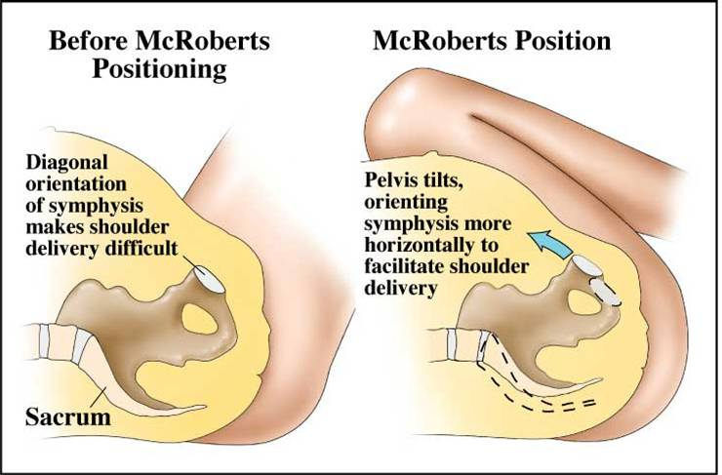
McRoberts Position

Slide 41
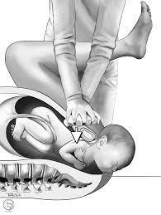
Suprapubic Pressure

Slide 42
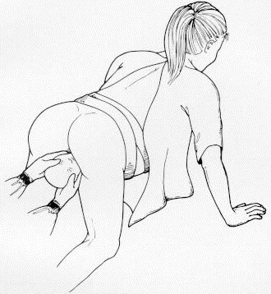
All Fours (Gaskin Maneuver)

Slide 43
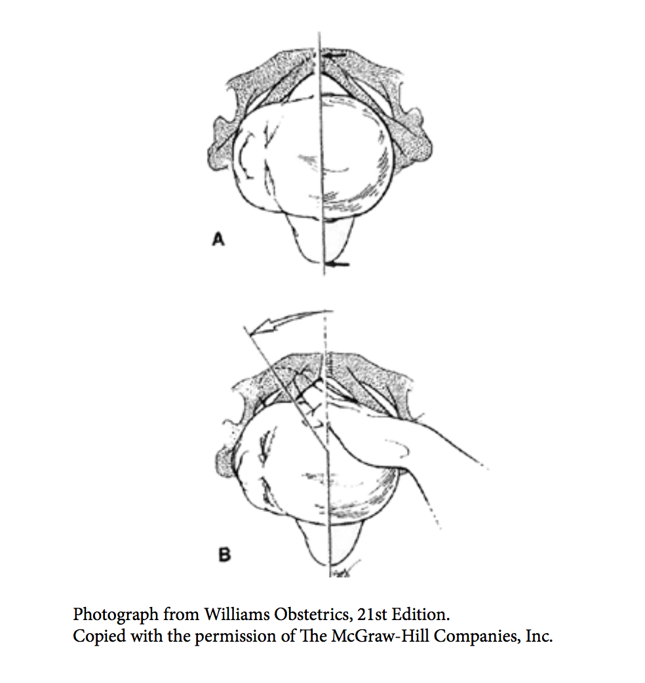
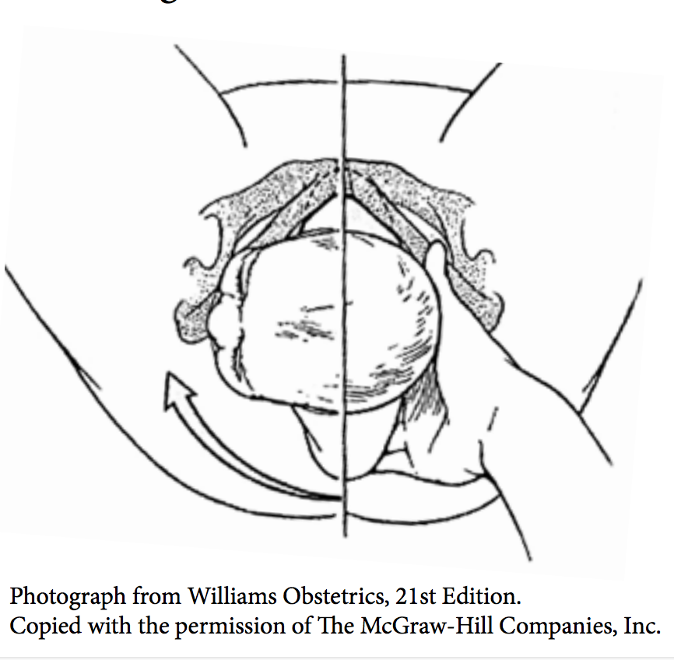
Additional Maneuvers

Slide 44
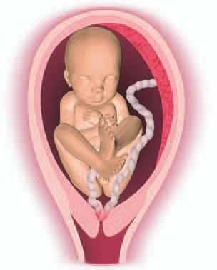
Cord Prolapse

Slide 45
Cord Prolapse
Prolapse of the umbilical cord through the cervix before any fetal presenting part
Risk factors
  Ruptured membranes before fetal engagement
  Prematurity
  High volume amniotic fluid
  Small fetus

Slide 46
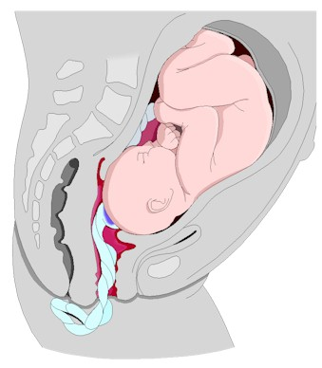
Cord Prolapse

Slide 47
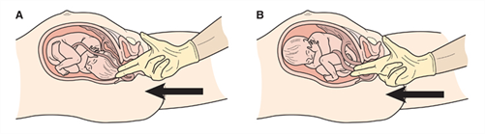
Cord Prolapse

Slide 48
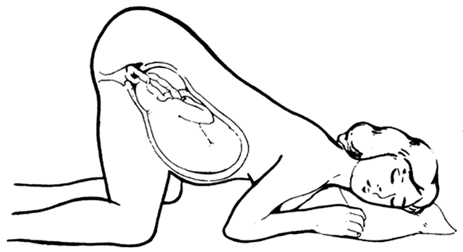
Cord Prolapse

Slide 49
Cord Prolapse
Emergency delivery, usually via Cesarean
Someone will have to elevate the presenting part off of the cord until delivery
Cord pulsations reassuring

Slide 50
Fetal Malpresentations
High-flow oxygen to mother
Execute maneuvers but if not immediately successful, do not delay transport! Get moving….but keep trying!

Slide 51


Slide 52
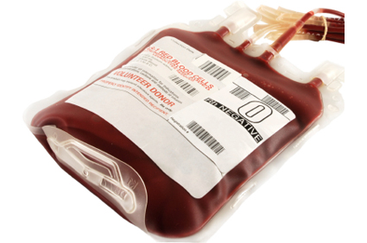
Postpartum Hemorrhage

Slide 53
Postpartum Hemorrhage
Childbirth should not be a gigantic bloodbath.
Usually occurs within the first day of a birth, but can be days or even weeks after the birth

Slide 54
Postpartum Hemorrhage
Significant cause of maternal mortality, particularly in the developing world
  Fifteen percent of maternal deaths in USA
Any degree of bleeding that threatens the patient’s hemodynamic stability (Society of Ob-Gyns of Canada)
Notes:
Major cause of maternal mortality worldwide, accounting for 127,000 maternal deaths globally each year ^{(WHO)}

Slide 55
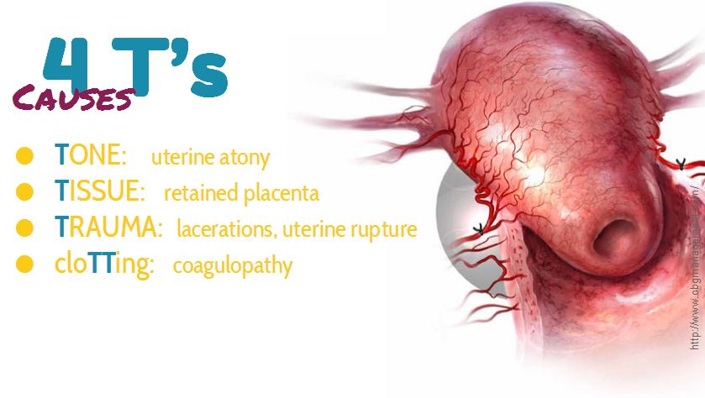
Postpartum Hemorrhage

Slide 56
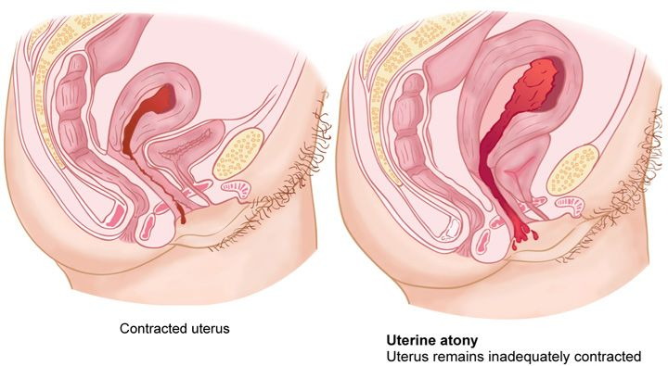
Uterine Atony

Slide 57
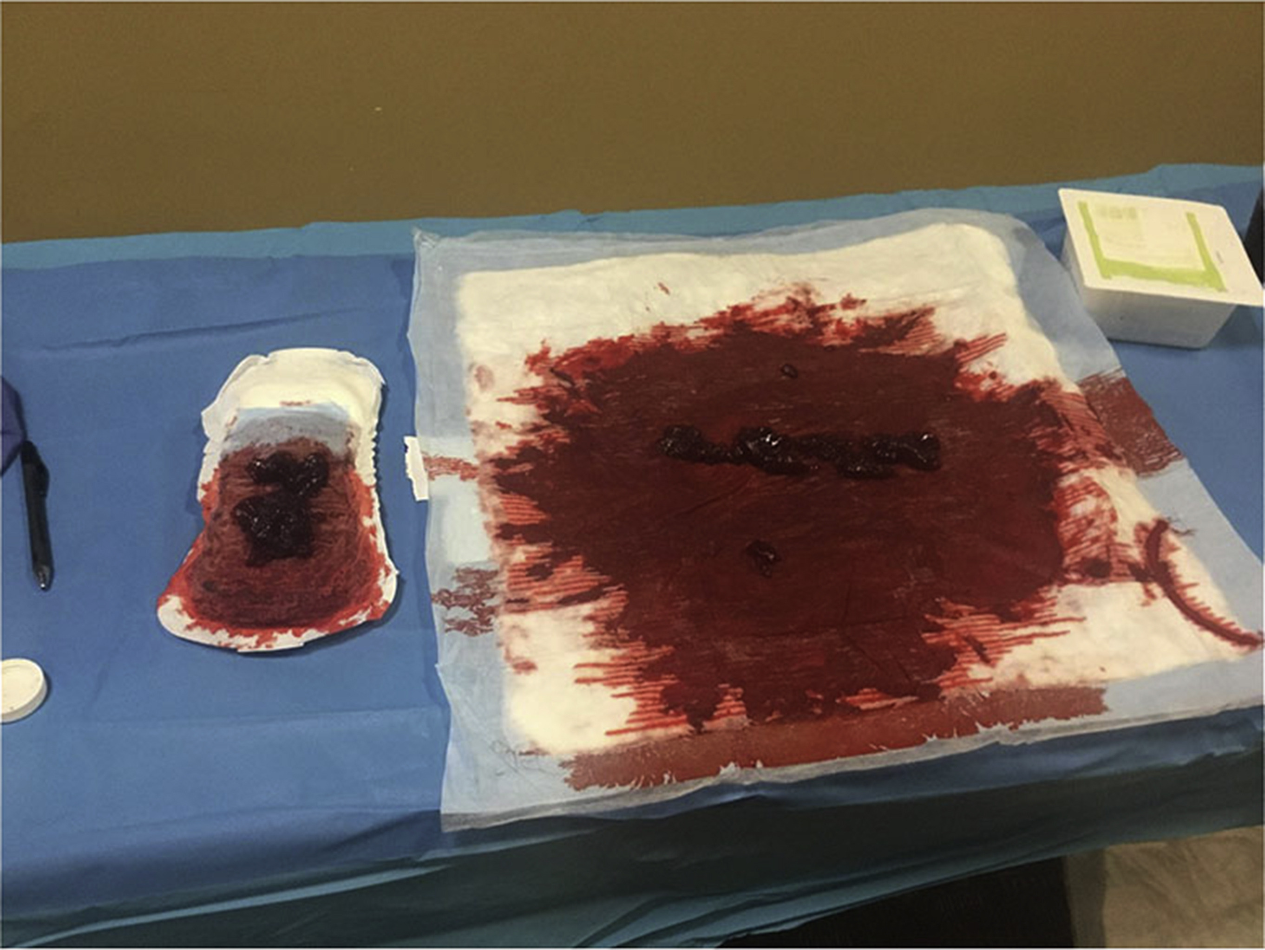
Recognizing Postpartum Hemorrhage

Slide 58
Recognizing Postpartum Hemorrhage
After delivery, bleeding should slow and stop
  Any ongoing bleeding is concerning
Vital sign changes
Quantitative Blood Loss (QBL)

Slide 59
Recognizing Postpartum Hemorrhage
Quantitative Blood Loss
  Save all the bloody stuff and transport to the hospital with the patient
    Sheets
    Chux pads
    Trauma dressings
    Patient’s clothing

Slide 60
If Ongoing Blood Loss After Delivery, It’s Time to Act
Get the uterus to contract
  Manually
  Pharmacologically
Tip the balance of coagulation – clot breakdown towards coagulation

Slide 61
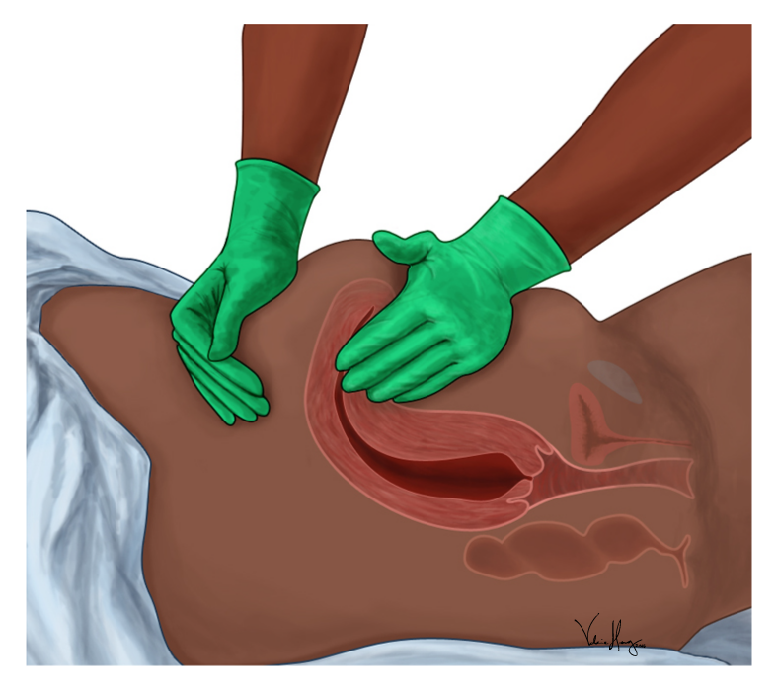
Get the Uterus to Contract: Manually
Uterine Massage
“You ain’t pettin’ a puppy….”
- Nancy Bryant, MD

Slide 62
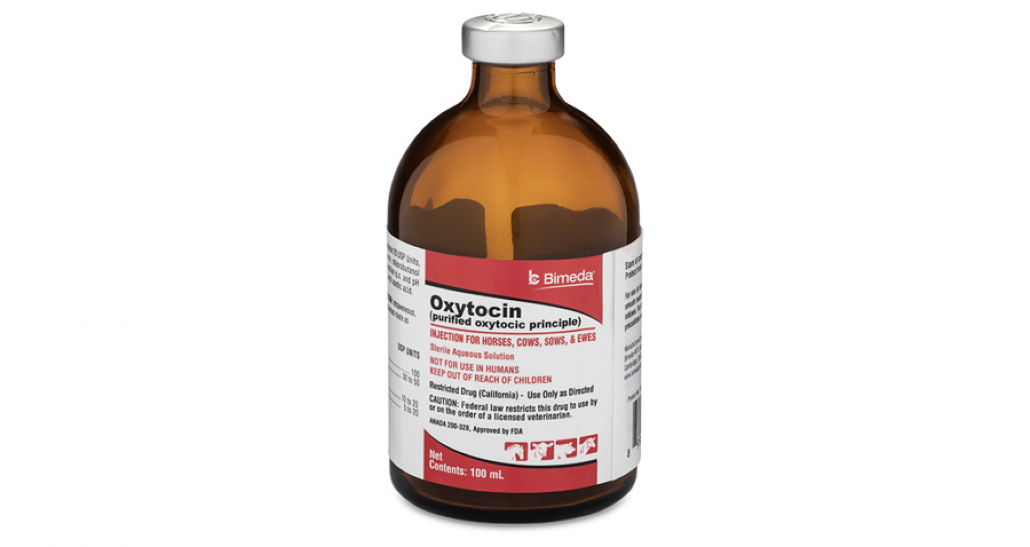
Get the Uterus to Contract: Pharmacologicallly
Can also be released
endogenously through
breastfeeding or
pumping

Slide 63

Shift the Balance
Clot Formation
Clot Breakdown

Slide 64
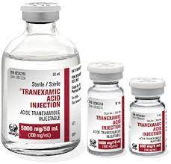
Shift the Balance: Tranexamic Acid (TXA)

Slide 65
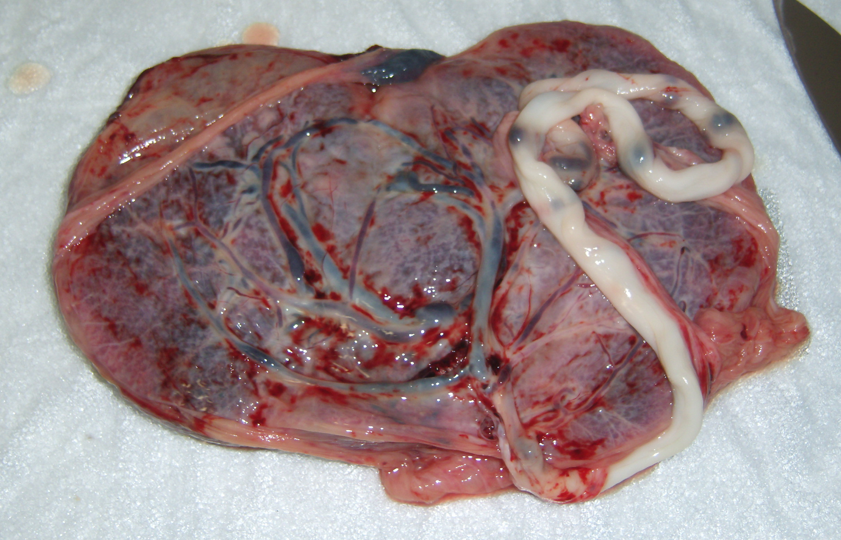
Tissue: Retained Placenta
Careful delivery of the placenta
Transport placenta (and all its parts) to hospital with patient
Notes:
Placenta accreta (placental growing into muscle layers of uterine wall) may have occurred if significant bleeding after placental delivery

Slide 66
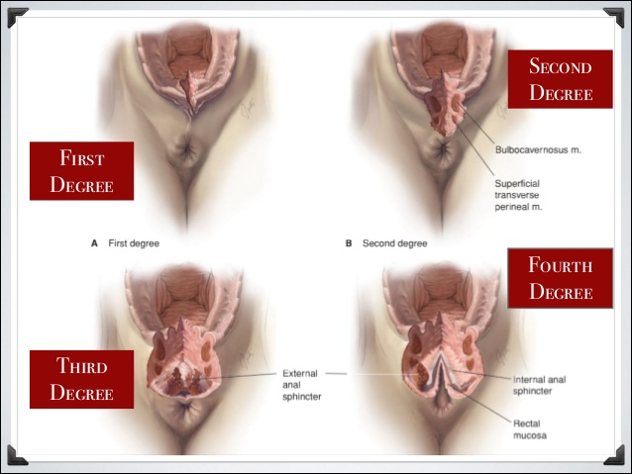
Trauma: Perineal Lacerations

Slide 67
Preventing Postpartum Hemorrhage
Best accomplished by active management of the third stage of labor
  Oxytocin as soon as infant has delivered
  Controlled cord traction
  Uterine massage as placenta is delivered and immediately following; close post-partum monitoring of uterine tone

Slide 68
Other Important Post-Delivery Care
Vital Signs are vital
Safe transport of mom and baby
Informed refusals of transport while adhering to birth justice principles

Slide 69


Resources
Global Health Media Breech Delivery Video
Global Health Media “Stuck Shoulders” Video
Notes:
https://globalhealthmedia.org/videos/the-breech-birth/

