Slide 1
NASH Update 2023
AASLD Practice Guidance Update
Richard Manch, MD, FAASLD, FACP, FACG
Director of Hepatology
Arizona Liver Health
Clinical Professor of Medicine
University of Arizona

Slide 2
NAFLD: Definitions
NAFLD: Histology of >5% macrovessicular steatosis in individual without significant EtOH use (<30 g men; <20g women)
NASH (Non-Alcoholic Steatohepatitis): histologic evidence of steatosis, cellular ballooning degeneration, and lobular inflammation
Ref: Clin Gastro Hepatol. 2015;13: 2062.

Slide 3
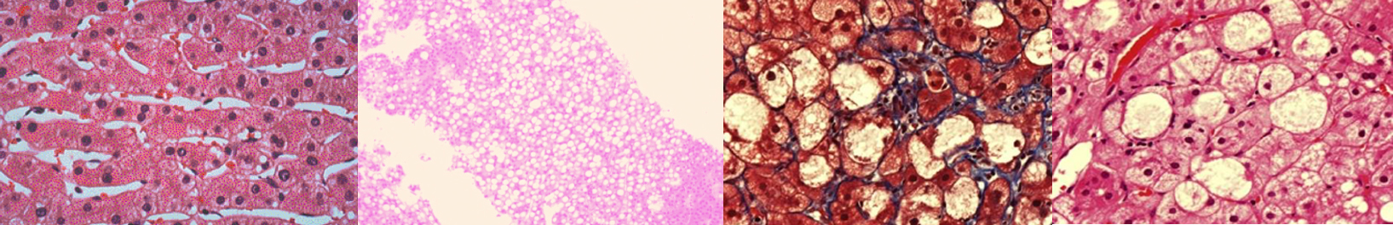
NAFLD Encompasses the Entire Spectrum of Fatty Liver Disease
NAFLD
Disease of hepatic fat accumulation, absent alcohol consumption, hereditary disorders, or steatogenic medication use
Normal
NAFL
NASH
NASH Cirrhosis
>5% hepatic steatosis
No evidence of hepatocyte injury (ballooning) or fibrosis
Progressive type of NAFLD
>5% hepatic steatosis ±
inflammation with hepatocyte injury (ballooning) ± fibrosis
Cirrhosis + current or previous histological evidence of steatosois
Chalasani N et al. Hepatology. 2018;67(1):328-357.

Slide 4


NAFLD in the United States
30% to 40%
of Americans have NAFLD¹
#2
leading indication for liver transplantation in the US after HCV²
3% to 12%
of Americans have NASH¹
#3
most common cause of HCC in the US³
$103 billion
estimated annual direct costs of NAFLD⁴
1. NIDDKD. Available at https://www.niddk.nih.gov/health-information/liver-disease/nafld-nash/definition-facts.
Accessed May 18, 2018; 2. Wong RJ et al. Gastroenterology. 2015;148:547-555;
3. Mohamad B et al. Hepatol Int. 2016;10:632-639; 4. Younossi ZM et al. Hepatology. 2016;64(5):1577-1586.

Slide 5







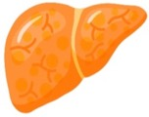
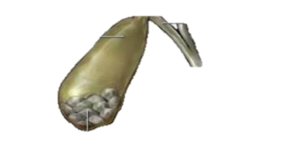

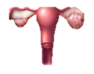
Not to Forget NASH as a Part of a
Multisystem Disorder
Osteoarthritis
Cardiac disease
Vascular disease
Chronic kidney disease
Cerebrovascular disease
Diabetes
Malignancy
NAFLD
Gallstone disease
Obstructive sleep apnea
Polycystic ovary syndrome
Angulo P et al. Gastroenterology. 2015;149:389–397; Söderberg C et al. Hepatology. 2010;51:595–602;
Ekstedt M et al. Hepatology. 2006;44:865–873; Dam-Larsen S et al. Scand J Gastroenterol. 2009;44:1236–1243;
Rafiq N et al. Clin Gastroenterol Hepatol. 2009;7:234–238; Hicks SB et al. J Hepatol. 2019;71:1229-1236.

Slide 6
Identification of Patients at Risk for NASH
RISK FACTORS for NASH
  Age >50
  BMI >30
  Elevated Liver enzymes
  (AST >20 U/L, AST/ALT ≥1)
  Diabetes
  Hypertension
  Dyslipidemia
  Metabolic Syndrome
  Fatty liver on ultrasound
  Historical Fibroscan >8 kpa, CAP >280
Highest risk profile:
Post-menopausal, obese, diabetic, Hispanic, female

Slide 7
NASH: Mortality
Fibrosis stage strongest predictor of mortality
C-V disease: 13-30%
All cause malignancy: 6-28%
Liver related death: 2.8-19%
Clin Gastro Hepatol. 2015: 13: 2062.

Slide 8
The Challenge: Diagnosing a Silent
Disease Using Liver Biopsy
Liver biopsy is the ‘gold standard’ tool
for the diagnosis and staging of chronic liver disease
However, the limitations are widely acknowledged
  Painful, invasive procedure
  High-cost, with significant risk of complications;
    Complications in 1 in 1,000; Mortality Rate 1 in 5,000
Therefore, liver biopsy is a Diagnostic of ‘Last Resort’
  Only 60K biopsies annually performed for 64M patients with non-alcoholic fatty liver disease in the US
Most patients not diagnosed, and if found, are found late
“Novel strategies are needed to move the field forward”
Pierre Bedossa, Department of Pathology, INSERM

Slide 9
Routine Clinical Biochemistry (LFTs)
NAFLD is the most common diagnosis in patients with ‘incidental’ abnormal LFTs
Liver enzymes may be normal in up to 80% of NAFLD patients
  Transaminases are not a sensitive test for NAFLD/NASH
  Poor correlation between ALT and histology
  ALT typically falls with advanced fibrosis
  ALT> AST → ALT <AST
Severity of histology in NAFLD with normal LFTs no different from those with abnormal LFTs
Grade/Stage of NAFLD with normal LFTs no different from those with abnormal LFTs
Pattern | Normal ALT (n = 51) | Abnormal ALT (n = 50) | P Value
Fat alone, n | 8 | 10 | NS
Fat + scattered inflammation, n | 8 | 10 | NS
Fat + ballooning ± inflammation, n | 13 | 11 | NS
Fat + ballooning ± Mallory hyaline ± pericellular fibrosis, n | 22 | 19 | NS
Routine LFTs do not differentiate Steatosis/NASH or Stage of fibrosis
Daniel. 1999; Skelly. 2001; Pendino. 2005; Browning. 2004; Mofrad. 2003; Sorrentino. 2004; Francaza. 2008;
Mofrad et al. Hepatology. 2003.

Slide 10
NAFLD/NASH Screening Algorithm
Suspected NAFLD/NASH based on US findings +/- metabolic syndrome/risk factors +/- elevated liver enzymes
Rule out potential other causes of
elevated liver enzymes
and steatosis
Review history of alcohol use
and other considerations
Obtain liver imaging and/or use noninvasive biomarkers for risk stratification
Available at: https://chronicliverdisease.org/disease_focus/NASH-Leadership.cfm. Accessed May 21, 2020.

Slide 11
Goals of NASH Treatment
Improve metabolic abnormalities
Decrease inflammation
Prevent/arrest/reverse liver fibrosis
Prevent advanced liver disease, liver failure, liver cancer and related outcomes
Systemic outcomes
Chalasani N, et al. Hepatology. 2018;67:328-35.

Slide 12
AASLD Practice Guidance: 2018
Management of NAFLD should consist of treating liver disease and associated metabolic comorbidities such as obesity, hyperlipidemia, insulin resistance, and type 2 diabetes
  Pharmacologic treatments aimed primarily at improving liver disease should generally be limited to those with biopsy-proven NASH and fibrosis
Dietary and lifestyle modification
  Basis of any management strategy, but challenging for many patients to achieve and maintain
  Weight loss (hypocaloric diet ± physical activity)
    3% to 5% loss: generally reduces hepatic steatosis
    7% to 10%: needed to improve most histopathologic features of NASH, including fibrosis
  Exercise alone
    May improve or reduce hepatic steatosis
    Impact on liver histology is unknown
Chalasani N, et al. Hepatology. 2018;67:328-357.
Notes:
Slide: AASLD Practice Guidance: Whom to Treat
The management of NAFLD should consist of treating liver disease as well as the associated metabolic comorbidities such as obesity, hyperlipidemia, IR, and type 2 diabetes.¹
Pharmacologic treatments aimed primarily at improving liver disease should generally be limited to those with biopsy-proven NASH and fibrosis.
Dietary and lifestyle modification (basis of any management strategy, but challenging for many patients to achieve and maintain).¹
Weight loss generally reduces steatohepatitis, achieved either by hypocaloric diet alone or in conjunction with increased physical activity. A combination of a hypocaloric diet (daily reduction by 500-1000 kcal) and moderate-intensity exercise is likely to provide the best likelihood of sustaining weight loss over time.
Weight loss of at least 3%-5% of body weight appears necessary to improve steatosis, but a greater weight loss (7%-10%) is needed to improve the majority of the histopathological features of NASH, including fibrosis.
Exercise alone in adults with NAFLD may prevent or reduce steatohepatitis but its ability to improve other aspects of liver histology remains unknown.
Reference
Chalasani N, Younossi Z, Lavine JE, et al. The diagnosis and management of non-alcoholic fatty liver disease: practice guideline by the American Association for the Study of Liver Diseases, American College of Gastroenterology, and the American Gastroenterological Association. Hepatology. 2018;67:328-357.

Slide 13
AASLD Practice Guidance: 2022
Major advances from 2018 guidance document:
Pediatrics separated into an independent guidance
Screening for advanced fibrosis in high-risk populations
Risk stratification algorithm
Non-invasive diagnosis of ‘at risk’ NASH. Advanced fibrosis and cirrhosis
Off-label use of available medications
Optimal care model
Notes:
Slide: AASLD Practice Guidance: Whom to Treat
The management of NAFLD should consist of treating liver disease as well as the associated metabolic comorbidities such as obesity, hyperlipidemia, IR, and type 2 diabetes.¹
Pharmacologic treatments aimed primarily at improving liver disease should generally be limited to those with biopsy-proven NASH and fibrosis.
Dietary and lifestyle modification (basis of any management strategy, but challenging for many patients to achieve and maintain).¹
Weight loss generally reduces steatohepatitis, achieved either by hypocaloric diet alone or in conjunction with increased physical activity. A combination of a hypocaloric diet (daily reduction by 500-1000 kcal) and moderate-intensity exercise is likely to provide the best likelihood of sustaining weight loss over time.
Weight loss of at least 3%-5% of body weight appears necessary to improve steatosis, but a greater weight loss (7%-10%) is needed to improve the majority of the histopathological features of NASH, including fibrosis.
Exercise alone in adults with NAFLD may prevent or reduce steatohepatitis but its ability to improve other aspects of liver histology remains unknown.
Reference
Chalasani N, Younossi Z, Lavine JE, et al. The diagnosis and management of non-alcoholic fatty liver disease: practice guideline by the American Association for the Study of Liver Diseases, American College of Gastroenterology, and the American Gastroenterological Association. Hepatology. 2018;67:328-357.

Slide 14
Key Points
Pts with NASH and F2-4 fibrosis are at higher risk for liver related events and mortality “High risk NASH”
Rates of progression and decompensation vary depending on baseline disease severity, genetic, individual environmental, and comorbid disease
CVD and non-hepatic malignancies are the most common causes of mortality in pts with NAFLD without advanced fibrosis; death from liver disease predominates in pts with advanced fibrosis

Slide 15
Key Points
Fundamental elements of NASH pathogenesis include an imbalance between nutrient delivery and their utilization and disposal coupled with adipose tissue dysfunction. Differences in genetic, dietary, behavioral, and environmental factors influence disease course
Systemic inflammation, particularly stemming from dysfunctional adipose tissue, contributes to disease progression
Insulin resistance contributes to the development of NAFLD and promotes disease progression

Slide 16
Guidance Statements
Statins are safe and recommended for CVD risk reduction in pts with NAFLD across the disease spectrum, including compensated cirrhosis
Limited data exist in the use of statins in decompensated cirrhosis, although statin use with careful monitoring could be considered in pts with high CVD risk
Hypertriglyceridemia can be managed through lifestyle changes and supplementation with omega 3 fatty acids, icosapent ethyl or fibrates
Pts with DM2 are at higher risk for NASH and advanced fibrosis and should be screened for advanced fibrosis

Slide 17
Key points
Prevalence and incidence of CKD is higher among patients with NASH and advanced fibrosis
Death from non-hepatic malignancies is a common cause of death in pts with NAFLD, and adherence to age-appropriate cancer screening has the potential to improve survival

Slide 18
Guidance Statements
In pts with NAFLD, alcohol can be a cofactor for liver disease progression, and intake should be assessed on a regular basis
Patients with clinically significant fibrosis (F2-F4) should abstain from alcohol COMPLETELY
Abstinence may lower the risks of fibrosis progression and hepatic and extrahepatic malignancies in patients with NAFLD

Slide 19
Guidance Statements
NAFLD is more common in men with androgen deficiency, but current data DO NOT support routine measurement of testosterone levels. If hypogonadism is present, as suggested by clinical signs or symptoms, this should be treated accordingly.
Although GH deficiency and panhypopituitarism may be associated with hepatic steatosis, their independent role on development and progression of steatohepatitis and fibrosis remains to be established
Androgen excess can worsen insulin resistance in women with PCOS, which together with obesity and DM2 can promote NAFLD and potentially more progressive disease in this population

Slide 20
Guidance Statements
General population-based screening is not advised
All patients with hepatic steatosis or clinically suspected NAFLD based on the presence of obesity and metabolic risk factors should undergo primary risk assessment with FIB-4
High risk individuals such as those with prediabetes or DM2, medically complicated obesity, family history of cirrhosis, more than mild alcohol consumption should be screened for advanced fibrosis
In pts with pre-DM or DM2, or two or more metabolic risk factors (or imaging evidence of steatosis) primary risk assessment with FIB-4 should be repeated every 1-2 years

Slide 21
Guidance Statements
Pts with NASH cirrhosis are at the highest risk for liver related outcomes and require routine surveillance for HCC, varices, and monitoring for decompensation
Pts with suspected advanced NASH or discordant non-invasive tests (NITs) should be referred to a specialist for evaluation, management, and / or further diagnostic evaluation
Aminotransferase levels are frequently NORMAL in pts with advanced liver disease due to NASH and should not be used in isolation to exclude NASH with advanced fibrosis
First degree relatives of patients with NASH cirrhosis should be counseled regarding their increased risk and offered screening

Slide 22
Guidance Statements
Although standard ultrasound can detect hepatic steatosis, it is NOT recommended as a tool to identify hepatic steatosis due to low sensitivity across the NAFLD spectrum
CAP as a point-of-care technique may be used to identify steatosis. MRI-PDFF can additionally quantify steatosis
If FIB-4 is > 1.3; VCTE, MRE or ELF may be used to exclude advanced fibrosis

Slide 23
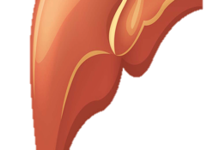
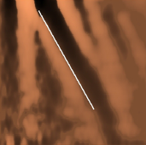

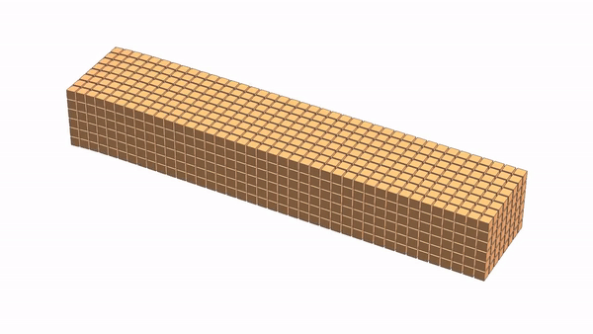

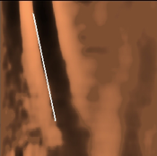

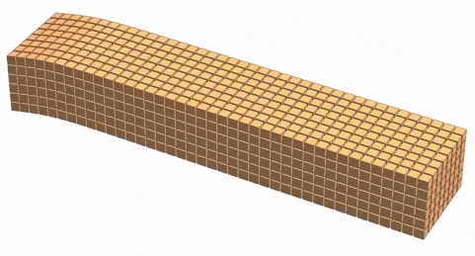
Liver Stiffness Correlates to Fibrosis Level
Healthy
Slow Shear Wave
Fibrosis
Fast Shear Wave
FibroScan VCTE Range: 2.5-75 kPa

Slide 24
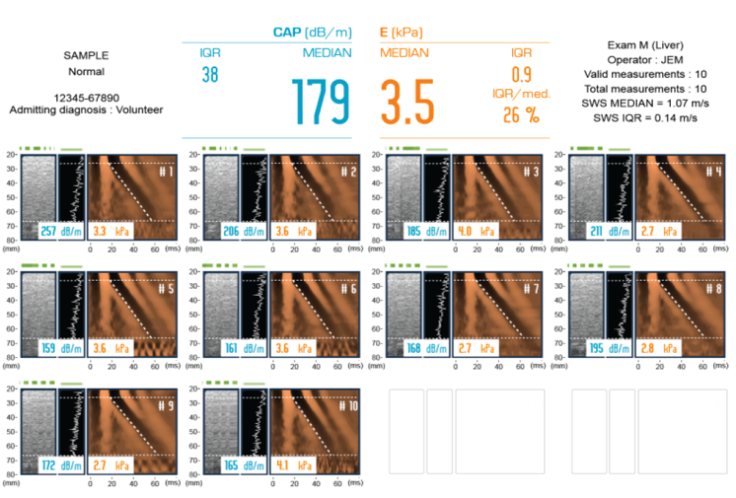
Sample FibroScan Report
CAP (dB/m)
MEDIAN
E (kPa)
MEDIAN
SAMPLE
Normal
Exam M (Liver)
Valid measurements: 10
Total measurements: 10
179
3.5
QR/med.
26%

Slide 25
ELF Score
SROC curve
1.0
0.8
0.6
0.4
0.2
0.0
11 studies were included in the meta-analysis of advanced fibrosis
AUC: 0.83 (0.71, 0.90)
Sensitivity: 0.73 (0.60, 0.83)
Specificity: 0.80 (0.68, 0.88)
Hyaluronic acid (HA)
Procollagen III amino terminal peptide (PIIINP)
Tissue inhibitor of metalloproteinase 1 (TIMP-1)
Sensitivity
0.0 0.2 0.4 0.6 0.8 1.0
1-Specificity
Meta-analysis of 11 studies
ELF test had a sensitivity of >0.90 for excluding fibrosis at a threshold of 7.7
To achieve a specificity of 0.90 for advanced and significant fibrosis, thresholds of 10.18 (sensitivity: 0.57) and 9.86 (sensitivity: 0.55) were required, respectively
Vali et al; J Hep 2020

Slide 26
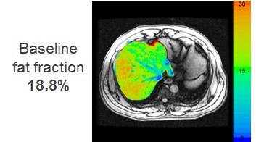
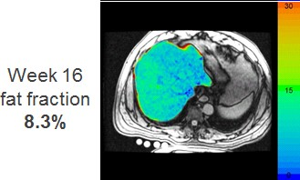
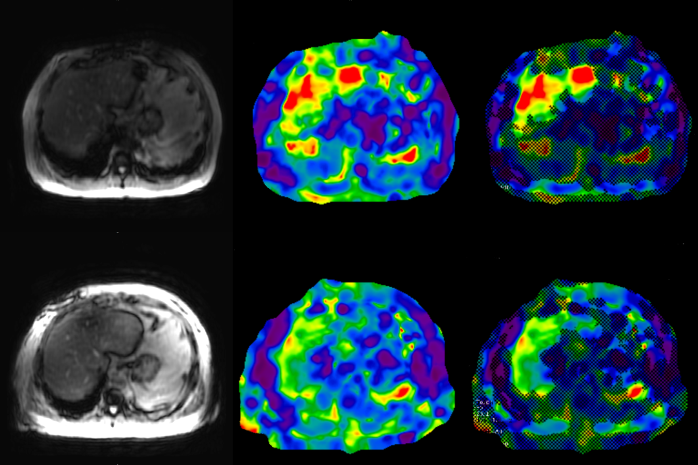
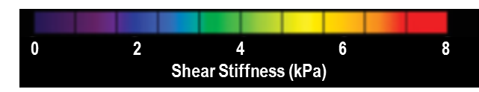
?MRE/ cT1/ LSM?
Biomarkers to Assess Treatment Response
ALT/ AST
≥ 17 U/L reduction predicts histologic response
Liver Fat Fraction (MRI-PDFF)
≥ 5% absolute/ ≥ 30% relative reduction associated with improvement in NAS
MRE: ≥ 15% relative
reduction from BL?
cT1: > 80 ms reduction from
BL (21%) or change in category?
LSM decrease by 20-25% from BL?
Baseline
EOT
Loomba. Gastroenterology. 2019;156:88. Patel. Therap Adv Gastro 2016;9:692.

Slide 27
Guidance Statement
Pts with NAFLD who are overweight or obese should be prescribed a diet that leads to caloric deficit. When possible, limited carbohydrates and saturated fat enriched with high fiber and unsaturated fats should be encouraged
Pts with NAFLD should be encouraged to increase their activity level to the extent possible. Individualized prescriptive exercise recommendations may increase sustainability and have benefits independent of weight loss

Slide 28
Key Points
Weight loss improves hepatic steatosis, NASH and hepatic fibrosis in a dose dependent manner
The necessary support to manage comorbid disease and foster the adoption of protective liver health behaviors is best achieved using a multidisciplinary approach
Coffee Consumption (caffeinated or not) at least 3 cups daily is associated with less advanced liver disease

Slide 29





Lifestyle Recommendations for Treating NASH
Caloric intake reduction
≥30% or
~750-1,000 kcal/day improved insulin resistance
and hepatic steatosis
*Limit consumption of fructose-enriched beverages
Weight loss
of 3% to 5% can improve steatosis, but 6% to 10% is needed to improve NASH/fibrosis
Exercise
alone may reduce steatosis, but effect on other histologic features unknown
No heavy alcohol consumption
Insufficient data to guide recommendations regarding nonheavy alcohol consumption
**Drink 3 cups of coffee daily
*Fructose increases the odds of the development of nonalcoholic fatty liver in high-risk patients and of nonalcoholic steatohepatitis and more advanced liver fibrosis in patients who already have nonalcoholic fatty liver disease.
**Caffeinated coffee reduces the risk of liver fibrosis in several liver diseases, including nonalcoholic fatty liver disease.
Chalasani N et al. Hepatology. 2018;67(1):328-357; Diehl AM, Day C. New Engl J Med. 2017; 377:2063-72..

Slide 30
Guidance Statements
Bariatric surgery should be considered as a therapeutic option in pts who meet criteria for metabolic weight loss surgery, as it effectively resolves NAFLD or NASH in the majority of pts without cirrhosis and reduces mortality from CVD and malignancy
The type, safety and efficacy of bariatric surgery in pts with well-compensated NASH cirrhosis is not established and requires a careful benefit-risk assessment by multidisciplinary team of experts that includes a hepatologist
Decompensated cirrhosis should be considered an absolute contraindication for bariatric surgery due to increased risk and unproven liver-related benefit, unless performed in conjunction with liver transplant at experienced centers.

Slide 31
Guidance Statements
Currently no FDA approved treatments for NAFLD, but drugs approved to treat comorbid conditions with potential benefit in NAFLD may be considered
Semaglutide confers cardiovascular benefit and improves NASH
Pioglitazone improves NASH and can be considered in pts with DM2
Vitamin E can be considered in select individuals as it improves NASH in some pts without diabetes
Available data on semaglutide, pioglitazone and vitamin E do not demonstrate an antifibrotic benefit, and none have been carefully studied in cirrhotic pts
Metformin, UDCA, DPP-4, statins, silymarin are well studied in NASH and should not be used as treatment for NASH as they do not offer meaningful benefit

Slide 32
Guidance Statements
Improvement in ALT or reduction in liver fat content by imaging in response to intervention can be used as a surrogate for histological improvement in disease activity
ALT reduction of > 17 U/L is associated with histologic improvement; however, thresholds may differ for type of histologic response (eg NASH resolution or fibrosis improvement) and may be mechanism of action specific

Slide 33
Conclusions
NAFLD is a silent and progressive disease that, if left uncontrolled, can lead to a more severe form called NASH
NAFLD/NASH is growing in prevalence
  By 2030, there are projected to be nearly 800,000 excess liver deaths
Common comorbidities (e.g. Metabolic syndrome) are bi-directionally associated with NAFLD and contribute to the growing prevalence
Fibrosis (F2-F4) is the most important histological feature of NAFLD associated with long-term mortality

Slide 34
Conclusions (cont’d)
Liver biopsy is the gold standard for diagnosing NASH, but is met with many disadvantages
Noninvasive biomarkers (i.e. serum and imaging) are being used more frequently
Patients with histologic NASH or evidence of significant fibrosis should be treated according to updated AASLD guidance
Multiple treatments that interrupt the pathophysiological properties of NASH are in development
Combination therapy using drugs with different mechanisms-of-action is likely the future of NASH treatment

Slide 35
FDA Efficacy Endpoints for Phase 3 Trials: Liver
Histologic Improvement
NASH Resolution
Resolution of steatohepatitis on overall histopathologic reading
and
No worsening of liver fibrosis
Fibrosis Improvement
Improvement ≥ 1 fibrosis stage
and
No worsening of steatohepatitis
OR BOTH
1. US FDA. Draft Guidance. Noncirrhotic NASH With Liver Fibrosis. December 2018.

Slide 36
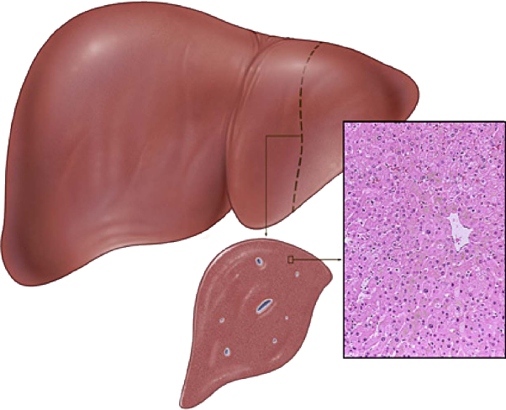
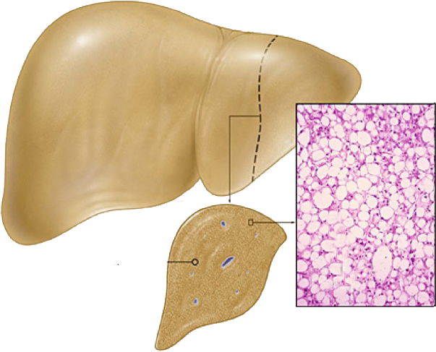
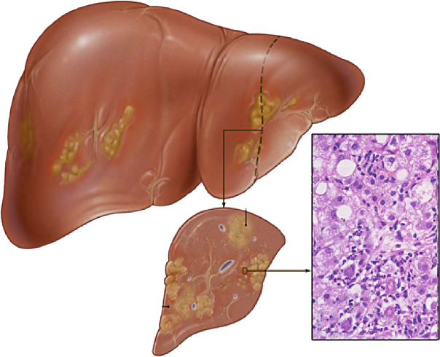
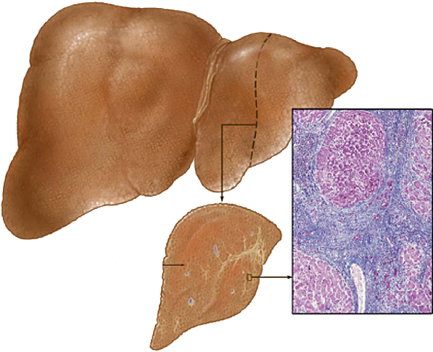





Targeting Pathophysiological Processes
NORMAL LIVER
STEATOSIS
STEATOHEPATITIS
CIRRHOSIS
Targets related to insulin resistance and/or lipid
metabolism
Targets related to lipotoxicity &
oxidative stress
Targets related to inflammation and immune activation
Targets related to cell death
(apoptosis and necrosis)
Targets related to fibrogenesis & collagen turnover
GLP-1: | Liraglutide, Semaglutide
GLP-1/GR/GIP | MEDI0382, BI456906, Tirzepatide, Cotadutide, HM15211
SCD1: | Aramchol
SGLT1/2: | Licogliflozin
FGF21: | Pegbelfermin, Efruxifermin, BIO89-100, BOS-580
THR-β: | MGL-3196, VK2809
FGFR1/KLB | BFKB8488A, MK-3655
MPC | PXL065
Mixed ag-antag GR and antag MR | Miricorilant
FASN Inh | TVB-2640
GHRH analog | Tesamorelin
Berberine/UDCA | HTD1801
DGAT2 Inhib./ACCi | Ervogastat/Clesacostat
DGAT2 Inhib. | ION224
AAs | AXA1125
PPARα/∂/γ | Lanifibranor
PPARα/γ | Saroglitazar
MPC | MSDC-0602K, PXL065
FXR: | OCA, EYP001, MET409, MET462, TERN-101
FGF19: | Aldafermin
Testosterone prodrug | LPCN 1144
Cyclo Inh | CRV431
Structurally Engineered Fatty Acid | Icosobutate
Cyclo Inh
CRV431
Galectin | Belapectin
Cyclo Inh | CRV431
JNK Inh. | CC-90001
GLP1 ag + ACCi + FXR | Semaglutide + Firsocostat + Cilofexor
Phase 3 drugs in red
Some drugs have pleiotropic effects

Slide 37
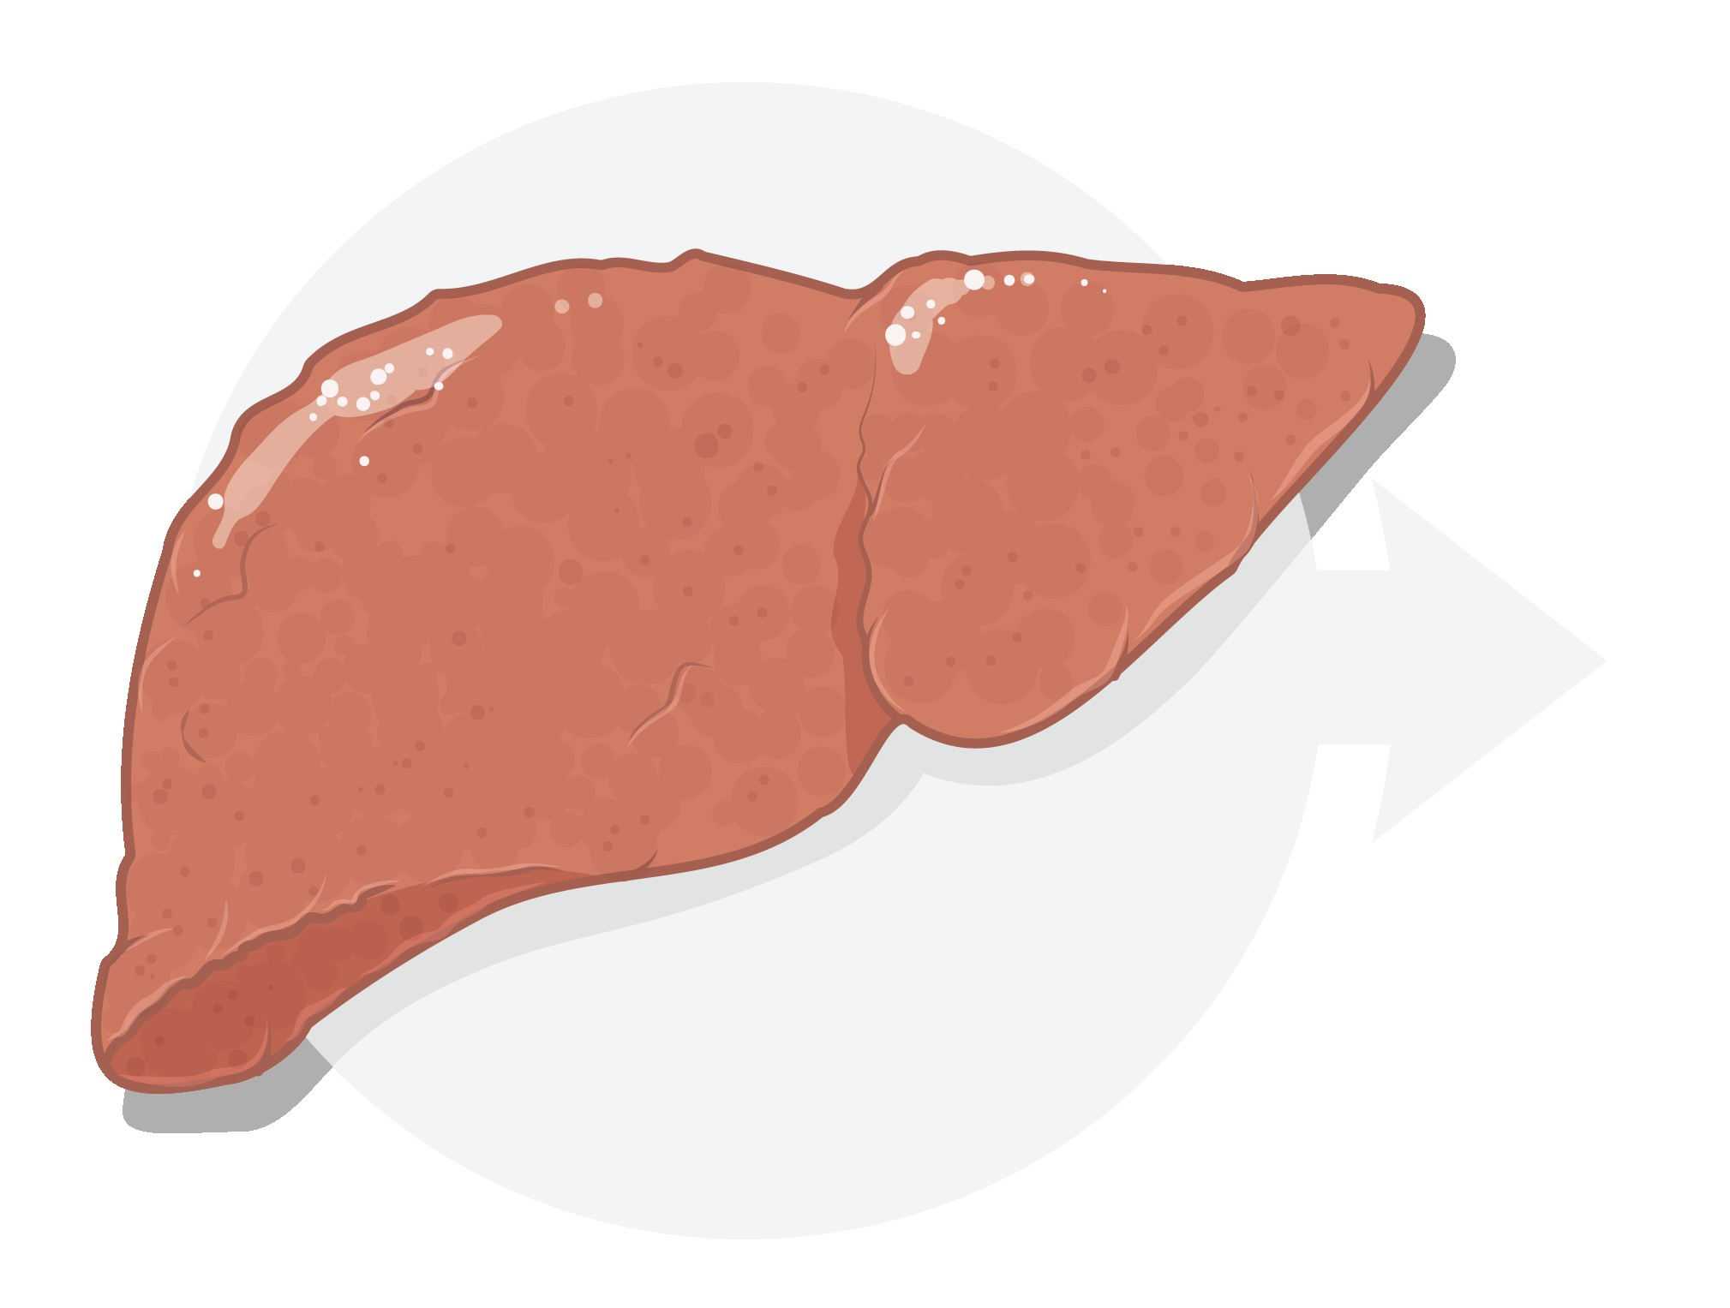
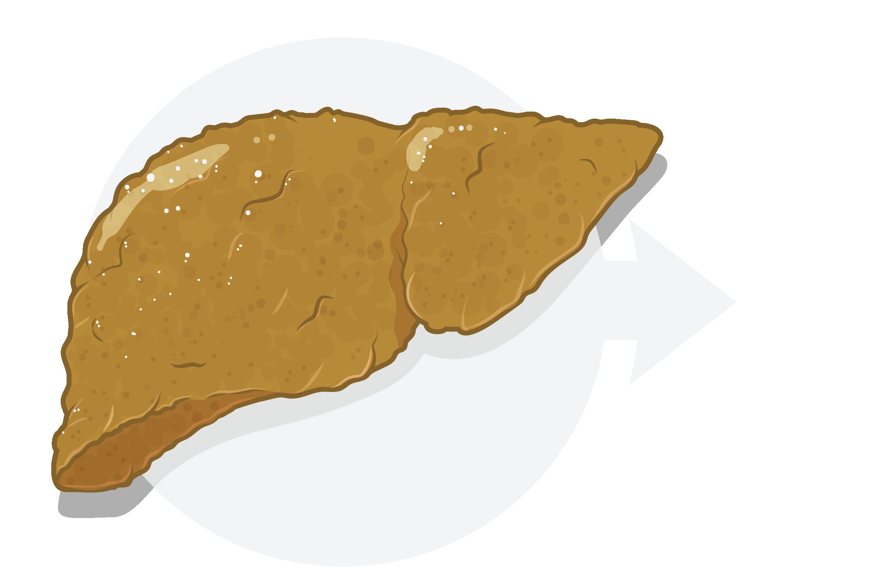

Combination Therapy
F0
F1
F2
Liver Disease Progression
F3
F4
Risk Tolerance
Safety First
Combination Therapy for Noncirrhotic NASH
Combination Therapy for Cirrhotic NASH
Agents with liver fat/metabolic effects
Agents with antifibrotic effects

Slide 38
Ideal Combination
Glycemic control
Atherogenic lipid improvement
Oral
Well tolerated and safe
Synergistic
  Improves histopathology
Weight loss
Improves extrahepatic metabolic profiles
Enhances long term outcomes
Reduction in lipotoxic fat
NASH resolution
Fibrosis improvement

Slide 39
Summary: Drug Development for NASH
As our understanding of NASH pathogenesis improves, the number of targets in NASH drug development continues to expand
Therapies aimed at both histopathology and dysregulated metabolism are ideal
Synergistic combination approaches-potentially overlaid with precision medicine advances may allow for broad application
Current regulatory endpoint challenges exist, but they are not insurmountable-with potential modifications
Data supporting non-invasive tests that demonstrate long term outcome benefit are growing and offer hope for usurping liver biopsy-based endpoints

Slide 40
THANK YOU!
Richard Manch, MD, FAASLD, FACP, FACG drmanch@azliver.com

