Slide 1


Welcome!
RA Mimics:
Other Forms of
Inflammatory Arthritis
Mimi Margaretten, MD
February 16, 2023
RAE Initiative| Spring 2023

Slide 2
DISCLOSURES
AMA Designation Statement
The University of California, San Francisco School of Medicine (UCSF) is accredited by the Accreditation Council of Continuing Medical Education (ACCME) to provide continuing medical education for physicians. UCSF designates this live activity for a maximum of 1 AMA PRA Category 1 Credit™. Physicians should claim only the credit commensurate with the extent of their participation in the activity.
Disclosure Statement
Planners Jennifer Mandal, MD, Leslie Dexheimer Gleason, RN, and Tabitha Carroway, MPH have stated they have no relationships to disclose. Speaker Mimi Margaretten, MD has stated she has no relationships to disclose.
RAE Initiative| Spring 2023

Slide 3
Case 1. 27 yo woman presents in clinic with 3 weeks of morning stiffness & “swelling in my wrists and fingers.” Examination shows symmetric polyarthritis of wrists and PIPs. RF & CCP are negative, CRP 88 mg/L and ESR >120 mm/h. X-rays show soft tissue swelling without erosions. The factor that makes you most suspicious that this is NOT RA is:
Acute time course
Negative RF/CCP
Highly elevated CRP & ESR
No erosions on X-rays
RAE Initiative| Spring 2023
Notes:
Poll Question

Slide 4
Case 1. 27 yo woman presents in clinic with 3 weeks of morning stiffness & “swelling in my wrists and fingers.” Examination shows symmetric polyarthritis of wrists and PIPs. RF & CCP are negative, CRP 88 mg/L and ESR >120 mm/h. X-rays show soft tissue swelling without erosions. The factor that makes you most suspicious that this is NOT RA is:
Acute time course
Negative RF/CCP
Highly elevated CRP & ESR
No erosions on X-rays
RAE Initiative| Spring 2023

Slide 5
Viral Mimics of RA
A number of viral infections can cause acute polyarthritis (rubella, parvovirus B19, acute Hepatitis B).
RF can be positive with infections (i.e. chronic HCV) but anti-CCP negative.
Remember to be suspicious with RF+/CCP- (only 5% of RA).
RAE Initiative| Spring 2023

Slide 6
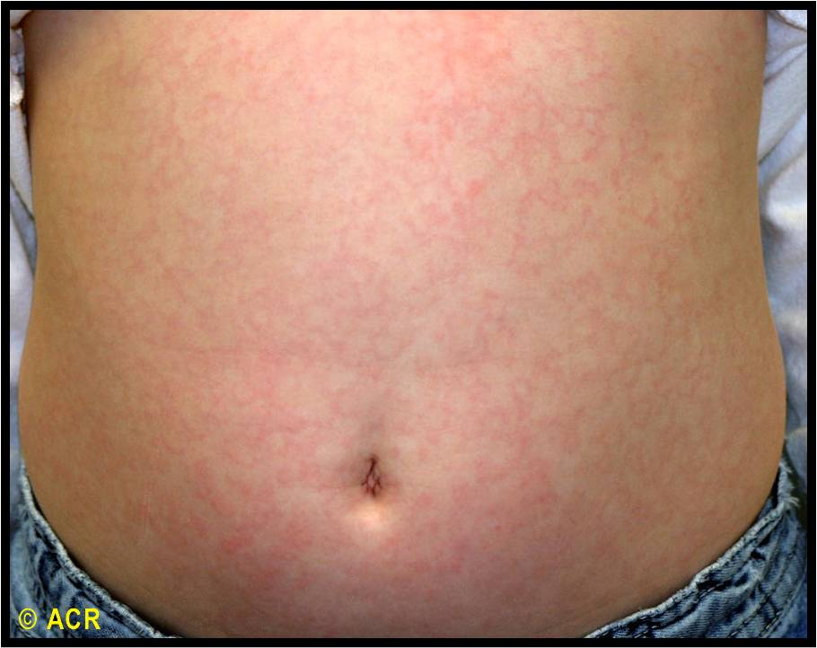
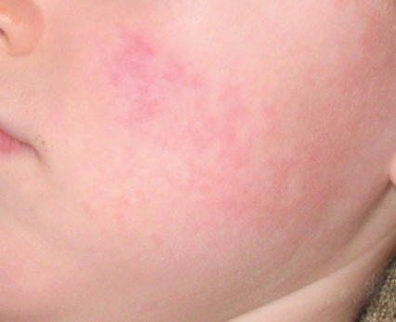
Case 1. con’t. You obtain more history from the patient and she tells you that two of her 3 children were home from school a few weeks ago for a febrile illness and rash.
RAE Initiative| Spring 2023

Slide 7
Viral Mimics of RA
Human parvovirus B19, responsible for erythema infectiosum or Fifth disease in children, can cause inflammatory arthritis in adults.
Although the median duration of Parvo B19 arthritis is 10 days, some patients may have arthritis considerably longer, leading to confusion with RA.
RAE Initiative| Spring 2023

Slide 8
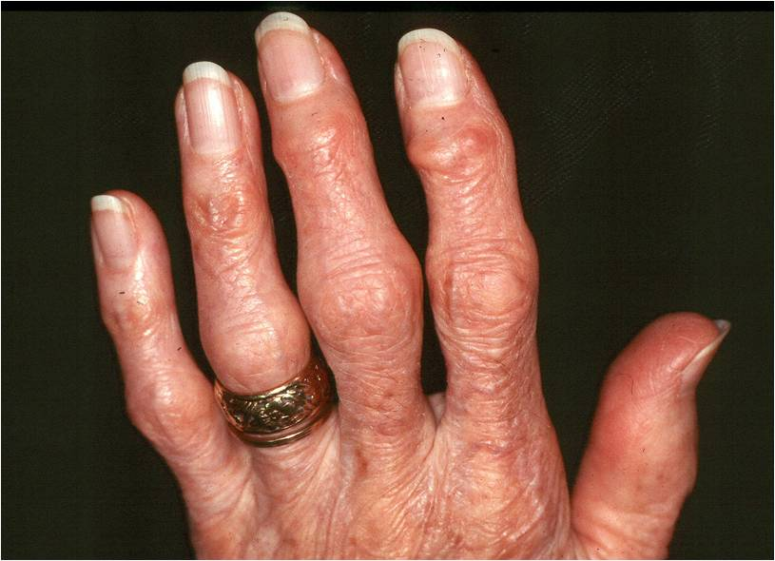
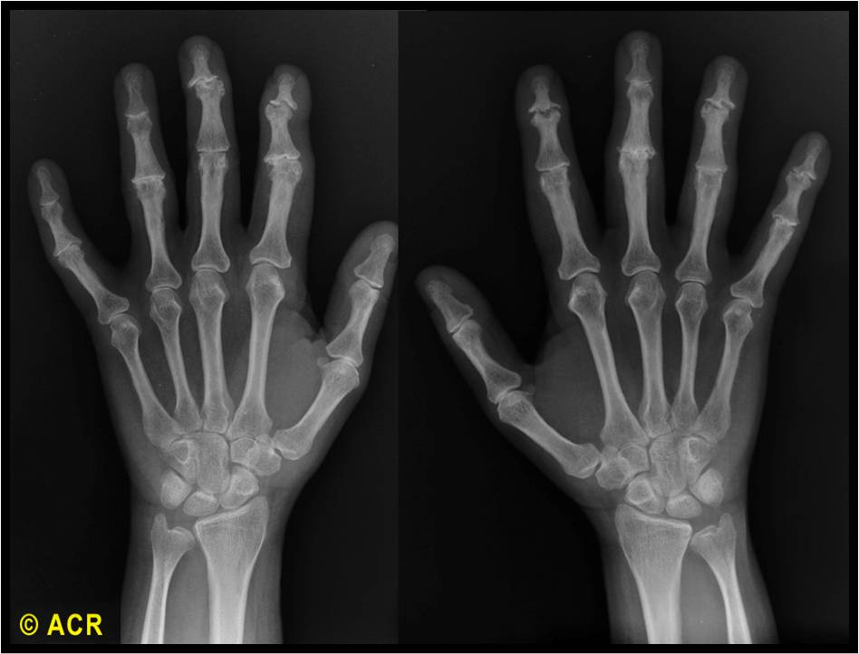
Case 2. 62 yo man presents with 8 months of stiffness & “pain & swelling in my fingers and knees.” Exam shows symmetric polyarthritis of PIPs & DIPs & R>L knee effusions. RF-/CCP-. X-rays report “erosions.” The factor that makes you most suspicious that this is NOT RA is:
Age and gender of patient
Chronic time course
DIP involvement
Knee involvement
Negative RF/CCP
RAE Initiative| Spring 2023
Notes:
Poll Question

Slide 9
Case 2. 62 yo man presents with 8 months of stiffness & “pain & swelling in my fingers and knees.” Exam shows symmetric polyarthritis of PIPs & DIPs & R>L knee effusions. RF-/CCP-. X-rays report “erosions.” The factor that makes you most suspicious that this is NOT RA is:
Age and gender of patient
Chronic time course
DIP involvement
Knee involvement
Negative RF/CCP
RAE Initiative| Spring 2023
Notes:
Poll Question

Slide 10
RA vs. OA
Feature | Rheumatoid Arthritis | Osteoarthritis
Primary Joints Affected | Wrists, MCPs & PIPs | 1st CMC (base of thumb), PIPs & DIPS
Bouchard/Heberden Nodes | Absent | Often present
Joint Characteristics | Soft, warm tender | Hard and Bony
Stiffness | Worse after resting (i.e. morning) | If present can be in evening
Lab Findings | Often +RF/+CCP, elevated ESR & CRP | Normal ESR & CRP
RAE Initiative| Spring 2023

Slide 11
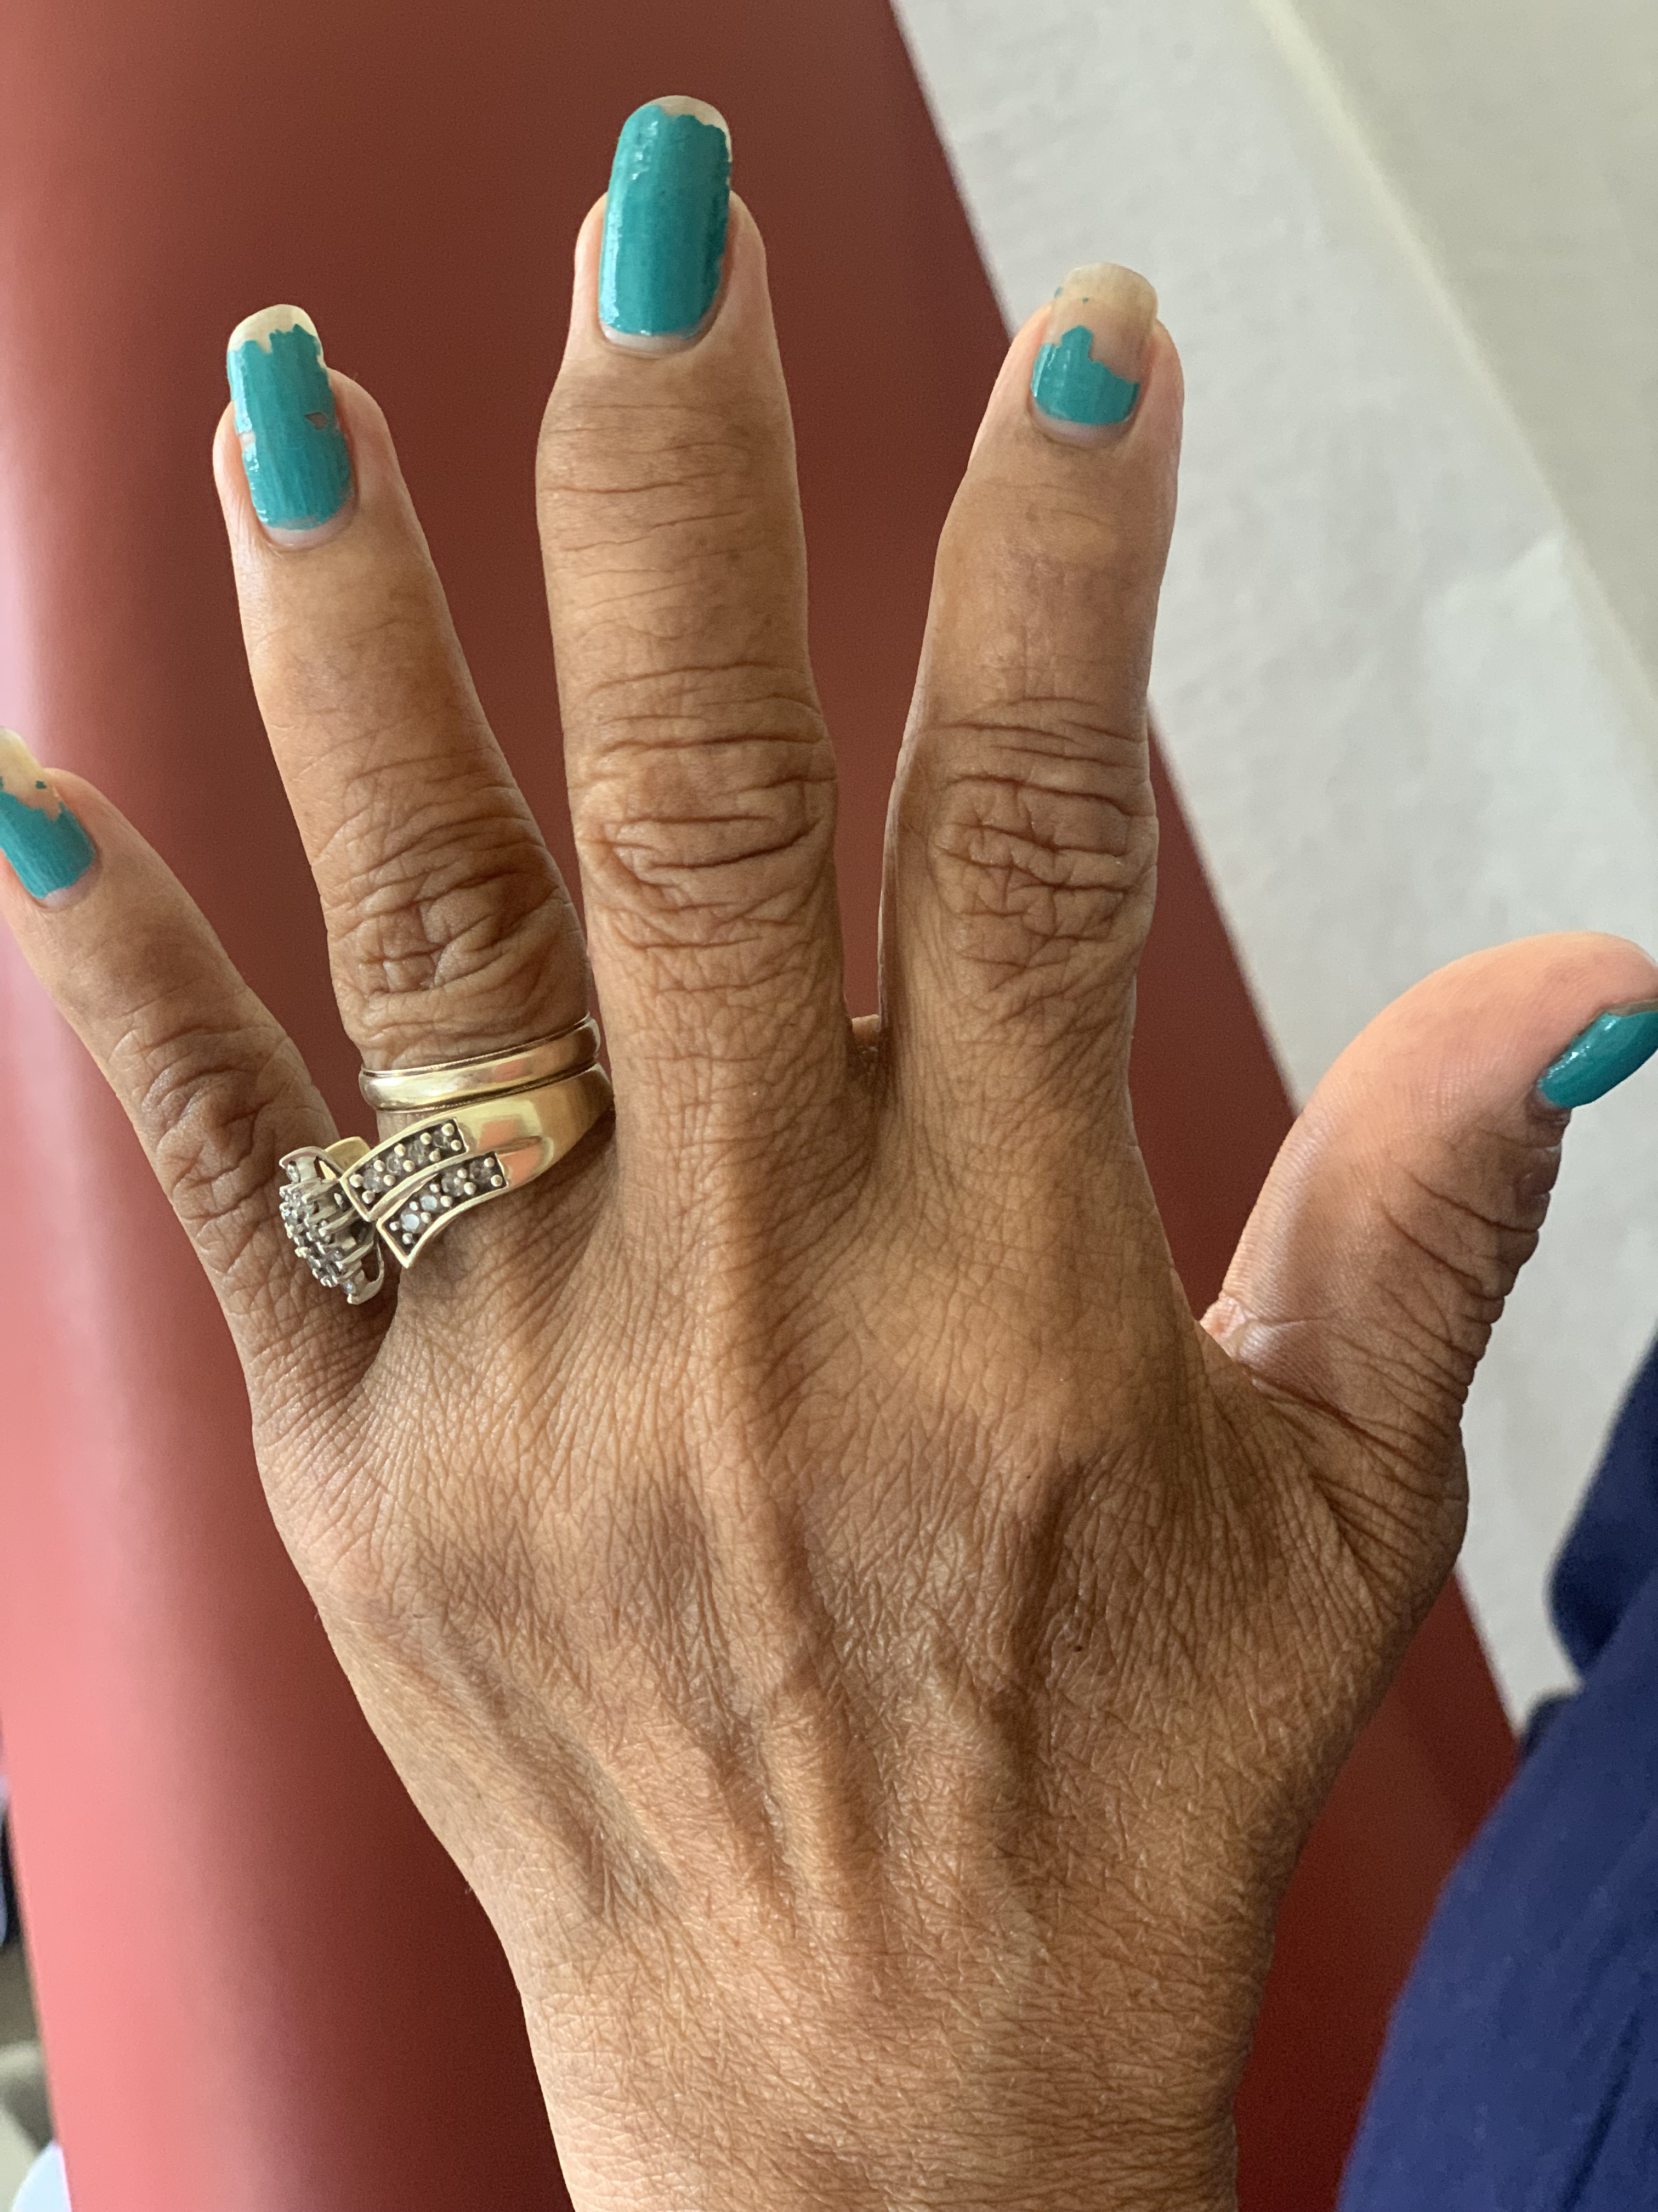
Case 3. 44 yo woman presents in clinic with 8 weeks of morning stiffness, foot pain, & “swelling in my L middle finger & R knee.” Exam shows R knee effusion, L 3rd swollen finger, and tenderness with heel squeeze. RF & CCP are negative, CRP 88 mg/L and ESR >120 mm/h. X-rays show soft tissue swelling without erosions. The factor that makes you most suspicious that this is NOT RA is:
Knee involvement
3rd finger swelling and heel tenderness
Negative RF/CCP
Highly elevated CRP & ESR
RAE Initiative| Spring 2023
Notes:
3rd finger = dactylitis and heel squeeze is enthesopathy

Slide 12
Case 3. 44 yo woman presents in clinic with 8 weeks of morning stiffness, foot pain, & “swelling in my L middle finger & R knee.” Exam shows R knee effusion, L 3rd dactylitis, and tenderness to heel squeeze. RF & CCP are negative, CRP 88 mg/L and ESR >120 mm/h. X-rays show soft tissue swelling without erosions. The factor that makes you most suspicious that this is NOT RA is:
Knee involvement
Dactylitis and enthesopathy
Negative RF/CCP
Highly elevated CRP & ESR
RAE Initiative| Spring 2023
Notes:
Enthesopathy = inflammation at the site where a tendon inserts into a bone, i.e. the insertion point of the Achilles tendon into the calcaneus

Slide 13
Case 3 con’t. You obtain more history and learn that she endorses low back pain for years s/p car accident, an episode of food poisoning 1 month ago with vomiting and bloody diarrhea that resolved after 3 days, and a dry rash on her elbows that “comes and goes.” Most likely she has:
Ankylosing Spondylitis
Psoriatic Arthritis
Reactive Arthritis
IBD associated Arthritis
RAE Initiative| Spring 2023
Notes:
Enthesopathy = inflammation at the site where a tendon inserts into a bone, i.e. the insertion point of the Achilles tendon into the calcaneus

Slide 14
Case 3 con’t. You obtain more history and learn that she endorses low back pain for years s/p car accident, an episode of food poisoning 1 month ago with vomiting and bloody diarrhea that resolved after 3 days, and a dry rash on her elbows that “comes and goes.” Most likely she has:
Ankylosing Spondylitis
Psoriatic Arthritis
Reactive Arthritis
IBD associated Arthritis
RAE Initiative| Spring 2023
Notes:
Enthesopathy = inflammation at the site where a tendon inserts into a bone, i.e. the insertion point of the Achilles tendon into the calcaneus

Slide 15
Reactive Arthritis
Reactive arthritis = arthritis that develops after (rarely during except for Chlamydia trachomatis) an infection elsewhere in the body, but in which the organism cannot be recovered from the joint.
Interval between the antecedent infection and arthritis ranges from several days to weeks.
Causative GI, urogenital, & upper respiratory pathogens:
Chlamydia trachomatis, Yersinia, Salmonella, Shigella, Campylobacter, E coli., C. diff, & Chlamydia pneumoniae
The following are more consistent with reactive arthritis than RA:
History of recent urethritis or enteric infection
Asymmetric pattern of joint involvement
Symptoms or signs of enthesopathy
Keratoderma blennorrhagica or circinate balanitis
Radiologic evidence of sacroiliitis and/or spondylitis
The presence of human leukocyte antigen (HLA)-B27
RAE Initiative| Spring 2023

Slide 16
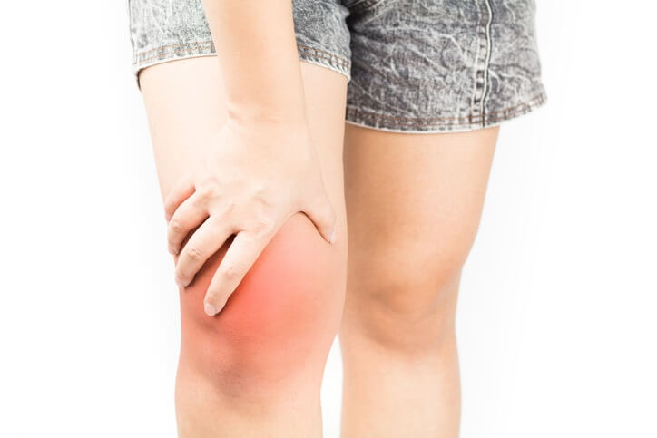
Case 4. A 38 yo woman with RF+/CCP+ RA on MTX and Humira comes to clinic for routine f/u. She reports L knee pain and swelling. Exam shows:
Wrists/hands: unchanged ↓flexion of wrists and swan neck deformities without synovitis.
Left Knee: Erythema, warmth, & decreased range of motion with a moderate effusion
Feet: no MTP tenderness to squeeze
Next step . . .
RAE Initiative| Spring 2023
Notes:
Mimic in a Patient with known RA

Slide 17
Next step = arthrocentesis for synovial gram stain, culture, cell count, crystal ID)
Monoarticular inflammatory arthritis in an immunosuppressed patient with RA is infection (septic arthritis) until proven otherwise
After you rule out septic arthritis with negative synovial culture then you can treat “RA flare”
Risk factors for septic arthritis include:
Pre-existing joint disease
Immunosuppression
Knee is involved > 50% of the time
S. aureus is most common pathogen
Treatment = joint drainage + IV antibiotics
“Do not treat an infection with steroids”
RAE Initiative| Spring 2023
Notes:
Mimic in a Patient with known RA

Slide 18
Case Presentation
RAE Initiative| Spring 2023

Slide 19

CME Credit Link
RAE Initiative| Spring 2023
Notes:
https://ucsf.co1.qualtrics.com/jfe/form/SV_83and0CnmxLjZJA

