Slide 1
Sepsis in EMS
Neal Nettesheim MD, MS FAAEM
UNM EMS FELLOW

Slide 2
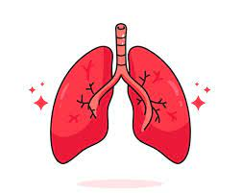
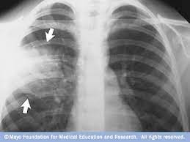
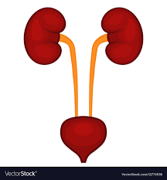
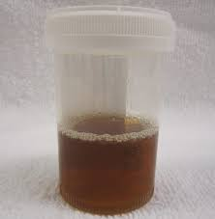
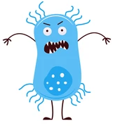
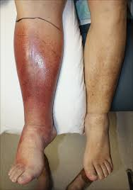
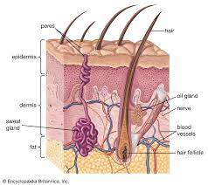
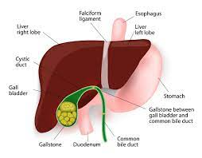
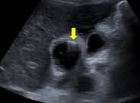

Slide 3
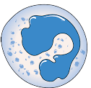
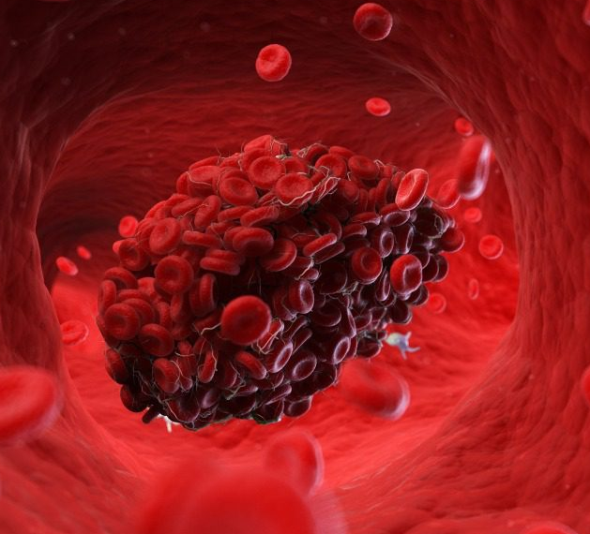
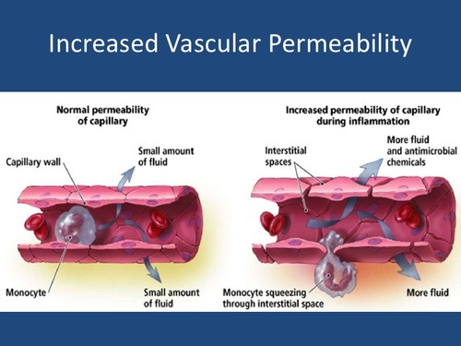

Recruit White Blood Cells
Tiny Blood Clots
CYTOKINES
Increase Capillary Permeability

Slide 4

Blood Flow
Lactic Acid Production
Cell Death
Oxygen
Increase Respiratory Rate
What happens to the blood pressure in that blood vessel
UP or DOWN?

Slide 5


Blood Flow
Heart Rate to maintain same pressure
Oxygen
Blood Pressure

Slide 6
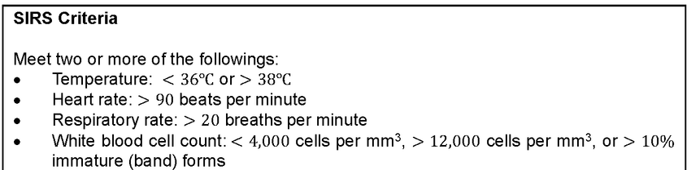
Sepsis Diagnosis
SEPTIC SHOCK: Mean Arterial Pressure <65mmHG or Elevated Lactate after being given Fluid bolus

Slide 7
Sepsis Differential Diagnosis
Pulmonary Embolism
Congestive Heart Failure
Anemia
Bleeding
DVT
Pneumothorax
Broken Bones
Sprained Joints
Dehydration
Vomiting/Diarrhea
Kidney Failure
Heat Stroke
Burns
Hypothermia
Pericardial Effusion
MANY, MANY MORE

Slide 8

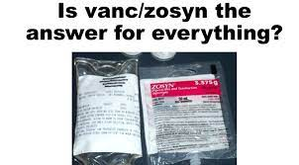
Sepsis Treatment- Antibiotics
Antibiotics are not very common for many EMS agencies
Sepsis can be a challenging diagnosis to make sometimes
Antibiotic Stewardship
Does it save lives to give early antibiotics?

Slide 9
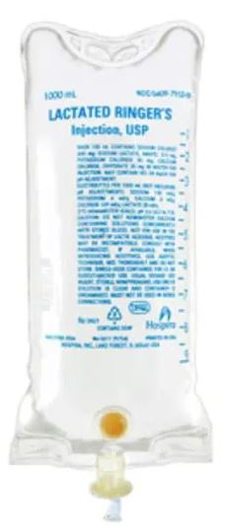
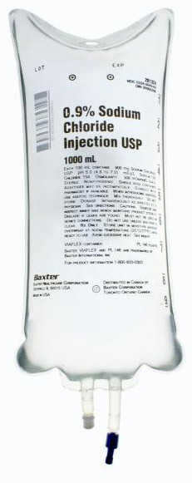
Sepsis Treatment- Fluids
- Replacing lost fluids
- Restoring the pressure that was lost

Slide 10
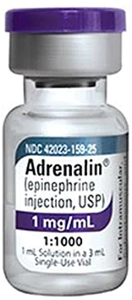
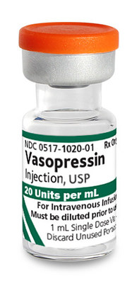
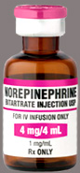
Sepsis Treatment- Vasopressors

Slide 11
Sepsis Takeaways
-Fluids treats sepsis
-Forewarned is forearmed; communicating that this patient may be septic is valuable to the receiving hospital

