Slide 1
Diabetes Foot Exam
Team-based Care
Presented by:
Carol Greenlee, MD MACP
January 31, 2023

Slide 2

Part of Team Care:
Help with Foot Exams & Teach Foot Care

Slide 3
Pre-Question
1) The Annual Foot Exam should include
  Checking blood flow in the pulses in the foot and ankle
  Checking for loss of protective sensation (LOPS)
  Checking for deformities
  Checking for any lesions
  All the above
  A
  A and B
  B and C
  C and D
  B, C and D

Slide 4
Pre-Question
2) Signs of poor blood flow to the feet can include
  Warm and pink feet
  Pale, cool to touch skin
  Waxy or Shiny skin
  Loss of hair from toes & feet
  All the above
  A
  A and B
  A and C
  B and C
  B, C and D

Slide 5
Pre-Question
3) Ulcers put the foot at risk for amputation; What puts the foot at risk for ulcers
  Loss of Protective Sensation (LOPS)
  Foot Deformities
  Prior amputation
  Well lubricated skin
  A & B
  A & C
  A & D
  A, B & C
  All the above

Slide 6
Why do foot exams in our patients with diabetes?
To determine if foot is safe or at risk (risk assessment)
Hoping to help prevent foot ulcers and amputations in our patients
Goal = to help our patients with diabetes stay healthy –
Reduce complications & improve outcomes

Slide 7

Be ready to learn….
Be engaged
Be willing to try
Be willing to get feedback & coaching
Be willing to practice techniques
Be energized to help provide care to your patients
Be energized to help prevent foot ulcers & amputations
Recommend Medical Assistants/Nursing practice on each other and/or on clinicians
Clinicians help guide exam & feedback

Slide 8
Why are feet at risk for people with diabetes?
Neuropathy
  Loss of feeling (numbness)
  Loss of temperature sensation or abnormal sensation (feet “feel” cold)
  Loss of skin oil (dryness)
  Deformity prone-abnormal “rub” points
  Abnormal gait
Reduced blood flow
  Nutrition for tissues (O2 and nutrients)
  Ischemic changes / Gangrene
Impaired Immunity
  WBC can’t do their job when BG is high

Slide 9
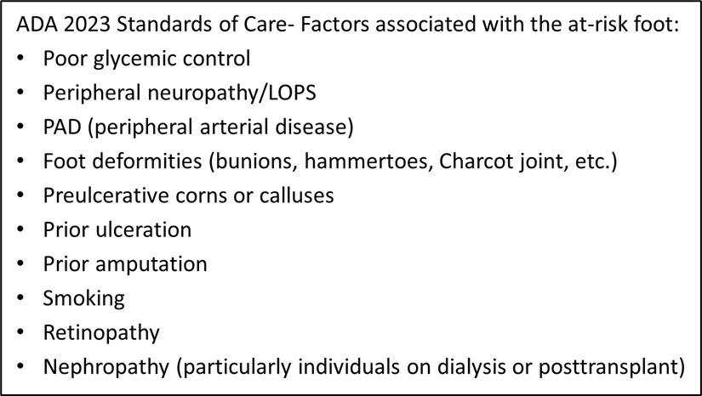
Why are feet at risk for people with diabetes?

Slide 10
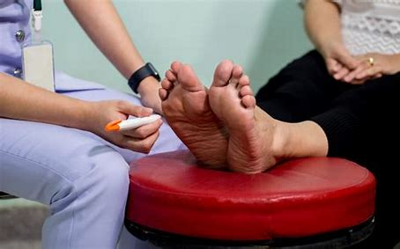
The Foot Exam
Check for symptoms of peripheral neuropathy
  Allodynia: unusual sensitivity or tenderness
  Tingling, prickly
  Pain: burning, sharp or shooting pain
  Numbness
Foot Exam
  Inspection (Deformities, lesions, infection)
  Circulation/pulses (blood flow)
  Vibration sensation
  Pressure/protective sensation
3. Review Footwear
  Appropriate wear
  Fit and size
Foot Exam Components
Musculoskeletal
Dermatologic
Vascular
Neurologic

Slide 11
Background – Clinical caveats -Lack of symptoms &/or signs
25–30% of people with diabetes will experience peripheral neuropathy pain (as a sign of early disease – small fiber damage – exam often normal) – usually this pain
  is burning, lancinating, tingling, or shooting (electric shock–like)
  is typically worse at night
~50% of people with diabetic peripheral neuropathy do not have pain symptoms – requires exam to detect that they have neuropathy
Just because they don’t have neuropathy pain doesn’t mean they don’t have neuropathy
They can have loss of feeling (insensate feet- loss of the “gift of pain”) – vulnerable to damage
See didactic on Diabetic Peripheral Neuropathy https://youtu.be/2RQyNLot8Ss

Slide 12
Post-Question
1) The Annual Foot Exam should include
  Checking blood flow in the pulses in the foot and ankle
  Checking for loss of protective sensation (LOPS)
  Checking for deformities
  Checking for any lesions
  All the above
  A
  A and B
  B and C
  C and D
  B, C and D

Slide 13
Why We do FOOT EXAM: to find out if FOOT is SAFE or AT RISK
Start with Inspection:
  Look from thighs or knees down, if possible →look between toes
  General foot hygiene (dirt, paper stuck to feet, etc.)
  Loss of hair
  Nails (thick, discolored, long, ingrown)
  Dry skin, cracks
  Deformities (previous amputation, bunions, hammertoes, etc.)
  Lesions (callouses, ulcers)
  Footwear (worn areas, fit, etc.)
  Gait (watch patient walk, can watch as the walk into room)
    Abnormal shoe wear/pressures
    Increased Fall Risk with diabetes…is the Patient safe as well as is their foot safe

Slide 14
Why We do FOOT EXAM: to find out if FOOT is SAFE or AT RISK
Check for deformity (Musculoskeletal [Orthopedic] exam)
  Prior amputations – very high-risk foot
  Claw foot/ Hammer-toe (toes rub on top of shoes)-need extra depth
  Lack of padding on bottom of foot bones (need extra thick soles)
  Other (Bunions, Rocker bottom/ Charcot deformity)

Slide 15
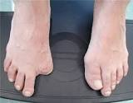
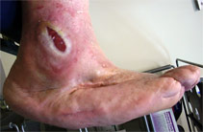
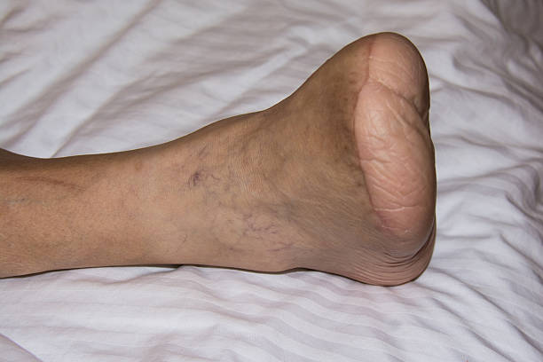
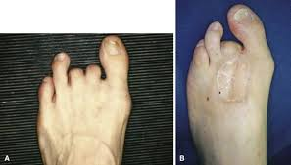
Check for Deformity: prior amputations
Prior amputation = HIGH RISK foot
Notes:
Ask about prior amputations – also inspect for any associated raw or breakdown areas

Slide 16
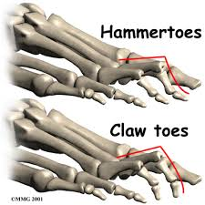
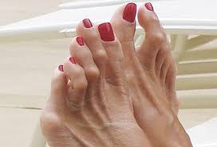
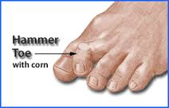
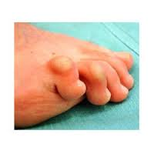
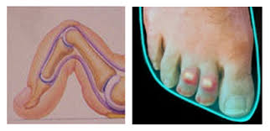
Hammer toes & Claw toes
Due to an imbalance in the muscles,
tendons or ligaments that normally
hold the toe straight
Worsened by foot cramped in shoe
Notes:
due to an imbalance in the muscles, tendons or ligaments that normally hold the toe straight (neuropathy can cause atrophy of small muscles in the foot)– can also be worsened by shoes that are too short and cramp the toes – with the deformity, the tops of toes can rub so need deeper shoe

Slide 17
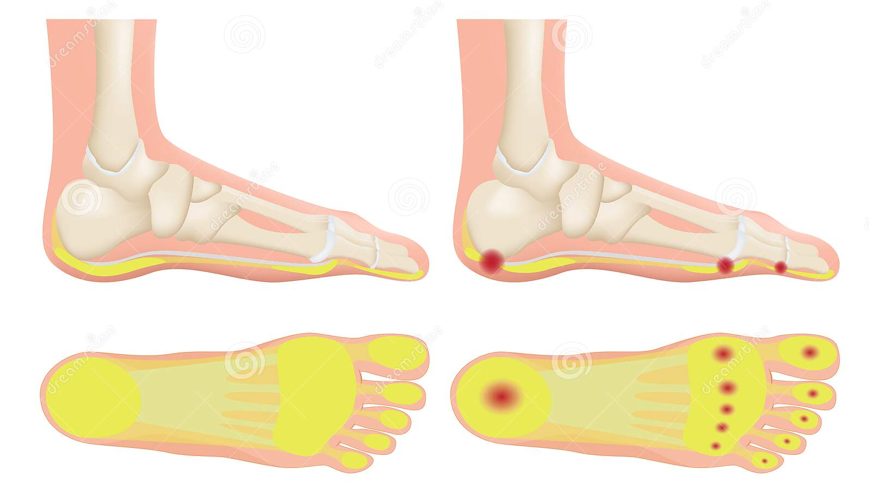
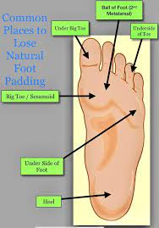
Fat Pad Atrophy
Due to age, abnormal pressure on foot,
improper or no footwear &
effects of neuropathy, deformity

Slide 18
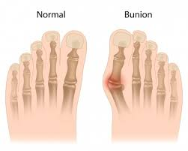
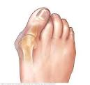
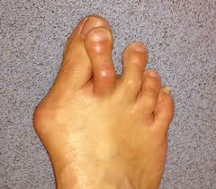
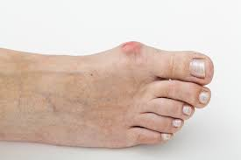
Bunion
Usually caused by prolonged pressure
compressing the foot (footwear/shoes)

Slide 19
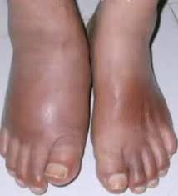
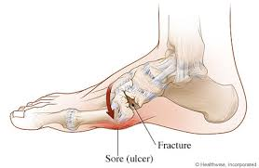
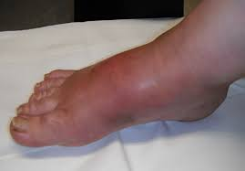
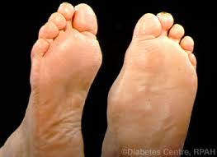
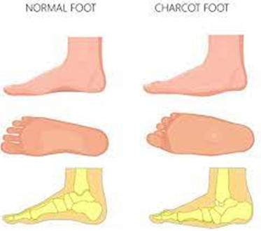
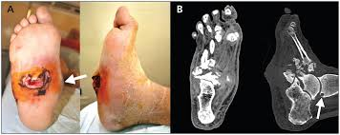
Charcot Foot: Acute & Chronic
Acute Charcot Foot
Red
Swollen
Hot
Chronic Charcot Foot
Rocker – bottom foot

Slide 20
Why We do FOOT EXAM: to find out if FOOT is SAFE or AT RISK
Inspection:
Check for deformity (Musculoskeletal [Orthopedic] exam)
  Claw foot (toes rub on top of shoes)-need extra depth
  Lack of padding on bottom of foot bones (need extra thick soles)
  Other (Bunions, Rocker bottom)
Check for “lesions” (Dermatologic exam)
  Toenail changes
  Dry skin, cracks and fissures, peeling
  Red areas, raw areas, blisters, callouses
  Ulcers

Slide 21
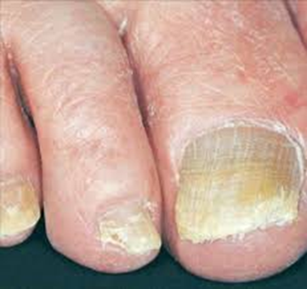
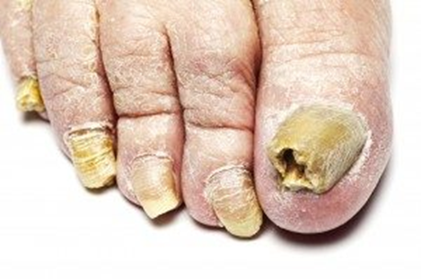
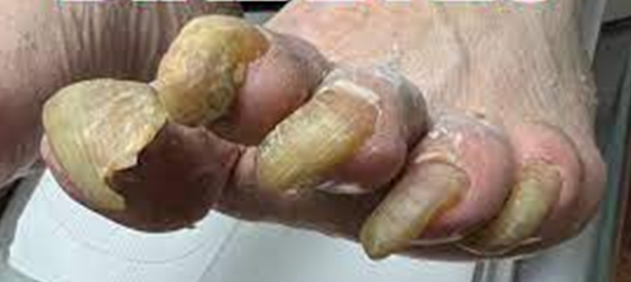
Toenail Changes
Changes due to
  age
  neuropathy/trauma
  reduced blood flow
  increased susceptibility to fungal infections
https://blog.wcei.net/diabetic-toenails-watch-for-change
https://blog.wcei.net/diabetic-toenails-top-tips-for-proper-trimming

Slide 22
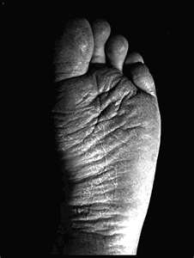
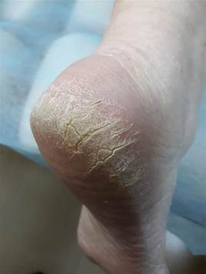
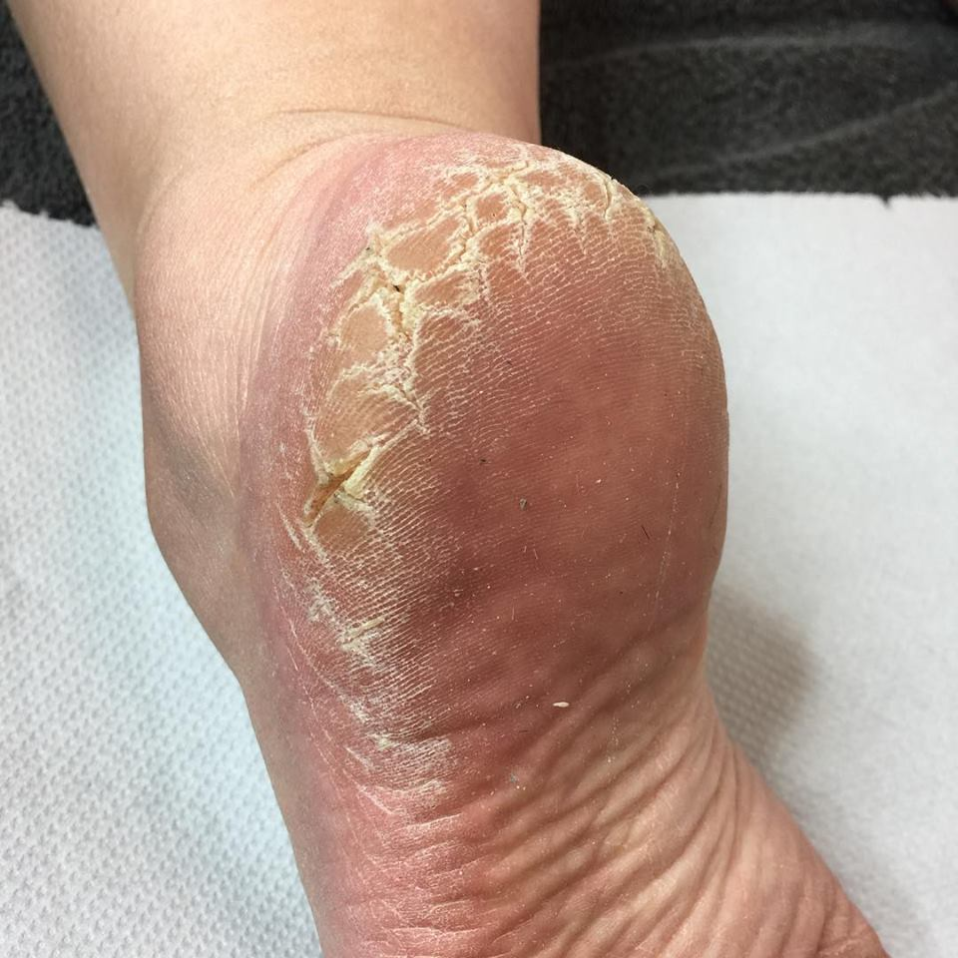
Dry cracked skin
https://blog.wcei.net/dry-skin-alert-foot-xerosis-in-diabetic-patients

Slide 23
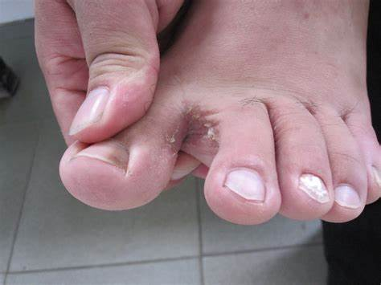
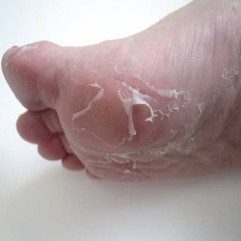
Check Skin for Peeling
Peeling on foot
can be due to dry skin, sweaty feet
or conditions such as fungus (athlete’s foot)
or eczema
Peeling between toes
Can be due to maceration or fungus
Notes:
Loss of skin barrier – more susceptible to damage (pressure, breakdown) and infection

Slide 24
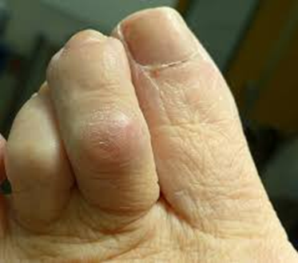
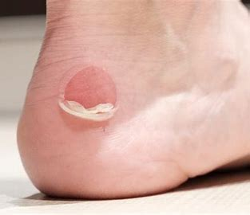
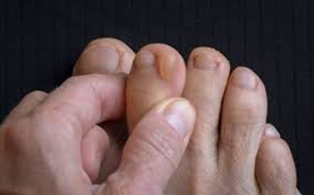
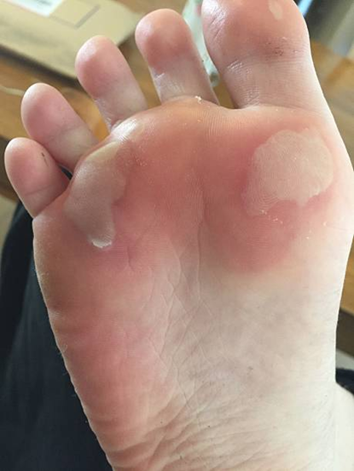
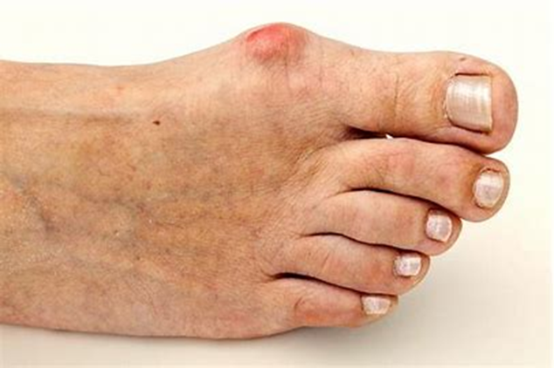
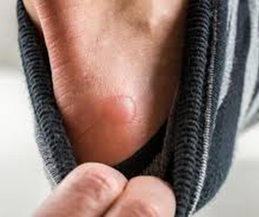
Red or Raw Spots & Blisters
Something is rubbing – check the socks & shoes…

Slide 25
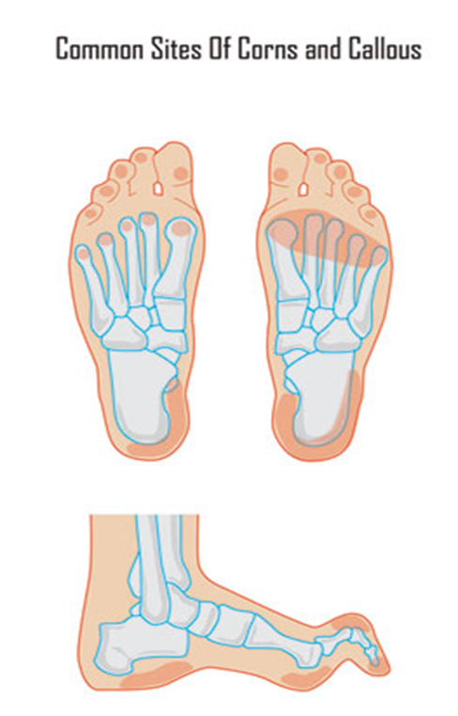
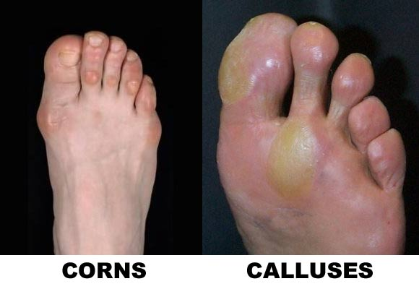
Check for Lesions
Notes:
Corns and calluses are thick, hardened layers of skin that develop when the skin tries to protect itself against friction or pressure. With combo of claw toes and atrophy of plantar fat pads, can get rubbing on top of toes and increased pressure on ball of foot and/or heel – this would normally cause pain when barefoot or thin sled shoes but with LOPS cannot detect and can result in calluses and ulcers. Fat pad atrophy can occur/worsen with aging, prolonged standing high-heel shoes or shoes that are too tight as well as diabetes

Slide 26
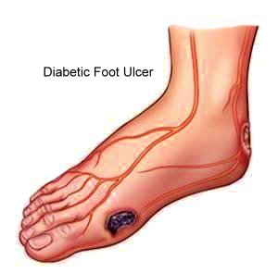
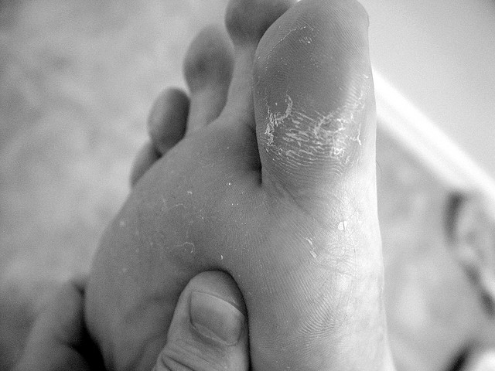
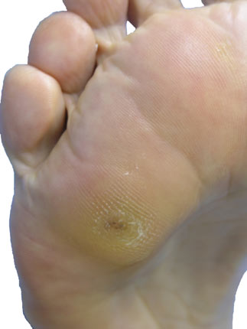
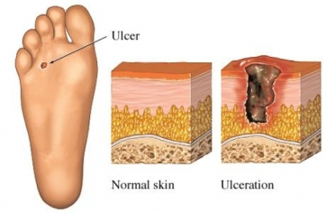
Check for “lesions”
Callouses with bleeding Ulcers
Notes:
As the callus builds up, it can cut off the blood supply to the skin below and damage the skin. The result can be a sore or an ulcer. Pain or bleeding is an indication that the deeper layers of skin have been affected. Ignoring these symptoms may result in otherwise avoidable complications, such as infection or ulceration
https://www.verywellhealth.com/corns-and-calluses

Slide 27
Why We do FOOT EXAM: to find out if FOOT is SAFE or AT RISK
Check for signs of Infection
  Fungus
  Ulcer (red streaks, pus)
    Not all ulcers are infected

Slide 28
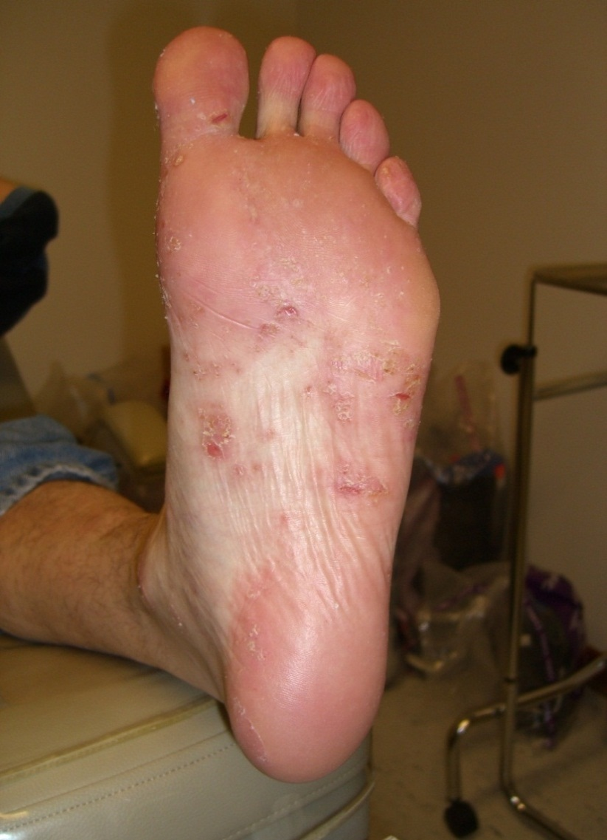
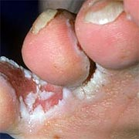
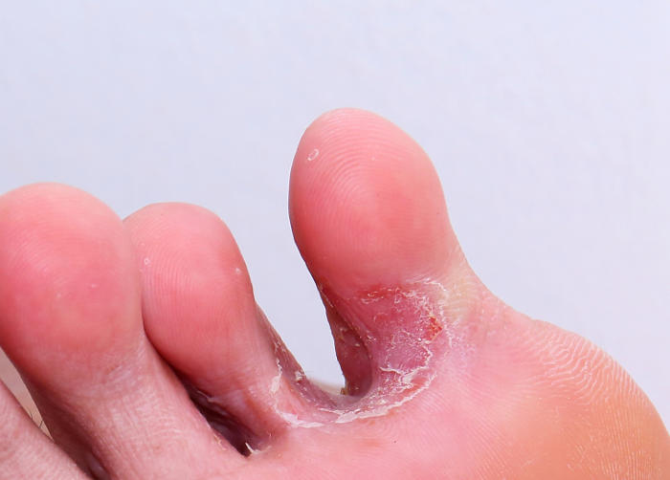
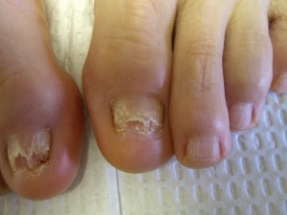
Foot Fungus

Slide 29
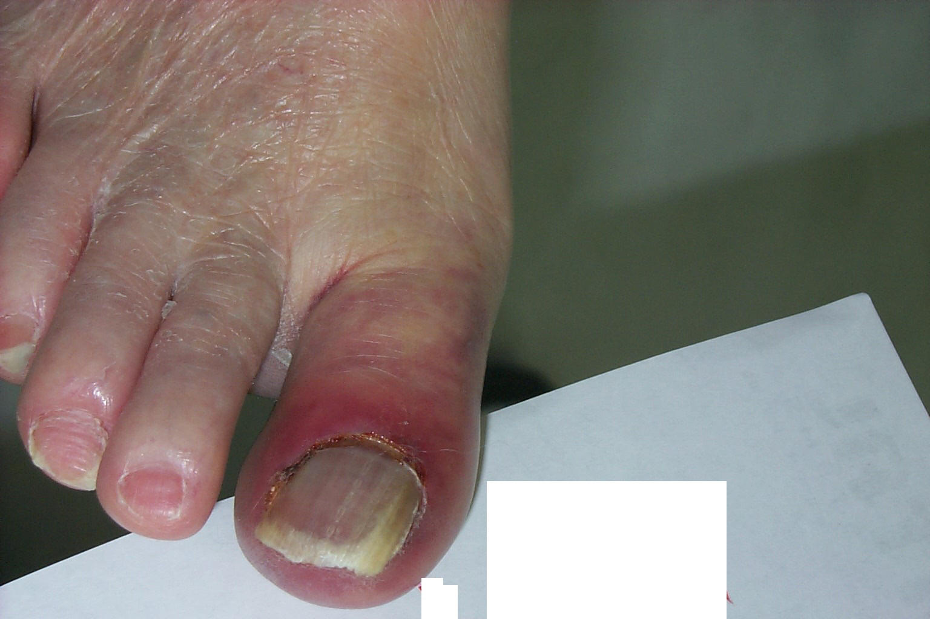
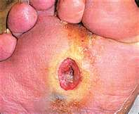
Bacterial Infection

Slide 30
Practice Session
Look for Deformities
Look for Lesions
Inspect both feet and note
Post-amputation changes
Deformities
  Hammer toes/ claw foot
  Bunion
Padding under metatarsals & heel (adequate or decreased)
Rocker bottom foot
Other
Red spots
Raw spots, blisters, cracks, tears in skin
Maceration between toes
Callouses
  Bleeding in callous
Ulcers
Bleeding
Peeling
Burns
Black area
Nail changes
Do shoes fit, what shape are shoes in*
Notes:
* More detail on upcoming Tribal Diabetes ECHO session – also see videos at end of slide deck -- if you see deformities or skin lesions very important to check shoes

Slide 31
Why We do FOOT EXAM: to find out if FOOT is SAFE or AT RISK
Check blood flow (Vascular exam)
  Pulses
    Dorsalis Pedis (top of foot next to extender tendon from great toe)
    Posterior Tibialis (behind inside (medial) ankle bone)
  Signs of reduced blood flow
    Cold (vs warm) to touch
    Loss of hair
    Waxy skin or shiny (“atrophic”)
    Pale skin when foot elevated – “dependent rubor” (dusky) when foot down

Slide 32
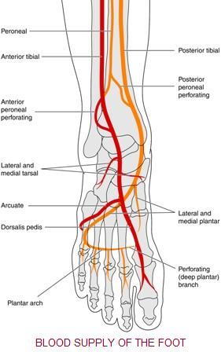


Check for Pulses

Slide 33

Post-Question
Signs of poor blood flow to the feet can include
  Warm and pink feet
  Pale, cool to touch skin
  Waxy or Shiny skin
  Loss of hair from toes & feet
  All the above
  A
  A and B
  A and C
  B and C
  B, C and D

Slide 34
Practice Session: Check for Blood Flow
Note temperature of feet
Note coloring of skin
Note texture of skin
Check Dorsalis Pedis (DP) and Posterior Tibialis (PT) pulses on each foot

Slide 35
Why We do FOOT EXAM: to find out if FOOT is SAFE or AT RISK
Check for Loss of Protective Sensation (LOPS) (Neurologic exam)
ADA Standards of Care recommends
  10-gram Monofilament in 4 (3-5) locations plus 1 other test
    Temperature or pinprick
      Can use tuning fork or other metal item as a cold object
    Vibration (128 Hz tuning fork)
    Ankle reflexes
  One or more abnormal tests would suggest LOPS, while at least two normal tests (and no abnormal test) would rule out LOPS.
  Note - this is not testing for early diabetic peripheral neuropathy – see https://youtu.be/2RQyNLot8Ss

Slide 36
ADA 2023 Standards of Care
Recommends “assessment for LOPS using the 10-g monofilament along with at least one other neurological assessment tool”
For this training we will focus on 10-gram Monofilament & vibration sensation
  If do not have monofilaments -
    recommend using the Ipswich touch test (IpTT)
  If do not have the correct tuning forks (128 Hz) –
    use temp or pinprick
Notes:
Hearing can be assessed with a 512-Hz tuning fork

Slide 37


The 10-g Semmes-Weinstein Mono­filament

Slide 38

https://diabetesjournals.org/care/article/34/7/1517/38624/The-Ipswich-Touch-TestA-simple-and-novel-method-to
CARE / EDUCATION / NUTRITION / PSYCHOSOCIAL RESEARCH| JUNE 17 2011
The Ipswich Touch Test: A simple and novel method to identify inpatients with diabetes at risk of foot ulceration
The IpTT involves lightly touching/resting the tip of the index finger for 1–2 s on the tips of the first, third, and fifth toes and defined neuropathy as ≥2 insensate of the 6 sites.
Examiners should not to push, prod, tap, or poke because this may elicit a sensation other than light touch.
With eyes closed, subjects are instructed to say yes whenever they feel the touch.
Notes:
https://diabetesjournals.org/care/article/34/7/1517/38624/The-Ipswich-Touch-TestA-simple-and-novel-method-to

Slide 39


Practice Session : Testing Pressure Sensation for LOPS
Place Monofilament (wire) on sole of foot, press until slight bend / curve
  Let patient know it is very light pressure - show them on their hand or arm first, so they know how light it is
  Ask patient to close their eyes
  Ask the patient to tell you when they feel something and where they feel it – move randomly among spots
  Another suggestion: touch spot twice and ask “do you feel it now? Or now?”
Test on bottom of forefoot in 4 spots for each foot (at least 3-5 spots)
If abnormally thick skin or callouses – test other sites or use another test
Notes:
Patients want to do well when we “test” them – use word “check” – many people try to guess when they can’t feel for sure –by using methods to try to reduce guessing, we are not trying to trick them but trying to get accurate assessment

Slide 40

Practice Session
Notes:
See the Global Health Media video for example of this test being performed – good to know how to use it – it is equivalent to monofilament in identifying at-risk foot

Slide 41



Checking Vibration (128 Hz)
Demonstrate on wrist or
forearm bone so patient
aware of vibration
sensation vs just sensation
of touch
With patient’s eyes closed
Test on top of great toe.
If can feel at great toe – no
need to test other sites
Might have reduced (not totally absent)
vibration sensation
If vibration sensation is absent
at great toe, test at ankle. *
If absent at ankle move to
shin bone, then kneecap
Notes:
Be sure they tell you if they feel vibration, not just touch or temp – if they can’t feel vibration at all at the toe move to ankle bone - *if absent at toe & ankle, you know patient has a high-risk foot - recommend have clinician perform testing beyond the ankle// many patients will have impaired vibration sensation but not total loss – they stop feeling the vibration while you still feel it – this still indicates large fiber damage and is an abnormal test

Slide 42




Checking Temperature or Pinprick Sensation
Can use
side of tuning fork
handle of reflex hammer
metal spoon
Test first on patient’s arm
so that they are familiar with
the feeling – then ask them
to close their eyes & test foot
Can use
disposable safety pin
disposable push pin
Light prick (no blood)
just below nail on
dorsum of toes
Notes:
Neurologic Examination of the Foot: Pin Prick Testing – YouTube // pinprick and temp pick up earlier damage to smaller nerve fibers – can be part of annual check for DPN – see DPN recording

Slide 43
Practice Session : Testing Vibration Sensation
Place vibrating tuning fork on bone of hand or arm and ask patient if s/he can feel the vibration, then test at base of great toe , if can’t feel vibration at toe then test the ankle (ankle bone)
  (be sure they are feeling vibration & not just the touch of the tuning fork)
Various methods:
  All or nothing: ask if feel vibration, tell you when it stops
    if they stop feeling it before you do, then vibration sensation is impaired
  Allow tuning fork to vibrate until it stops; have patient tell you when s/he stops feeling the vibration: time <10 sec abnormal
Test on great toe/ankle: try different methods
If no 128 Hz tuning fork – try temperature or pin prick testing

Slide 44
Post-Question
3) Ulcers put the foot at risk for amputation; What puts the foot at risk for ulcers
  Loss of Protective Sensation (LOPS)
  Foot Deformities
  Prior amputation
  Well lubricated skin
  A & B
  A & C
  A & D
  A, B & C
  All the above

Slide 45
Teach Foot Care
At time of annual foot exam for patients with or without neuropathy
For patients with neuropathy, look at feet every visit (inspect for lesions) & re-enforce foot care
  Just knowing you will look helps re-enforce
Provide simple handout & do teach back
  “I’m not sure if I explained it clearly, in your own words can you tell me what you are supposed to do to take care of your feet”
Ask patients to call if they note raw spots, red areas, etc.
Special shoes to for hammertoes & other foot changes
New data shows low-cost efforts reduce amputations
  “Early recognition of at-risk feet, pre-ulcerative lesions, and prompt treatment of ulcerations and other lower-extremity complications can delay or prevent adverse outcomes.”
Notes:
ADA 2023vstandards of care // in approach of being on their side, not judging the, tell them you want to check next visit to be sure their feet stay in good shape – ask them to remove shoes whenever they come for visit – ask them to call if any red, raw spots, etc.// many athletic shoes work well (not the “barefoot” type of athletic shoe)

Slide 46
Patient Self Management: Foot Care Checklist (Dos and Don’ts)
Wear shoes or slippers at all times ( Don’t go barefoot)
  Wear comfortable shoes with socks (not tight; watch seams)
  Check inside shoe before putting it on
Keep skin soft, not dry & cracked; use lotion on top & bottom
  Keep feet dry (not wet), especially between toes, use powder
Keep feet clean
  do not soak feet – dry skin & peeling
Use only lukewarm water (Don’t use hot water – test with hand)
  Do NOT use heating pads or hot water bottles
Look at feet daily
Cut toenails straight across
  Do not use iodine, razors or medicines for corns

Slide 47

Foot Exam Recommendations
Annual Comprehensive Foot Exam & Education
  Posters in rooms regarding removing shoes if diabetes
If patient has LOPS (loss of protective sensation) or other high-risk features, inspect feet with every visit
  inspect foot at every visit (shoes off & look for redness or “lesions” - additional elements such as pulses as indicated)- full exam annually
Every visit is an opportunity for education to reinforce self foot care (studies show need for reminders/refreshers)
  If patient with low-risk foot removes their shoes at a visit prior to their annual foot exam – take advantage to educate (also quick inspection & compliment/comment)

Slide 48
Ready to Take Action
Use of registry to know when annual foot exam is due
Leave shoes off (for provider exam) if new abnormalities noted
Teach foot care at time of foot exam
  Handout & teach back
Identify patients with “at risk” feet
  LOPS, past amputation, deformities, lesions
  How to mark in EMR (? PMH)
  Foot inspection each visit (shoes off) & foot care reminders

Slide 49
Be thinking ….
How can you document if patient has an “at risk foot” or feet that needs inspection every visit vs just needs annual exam?
  ? In Past medical history
  ? Problem list
How do you document foot exam findings
  Physical exam
  Structured data

Slide 50
Closing Comments from the Literature
Early detection is critical not only because of the severity of sequelae, but because up to half of diabetic peripheral neuropathy (DPN) is asymptomatic.
  Patients with insensate feet are at greater risk of foot injury than those without neuropathy, and more than 80% of amputations follow a foot injury or ulcer
“The best way to reduce amputation is not with expensive tests, but by observing the feet every time you see the patient.”
Notes:
https://lermagazine.com/article/monofilament-testing-withstands-critiques

Slide 51
Extra Slides & References
More information on Foot Care Education
& Foot-Wear Assessment & Education as well as
podiatry recommendations for “Beyond the Foot Exam”
(what to do if you find abnormalities on the foot exam)
will be presented during the Tribal Diabetes ECHO clinic
Sign-up for reminders, connect details,
and to receive emails w/ links to recordings at
https://www.indiancountryecho.org/program/diabetes/
Attend the sessions or catch the recordings

Slide 52
Practice Session Slides

Slide 53
Practice Session
Look for Deformities
Look for Lesions
Inspect both feet and note
Post-amputation changes
Deformities
  Hammer toes/ claw foot
  Bunion
Padding under metatarsals (adequate or decreased)
Rocker bottom foot
Other
Red spots
Raw spots, blisters, cracks, tears in skin
Maceration between toes
Callouses
  Bleeding in callous
Ulcers
Bleeding
Peeling
Burns
Black area
Nail changes
Do shoes fit, what shape are shoes in*
Notes:
* More detail on upcoming Tribal Diabetes ECHO session – also see videos at end of slide deck -- if you see deformities or skin lesions very important to check shoes

Slide 54
Practice Session: Check for Blood Flow
Note temperature of feet
Note coloring of skin
Note texture of skin
Check Dorsalis Pedis (DP) and Posterior Tibialis (PT) pulses on each foot

Slide 55
Practice Session : Testing Pressure Sensation for LOPS
Place Monofilament (wire) on sole of foot, press until slight bend / curve
  Let patient know it is very light pressure - show them on their hand or arm first, so they know how light it is
  Ask patient to close their eyes
  Ask the patient to tell you when they feel something and where they feel it – move randomly among spots
  Another suggestion: touch spot twice and ask “do you feel it now? Or now?”
Test on bottom of forefoot in 4 spots for each foot (at least 3-5 spots)
If abnormally thick skin or callouses – test other sites or use another test
Notes:
Patients want to do well when we “test” them – use word “check” – many people try to guess when they can’t feel for sure –by using methods to try to reduce guessing, we are not trying to trick them but trying to get accurate assessment

Slide 56
Practice Session : Testing Vibration Sensation
Place vibrating tuning fork on bone of hand or arm and ask patient if s/he can feel the vibration, then test at base of great toe , if can’t feel vibration at toe then test the ankle (ankle bone)
  (be sure they are feeling vibration & not just the touch of the tuning fork)
Various methods:
  All or nothing: ask if feel vibration, tell you when it stops
    if they stop feeling it before you do, then vibration sensation is impaired
  Allow tuning fork to vibrate until it stops; have patient tell you when s/he stops feeling the vibration: time <10 sec abnormal
Test on great toe/ankle: try different methods
If no 128 Hz tuning fork – try temperature or pin prick testing

Slide 57
References & Resources

Slide 58
Videos from Global Health Media
Choosing well-fitting shoes in the market
Choosing well-fitting shoes in the shoe store.
The diabetic foot exam
Taking care of your feet

Slide 59
ADA 2023 Standards of Care
12. Retinopathy, Neuropathy, and Foot Care: Standards of Care in Diabetes—2023
| Diabetes Care | American Diabetes Association (diabetesjournals.org)
Didactic on Diabetic Peripheral Neuropathy https://youtu.be/2RQyNLot8Ss
https://diabetesjournals.org/compendia/article/2022/1/1/147001/
Diagnosis-and-Treatment-of-Painful-Diabetic
Notes:
12. Retinopathy, Neuropathy, and Foot Care: Standards of Care in Diabetes—2023 | Diabetes Care | American Diabetes Association (diabetesjournals.org)
https://diabetesjournals.org/compendia/article/2022/1/1/147001/Diagnosis-and-Treatment-of-Painful-Diabetic

Slide 60

CHECKING THE DIABETIC FOOT
https://diabetesanddust.wordpress.com/checking-the-diabetic-foot/

Slide 61
Toenails & Dry Skin
https://blog.wcei.net/diabetic-toenails-watch-for-change
https://blog.wcei.net/diabetic-toenails-top-tips-for-proper-trimming
https://blog.wcei.net/dry-skin-alert-foot-xerosis-in-diabetic-patients

Slide 62
Need for Reliable Monofilaments
A study published in Diabetes Care in 2000 reported that of 160 new 10-g nylon monofilaments, only those from a couple of manufacturers actually buckled within a gram of 10g. Worse, the devices—even the accurate ones—experienced material fatigue, bending too easily and giving false positives after testing about 10 patients. They had to be rested for 24 hours before regaining their firmness.
As Armstrong pointed out in an editorial in that issue of Diabetes Care, “Cycles of applied stress may make these devices inaccurate, rendering them potentially hypersensitive in identifying loss of protective sensation.” Clinics should, he suggested, have multiple monofilaments available so clinicians don’t overdiagnose as the day wears on. “We can no longer afford to look at any tool, even one as useful and important as the monofilament, as an infallible diagnostic divining rod,” he concluded.
Notes:
https://lermagazine.com/article/monofilament-testing-withstands-critiques

Slide 63
Vibration & Pinprick
128-Hz tuning forks. The tuning fork is widely used in clinical practice and provides an easy and inexpensive test of vibratory sensation.
  Vibratory sensation should be tested over the tip of the great toe bilaterally.
  An abnormal response can be defined as when the patient loses vibratory sensation and the examiner still perceives it while holding the fork on the tip of the toe.
Pinprick sensation. Similarly, the inability of a subject to perceive pinprick sensation has been associated with an increased risk of ulceration.
  A disposable pin should be applied just proximal to the toenail on the dorsal surface of the hallux, with just enough pressure to deform the skin.
  Inability to perceive pinprick over either hallux would be regarded as an abnormal test result

Slide 64
https://www.diabetesselfmanagement.com/managing-diabetes/complications-prevention/how-to-choose-footwear/

Slide 65
CDC (for patients) & Indian HS Resources
Diabetes and Your Feet - CDC
  https://www.cdc.gov › library › features › healthy-feet
  https://www.cdc.gov/diabetes/library/factsheets/diabetes-and-healthy-feet.html
https://www.ihs.gov/sdpi/sdpi-community-directed/diabetes-best-practices/foot-exam/

Slide 66
ADA & ACFAS resources (for patients)
http://main.diabetes.org/dorg/PDFs/foot_care_for_a_lifetime.pdf
https://diabetes.org/healthy-living/seniors/foot-care-tips
https://diabetes.org/diabetes/foot-complications
Poster(the PDF) https://diabetesjournals.org/clinical/article/39/2/225/40621/Taking-Care-of-Your-Feet
From American College of Foot and Ankle Surgeons https://www.foothealthfacts.org/conditions/diabetic-foot-care-guidelines

Slide 67

“The physical examination can stratify patients into different categories and determine the frequency of these visits”

Slide 68
Screening for Peripheral Artery Disease (PAD)

Slide 69
Foot Care
ADA 2023 Standards of Care - Recommendations
12.25 Initial screening for peripheral arterial disease should include
  assessment of lower-extremity pulses,
  capillary refill time,
  rubor on dependency, pallor on elevation, and venous filling time.
Individuals with a history of leg fatigue, claudication, and rest pain relieved with dependency or decreased or absent pedal pulses should be referred for ankle–brachial index and for further vascular assessment as appropriate. B

Slide 70

Non-Invasive Studies for Peripheral Arterial Disease
Any patient exhibiting signs and symptoms of PAD should be referred for noninvasive arterial studies in the form of Doppler ultrasound with pulse volume recordings.
  While ankle–brachial indices will be calculated, they should be interpreted carefully, as they are known to be inaccurate in people with diabetes due to noncompressible vessels.
  Toe systolic blood pressure tends to be more accurate. Toe systolic blood pressures <30 mmHg are suggestive of PAD and an inability to heal foot ulcerations.
Individuals with abnormal pulse volume recording tracings and toe pressures <30 mmHg with foot ulcers should be referred for immediate vascular evaluation.
Due to the high prevalence of PAD in people with diabetes, it has been recommended by the Society for Vascular Surgery and the American Podiatric Medical Association in their 2016 guidelines that all people with diabetes >50 years of age should undergo screening via noninvasive arterial studies.
  If normal, these should be repeated every 5 years.

