Slide 1
Community Dental Education
Presented by the Sac and Fox Nation Black Hawk Health Center -Community Health Representative (CHR) Program
Angel Martinez-Thornton RN

Slide 2
Learning Objective
Educate CHRs and Community Health Programs on comprehensive Community Dental Education Program

Slide 3
Black Hawk Health Community Health Objective
Educate children on proper oral hygiene techniques and dental health by conducting oral health instructional demonstrations and providing associated educational materials necessary for proper dental care.

Slide 4
How Did We Do This?
Community Outreach
Spoke with a local Dental Hygienist on community needs
Partner with Special Diabetes Program for Indians (SDPI)
Studies show that oral disease could increase the risk of poor metabolic control
The correlation of carbohydrates between diabetics and dental have resulted in more studies due to the two’s relation
The SDPI Program was able to provided the needed supplies

Slide 5
Community Outreach
Contacted school administration in the Sac and Fox Nation jurisdiction
Provided school administrators with the article “Oral Health and Learning: When Children’s Oral Health Suffers, So Does Their Ability to Learn”
https://www.mchoralhealth.org/PDFs/learningfactsheet.pdf
Informed school administration educational presentation would consist of 30 minute educational demonstration on proper oral hygiene techniques and dental health
Communicated with school administration through both email and telephone
Education demonstrations were conducted during Physical Education or Music Period

Slide 6
Materials
Tooth Paste
Floss Sticks
Plaque disclosing tablets
Dental emoji stickers
Jump Rope
White Tee Shirts
Dental Teeth Care Model
Purchased all from Amazon
Total cost $4,951.51

Slide 7
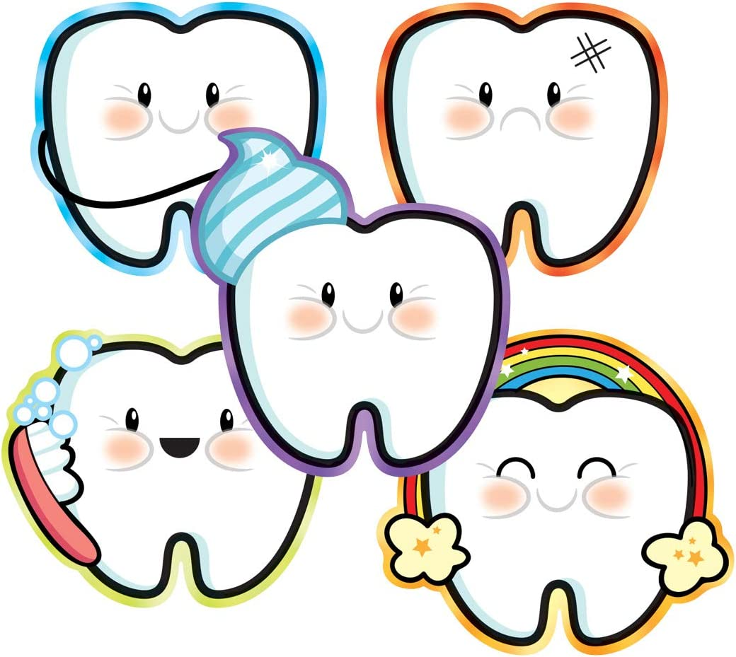

Dental Bags

Slide 8
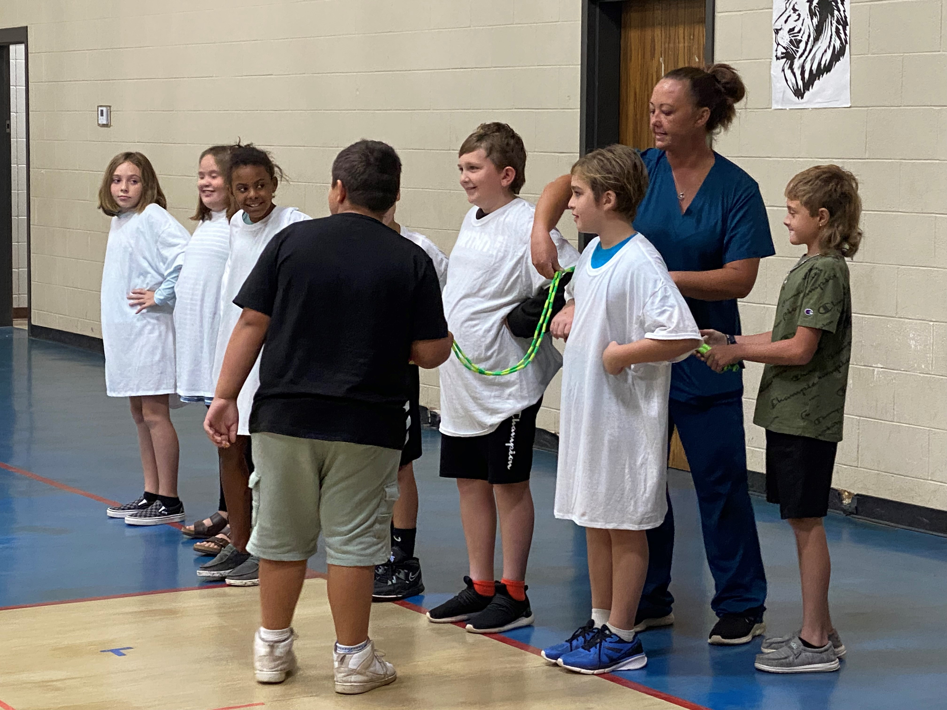
Dental Education Topics Discussed
Topics
Why are teeth important?
How many teeth do we have?
What jobs do our teeth have?
How can I keep my teeth healthy?
What is Plaque?
What is a cavity?
How should you brush your teeth?
Floss Activity

Slide 9
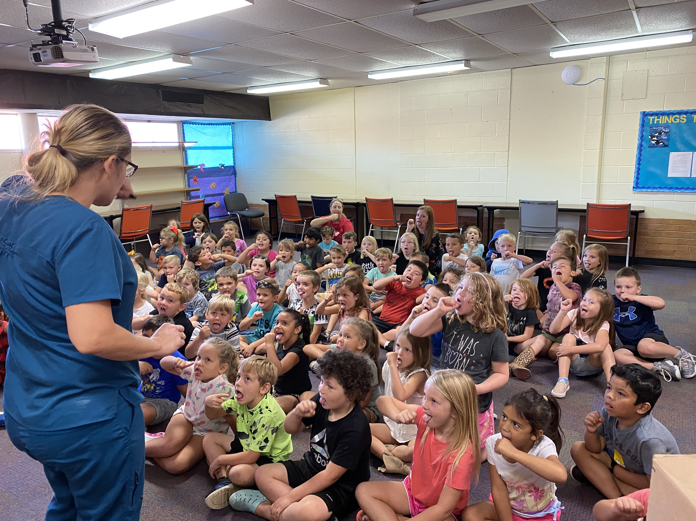
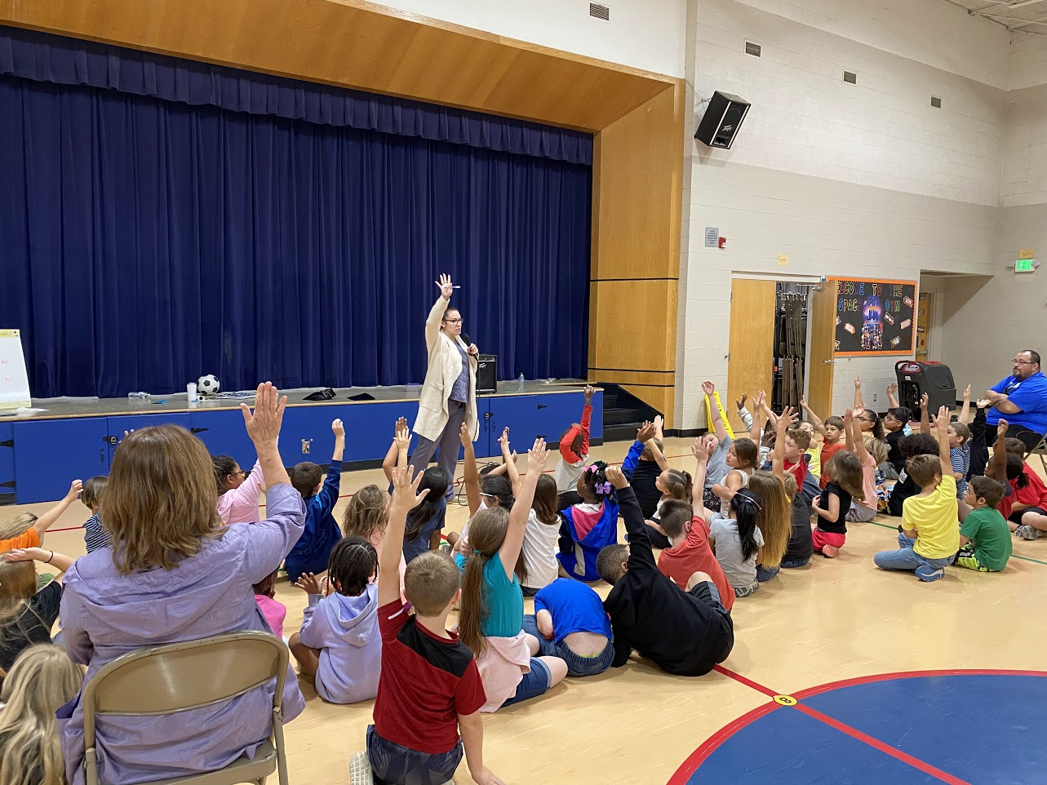
Student Questions and Answers
Shawnee Public School
Cushing Public School

Slide 10
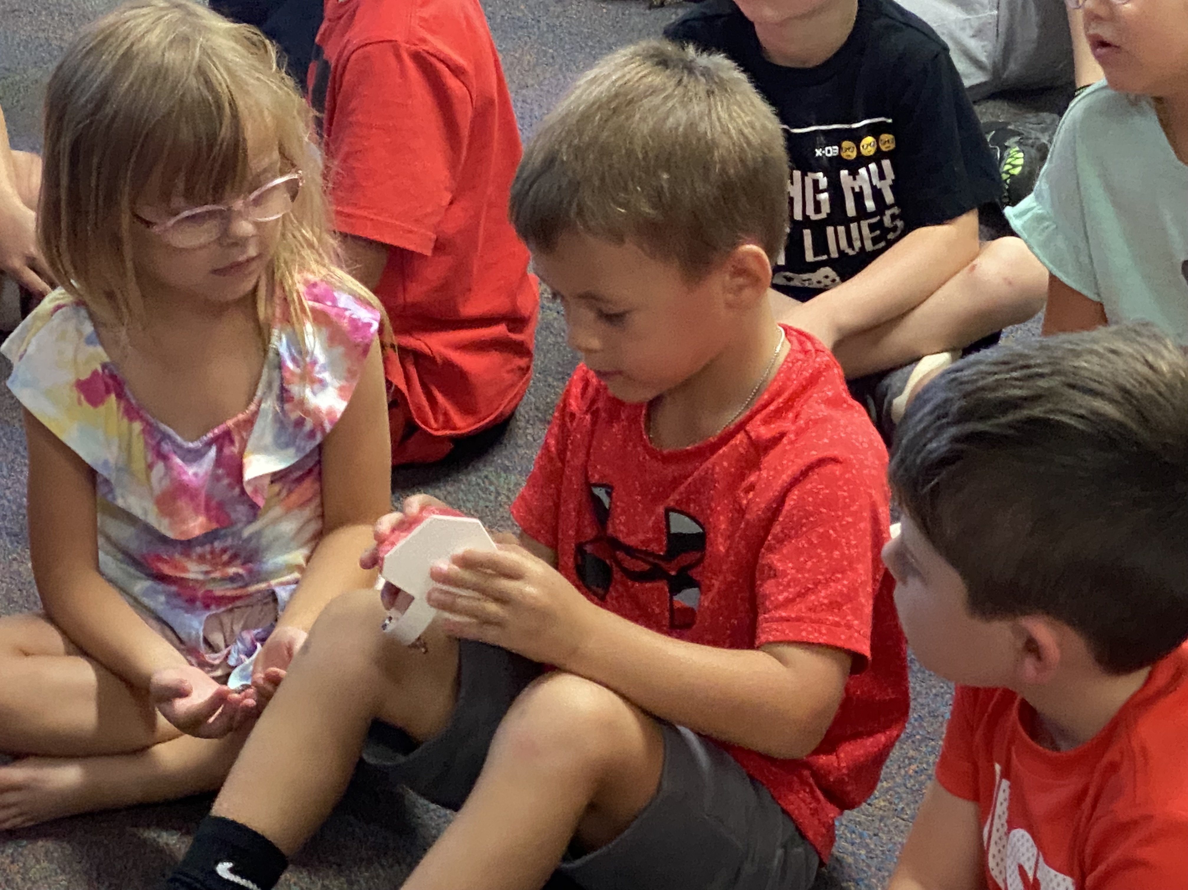
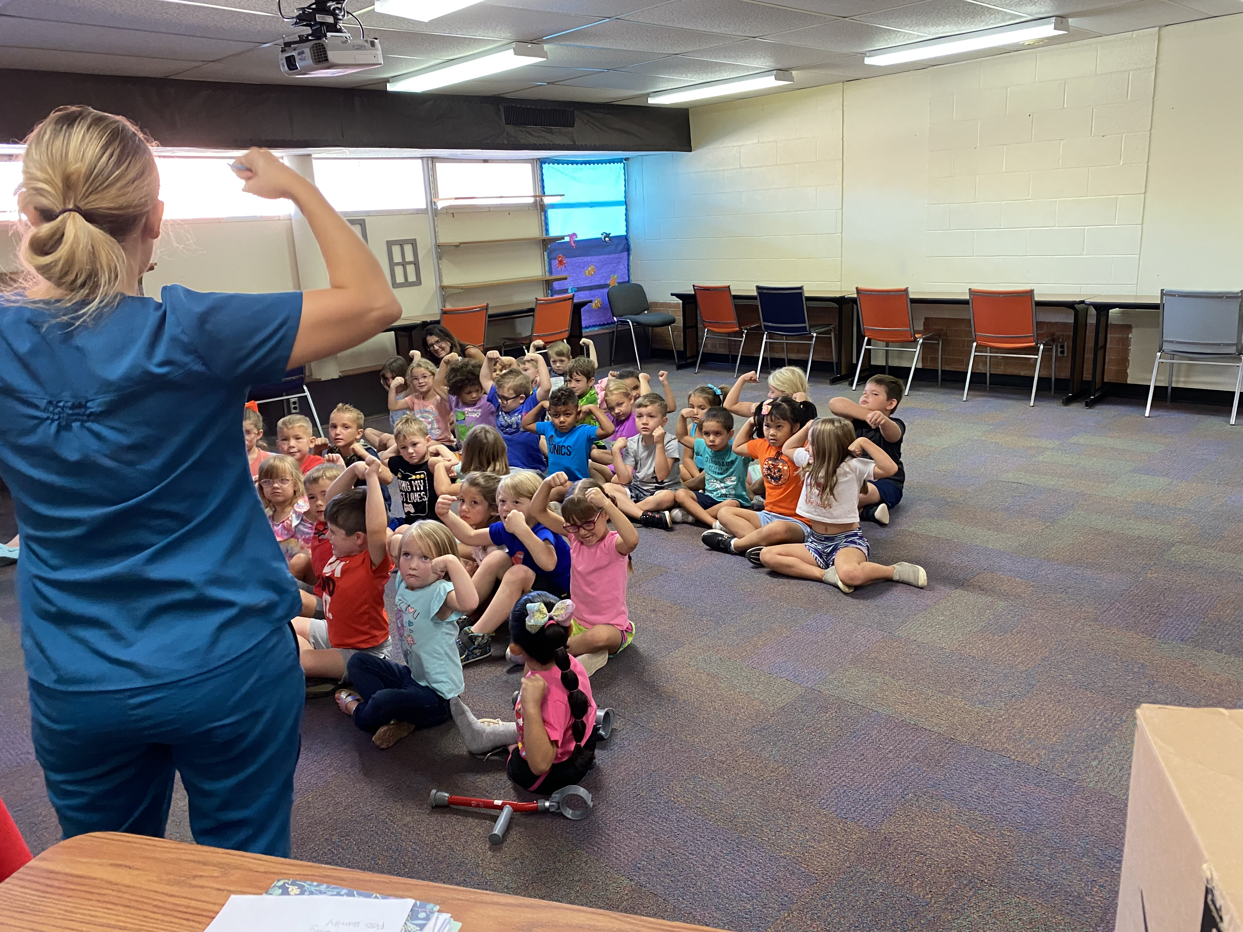
Total Students Educated 3,365
Strong Muscle and Strong Teeth
Looking at Mr. Mouth

Slide 11
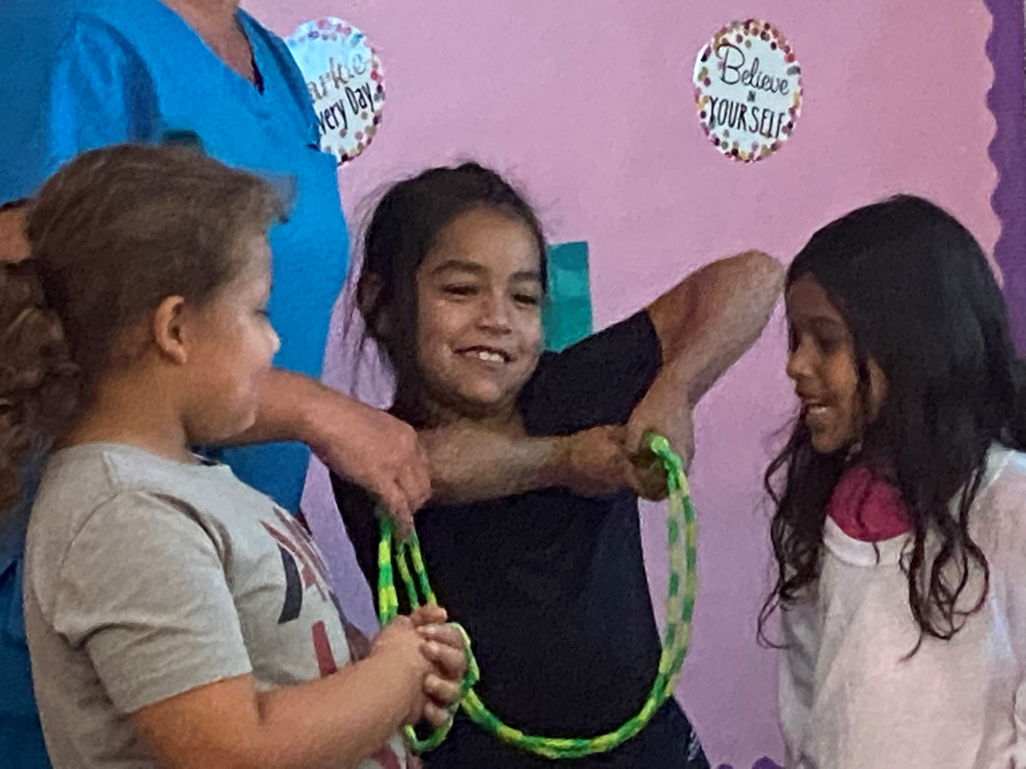
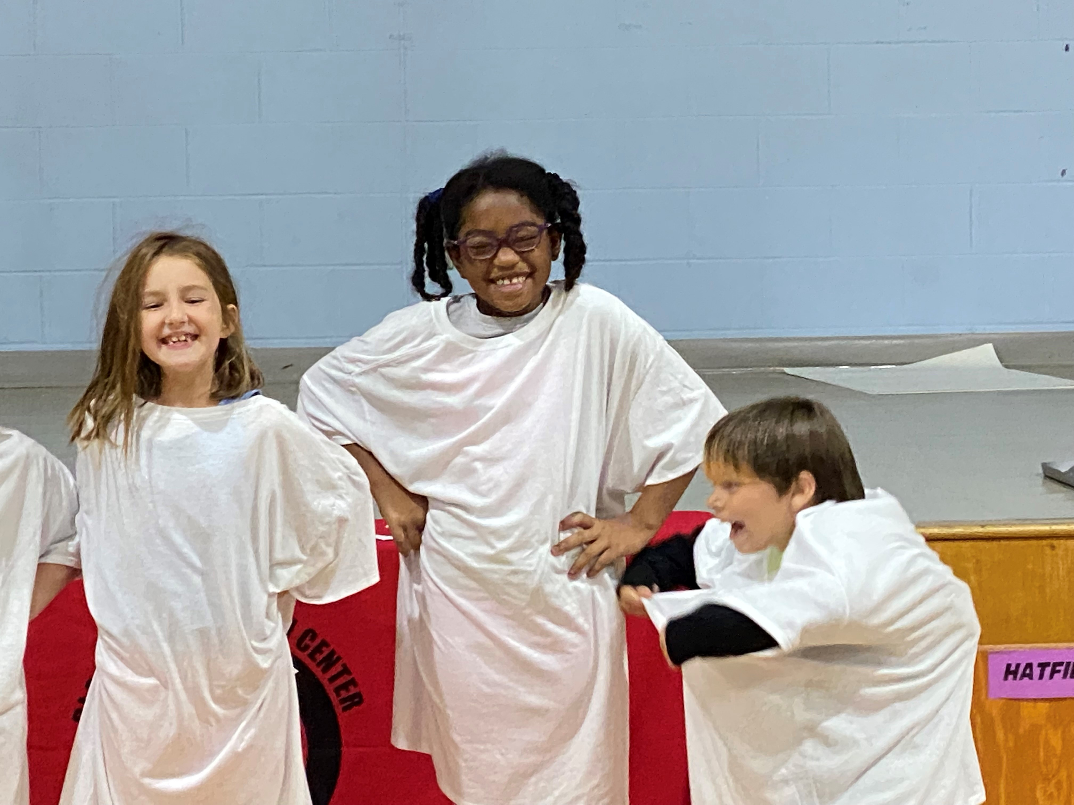
Total Students Educated 3,365
Excited to help with flossing!
All the happy smiles!

Slide 12
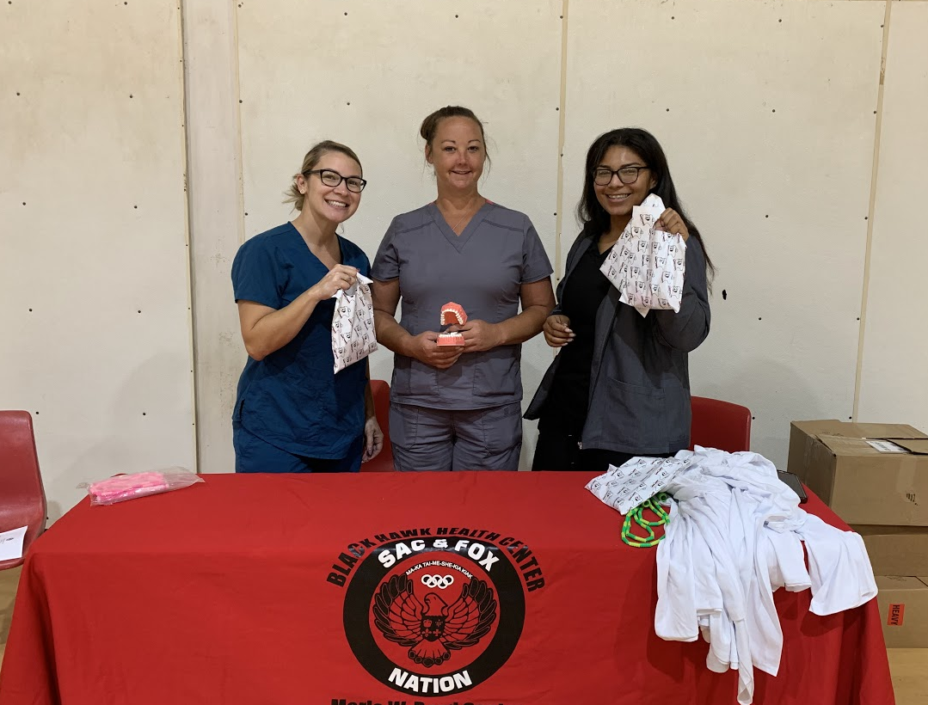
The Sac and Fox Nation Community Health Representative Program
Aislinn Munson CAN/CMA, Carolyn Annanders CHR, Wanda Williams CHR, Sandra Harris CHR, and Cierra Layman LPN (left to right above)
Angel Martinez-Thornton RN, Cierra Layman LPN, and Aislinn Munson CNA/CMA (left to right above)

Slide 13
References
Holt K, Barezel R. 2013. Oral Health and Learning: When Children’s Oral Health Suffers, So Does Their Ability to Learn (3rd ed.). Washington, DC: National Maternal and Child Oral Health Resource Center.
Lulëjeta Ferizi, Fatmir Dragidella, Lidvana Spahiu, Agim Begzati, Vjosa Kotori, "The Influence of Type 1 Diabetes Mellitus on Dental Caries and Salivary Composition", International Journal of Dentistry, vol. 2018, Article ID 5780916, 7 pages, 2018. https://doi.org/10.1155/2018/5780916

