Slide 1
Screening Pregnant & Parenting Women with Substance Use Disorder
Mishka Terplan MD MPH FACOG DFASAM Medical Director, Friends Research Institute Substance Use Warmline Clinician, UCSF

Slide 2
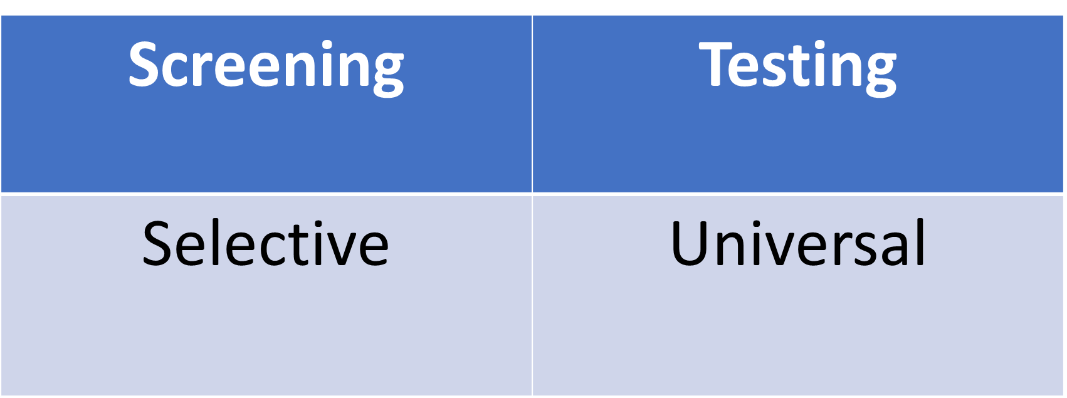
Professional Society Recommendations
Universal Screening:
Recommended (ACOG, ASAM, SMFM, AAP, SAMHSA, CDC)
Voluntary (ACOG, SAMHSA, CDC)
Testing:
Not Recommended - Not an appropriate measurement of addiction (ACOG, ASAM, SAMHSA)
AAP: positive test = exposure, NOT indication of health or ill-health, not injury or harm, not mentioned in discharge criteria
Definitive testing required “when the results of inform decisions with major clinical or non-clinical implications for the patient” (ASAM)
Consent required (ACOG, ASAM, SMFM, SAMHSA)
Notes:
Presumptive – elisa, point of care --- definitive mas spec gas chromotography

Slide 3
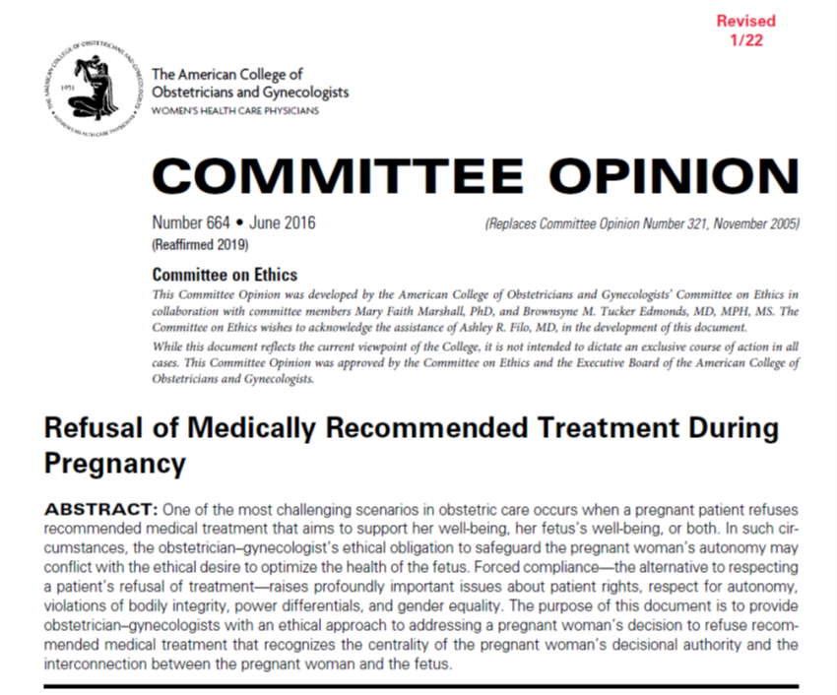
Professional Society Recommendations are grounded in Ethics and Opposition to Coercion

Slide 4
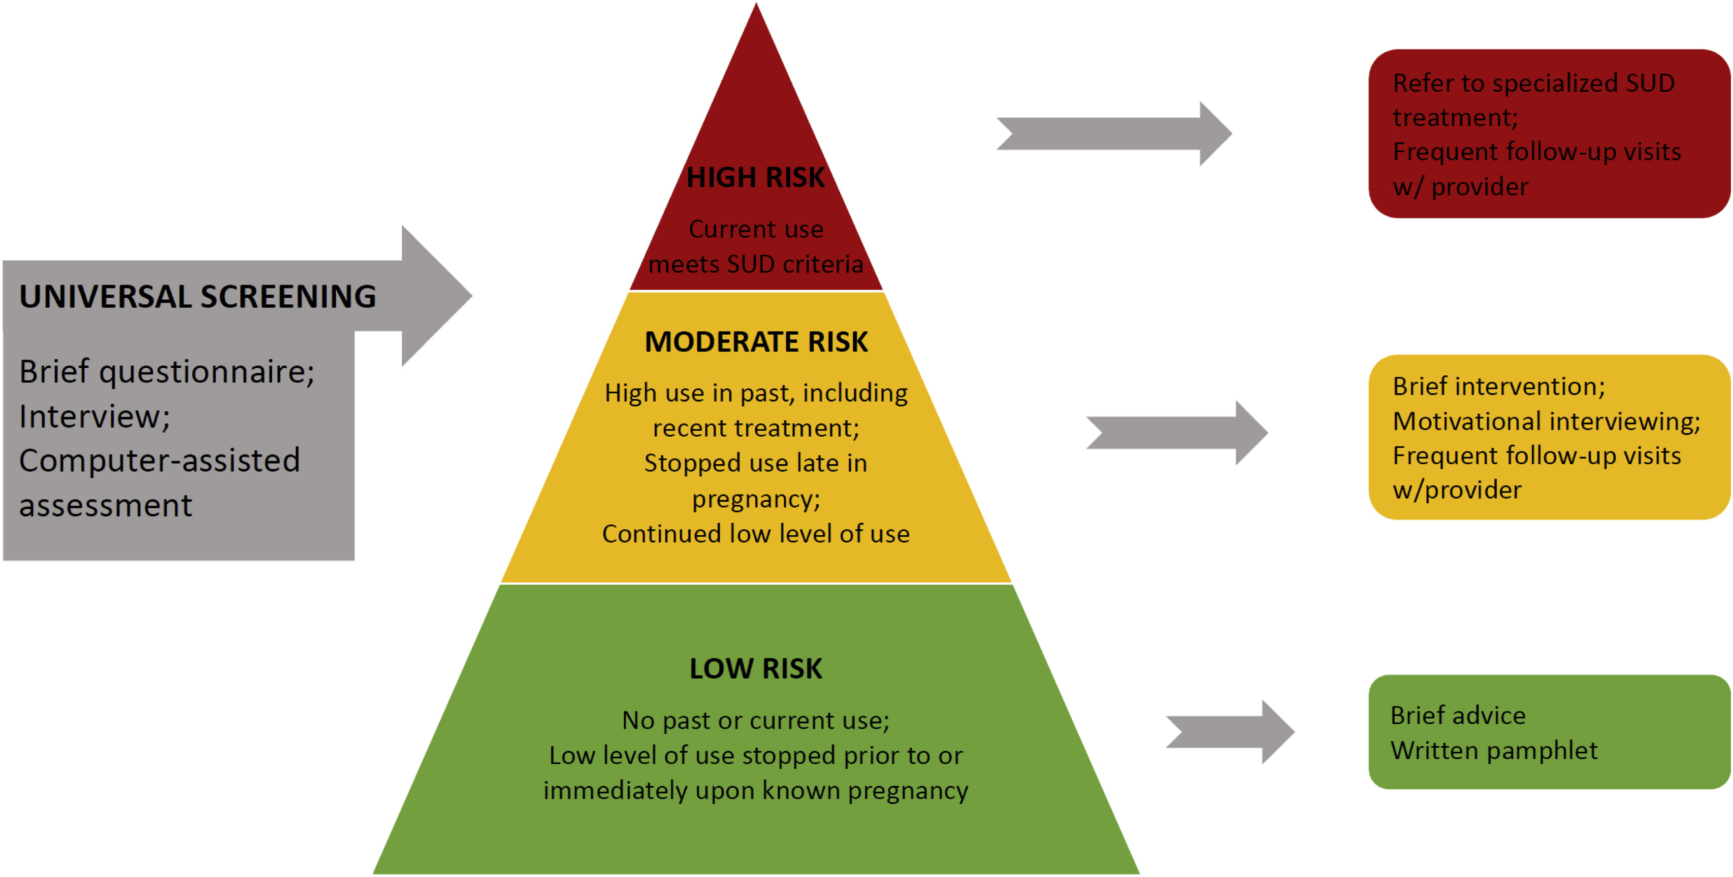

Slide 5
CAPTA/CARA and Drug Testing
Is a Positive Drug Test The Same as Being “Affected” by substance exposure?
Does CAPTA Require Maternal Testing at Delivery?
Does CAPTA Require Testing Newborns for Drug Exposure?
NO
CAPTA is it clear that a demonstrable health impact beyond a positive test is needed

Slide 6
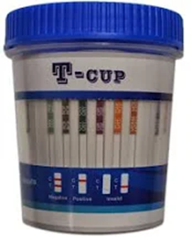

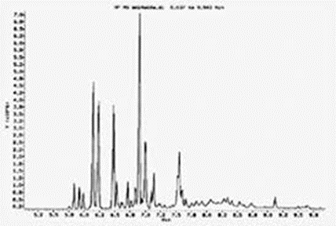

What is a Drug Test?
Presumptive
Definitive
Point-of-care
Elisa
Rapid and Cheap
Results Binary
Gas Chromatography / Mass Spectrometry
Costly and Timely
Results specific and quantified

Slide 7
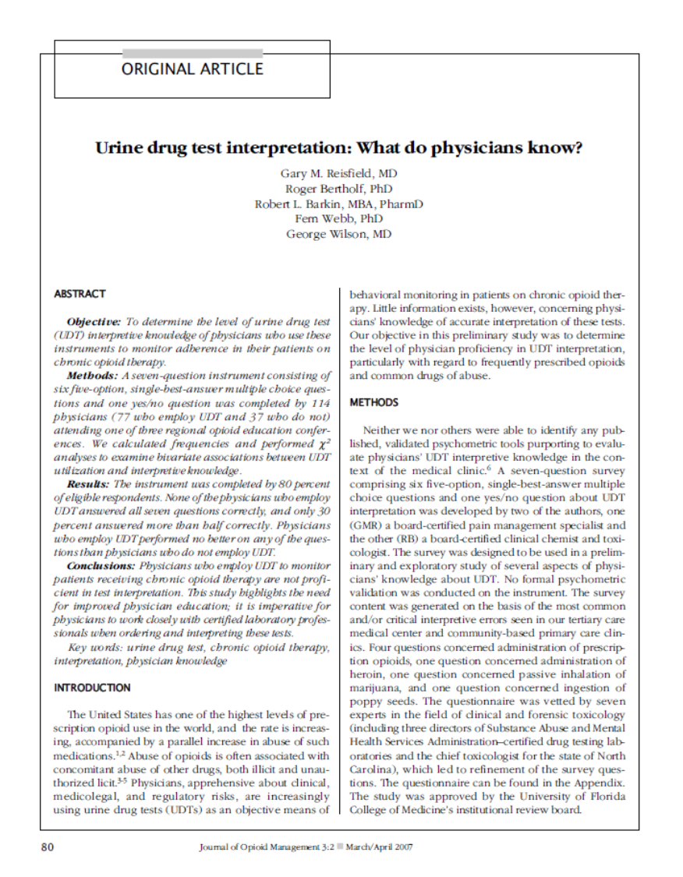
Problem 1: Professional Society Recommendations are not Observed
Providers lack knowledge and often misinterpret urine drug tests or employ poor screening
Do not know the difference between presumptive and definitive tests
Are ill-informed about CAPTA/CARA
Do not understand the consequences of a report or function of the family separation system
Often work in systems with vague or absent policies
Leads to both over-reporting and provider confusion and frustration

Slide 8
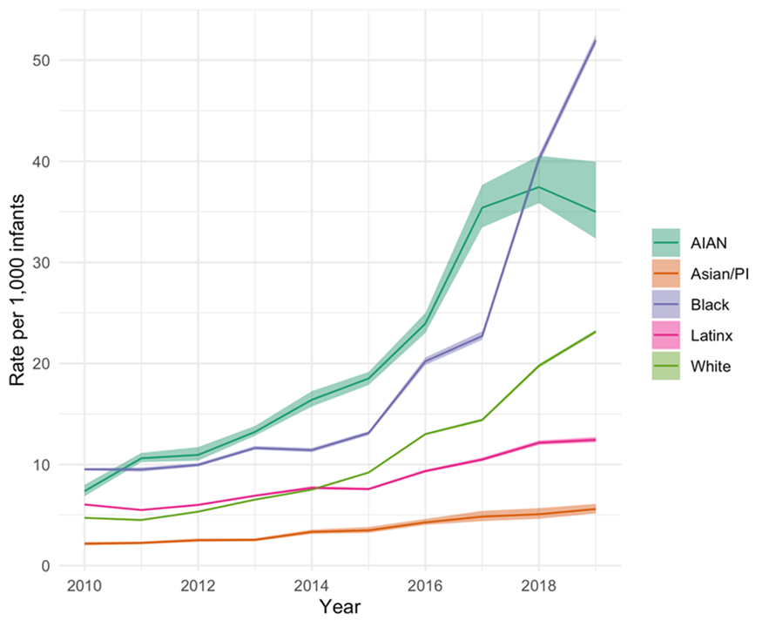
Drug Testing at Birth
Child removals are common and increasing during the birthing hospitalization
Primary reason for removal is drug use
Primary driver of removals are healthcare providers (400% increase in last decade)
Marked racial inequities in report and consequence
National Child Abuse and Neglect Data System Manuscript in preparation by Edwards F, Terplan M, Roberts S, and Raz M

Slide 9
The Family Regulation System Pipeline (simplified)
Urine
Drug
Testing
System Notification or Report
Foster Placement
Parental Custody Termination
Notes:
Cannabis – most common urine drug test result

Slide 10
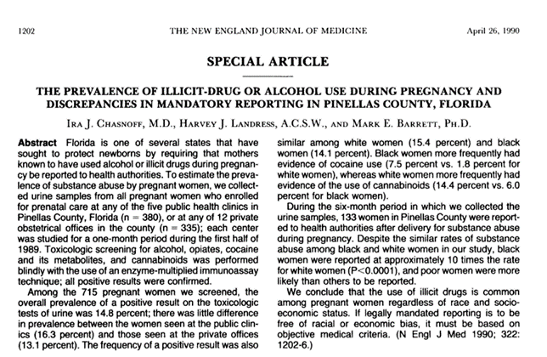
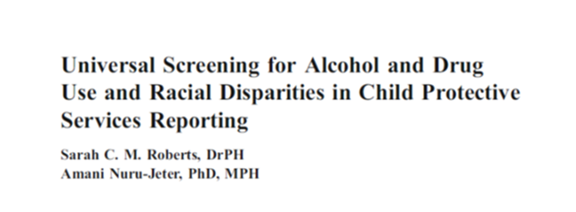
Racial Inequities in Drug Testing and Selection Bias in Child Welfare Reporting
 | Chasnoff (1990) | Roberts (2011)
Positive Urine Drug Test Black Women White Women | 14.1% 15.4% | 14% 14%
Child Welfare Report Black Women White Women | 10.7% 1.1% | 13.5% 7.6%
Equality vs. Equity:
Increasing number of White people reported to achieve “racial parity” with Black people is not equity

Slide 11
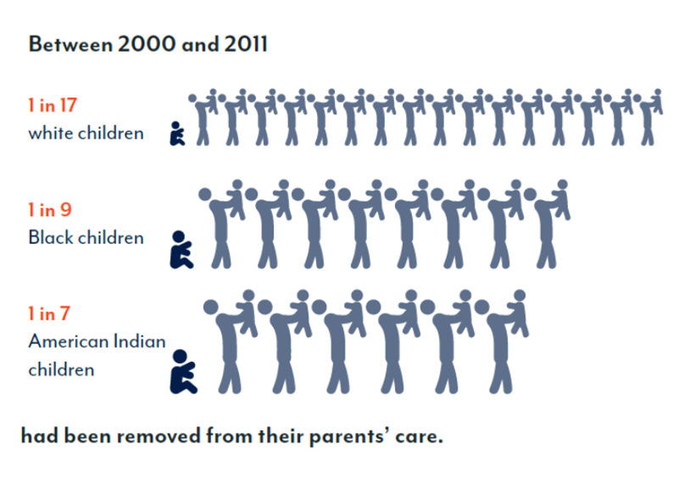
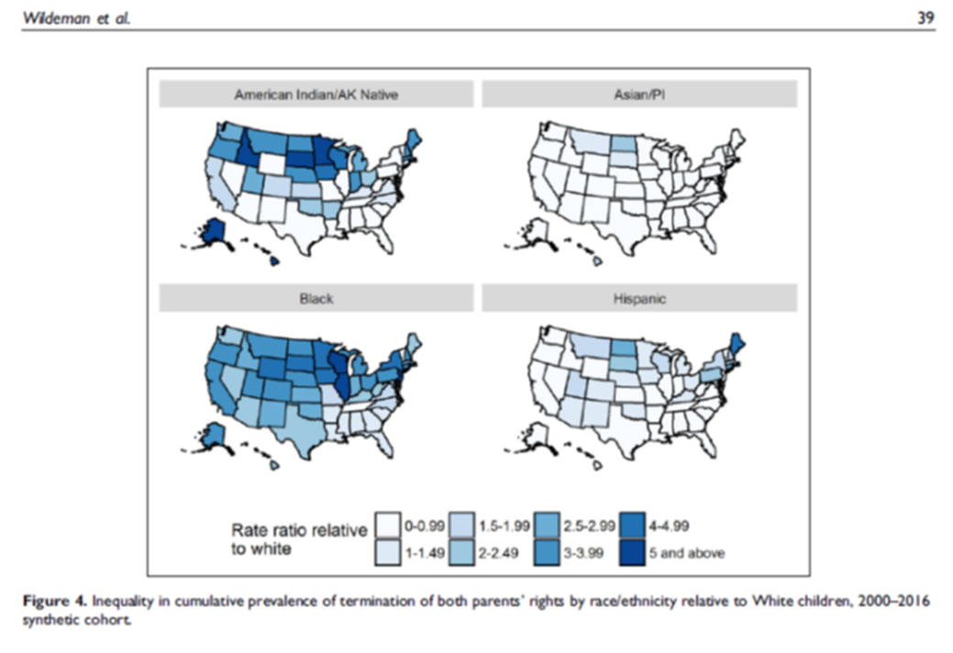
Racial Inequities in Family Separation
MFP 2020
Wildeman C, 2020 Child Maltreatment 25(1)

Slide 12
Provider Assumptions: Social/Legal Distinctions = Biological/Public Health
Prescribed Medication
Legal Substances
Illegal Substances
HARM
Known Teratogens: ACE-Inhibitors, Alcohol, Carbamazepine, Diethylstilbetrol (DES), Isotretinoin, Phenytoin, Tobacco, Valproic Acid (partial list)

Slide 13
Problem 2: Cognitive Dissonance in Practice
Public Health vs. Criminalization – can’t be both
Conflict between providing health care and mandatory reporting
Drug screening, testing, and lack of (or poor) consent erodes provider/patient trust
Creates a climate of “mutual mistrust”
And contributes directly to provider moral injury
“The laws, regulations, and policies that require health care practitioners and human service workers to respond to substance use and substance use disorder in a primarily punitive way, require health care providers to function as agents of law enforcement.” ACOG 2020, Opposition to Criminalization of Individuals During Pregnancy and the Postpartum Period: Statement of Policy

Slide 14
Conclusion 1: Return to basics
Critically examine drug testing: What are the indications for the test; How will results influence clinical care?
Need clear, consistent, and transparent (hospital) policy regarding indications for (screening and) testing and what happens to the information
Participation in screening and testing must voluntary, grounded in right of refusal, and symbolized with explicit consent

Slide 15
Conclusion 2: Decouple Healthcare from Criminalizing Systems
Behavioral health is important dimension of health
But information regarding drug use (however obtained), can be (and is) used to punish and ultimately to report
For provider sanity, for patient safety, for family preservation, for a more just world, we must decriminalize healthcare

Slide 16
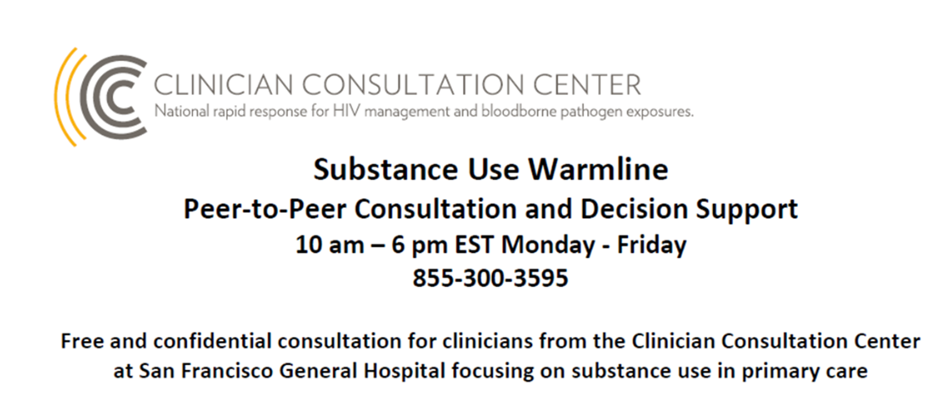
Thank you
Mishka Terplan
@Do_Less_Harm
mterplan@friendsresearch.org

