Slide 1
Coccidioidomycosis: Presentation, Diagnosis, and Treatment Indian Country Infectious Diseases ECHO October 20, 2022
John N Galgiani MD
Valley Fever Center for Excellence
University of Arizona

Slide 2
Disclosures
John Galgiani has no conflicts of interest to disclose.

Slide 3
What Is Coccidioidomycosis?
Caused by soil fungi
Coccidioides immitis
Coccidioides posadasii
Other names:
Cocci
Valley fever
Desert rheumatism
Infection results from inhaling a spore
Severity varies
Mild: 60%
Moderate: 30%
Complicated: 10%
After infection, most (all?) persons develop life-long immunity to a second infection

Slide 4
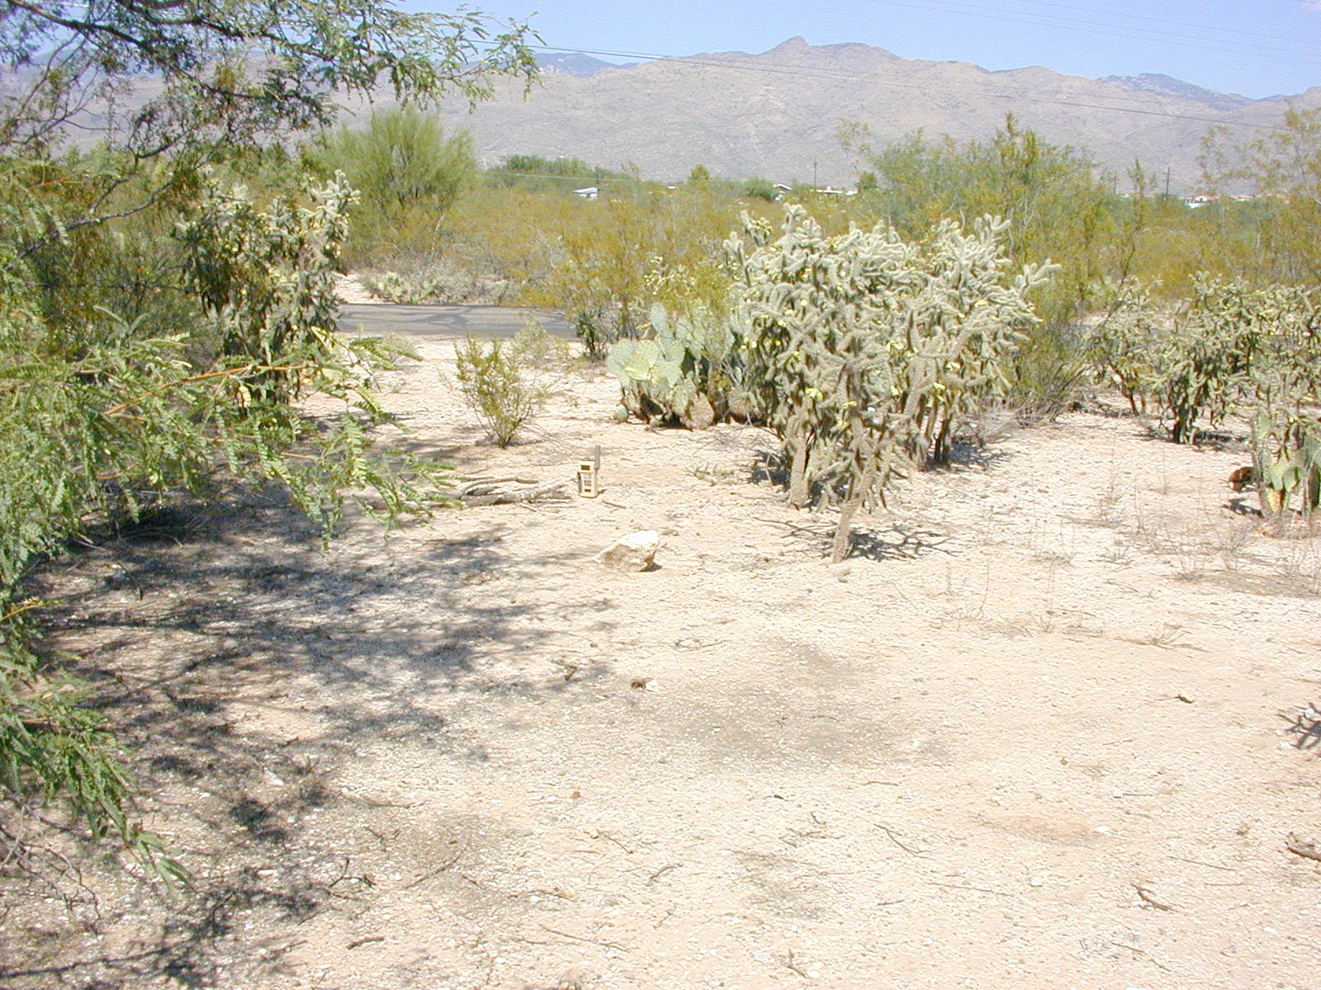
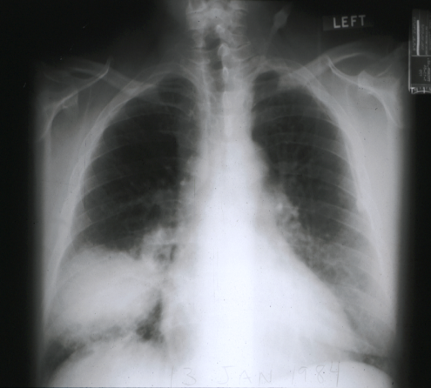
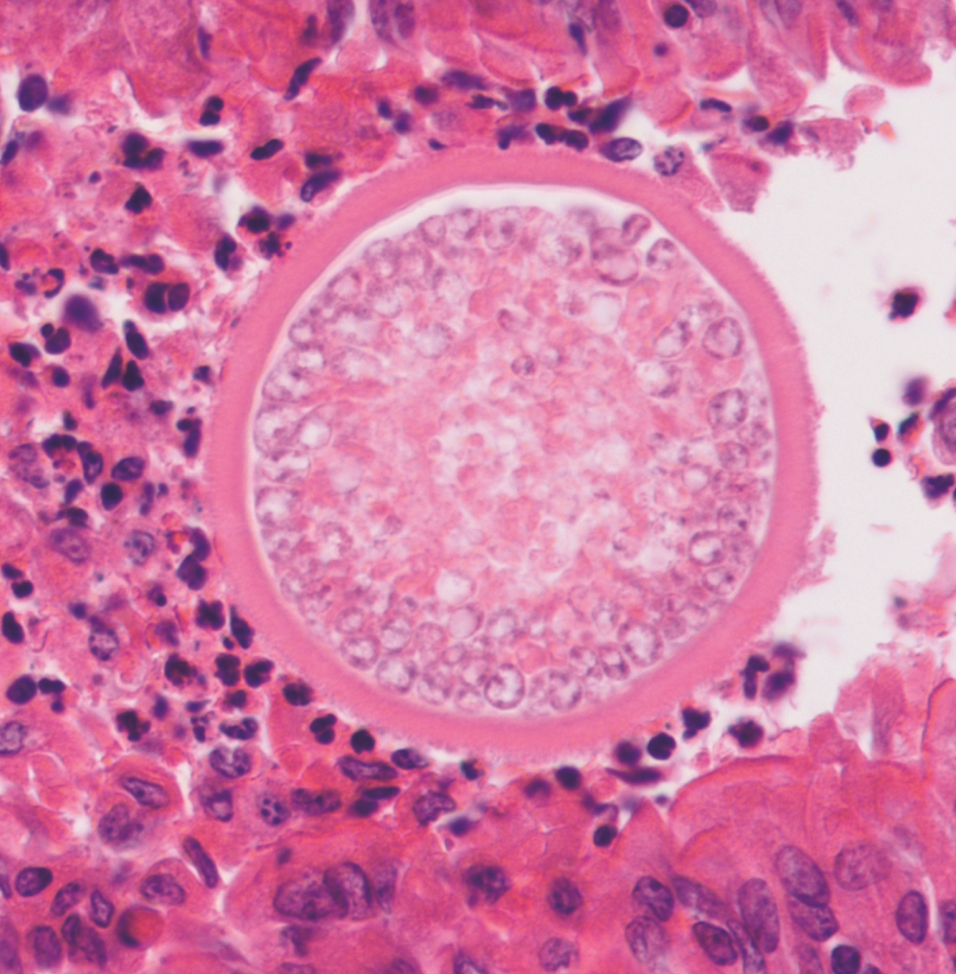
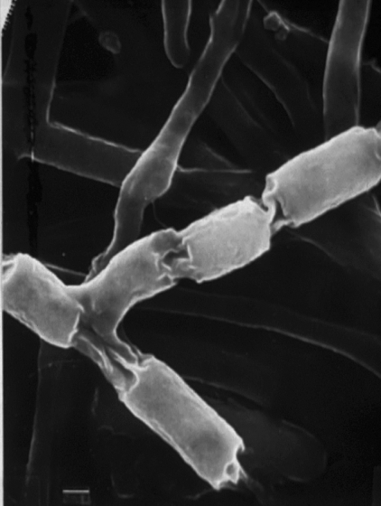

Slide 5
Reported U.S. Valley Fever
*

Slide 6
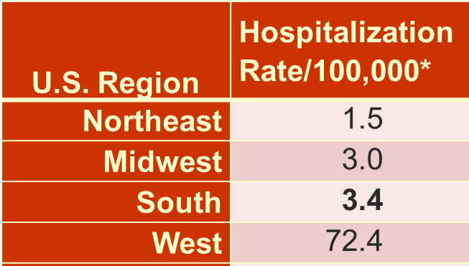
Impact of Valley Fever by Geography
* McCotter et al. 2019 OFID

Slide 7
Impact of Valley Fever on Native Americans
Race | Hospitalization Rate/100,000* | Relative Risk Cocci Death**
 |  | US | AZ | CA
White | 13.4 | Ref | Ref | Ref
Black | 16.4 | 1.38 | 3.42 | 3.50
Hispanic | 36.3 | 6.74 | 2.10 | 5.21
Asian/Pacific | 15.6 | 5.48 | 5.51 | 2.70
Indian/Alaskan | 58.0 | 6.15 | 2.18 | 3.01
* McCotter et al. 2019 OFID
** Noble et al. 2016 EID.

Slide 8
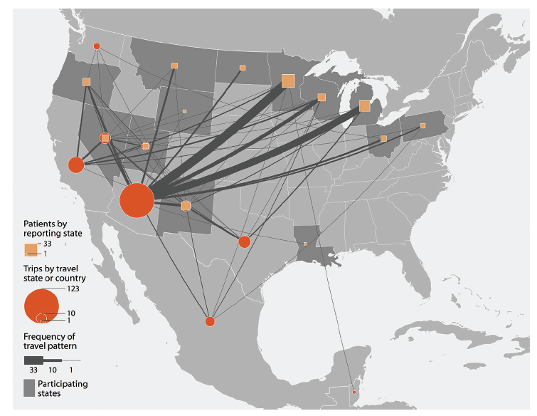
Travel for Non-Endemic Valley Fever
Benedict et al. EID 2018

Slide 9
Coccidioidomycosis as Community-Acquired Pneumonia
In Southern Arizona
29% (CI: 16% - 44%) of all CAP
is Valley Fever
Tourists to Arizona: average risk is <1:15,000
But
CAP weeks after trip to Arizona,
Risk same as if you live in Arizona
Valdivia et al, Emerg. Inf. Dis, 2006
Notes:
Clinicians within the endemic region who have taken this approach are likely to be missing a correct diagnosis in a sizable proportion of their patients with community acquired pneumonia. In a paper just published this summer, patients with a clinical diagnosis of CAP were enrolled in an observational study, and of 55 subject 16 were found to be serologically positive for coccidioidal antibodies. Even with this relatively small sample, the 95% confidence interval ranged from 16% to 44%.
Of course, an important correlate to this finding is that tourists who develop a pneumonia in the weeks after leaving an endemic area have this same high likelihood of having Valley Fever.

Slide 10
Learning Objectives
Understand the gap in current primary care practice for the early diagnosis of Valley fever.
Incorporate into practice rational management strategies to the various symptoms caused by new uncomplicated Valley fever.

Slide 11
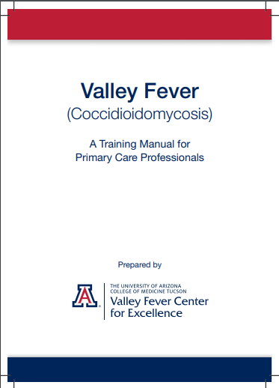
Banner Health
Clinical Consensus
Group
“Clinical Practice for Diagnosing and Managing Coccidioidomycosis”
This syllabus is available at
htpp://vfce.arizona.edu

Slide 13
Primary Care of Coccidioidomycosis
C onsider the diagnosis
O rder the right tests
C heck for risk factors
C heck for complications I nitiate management

Slide 14
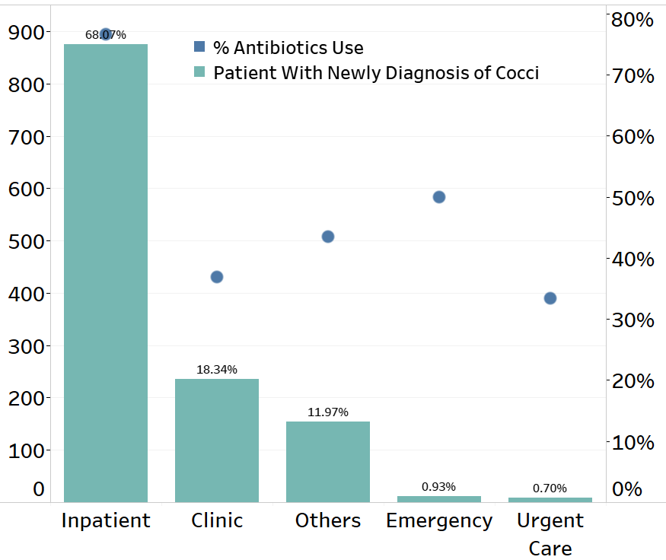
All Cocci Diagnoses in Banner Health, 2017-18
Pu et al. CID. 2020.
68% of new cocci diagnoses were after hospital admission.
Only 12% were from 1⁰ care clinics (yellow bar).
<1% from urgent care clinics.

Slide 15
Banner Hospital VF Diagnoses, 2019
Of 1,491 hospitalized patients, 41% had no ICU or surgeries
Median LOS: 3 days
Median antibiotic doses: 14
Total hospital cost: $28.4 million
49% had outpatient visit(s) with VF Symptoms
Pu et al. CID. 2020.
Notes:
Abbreviations:
ICU=intensive care unit
LOS=length of stay
VF= Valley fever

Slide 16
Delay of Valley Fever Diagnosis
BUMC-Tucson
1º Care
43% of Diagnoses
Delayed > 1 month
Donovan et al.
EID, 2019

Slide 17

Valley Fever case numbers in Banner Urgent Care 2020-2021YTD (22 months)
Patients seen in BUCS: 1,290,201
Patiens with ICD10 for pneumonia (J18.9): 7,031
Total J18.9 patients tested for VF: 1,513
Number (%) of tested patients positive: 327 (21.6%)
Projection:
If all J18.9 patients were tested in BUCS for Valley Fever, 1,186 more would have been positive.
BUCS misses 3 of 4 Valley Fever diagnoses!
Pu et al. Banner Data Analytics, unpublished

Slide 18
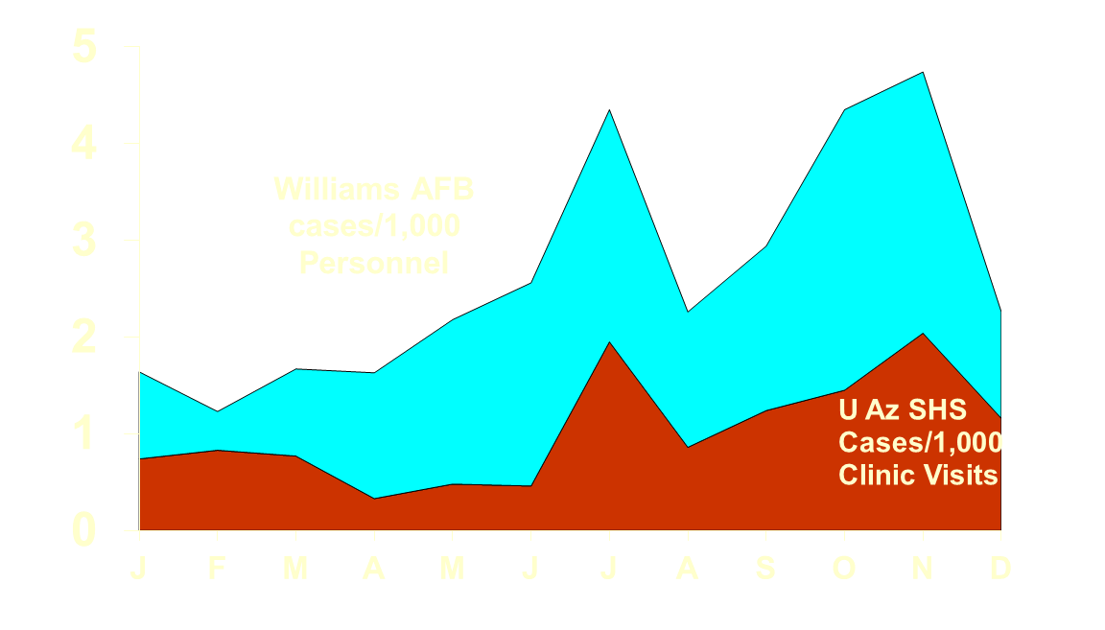
Consider the diagnosis in Arizona
In Arizona, Valley Fever is very common. It should be in the differential often.
More frequent between the monsoons and the winter rains.
Syndromes:
Always in community acquired pneumonia.
Rheumatism.
Rashes.
Jan Jun Dec

Slide 19
Order the Right Tests: EIA screen for Coccidioidal Antibodies
Enzyme Immunoassay (EIA) test
A positive test is very specific and usually is diagnostic.
A negative test never rules out Valley Fever. Repeated testing improves diagnostic sensitivity.

Slide 20
Risk Factors
Pulmonary Complications
Diabetes mellitus
Cardio-pulmonary or other co-morbidities (Evidence: “common sense”).
Disseminated Infection
Major and critical
Cell immunodificiency
Pregnancy
Minor and small effect
Males > Females
Racial background
Adults > Children

Slide 21
Check for Complications
Most complications are focal
A review of systems and physical examination will usually detect or exclude the possibility of complications.
New focal findings warrant either evaluation or referral for Infectious Diseases or Pulmonary consultation.

Slide 22
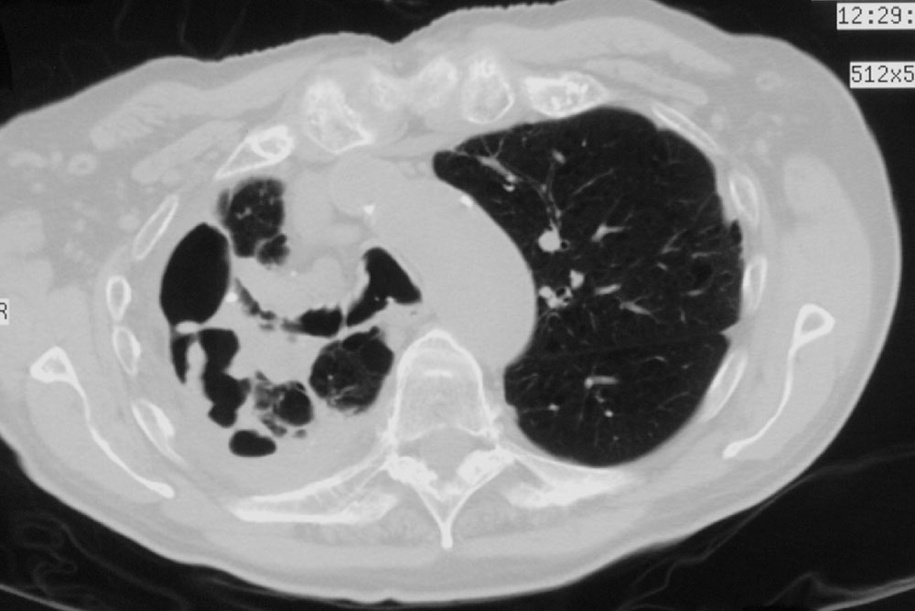
Fibro-cavitary Coccidioidomycosis
Complex
Thin-walled

Slide 23
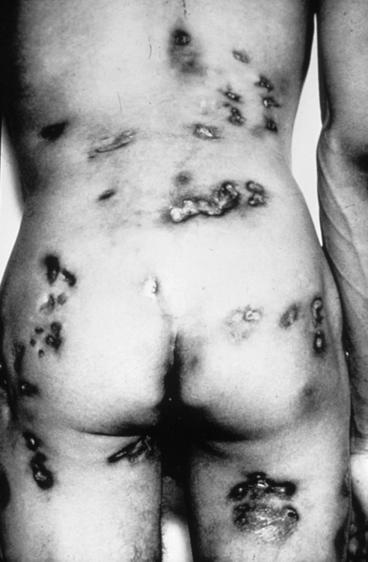
Widely
Disseminated
Coccidioidomycosis

Slide 24
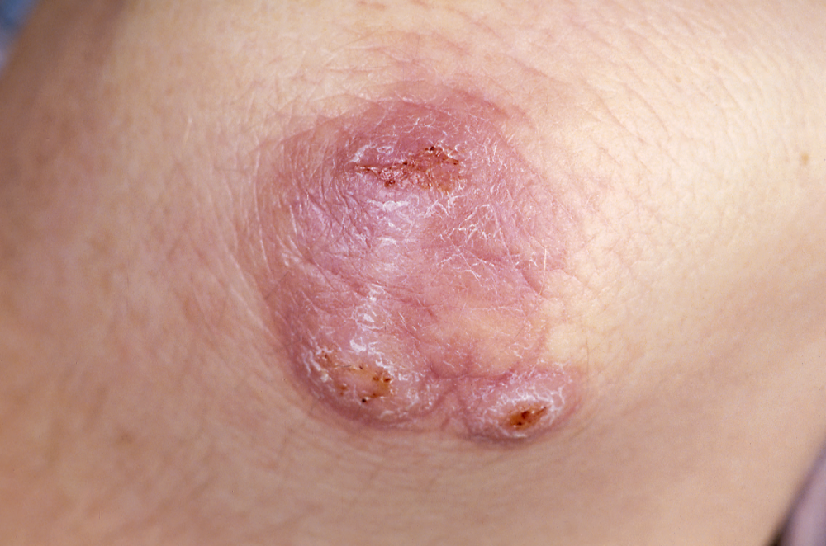
Disseminated
Coccidioidomycosis

Slide 25
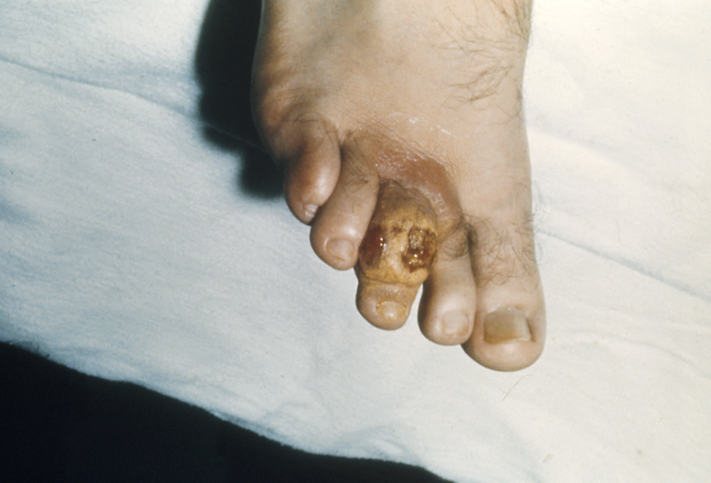
Disseminated
Coccidioidomycosis

Slide 26
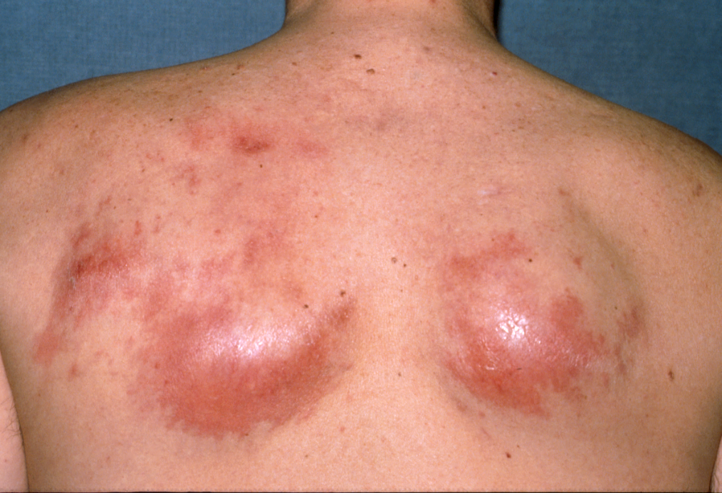
Disseminated
Coccidioidomycosis

Slide 27
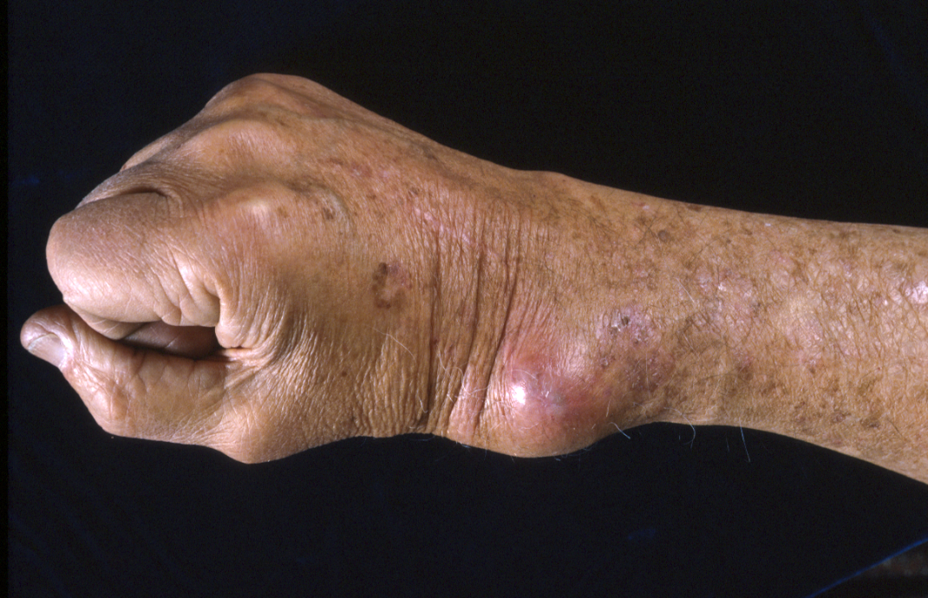
Disseminated
Coccidioidomycosis

Slide 28
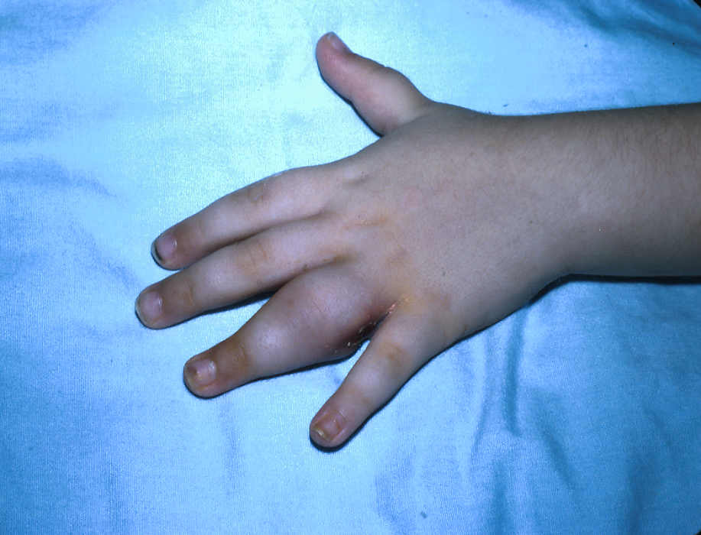
Disseminated
Coccidioidomycosis

Slide 29
Primary Care of Coccidioidomycosis
Compatible Symptoms
Diagnostic Studies
Serology or Cultures
-
Retest
+
Risk Factors Present?
Specialty Referral and / or Treatment
Repeated evaluations
N
Focal Signs or Symptoms?
N
Start Anti-fungal ?
Observe

Slide 30
2016 IDSA Guidelines Treatment of Coccidioidomycosis
“It should be emphasized that no randomized trials exist to assess whether antifungal treatment either shortens the illness of early uncomplicated coccidioidal infections or prevents later complications.”
Notes:
On the basis of these numerous studies, the recently revised Infectious Diseases Society of America Practice Guidelines state that “Azole therapy (fluconazole, itraconazole) has largely supplanted amphotericin B as treatment of progressive coccidioidal infections” with polyenes largely being reserved for the most fulminant or progressive infections. The thinking here is that safety and the ability to administer long, even life-long courses of therapy makes azole therapy the preferable first-line treatment.
But, in the same IDSA Guidelines there is also the following statement: “How best to manage primary respiratory coccidioidal infections is an unsettled issue because of the lack of prospective controlled trails.” So how is it that what is now an achievable and potentially useful direction for clinical trials has been left so completely unexplored?
For me, the answer hinges on a reversal in the relationship between therapeutic technology and our perception of the disease we our treating. Up until this time, treatment was so difficult and toxic that that only the most seriously ill would benefit. This situation existed for so long, some 30 or 40 years, that it engendered several fixed perceptions that treatment should be reserved for only the most seriously ill. As a result, even though safer and more convenient drugs have become available, they have not been studied to help patients with the commonest forms of coccioidomycosis. For the remainder of my presentation this morning, I would like to examine these perceptions in more detail to see if perhaps they might be worth changing.

Slide 31
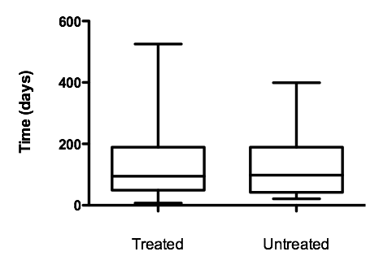
Median days to ≥50% decline in total clinical score
P = 0.899
Ampel et al. CID 2009

Slide 32
Outcome of Subjects (> 1 month follow-up)
50 not treated
Median follow-up: 3.1 years
All without complications
51 treated
Median follow-up: 2.9 years
38 off-therapy and without complications
5 remained on treatment
8 had relapses
5 with pulmonary disease
3 with extrapulmonary dissemination
Relapses occurred up to 2 years after stopping treatment
Ampel et al. CID 2009

Slide 33
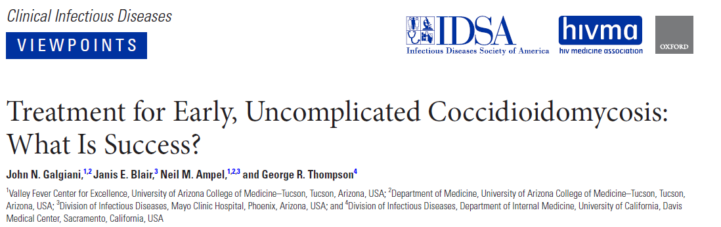
The Problem: Coccidioides infection produces many signs and symptoms.
Some are the result of fungal proliferation.
Some are the result of immune responses.
Hypothesis: Rational management depends upon recognizing which is which.
May 1, 2020

Slide 34
When Do Antifungals Benefit Cocci Patients?
When spherules rupture, they stimulate acute inflammation (PMNs, Eosinophils)

Slide 35
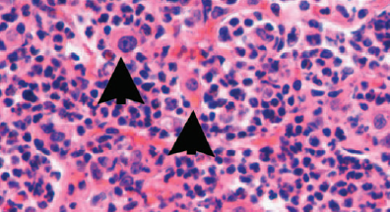
Acute Inflammation for Spherule Proliferation

Slide 36
When Do Antifungals Benefit Cocci Patients?
When spherules rupture, they stimulate acute inflammation (PMNs, Eosinophils)
The acute inflammation causes:
Tissue destruction/necrosis.
Necrosis leads to SIGNS (not just symptoms) evident on exam or imaging.
Key Point: If a cocci infection is causing tissue destruction, the fungus is growing, and antifungals help.

Slide 37
When Do Antifungals Not Benefit Cocci Patients?
Since spherule rupture stimulates acute inflammation, absence of signs of inflammation is strong evidence that spherules are not proliferating.
Antifungals only inhibit fungal proliferation.
Key Point: If there are no signs of tissue destruction, fungal growth is absent and antifungals will not help.

Slide 38
Cocci Problems Not Helped by Antifungals
“Desert Rheumatism”
Symmetrical arthralgias, especially ankles and knees, sometimes very painful
Joint effusions are absent.
E. nodosum, E. multiforme
Resolve without damage.
Approach: Reassurance; NSAIDS
Headache
Very common.
In some, exclude meningitis with LP.
Fluconazole may cause sinusitis and cause headache.
Fatigue (exertion intolerance).

Slide 39
Fatigue: Often the Last Symptom Typical Case
Primary coccidioidal pneumonia diagnosed serologically in an otherwise healthy active person.
Over several weeks, weight returns to normal, fever resolves and pulmonary symptoms gone. ESR becomes normal. CF low or neg.
However, patient complains of profound inability to carry out normal activities.
How should this be managed?

Slide 40
Potential Causes of Fatigue
In some, striking deficit in O₂ utilization (VO₂ peak <10% of predicted)*
Physical deconditioning because of decreased activity.
Lack of experience by the patient with subacute or chronic disability.
Patient with excessive expectations of own performance.
*Ganley, Open Forum Infectious Diseases 2017

Slide 41
Fatigue Management Strategies Instead of Antifungals
Exclude objective evidence of tissue destruction or focal lesions.
Patient Education
Prolonged fatigue common and resolves
No evidence of permanent damage
Deconditioning and unrealistic expectations
Patient Actions
Keep a journal
Refer patient to Physical Therapist for reconditioning

Slide 42
Unexpected Increase in CF Antibody Titer
Textbook Teaching: Increasing CF titers “means” cocci is getting worse.
What is the supporting evidence?
From 1940s; never re-validated.
From one research laboratory.
Before antifungal therapy.
Today, results from many labs; effect of treatment unstudied.

Slide 43
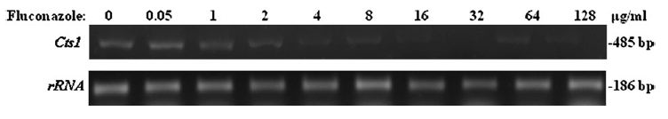
Serology in Cocci Pts treated before IgG (CF) Abs was detectable
 | Time fluconazole Treatment Initiated
 | Early (<14 d) | Late (>14 d)
Number of subjects | 15 | 66
% that developed IgG Antibodies | 0% | 97%
Expression of the CF antigen (Cts1) is blocked in vitro by fluconazole
*Thompson, et al. Clin Infect Dis, 2011

Slide 44
Case Presentation
Jonathan Vilasier Iralu, MD, FACP, FIDSA
Indian Health Service Chief Clinical Consultant
for Infectious Diseases

Slide 45
The patient is a 60 year old iron worker who was stationed east of Phoenix, AZ at a job site. He had heavy exposure to dust and dirt.
July 4th, he developed cough and body aches. At Urgent Care, received a diagnosis of cough.
One week later, returned to urgent care, a CXR was normal and was prescribed azithromycin and prednisone for sinusitis/bronchitis.

Slide 46
In early August, he went to the ED with cough, dyspnea and 14 lb weight loss. His glucose was 353 and WBC was 15K. A CXR showed diffuse interstitial nodular infiltrates and a mass like lesion in the R costrophrenic sulcus.
He was admitted and the next day his CBC showed 28% eosinophils. BAL also showed 28% eosinophils. The patient as placed on fluconazole, Vancomycin and Piperacillin-Tazobactam

Slide 47
AFB smears and NAATs were negative for Mycobacterium tuberculosis. A pulmonologist was consulted by phone and prednisone therapy was recommended.
A cocci antibody panel came back positive:
IgM 4.7
IgG 7.6
ID detected
CF 1:16
What should be done now?

Slide 48
The patient was treated with 1 year of fluconazole therapy. He became asymptomatic and his CXR became normal
Two years later his titer was checked. It rose from a nadir of <1:2 to 1:128. The patient was completely asymptomatic and had a normal physical exam. A CXR was also completely normal.
Now what should be done?

Slide 49
Summary
Early diagnosis is essential to optimal management of coccidioidomycosis.
The value of antifungals is to reduce tissue damage and nothing else.
Many symptoms produced by cocci are not helped by antifungal therapy and other treatment strategies are more useful.

Slide 50


Valley Fever Center for Excellence
Questions?

