Slide 1
Pre-Exposure Prophylaxis (PrEP) for Prevention of HIV 101
Alithea Gabrellas, MD
Infectious Diseases Physician
Gallup Indian Medical Center

Slide 2
Identifying Indications for PrEP
All sexually active adults and adolescents should be informed about PrEP for prevention of HIV acquisition
Studies have shown that patients often do not disclose stigmatized sexual or substance use behaviors to their health care providers (especially when not asked about specific behaviors)
Patients may request PrEP because of concern about acquiring HIV but not feel comfortable reporting sexual or injection behaviors to avoid anticipated stigmatizing responses in health care settings. For this reason, after attempts to assess patient sexual and injection behaviors, patients who request PrEP should be offered it, even when no specific risk behaviors are elicited

Slide 3
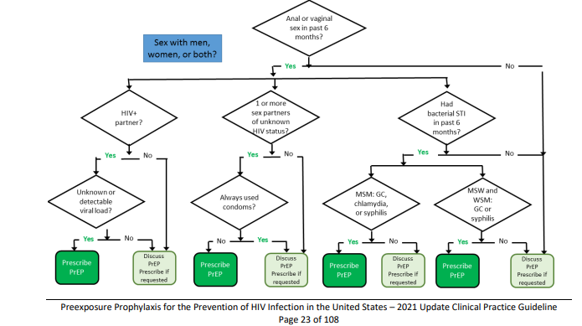

Slide 4
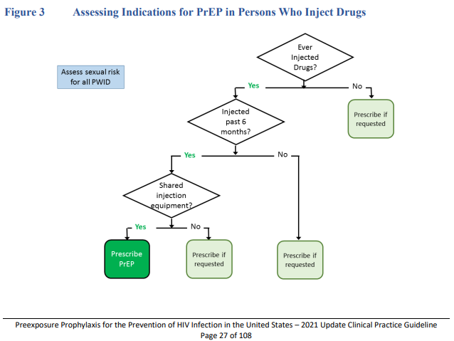

Slide 5
HIV Testing
HIV testing with confirmed results from within the past 7 days is required to document that patients do not have HIV when they start or re-start taking PrEP medications
The required HIV testing before initiation can be accomplished by drawing blood (serum) and sending the specimen to a laboratory for an antigen/antibody test or performing a rapid, point-of-care, FDA-approved, fingerstick antigen/antibody blood test
In the context of PrEP, rapid tests that use oral fluid should not be used to screen for HIV infection because they are less sensitive for the detection of acute or recent infection than blood tests

Slide 6
Acute HIV Infection
Clinicians should suspect acute HIV infection in persons who report having engaged in exposure-prone behaviors in the 4 weeks prior to evaluation for PrEP (e.g., a condom broke during sex with an HIV-infected partner, relapse to injection drug use with shared injection equipment)
For all PrEP candidates with a negative or an indeterminate result on an HIV antigen/antibody who report a recent possible HIV exposure event, clinicians should next solicit a history of signs or symptoms of viral infection during the preceding month

Slide 7
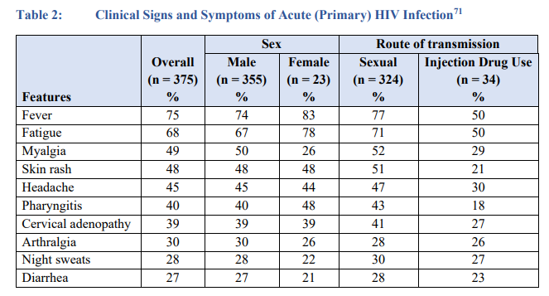

Slide 8
HIV Testing
While HIV-1 RNA testing is sensitive, healthcare providers should be aware that available assays might yield false-positive low viral load results (e.g., <200 copies/mL)
Without confirmatory tests, such false-positive results can lead to misdiagnosis of HIV infection
When clinicians prescribe PrEP based solely on the results of point of care rapid tests, a laboratory antigen/antibody test should always be ordered at the time baseline labs are drawn. This will increase the likelihood of detecting unrecognized acute infection so that the patient can be transitioned from PrEP to antiretroviral treatment in a timely manner

Slide 9
Testing for Sexually Transmitted Infections
Tests to screen for syphilis are recommended for all adults prescribed PrEP, both at screening and at semi-annual visits
Tests to screen for gonorrhea and chlamydia are recommended for all sexually active adults prescribed PrEP, both at screening, for MSM at quarterly visits, and for cis-gender women at semi-annual visits (gonorrhea) and every 12 months (chlamydia)
For MSM, gonorrhea and chlamydia screening using NAAT tests are preferred because of their sensitivity. Pharyngeal, rectal, and urine specimens should be collected (“3-site testing”) to maximize the identification of infection. Patient self-collected samples have equivalent performance as clinician-obtained samples and can help streamline patient visit flow

Slide 10
Renal Function
In addition to confirming that any patient starting PrEP medication is not infected with HIV, a clinician must assess renal function because decreased renal function is a potential safety issue for the use of F/TDF or F/TAF as PrEP
For all persons considered for PrEP with either F/TDF or F/TAF, a serum creatinine test should be done, and an eCrCL should be calculated by using the Cockcroft-Gault formula.
Any person with an eCrCl of ≥60 ml/min can safely be prescribed PrEP with F/TDF. PrEP with F/TAF can be safely prescribed for persons with eCrCl >30

Slide 11
Testing for Infection with Hepatitis B Virus (HBV)
Tenofovir and emtricitabine are also used to treat chronic HBV infection. When these drugs are discontinued, patients with HBV infection may experience clinically significant hepatitis flares.
Prior to prescribing PrEP, patients should be screened for HBV so that in the event they have HBV infection, they can be informed of the danger of stopping PrEP medication without appropriate monitoring for potential hepatitis flares. However, PrEP initiation should not be withheld while waiting for HBV test results.
Patients who are not immune and do not have HBV infection should be vaccinated. Providers prescribing F/TDF or F/TAF as PrEP for patients who have HBV infection (either known or first diagnosed as part of a PrEP evaluation) should do so in consultation with a provider expert in HBV treatment.

Slide 12
Lipid Profile
In the DISCOVER clinical trial comparing F/TDF and F/TAF for PrEP in MSM and transgender women, higher rates of triglyceride elevation and of weight gain were seen among men taking F/TAF than among men taking F/TDF
This may indicate a longer-term safety risk when prescribing F/TAF PrEP for men with pre-existing cardiovascular health risk factors (e.g., obesity, age, lipid profiles)
Persons prescribed F/TAF for PrEP should have monitoring of triglyceride and cholesterol levels every 12 months

Slide 13
Testing Not Indicated for Oral PrEP
In clinical trials for PrEP with F/TDF or F/TAF, additional testing was done to evaluate safety
Findings in those trials indicated that DEXA scans to monitor bone mineral density, liver function tests, hematologic assays, and urinalysis are not indicated for the routine care of all persons prescribed daily oral PrEP

Slide 14
Prescribing Oral PrEP
The fixed-dose combination of F/TDF in a single daily dose is approved by FDA for PrEP in healthy adults and adolescents at risk of acquiring HIV
F/TDF continues to be most commonly prescribed for PrEP (including PWID) who meet criteria for PrEP use
F/TDF is available as a generic medication that is equivalent to the brand name medication

Slide 15
Prescribing Oral PrEP
F/TAF is approved for daily PrEP use by men and transgender women at sexual risk
F/TAF is not approved for PrEP use by women at risk through receptive vaginal sex for whom F/TDF should be prescribed instead
F/TAF and F/TDF have equivalent high efficacy and safety as PrEP for men at sexual risk
Generic F/TAF is not available

Slide 16
Managing Side Effects of Oral PrEP
Patients taking PrEP should be informed of potential side effects. Some (<10%) of patients prescribed F/TDF or F/TAF experience a “start-up syndrome” that usually resolves within the first month of taking PrEP medication. This may include headache, nausea, or abdominal discomfort. OTC medications can help.
Patients should also be counseled about signs or symptoms that indicate a need for urgent evaluation when they occur between scheduled follow-up visits (e.g., those suggesting possible acute renal injury or acute HIV infection)
Weight gain is a reported side effect of F/TAF for PrEP

Slide 17
Follow-up PrEP Care Visits for Oral PrEP
All patients receiving oral PrEP should be seen in follow-up at least every 3 months to:
  Repeat HIV testing and assess for signs or symptoms of acute infection to document that patients are still HIV negative
  Provide a prescription or refill authorization of daily PrEP medication for no more than 90 days (until the next HIV test)
  Assess and provide support for medication adherence and risk-reduction behaviors
  Conduct STI and other recommended testing

Slide 18
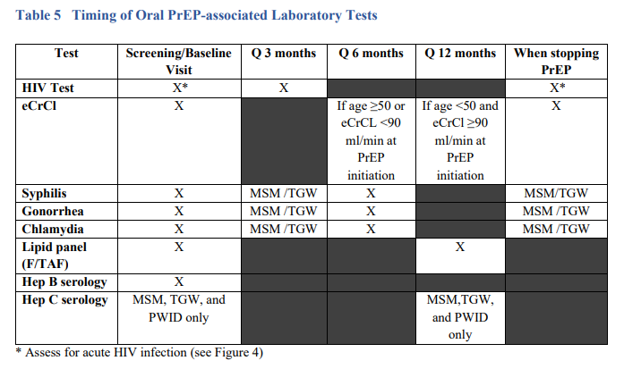

Slide 19
Non-Daily Oral PrEP Regimens for MSM
The “2-1-1” regimen (also called event-driven, intermittent, or “on-demand”) is a nondaily PrEP regimen that times oral F/TDF doses in relation to sexual intercourse events
While not an FDA approved regimen, two clinical trials, IPERGAY and the subsequent Prévenir open label study in Paris have demonstrated the HIV prevention efficacy of 2-1-1 dosing only with F/TDF and only for MSM

Slide 20
Non-Daily Oral PrEP Regimens for MSM
This not an FDA approved regimen and not commonly used in the IHS, but based on trial experience, MSM who are using the 2-1-1 regimen should be counseled to take F/TDF as follows:
• 2 pills in the 2-24 hours before sex (closer to 24 hours preferred) • 1 pill 24 hours after the initial two-pill dose
• 1 pill 48 hours after the initial two-pill dose

Slide 21
Non-Daily Oral PrEP Regimens for MSM
Based on the timing of subsequent sexual events, MSM should be instructed to take additional doses as follows:
If sex occurs on the consecutive day after completing the 2-1-1 doses, take 1 pill per day until 48 hours after the last sexual event.
If a gap of <7 days occurs between the last pill and the next sexual event, resume 1 pill daily
If a gap of 7 days or more occurs between the last pill and next sexual event, start again with 2 pills

Slide 22
Non-Daily Oral PrEP Regimens for MSM
The only U.S. data concerning nondaily dosing among MSM came from the ADAPT HPTN 067 study participants in Harlem, New York
Investigators estimated PrEP effectiveness among those MSM prescribed a time-driven regimen (two doses per week 3-4 days apart) or an event-driven regimen (one pill taken before and another after sex) compared to MSM who were prescribed daily dosing
When assessing PrEP coverage of reported sex acts, predicted effectiveness was significantly lower for the two nondaily dosing patterns (62% and 68%, respectively) compared to daily dosing (80%)

Slide 23
Cabotegravir PrEP Injections
Cabotegravir injections may be especially appropriate for patients with significant renal disease, those who have had difficulty with adherent use of oral PrEP and those who prefer injections every 2 months to an oral PrEP dosing schedule
600 mg of cabotegravir injected into gluteal muscle every 2 months is recommended for PrEP in adults at risk of acquiring HIV
30 mg daily oral cabotegravir is optional for a 4-week lead-in prior to injections

Slide 24
Laboratory Testing for CAB-PrEP Patients
Patients whose HIV test results indicate that they do not have acute or chronic HIV infection can be considered for initiation of cabotegravir injections
Because of the long duration of drug exposure following injection, exclusion of acute HIV infection is necessary with the most sensitive test available, an HIV-1 RNA assay
Ideally, this testing will be done within 1 week prior to the initiation visit. If clinicians wish to provide the first injection at the first PrEP evaluation visit based on the result of a rapid combined antigen/antibody assay, blood should always be drawn for laboratory confirmatory testing that includes an HIV RNA assay

Slide 25
Laboratory Testing for CAB-PrEP Patients
Based on the results of the CAB clinical trials the following laboratory tests are NOT indicated before starting CAB injection or for monitoring patients during its use:
  Creatinine, eCrCl
  Hepatitis B serologies
  Lipid panels
  Liver function tests

Slide 26
Managing Injection Site Reactions
In the clinical trials, injection site reactions (pain, tenderness, induration) were frequent following CAB injections. These reactions were generally mild or moderate, lasted only a few days, and occurred most frequently after the first 2-3 injections
For the first 2-3 injections patients may want to take an over-the-counter pain medication within a couple of hours before or soon after the injection and continue as needed for one to two days
Apply a warm compress or heating pad to the injection site for 15-20 minutes after the injection (e.g., after arriving back at home)

Slide 27
Clinical Follow-up and Monitoring for CAB
Once CAB injections are initiated, patients should return for follow-up visits 1 month after the initial injection and then every 2 months
At visit 1 month after initial injection (month 1, second injection), repeat HIV-1 RNA test and assess for signs or symptoms of acute infection, administer CAB injection and respond to new questions
At each bimonthly visit (beginning with the third injection – month 3), repeat HIV-1 RNA test and assess for signs or symptoms of acute infection and administer CAB injection

Slide 28
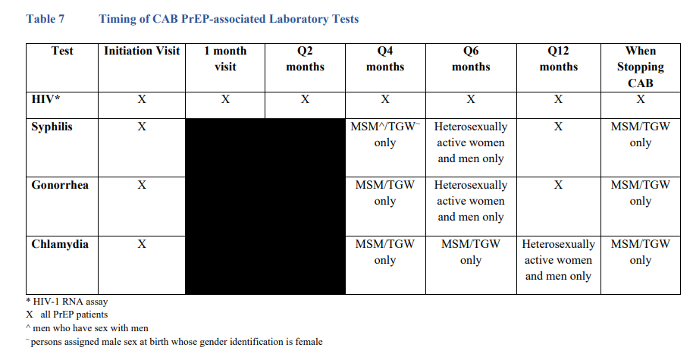

Slide 29
Considerations for HIV Testing in PrEP
Recent data have shown that the performance of HIV tests in persons who acquire HIV infection while taking antiretroviral medications for PrEP differs from test performance in persons not exposed to antiretrovirals at or after the time of HIV acquisition
The antiretrovirals used for PrEP can suppress early viral replication which can affect the timing of antibody development
In HPTN 083, detection among participants in the cabotegravir group with antigen/antibody testing was delayed by a mean of 62 days compared to detection by qualitative HIV-1 RNA assay for infections determined to have been present at baseline; the delay was 98 days for incident infections. Among participants in the F/TDF group, detection by antigen/antibody testing was delayed by a mean of 34 days from qualitative HIV-1 RNA detection for baseline infections and 31 days for incident infections

Slide 30
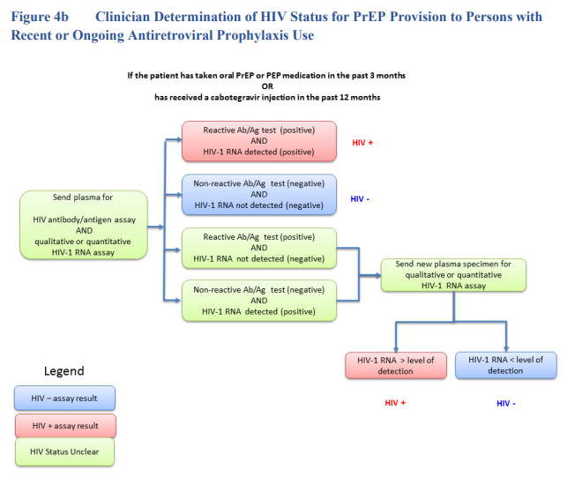

Slide 31
References
1. Grohskopf LA, Chillag KL, Gvetadze R, et al. Randomized trial of clinical safety of daily oral tenofovir disoproxil fumarate (TDF) among HIV-uninfected men who have sex with men (MSM) in the United States. J Acquir Immune Defic Syndr. 2013; 64(1):79-86.
2. Grant RM, Lama JR, Anderson PL, et al. Preexposure chemoprophylaxis for HIV prevention in men who have sex with men. N Engl J Med. 2010;363(27):2587-99. doi:10.1056/NEJMoa1011205
3.Mayer KH, Molina J-M, Thompson MA, et al. Emtricitabine and tenofovir alafenamide vs emtricitabine and tenofovir disoproxil fumarate for HIV pre-exposure prophylaxis (DISCOVER):primary results from a multicentre, active-controlled, phase 3, noninferiority trial. The Lancet. 2020;396(10246):239-254.
4. HIV Prevention Trials Network. HPTN 084 Study Demonstrates superiority of CAB LA to oral FTC/TDF for the prevention of HIV. 2020
5. Landovitz RJ, Donnell D, Clement ME, et al. Cabotegravir for HIV prevention in cisgender men and transgender women. N Engl J Med. 2021;385(7):595-608
6. Preexposure Prophylaxis for the Prevention of HIV Infection in the United States – 2021 Update Clinical Practice Guideline

