Slide 1
Resilience Challenges Beyond the COVID Response
.
.
Look
Link
Listen
.
Nomi C. Levy-Carrick, MD, MPhil
Vice Chair, Clinical Programs, Dept Psychiatry, Brigham and Women’s Hospital
Co-Chair, Mass General Brigham Trauma-Informed Care Initiative
Assistant Professor, Harvard Medical School
September 17, 2022

Slide 2

Acknowledging the Current Situation
in Indian Country and Beyond
  Inequity preceded COVID
  Inequity magnified and amplified by COVID
  Resilience/coping strategies preceded COVID
  Resilience/coping strategies utilized and further developed during COVID

Slide 3


Stress and coping in the age of COVID
Resilience: Individual and systems components
Challenges to resilience: shared nomenclature
Strategies for managing acute vs chronic stress

Slide 4
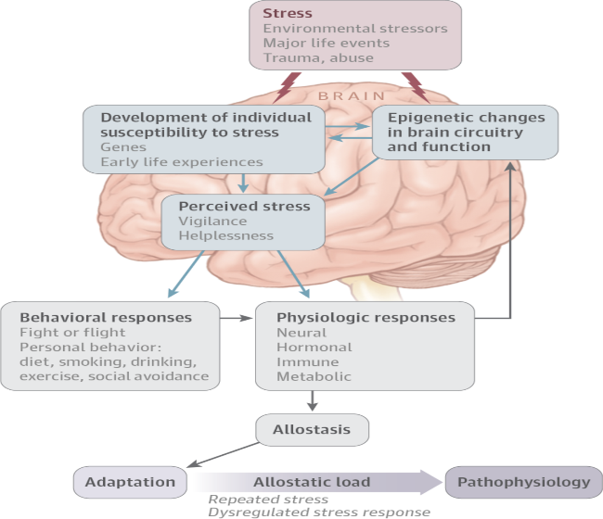
Stress response: seeking allostasis
“blood memory”
McEwen, JAMA Psychiatry 2017

Slide 5
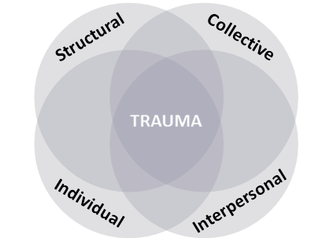
What is Trauma? (2.0)
©Lewis-O’Connor A 2015, ©Rittenberg E 2015, ©Grossman S 2015. Updated 2018, 2021
Notes:
Trauma is experienced by many patients in the emergency department, but also by staff, including clinicians. Since trauma has profound impacts on the delivery of care, policy should support education and culture that provides appropriate care in this context from the individual to the organizational level.

Slide 6
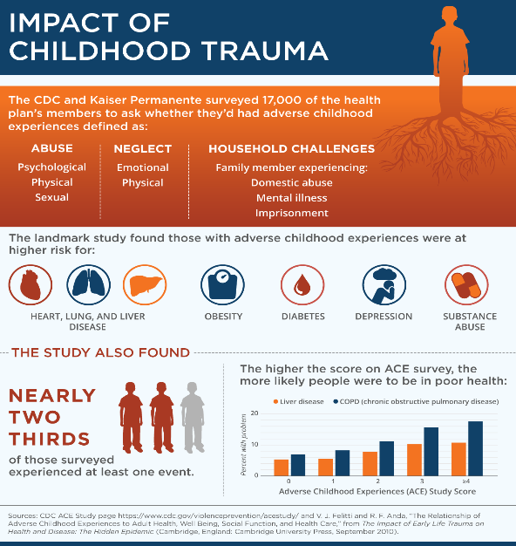


Slide 7
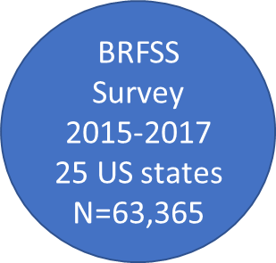
Health Impact of ACEs on Adults- 2019 MMWR
61% report at least 1 ACE
16% report 4+ ACEs
Women, AI/AN, Black, and Other
more likely to report 4+ ACEs than Men and Whites
Adjusted Odds Ratio: 4+ vs 0 ACE exposures
Obesity 1.2 Stroke 2.1 Depression 5.3
Diabetes 1.4 Asthma 2.2 COPD 2.8
CHD 1.8 Heavy drinking 1.8 Smoking 3.1
Merrick MT, Ford DC, Ports KA, et al. Vital Signs: Estimated Proportion of Adult Health Problems Attributable to Adverse Childhood Experiences and Implications for Prevention — 25 States, 2015–2017. MMWR Morb Mortal Wkly Rep 2019;68:999-1005. DOI: http://dx.doi.org/10.15585/mmwr.mm6844e1external icon.

Slide 8
Ubiquity of Trauma Exposures
World Mental Health Survey Consortium (2016) N=27 countries
  Lifetime trauma exposure >70%; 30.5% >4
Averse Childhood Experiences (ACE) Study (1998) N=17,377
  63% at least one trauma exposure, 20% >3
Benjet C, Bromet E, Karam EG, et al. The epidemiology of traumatic event exposure worldwide: results from the World Mental Health Survey Consortium. Psychol Med. 2016;46(2):327-343. doi:10.1017/S0033291715001981
Notes:
Violently injured patients who present to the ED are often affected by physical and psychological trauma, and these experiences may affect administration and acceptance of care.
The ED experience can be overwhelming with activity, interaction with large care teams, medical jargon, and fear of judgment, as well as reminders of past negative experiences for some patients (Fischer et al., 2019).
Patient perception of stigma from healthcare and of disparities between themselves and their providers, poor communication, and mistrust also reduce quality of care (Hawkins et al., 2021).

Slide 9
TRAUMA ON THE BRAIN
Emotional Regulation and Executive Function
Threat Detection
Contextual Processing
Fear Learning

Slide 10
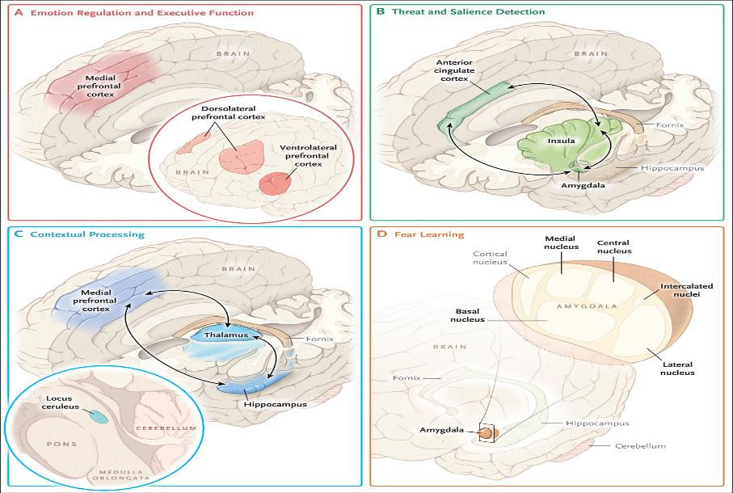
Shalev A et al. N Engl J Med 2017;376:2459-2469.
Notes:
Figure 1. Brain Regions Implicated in the Pathophysiology of Post-Traumatic Stress Disorder (PTSD). Shown are the known connectivity paths within four dysfunctional circuits that play a part in the psychopathology of PTSD: emotion regulation and executive function, threat detection, contextual processing, and fear learning.
From Admon et al 2013: These regions include the amygdala, hippocampus, insula, and various regions in the medial wall of the prefrontal lobe [including the dorsomedial prefrontal cortex, vmPFC, orbitofrontal cortex (OFC), rostral anterior cingulate cortex (rACC) and dorsal anterior cingulate cortex (dACC)]

Slide 11
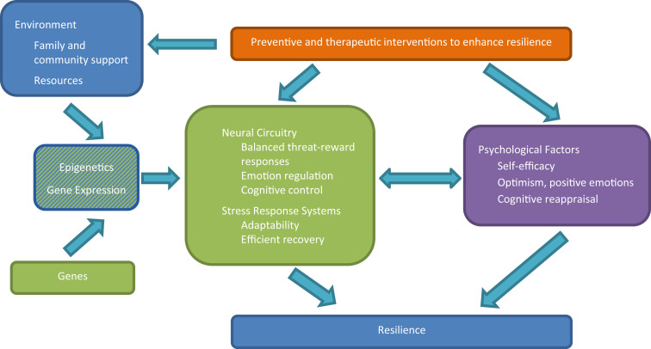
Feder A, Fred-Torres S, Southwick SM, Charney DS. The Biology of Human Resilience: Opportunities for Enhancing Resilience Across the Life Span. Biol Psychiatry. 2019 Sep 15;86(6):443-453. doi: 10.1016/j.biopsych.2019.07.012. Epub 2019 Jul 24. PMID: 31466561.
Resilience

Slide 12

A Shared Understanding (a.k.a. Definitions)
Resilience
Burnout
Moral Injury
Grief
Acute Stress Response
Post Traumatic Stress Disorder
Post Traumatic Growth
Trauma-Informed Care

Slide 13
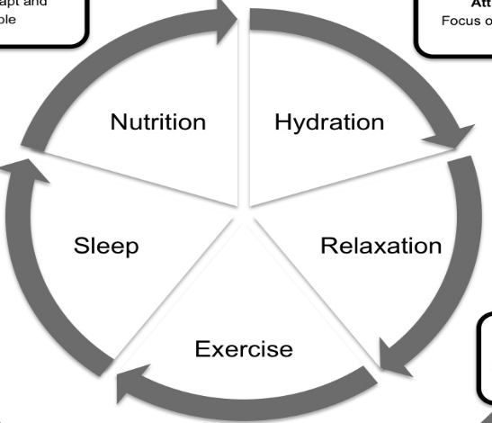
RESILIENCE-Associated Traits
Ability to problem solve
Optimism
Attitude to life
Self-belief
Focus
Sense of Humor
Emotional Awareness
Social Support
Control (of self)

Slide 14




Resilience Throughout the Life Span
Developmental Stage | Emotional Brain | Key Risk Factors | Key Protective Factors | Examples of Resilience-Enhancing Interventions
Childhood | Subcortical development ( 341 ) | Childhood trauma and neglect Poverty | Solid bond with caregiver 42434445464748 Family stability (48) Ample resources (132) | Early parenting and family interventions (4056129130131 Provision of resources (132)
Adolescence | Subcortical-cortical development (49) | Weaker executive function/self-control Poor self-efficacy Poor social skills Low parental support | Strong executive function (4648109) Self-efficacy (4648) Positive relationships with peers (5051) Mastering challenges (52) Family support and stability (4048) Role models (53) | Family and community interventions (4056) School-based interventions (133) Positive development programs (133134) Resiliency programs (135136)
Adulthood | Cortical development reaches maturity by young adulthood (49) | Poor self-efficacy Weaker executive function Low social support | Emotion regulation capacity, executive function (7172) Optimism/positive emotions 74757677 Habitual cognitive reappraisal (110111) Active coping (52) Meaning and purpose (52) Social support 798081 Role models (52) | Hardiness training (137) Preparedness training (138139) Cognitive behavioral therapies (52) Attention and cognitive emotional training 140141142
Older Age | Reduced prefrontal cortex stress resilience (102) | Poor health Impaired cognition Low social support | Intact cognition (101) Acceptance (104) Social support (143146) | Cognitive remediation (143) Social engagement (143146) Physical exercise (144145)
Feder A, Fred-Torres S, Southwick SM, Charney DS. The Biology of Human Resilience: Opportunities for Enhancing Resilience Across the Life Span. Biol Psychiatry. 2019 Sep 15;86(6):443-453. doi: 10.1016/j.biopsych.2019.07.012. Epub 2019 Jul 24. PMID: 31466561.
Notes:
Table 1
Resilience Throughout the Life Span
Resilience at each stage is influenced by genetics and gene × environment interactions (see text, Genetics and Genomics of Resilience).

Slide 15
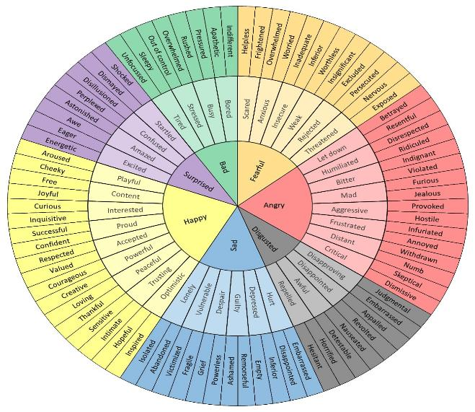
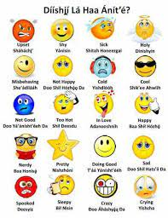
Emotional Vocab Wheel
no copyright infringement is intended
https://flowingdata.com/2020/03/20/wheel-of-emotional-words/
https://www.youtube.com/watch?v=N-ImeAGg26Y

Slide 16
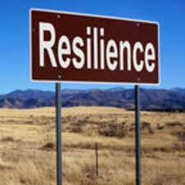
Resilience in an Organization
Good, clear, timely communication, information and training
Fostering team spirit and cohesion
Promoting wellbeing through flexible, responsive resourcing
Promoting self-efficacy through skills-building/training
Psychological and wellbeing resources for staff
  Voluntary huddles, not mandatory debriefing
COVID Trauma Response Working Group Rapid Guidance (www.traumagroup.org)

Slide 17
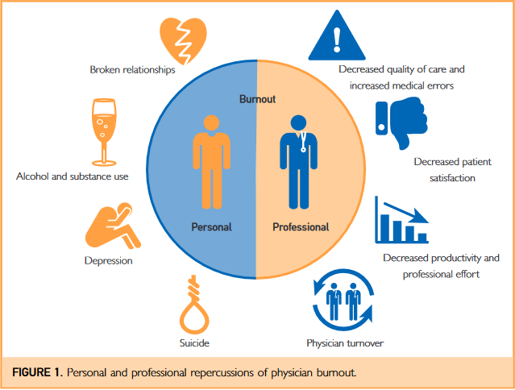
Burnout
A product of chronic workplace stress characterized by exhaustion, negativity, and reduced productivity.
Other signs include hopelessness, cynicism and mentally distancing oneself while at the workplace.
Tait D. Shanafelt, MD, and John H. Noseworthy, MD (2017) https://www.mayoclinicproceedings.org/article/S0025-6196(16)30625-5/pdf
Bryant-Genevier J, Rao CY, et al MMWR Morb Mortal Wkly Rep 2021;70:1680–1685.

Slide 18
Public Health Workers: CDC Study 2021
Thanks to Dr. Margaret Cary for bringing my attention to this study!
Surveyed state, tribal, local, and territorial public health workers (N=26,174)
52.8% reported symptoms of at least one mental health condition in the past 2 weeks.
Symptoms were more prevalent among:
  those who were unable to take time off or worked ≥41 hours per week
  More time on COVID response
  Younger (<29yo) and Transgender/non-binary
Bryant-Genevier J, Rao CY, Lopes-Cardozo B, et al. Symptoms of Depression, Anxiety, Post-Traumatic Stress Disorder, and Suicidal Ideation Among State, Tribal, Local, and Territorial Public Health Workers During the COVID-19 Pandemic — United States, March–April 2021. MMWR Morb Mortal Wkly Rep 2021;70:1680–1685. DOI: http://dx.doi.org/10.15585/mmwr.mm7048a6

Slide 19
Public Health Workers: CDC Study 2022
Surveyed state, tribal, local, and territorial public health workers (N=26,069)
48.0% reported symptoms of at least one mental health condition in the past 2 weeks.
Symptoms were more prevalent among:
  those who were unable to take time off or worked ≥60 hours per week
  More time on COVID response
  Younger (<29yo), Transgender/non-binary, or identified as multiple races
Koné A, Horter L, Thomas I, et al. Symptoms of mental health conditions and suicidal ideation among State, Tribal, Local, and Territorial Public Health Workers — United States, March 14–25, 2022. MMWR Morb Mortal Wkly Rep 2022;71:925–930. DOI: http://dx.doi.org/10.15585/mmwr.mm7129a4
Notes:
“Nationwide, 27% of the governmental public health workforce reported considering leaving their organization within the next 5 years for reasons other than retirement... A total of 44% reported considering leaving their organization to retire or for other reasons; 76% began thinking about leaving since the start of the COVID-19 pandemic.” (Hare et al., 2022)
Compared with the comparable 2021 study, prevalence of reported PTSD symptoms was 15.7% lower in public health workers who worked >60 hours/week with ≥76% of duty dedicated to COVID-19. However, prevalence ratios increased, and the prevalence of PTSD symptoms in this group was 49.5%.
Mental health symptoms were less likely to be reported among those who reported an increase in mental health support resources through their employer. However, 75.5% of public health respondents employers reported that their employers had not increased mental health support for staff since March 2021. (Koné et al., 2022).
Hare Bork R, Robins M, Schaffer K, Leider JP, Castrucci BC. Workplace Perceptions and Experiences Related to COVID-19 Response Efforts Among Public Health Workers — Public Health Workforce Interests and Needs Survey, United States, September 2021–January 2022. MMWR Morb Mortal Wkly Rep 2022;71:920–924. DOI: http://dx.doi.org/10.15585/mmwr.mm7129a3

Slide 20

Moral Injury or Moral Distress
Injury to core values and often occurs when one is unable to provide maximal care for individual patients due to limitations that are outside of their control.
  Can include witnessing or learning about these circumstances.
Signs include guilt, shame, outrage, distrust, and isolation.
Biopsychosociospiritual model recommended as framework for addressing moral injury
https://www.ptsd.va.gov/professional/treat/cooccurring/moral_injury.asp
Notes:
Guilt, shame, and betrayal are hallmark reactions of moral injury (e.g., 3). Guilt involves feeling distress and remorse regarding the morally injurious event (e.g., "I did something bad."). Shame is when the belief about the event generalizes to the whole self (e.g., "I am bad because of what I did.") (4). Betrayal can occur when someone observes trusted peers or leaders act against values and can lead to anger and a reduced sense of confidence and trust (5).

Slide 21

Grief – Six Stages, Multiple Sources
Denial
Anger
Bargaining
Sadness
Acceptance
Meaning
In Memorium
David Kessler, https://hbr.org/2020/03/that-discomfort-youre-feeling-is-grief

Slide 22
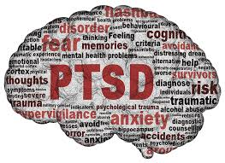

Trauma and Stress-Related Disorders
4 categories of symptoms
  Intrusion symptoms
  Avoidance
  Negative alterations in cognitions and mood
  Alterations in arousal and reactivity (incl sleep disturbance)
Time frames
  Acute Stress Disorder: 3 days to 1 month
  PTSD >1 month
  Delayed onset - >6 months after stressor
Functional impact
Heterogeneity: 636,120 ways to have PTSD
DSM-V, Galatzer-Levy and Bryant 2013
Notes:
exposure to trauma, as in emergency work, is associated with greater rates of distress and development of complex post-traumatic stress disorder, which can lead to difficulties in continuing a trauma-exposing position. Secondary traumatic stress results from indirect exposure to the trauma, as in patient care, and vicarious traumatization results from empathizing with a victim of trauma (Brooks, 2019).
The “second victim phenomenon,” or “vicarious trauma,” affects up to half of healthcare workers throughout their careers and occurs when a patient’s adverse event effects the mental health of the provider (Fischer et al., 2019; Gispen & Wu, 2018). Compassion fatigue results in increased mistakes and lower quality of care (Fischer, 2019).
Recognition of these in the self and in others is important in addressing them.
Intrusive memories, dreams, dissociative reactions (flashbacks), prolonged distress at exposure to trigger
Negative alterations: inability to remember important aspects of the event; persistent and exaggerated negative beliefs (“I am bad”, “no one can be trusted”, “my whole nervous system is permanently ruined.”; distorted cognitions that lead to self-blame; fear/horror/anger/guit/shame, anhedonia, feelings of detachment from others
Difficulty with sleep

Slide 23
A PATH TO POST-TRAUMATIC GROWTH
Fear Zone
Learning Zone
Growth Zone

Slide 24
THE PATH TO POST-TRAUMATIC GROWTH
Spiritual Changes
Personal Strength
New Possibilities
Growth Zone
Relating to Others
Appreciation
for Life
https://www.phoenixtraumacenter.com/post-traumatic-growth/

Slide 25

https://ifunny.co/picture/i-hate-that-moment-when-you-re-tired-and-sleepy-ggOJmYfu4?s=cl

Slide 26
The Trauma-Informed Approach
  Realizes the widespread impact of trauma and understands potential paths for recovery
  Recognizes how trauma affects all individuals involved in an organization, including its own workforce
  Responds by fully integrating knowledge about trauma into policies, procedures, and practices
  Resists re-traumatization
A TI approach refers to a change in organizational culture.

Slide 27
TRAUMA-INFORMED CARE
Safety: Physical and psychological
Trustworthiness and transparency
Collaboration and mutuality
Empowerment, voice, and choice
Cultural, historical, and gender acknowledgment
Peer
support
https://www.samhsa.gov/
www.samhsa.org/TIC

Slide 28
Trauma-Informed Approach vs Trauma-Focused Treatment
Focus on optimizing engagement [in health care]
Universal precautions
Universal framing
Avoid retriggering
Variability of role and context of care
Addressing trauma experience directly
Treatment focused on resolution of trauma-related symptoms
May require detailed trauma history as part of the treatment

Slide 29
Six Guiding Principles of TIC
(And corollaries to PFA Core Actions and VA’s Stress First Aid)
Safety: Physical & psychological
Trustworthiness & transparency
Safety and comfort
Stabilization (prn); info sharing
Peer Support
Collaboration & Mutuality
Connection with social supports
Contact and engagement
Empowerment, Voice, Choice
Cultural, Historical, & Gender Acknowledgment
Practical assistance,
link to services
Identify current needs, concerns
Nomi Levy-Carrick ©2020

Slide 30
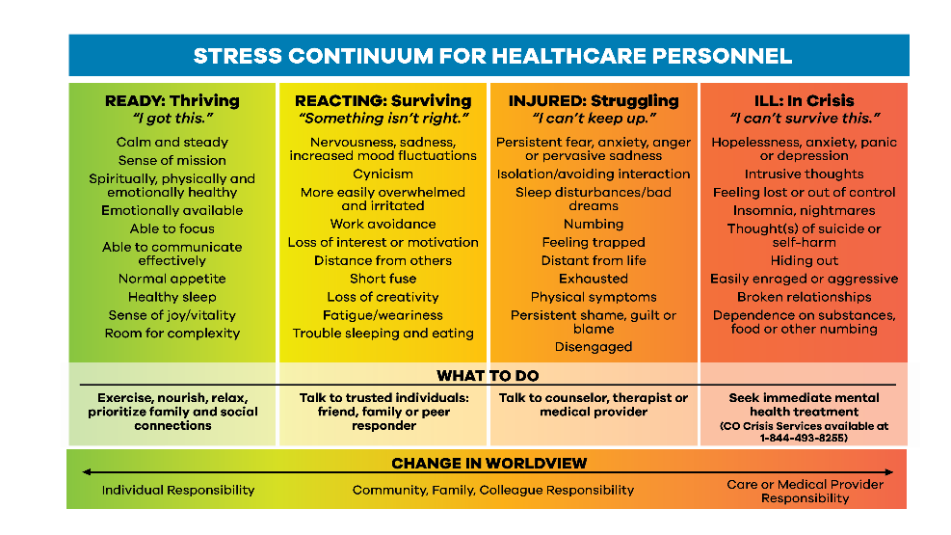
Denver Health/RISE
Suicide Postvention - https://www.mirecc.va.gov/visn19/postvention/workplace/your_plan.asp

Slide 31
Resilience on the Front Line
Role clarity
Self-Efficacy
Empower-ment
©Nomi Levy-Carrick 2019
Notes:
Empowerment cited explicitly in the Stop the Bleed literature; role-clarity as “immediate responder”
Elements of creativity, sense of humor
Resilience is really an umbrella term that encompasses many attributes that help us bounce back cognitively and emotionally after a major stressor – to bend, not break.
The first is Role Clarity: #this is our lane; clinical practice and public health leadership are crucial to promote prophylaxis, mitigation, healing and health. And peer support can never be reinforced enough as a crucial role
Self-efficacy refers to an individual (or community’s) belief in a capacity to apply skills to produce a desired outcome –and it is a modifiable psychological trait. It can be learned and taught, modeled, mentored and nurtured
The third aspect is empowerment: the process (and it is a process) of becoming stronger and more confident in our ability to make an impact in our roles. And so the cogs of the wheel intersect and move the mechanism forward. We can easily feel overwhelmed or helpless in the face of this magnitude of communal violence and individual suffering, and while distress may be unavoidable, the ability to retain a sense of agency and purpose, of collaboration with providers and patients, and of connectivity with supports means that while PTSD is a risk, post-traumatic growth is also a possibility (and these are not mutually exclusive).

Slide 32

SAFETY | Physical and psychological safety
TRUSTWORTHINESS + TRANSPARENCY | Decisions are made with transparency to establish trust
PEER SUPPORT | Integration of individuals in the organization with shared experiences to facilitate delivery of service
COLLABORATION | Recognition of power differences among staff and with patients Honor all perspectives in shared decision-making
EMPOWERMENT | Acknowledge and build on patient and staff strengths Believe in resilience and ability to recover from trauma
CULTURAL HUMILITY + RESPONSIVENESS | Recognize and address stigma, biases, stereotypes (e.g., based on race, ethnicity, gender identity, sexual orientation, age, social determinants of health, language, diagnosis, behaviors) and lived experiences
Adapted- Trauma-Informed Care, Implementation Resource Center https://www.traumainformedcare.chcs.org/what-is-trauma-informed-care/
Notes:
SAFETY
Partner with the patient to promote safety (Brown et al., 2022)
Are you aware how interpersonal and collective trauma impacts health and wellness
Understand and acknowledge that how a patient responds and reacts- may be from past trauma and experiences with structural systems.
Do you understand the importance of “What happened to you?” rather than ’What’s wrong with you?”
TRUSTWORTHINESS AND TRANSPARENCY
Share the computer screen with patients- review of meds, and documentation re: sensitive information.
Be explicit about the limits of confidentiality, who to share information with.
Listening and respecting patient’s preferences, while acknowledging strengths
PEER SUPPORT
Provide Community-based resources- connections reduces isolation and promotes healing
Closed loop communication is ideal re: follow-up to assess if patient got connected
Be intentional in developing peer support not only for patients but for staff
COLLABORATION
Set a shared agenda for the visit- “ What would you like to accomplish this visit?”
Consider ways to promote collaboration with patients, colleagues and staff.
Consider conducting 15 min huddles on complex cases.
Provide warm hand-overs and develop a closed feedback loop
EMPOWERMENT
Increase shared decision- proactively include patients in their plan of care.
Support the patient in self- management choices (even when you might not agree).
Ask permission as you move through encounter: (“Would that work?” “Do you need a break?”)
Acknowledge pt. strengths- “tell me what you are proud of” and seek to reflect on them “I am really impressed that you XXXX”
HUMILITY AND RESPONSIVENESS
Seek to increase self-awareness of unconscious bias, stigma- Avoid judgement or making assumptions by being reflective following encounters with staff and patients
Acknowledge that cultural and historical backgrounds differ and adopt a curious stance , suspending judgment and having humility around learning from your patients
Ask patients how their backgrounds have shaped their healthcare experiences ; and what would be helpful for them to engage

Slide 33
Strategies: short and long-term
Recognizing multiple roles
  as frontline clinician and colleague
  as advocate (lessons learned will always be relevant)
  as family member and friend
Contextual Processing
  Recognize limitations of the system
  Identify resources in the system, interpersonally, and individually
    Huddles, team-based care, EMR templates, resources & reminders of resources
    Formal and informal frameworks to support individual resilience and team cohesion
Maintaining meaning and sense of purpose

Slide 34
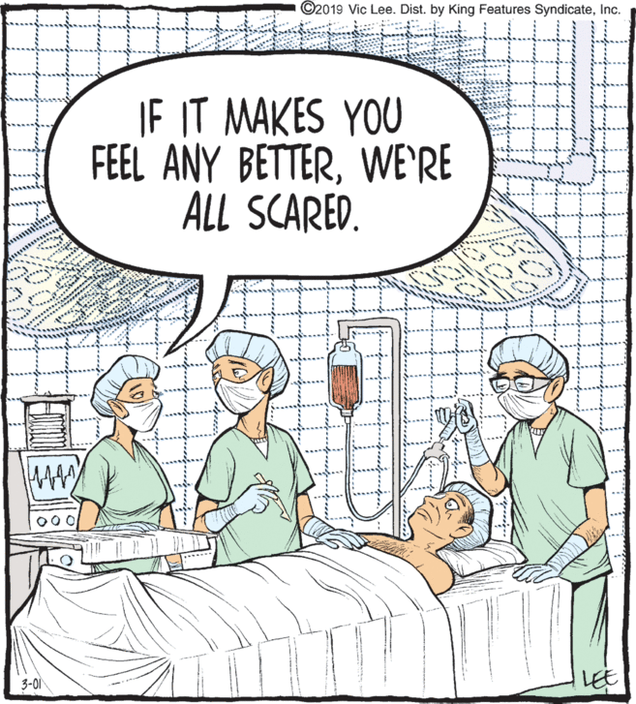
https://i0.wp.com/www.dailycartoonist.com/wp-content/uploads/2019/03/pmp.gif?ssl=1
Notes:
From https://i0.wp.com/www.dailycartoonist.com/wp-content/uploads/2019/03/pmp.gif?ssl=1

Slide 35
References
Admon R, Milad MR, Hendler T. (2013) A causal model of post-traumatic stress disorder: disentangling predisposed from acquired neural abnormalities. Trends in Cognitive Sciences, 17(7).
Agboola, Coupet, E., & Wong, A. H. (2021). “The Coats That We Can Take Off and the Ones We Can’t”: The Role of Trauma-Informed Care on Race and Bias During Agitation in the Emergency Department. Annals of Emergency Medicine, 77(5), 493–498. https://doi.org/10.1016/j.annemergmed.2020.11.021
Akhtar, Faize, F. A., Malik, R. Z., & Tabusam, A. (2022). Moral injury and psychological resilience among healthcare professionals amid COVID-19 pandemic. Pakistan Journal of Medical Sciences, 38(5), 1338. https://doi.org/10.12669/pjms.38.5.5122
Albuquerque J, Tulk S. Physician suicide (2019) CMAJ 2019 May 6; 191:E505.
American Psychiataric Association’s Diagnostic and Statistical Manual of Mental Disorders (2013), 5th Edition: DSM-5. Arlington VA: American Psychiatric Publishing.
Anand KS, Dhikav V. Hippocampus in health and disease: An overview. Ann Indian Acad Neurol. 2012 Oct;15(4):239-46. doi: 10.4103/0972-2327.104323. PMID: 23349586; PMCID: PMC3548359.
Arnsten AF. Stress signalling pathways that impair prefrontal cortex structure and function. Nat Rev Neurosci. 2009 Jun;10(6):410-22. doi: 10.1038/nrn2648. PMID: 19455173; PMCID: PMC2907136.
Averill, L. A., Averill, C. L., Kelmendi, B., Abdallah, C. G., & Southwick, S. M. (2018). Stress Response Modulation Underlying the Psychobiology of Resilience. Current psychiatry reports, 20(4), 27. https://doi.org/10.1007/s11920-018-0887-x
Benjet C, Bromet E, Karam EG, et al. The epidemiology of traumatic event exposure worldwide: results from the World Mental Health Survey Consortium. Psychol Med. 2016;46(2):327-343. doi:10.1017/S0033291715001981
Brooks, Amlôt, R., Rubin, G. J., & Greenberg, N. (2020). Psychological resilience and post-traumatic growth in disaster-exposed organisations: overview of the literature. BMJ Military Health, 166(1), 52–56. https://doi.org/10.1136/jramc-2017-000876
Brooks, Rubin, G. J., & Greenberg, N. (2019). Traumatic stress within disaster-exposed occupations: overview of the literature and suggestions for the management of traumatic stress in the workplace. British Medical Bulletin, 129(1), 25–34. https://doi.org/10.1093/bmb/ldy040
Brown, T., Ashworth, H., Bass, M., Rittenberg, E., Levy-Carrick, N., Grossman, S., Lewis-O'Connor, A., & Stoklosa, H. (2022). Trauma-informed Care Interventions in Emergency Medicine: A Systematic Review. The western journal of emergency medicine, 23(3), 334–344. https://doi.org/10.5811/westjem.2022.1.53674

Slide 36
References
Chang, & Yu, R. (2019). Hippocampal connectivity in the aftermath of acute social stress. Neurobiology of Stress, 11, 100195–100195. https://doi.org/10.1016/j.ynstr.2019.100195
Chakraborty, & Chattarji, S. (2019). Interventions after acute stress prevent its delayed effects on the amygdala. Neurobiology of Stress, 10, 100168–100168. https://doi.org/10.1016/j.ynstr.2019.100168
Fischer, Bakes, K. M., Corbin, T. J., Fein, J. A., Harris, E. J., James, T. L., & Melzer-Lange, M. D. (2019). Trauma-Informed Care for Violently Injured Patients in the Emergency Department. Annals of Emergency Medicine, 73(2), 193–202. https://doi.org/10.1016/j.annemergmed.2018.10.018
Fisher, Beauchamp, K. G., Roos, L. E., Noll, L. K., Flannery, J., & Delker, B. C. (2016). The Neurobiology of Intervention and Prevention in Early Adversity. Annual Review of Clinical Psychology, 12(1), 331–357. https://doi.org/10.1146/annurev-clinpsy-032814-112855
Galatzer-Levy IR and Bryan RA (2013) 636,120 Ways to Have Posttraumatic Stress Disorder. Perspectives on Psychological Science 8(6) 651-662.
Gispen, F., & Wu, A. W. (2018). Psychological first aid: CPR for mental health crises in healthcare. Journal of Patient Safety and Risk Management, 23(2), 51–53. https://doi.org/10.1177/2516043518762826
Goldberg, Eapen, B., & Kamen, L. (2020). Introduction to the thematic issue on stress, pain and the brain Conceptualizing rehabilitation as facilitated allostasis and the mitigation of uncertainty. NeuroRehabilitation (Reading, Mass.), 47(1), 1–10. https://doi.org/10.3233/NRE-200003
Goldstein. (2021). Stress and the “extended” autonomic system. Autonomic Neuroscience, 236, 102889–102889. https://doi.org/10.1016/j.autneu.2021.102889
Hambrick, E. P., Rubens, S. L., Vernberg, E. M., Jacobs, A. K., & Kanine, R. M. (2013). Towards Successful Dissemination of Psychological First Aid: A Study of Provider Training Preferences. The Journal of Behavioral Health Services & Research, 41(2), 203–215. https://doi.org/10.1007/s11414-013-9362-y
Hanson, & Nacewicz, B. M. (2021). Amygdala Allostasis and Early Life Adversity: Considering Excitotoxicity and Inescapability in the Sequelae of Stress. Frontiers in Human Neuroscience, 15, 624705–624705. https://doi.org/10.3389/fnhum.2021.624705
Hare Bork R, Robins M, Schaffer K, Leider JP, Castrucci BC. Workplace Perceptions and Experiences Related to COVID-19 Response Efforts Among Public Health Workers — Public Health Workforce Interests and Needs Survey, United States, September 2021–January 2022. MMWR Morb Mortal Wkly Rep 2022;71:920–924. DOI: http://dx.doi.org/10.15585/mmwr.mm7129a3
Hawkins, Coupet, E., Saint-Hilaire, S., & Dodington, J. (2021). Trauma-Informed Acute Care of Patients With Violence-Related Injury. Journal of Interpersonal Violence, 88626052110413–8862605211041375. https://doi.org/10.1177/08862605211041375
Holzel BK, Carmody J, Evans KC, Hoge EA, Dusek JA et al (2010). Stress reduction correlates with structural changes in the amygdala. Soc Cogn Affect Neurosci 5: 11–17.

Slide 37
References
Horn, & Feder, A. (2018). Understanding Resilience and Preventing and Treating PTSD. Harvard Review of Psychiatry, 26(3), 158–174. https://doi.org/10.1097/HRP.0000000000000194
Joels, Karst, H., & Sarabdjitsingh, R. A. (2018). The stressed brain of humans and rodents. ACTA PHYSIOLOGICA, 223(2), e13066–n/a. https://doi.org/10.1111/apha.13066
Kantor EM, Beckert DR. Psychological First Aid. In: Stoddard FS Jr, Pandya A, Katz CL, editors. Disaster Psychiatry: Readiness, Evaluation, and Treatment. Arlington: American Psychiatric Association Publishing; 2011. pp. 203-212.
Koné A, Horter L, Thomas I, et al. Symptoms of mental health conditions and suicidal ideation among State, Tribal, Local, and Territorial Public Health Workers — United States, March 14–25, 2022. MMWR Morb Mortal Wkly Rep 2022;71:925–930. DOI: http://dx.doi.org/10.15585/mmwr.mm7129a4
Li, S., Papale, L. A., Zhang, Q., Madrid, A., Chen, L., Chopra, P., Keleş, S., Jin, P., & Alisch, R. S. (2016). Genome-wide alterations in hippocampal 5-hydroxymethylcytosine links plasticity genes to acute stress. Neurobiology of disease, 86, 99–108. https://doi.org/10.1016/j.nbd.2015.11.010
Mao, Loke, A. Y., Fung, O. W. M., & Hu, X. (2019). What it takes to be resilient: The views of disaster healthcare rescuers. International Journal of Disaster Risk Reduction, 36, 101112. https://doi.org/10.1016/j.ijdrr.2019.101112
McCall T, Weil ZM, Nacher J, Bloss EB, El Maarouf A et al (2013). Depletion of polysialic acid from neural cell adhesion molecule (PSA-NCAM) increases CA3 dendritic arborization and increases vulnerability to excitotoxicity. Exp Neurol 241: 5–12.
McEwen, BS. Allostasis and the Epigenetics of Brain and Body Health Over the Life Course The Brain on Stress JAMA Psychiatry. Published online April 26, 2017. doi:10.1001/jamapsychiatry.2017.0270
McEwen, Nasca, C., & Gray, J. D. (2016). Stress Effects on Neuronal Structure: Hippocampus, Amygdala, and Prefrontal Cortex. Neuropsychopharmacology (New York, N.Y.), 41(1), 3–23. https://doi.org/10.1038/npp.2015.171
Merrick MT, Ford DC, Ports KA, et al. Vital Signs: Estimated Proportion of Adult Health Problems Attributable to Adverse Childhood Experiences and Implications for Prevention — 25 States, 2015–2017. MMWR Morb Mortal Wkly Rep 2019;68:999-1005. DOI: http://dx.doi.org/10.15585/mmwr.mm6844e1external icon.
Movahed, M., Khaleghi-Nekou, M., Alvani, E., & Sharif-Alhoseini, M. (2022). The Impact of Psychological First aid Training on the Providers: A Systematic Review. Disaster Medicine and Public Health Preparedness, 1-5. doi:10.1017/dmp.2022.27
Ressler KJ. Amygdala activity, fear, and anxiety: modulation by stress. Biol Psychiatry. 2010 Jun 15;67(12):1117-9. doi: 10.1016/j.biopsych.2010.04.027. PMID: 20525501; PMCID: PMC2882379.
Wang, L., Norman, I., Xiao, T., Li, Y., & Leamy, M. (2021). Psychological First Aid Training: A Scoping Review of Its Application, Outcomes and Implementation. International Journal of Environmental Research and Public Health, 18(9), 4594. https://doi.org/10.3390/ijerph18094594

Slide 38
Additional References
Feder A, Fred-Torres S, Southwick SM, Charney DS. The Biology of Human Resilience: Opportunities for Enhancing Resilience Across the Life Span. Biol Psychiatry. 2019 Sep 15;86(6):443-453. doi: 10.1016/j.biopsych.2019.07.012. Epub 2019 Jul 24. PMID: 31466561.
Harold G Koenig, M.D, Donna Ames, M.D et al, Screening for Moral Injury: The Moral Injury Symptom Scale – Military Version Short Form, Military Medicine, Volume 183, Issue 11-12, November-December 2018, Pages e659–e665, https://doi.org/10.1093/milmed/usy017
Samsha.org
http://click.alerts.jamanetwork.com/click/axac-1xbich-mk10ut-b7fgeru6/
https://www.ncbi.nlm.nih.gov/pmc/articles/PMC3573269/
https://www.apa.org/topics/resilience?utm_source=linkedin&utm_medium=social&utm_campaign=apa-pandemics&utm_content=building-resilience
https://onlinelibrary-wiley-com.ezp-prod1.hul.harvard.edu/doi/pdfdirect/10.1002/jclp.22598
Williamson V, et al: COVID-19 and Experiences of Moral Injury Front-Line Workers; Occupational Medicine doi:10.1093/occmed/kqaa052
https://www.npr.org/2020/04/20/839138181/indian-health-service-doctor-details-heavy-covid-19-impact-on-navajo-nation
https://www.statnews.com/2020/04/01/lessons-different-war-protecting-clinicians-moral-injury/
https://curriculum.covidstudentresponse.org/module-5-training-for-medical-student-specific-roles/managing-anxiety-and-stress-and-promoting-self-care
Nomi Levy-Carrick, COVID-related writing
  1-https://www.kevinmd.com/blog/2020/03/a-psychiatric-services-response-to-the-covid-19-crisis.html
  2-https://medium.com/@ariadnelabs/the-covid-resilience-marathon-4dee79f35a51
  3-https://medium.com/@ariadnelabs/bracing-for-the-surge-41ab72e69070
https://www.nytimes.com/2021/11/01/us/virus-navajo-vaccination-rates.html
https://www.healio.com/news/primary-care/20220318/ways-to-reduce-physician-burnout?utm_source=selligent&utm_medium=email&utm_campaign=news&M_BT=3382112830292
https://physiciansfoundation.org/press-releases/new-survey-reveals-55-of-physicians-know-a-physician-who-considered-attempted-or-died-by-suicide/
https://www.ptsd.va.gov/professional/treat/type/stress_first_aid.asp

Slide 39
Incorporation of TIC into Emergency Care
Universal precautions to address widespread impact: Assume Hx of trauma, don’t ask.
Recognition of signs of psychological trauma can prove difficult:
  Acute stress can appear as inattention, numbing as lack of cooperativity, hyperarousal as aggression.
  Recognizing trauma and adjusting treatment and communication can prevent inadvertently worsening the situation.
  Communicate with other staff to share understanding and spread awareness.
Responding: De-escalation where appropriate, minimum restrictive measures. Patient-centered language, awareness of reactions.
With compassionate care and trauma-informed approach, also address implicit and explicit bias.
Education and operations should support a culture of TIC.
Notes:
Fischer et al., 2019
Preliminary outcomes from emergency departments adopting TIC are promising: patients reported improved quality of care, outpatient follow-up rates increased, and patients in mental health crises spent less time in restraints (Brown et al., 2022).

Slide 40
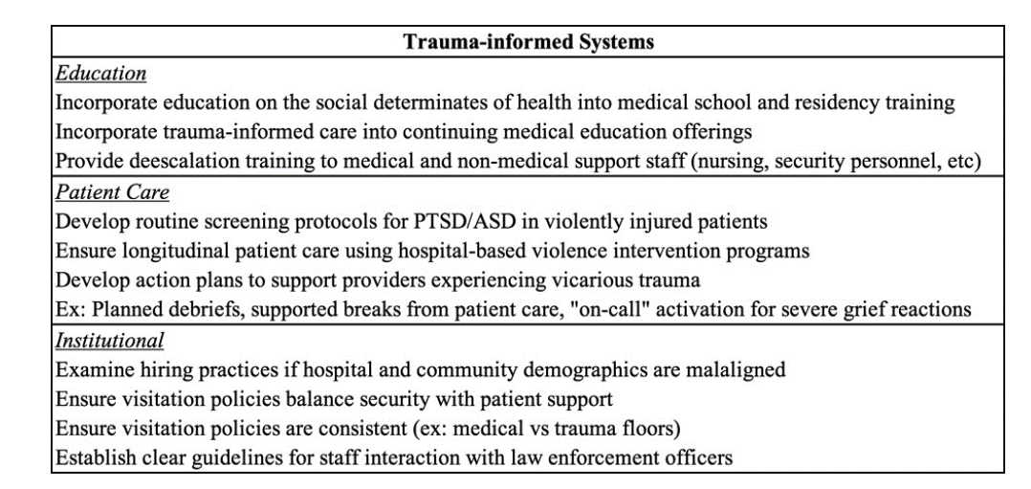
Notes:
ASD = Acute stress disorder. This chart gives some examples of systematic incorporation of trauma-informed principles in a hospital (Fischer et al., 2019).
Education: Propose adding PFA to basic EM curriculum. Recognition of the context in which the patient presents allows the practitioner to recognize and address urgent concerns with self-awareness and objective appreciation of the whole patient’s experience. The resulting dynamic can prophylax against trauma and create a better-attuned and more supportive clinical encounter.
Ops: Integration of a trauma-informed lens at all levels of the organization to promote a cultural shift. Communication among staff to share best practices and resources, recognition of ubiquity of trauma; balance of transparency with patient and establishment of trustworthiness; provision of resources within system for connection, scheduling, and flexibility (for example, connection with hospital-based violence intervention programs can help equip providers to meet the needs of traumatized patients with expert advice and supportive resources for integrated care (Fischer et al., 2019). Fostering collaboration within the hospital (e.g., among specialty teams) and with community resources supports patient care. Hospitals should intentionally foster such partnerships. Environmental analysis of the ED can indicate pathways for reducing exacerbating stress (Brown et al., 2022).
Together, these components work to build a culture that supports staff and patients.
Examples of incorporation on the following slides
(Image from Fischer et al., 2019)

Slide 41
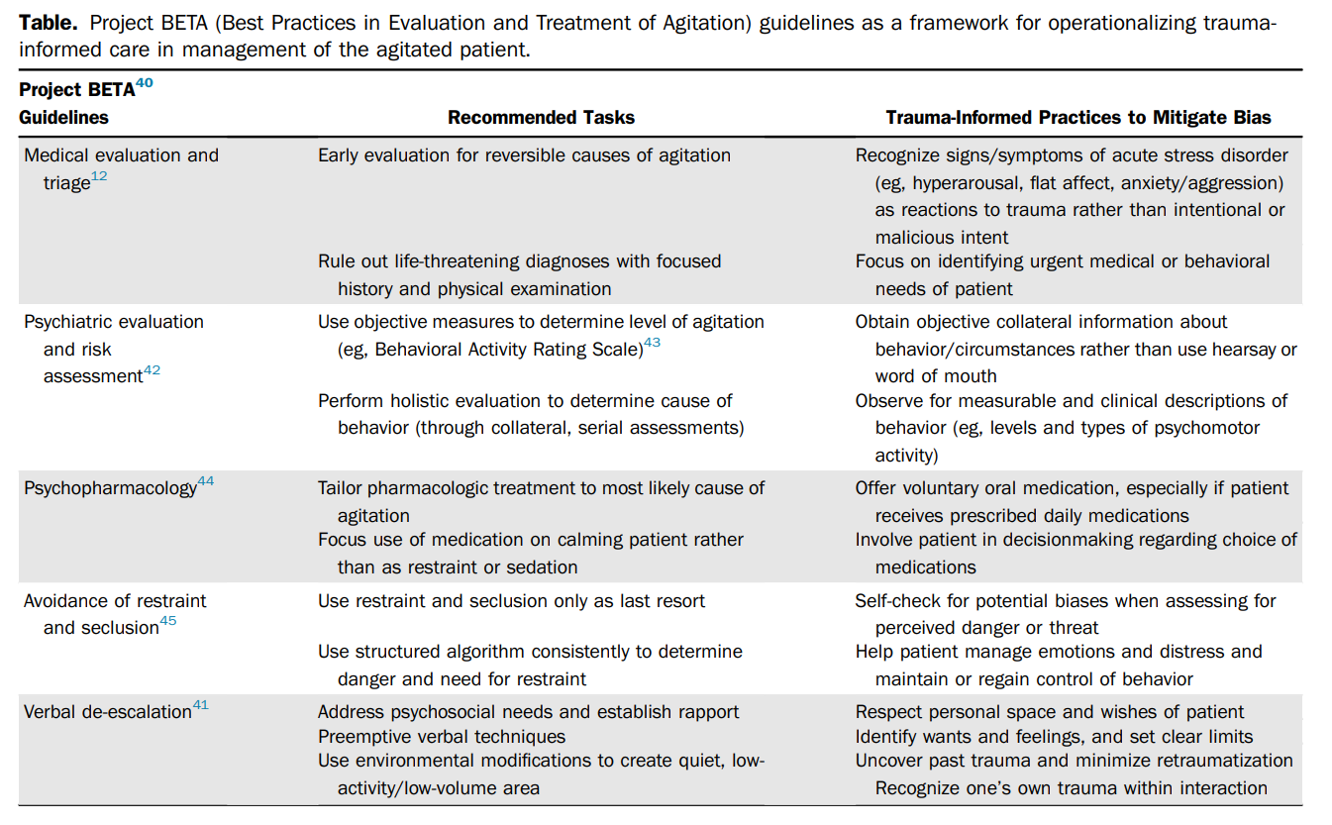
Notes:
This graphic gives examples of trauma-informed practices in addressing agitation in the emergency department with information about how such an approach reduces the damaging effects of bias in patient care.
Agboola, Coupet, & Wong, 2021

