Slide 1

Telehealth
Physical Therapy
Ben Larner DPT,OCS,COMT
May 17th,2022

Slide 2
Introduction:
Ben Larner DPT,OCS,COMT
  Doctor of Physical Therapy (DPT), 2009 MGH Institute of Health Professions
  Selective Functional Movement Assessment (SFMA), 2016 level I,II certified
  Orthopedic Certified Specialist (OCS), 2016 Board certification from APTA
  Certified Orthopedic Manual Therapist (COMT), 2019 Ola Grimsby Institute
  Lummi Tribal Health Center- 2018

Slide 3
Objectives:
Overview of telehealth PT
PT Compact
Optimal telehealth set up
Telehealth benefits and challenges
Overview of telehealth PT evaluation/assessment/treatment.
Importance of increasing activity level

Slide 4
Telehealth
Pre-pandemic
  Available but not largely used
  Cash based
Pandemic
  Demand surged, March 2020
    LTHC PT transitioned quickly
  Insurance companies had to respond and establish billing/reimbursement guidelines
Post-pandemic
  Usage has dropped
  Underutilized benefit to underserved and rural areas
Notes:
Pre pandemic
840,00 Medicare visits
pandemic – due to the public health emergency from COVID 19 insurance companies had to adjust to cover for telehealth, now all 50 stats cover telehealth in some form but it is variable by state.
2020- 63 fold increase to 52.7 million visits
Post pandemic
Telehealth use fell 37% from pandemic highs to the end of Q1’2021.
Mental health has been, and will continue to be, a key driver of telehealth demand. 35% of all telehealth visits were for mental health conditions, which is more than the next five leading drivers combined.
80% of consumers say they’d be willing to use home care models (like hospital at home schemes) if they were covered by insurance.

Slide 5
Implementing Telehealth PT
Eligibility
  Look at individual state licensing laws in state and cross state
  https://www.apta.org/your-practice/practice-models-and-settings/telehealth-practice/implementing
Compliance
  PT staff must be licensed in state where care will be provided
  Some states require additional training/certification
  Check malpractice insurance for telehealth coverages
  Document reason for providing telehealth
  HIPAA compliant technology

Slide 6
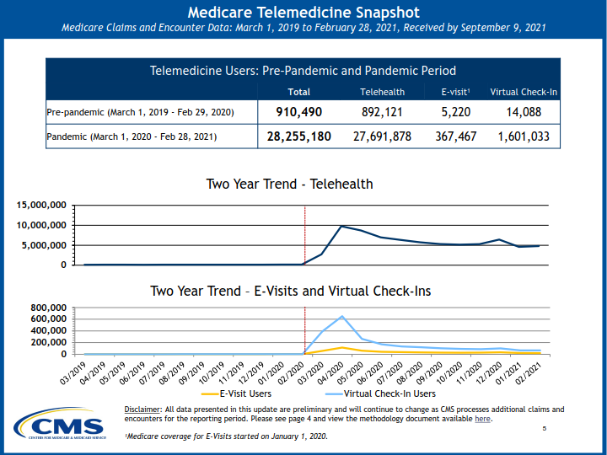
Medicare usage
https://www.hhs.gov/about/news/2021/12/03/new-hhs-study-shows-63-fold-increase-in-medicare-telehealth-utilization-during-pandemic.html
Notes:
See the surge in telehealth usage in March 2020, usage peaked and has been trending down. This is for all telehealth not just PT.

Slide 7
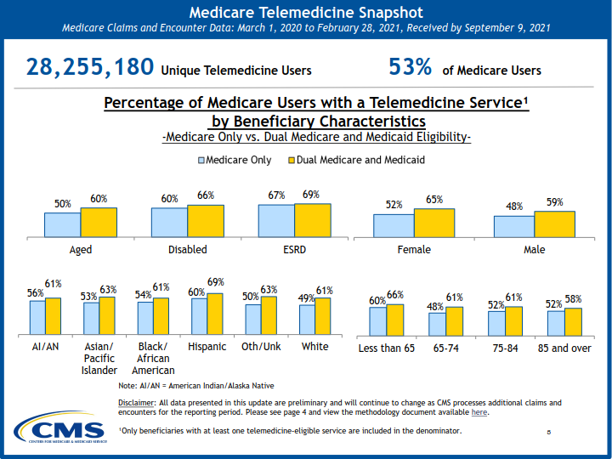
Telehealth Usage
https://www.hhs.gov/about/news/2021/12/03/new-hhs-study-shows-63-fold-increase-in-medicare-telehealth-utilization-during-pandemic.html
Notes:
First year of pandemic

Slide 8
Implementing Telehealth PT
Payment
  Commercial payer telehealth coverage
    https://www.apta.org/your-practice/practice-models-and-settings/telehealth-practice/billing-and-coding/commercial-payer-coverage
    Most insurances are paying for telehealth PT but important to check with individual plans/states f
Policies and Procedures
  Licensure
    Establish the patient's state of residency or location
    PT must be licensed in that state
  Relationship
    Some states require in person PT evaluation prior to patient being eligible for telehealth services
  Evaluation and treatment
    Standard of care- same for telehealth as in person

Slide 9
Implementing Telehealth PT
Informed consent
  specific to telehealth
    Obtaining written versus oral consent.
    Obtaining consent for each visit versus one time at the beginning of treatment.
    Obtaining consent for specific treatments versus visits.
    Using a standardized form for the patient's consent.
  For pediatric patients
    verify whether the caregiver, parent, or guardian is required to be present in accordance with state law, malpractice insurance, and/or payer policy.
    obtain informed consent from the parent or guardian.

Slide 10
Implementing Telehealth PT
Informed consent (cont)
  Obtain the names and contact information and of any prior PT contact or other treating health care providers
  Explain the technology you're using and identify yourself and any others involved during the session, such as PTA or other provider, including their credentials.
  Make sure no one other than you and the patient can hear or see your telehealth session, unless the patient has given consent for their presence.
  Explain that the session is not being recorded
  Explain any possible technical difficulties, including sound and video delay, and interruptions due to poor internet connection or tech breaches.

Slide 11
Implementing Telehealth PT
Informed consent (cont)
  Patient has the right to refuse the telehealth visit, request to be seen in the office, and can discontinue the telehealth visit at any time.
  Explain that PT may determine that PT should see the patient in the office, for some or all subsequent visits.
  Document the start and stop time of the telehealth session.
  Document your location, the location of the patient, and the location of any others involved during the session, including a PTA and any other provider(s).
  Provide the patient with follow-up instructions and next steps of treatment.

Slide 12
Telehealth PT: Benefits
Accessibility
  increased access to care
  Introduce patients to PT who might not have otherwise tried it
    Small percent of people who could benefit from PT seek it
Personalized
  one on one visits
  private
Compliance
  increases with telehealth

Slide 13
Telehealth PT Benefits
Time and cost saving
  no need for travel
    Cuts out gas costs, transportation difficulties, loss of work and childcare costs
  no waiting
Physical Activity
  Promote and increase activity during COVID 19 and social distancing

Slide 14
Telehealth PT Challenges
Internet Access
  Quality of coverage
  Hot spots
  Available team to assist
  Phone if needed
Location
  Ideally private
  Appropriate room for evaluation
Case Dependent
  Not all patients appropriate for telehealth
  Differential diagnosis
  Referral to appropriate provider

Slide 15
TelehealthPT Challenges
Manual Therapy
  Large component of PT
Billing
  Requires correct billing codes
  Document that visit was virtual in note

Slide 16
PT Compact
Agreement between member states to increase access to PT: Enacted in 2017
Currently 25 states
  8 states have enacted legislation
  4 states introduced legislation
Governance
  Participating state delegates
  Executive board
Compact Privilege
  Available to PTs and PTAs
  Apply online, pay fees
  Jurisprudence exam if required
    Increase access while reducing barriers to cross state practice
    Must be licensed in the state where patient physically is during visit.
Notes:
Allows for seeing patients in state that you have compact privileges, but you can not open a clinic in the state with a compact license.

Slide 17
PT Compact
Compact Privilege (cont.)
No requirement for time licensed or patient care hours to have privileges
Required to a standard license in home state
Follow all requirements of home state of licensure
Scope of practice
  Compact allows for in person and telehealth
  Must follow scope for state where patient resides at time of visit
    Spinal manipulation, dry needling
https://ptcompact.org/
Notes:
There are other professional compacts including: Medical, nursing, psychology, audiology, SLP, EMS, OT and counseling
Always follow the state practice acts.
Make sure to ask patient to confirm they are currently in a state that you are licensed

Slide 18
Telehealth Platforms
Make sure other streaming services are not running
  Will reduce quality of video during visit.
  Zoom, Doxy. me have lower priority then streaming service
Know your software
  Make sure you have practiced with it
  Make sure patient has used it, downloaded it
Notes:
Check if patient has used or downloaded software, have staff pre set up with patient and do a practice run. Zoom and doxy are some of the most popular but there are many nowadays, make sure the platform you use meets all requirements especially HIPAA

Slide 19
Telehealth Equipment: Computer
Memory
  At least 8 Gb
  Improved function with multiple programs running
Hard drive
  SSD
    Solid state, faster, at least 512 GB
Camera
  Get best available
Notes:
Ideally use an external camera for better quality but if using a laptop then try to get one with a higher quality camera.

Slide 20
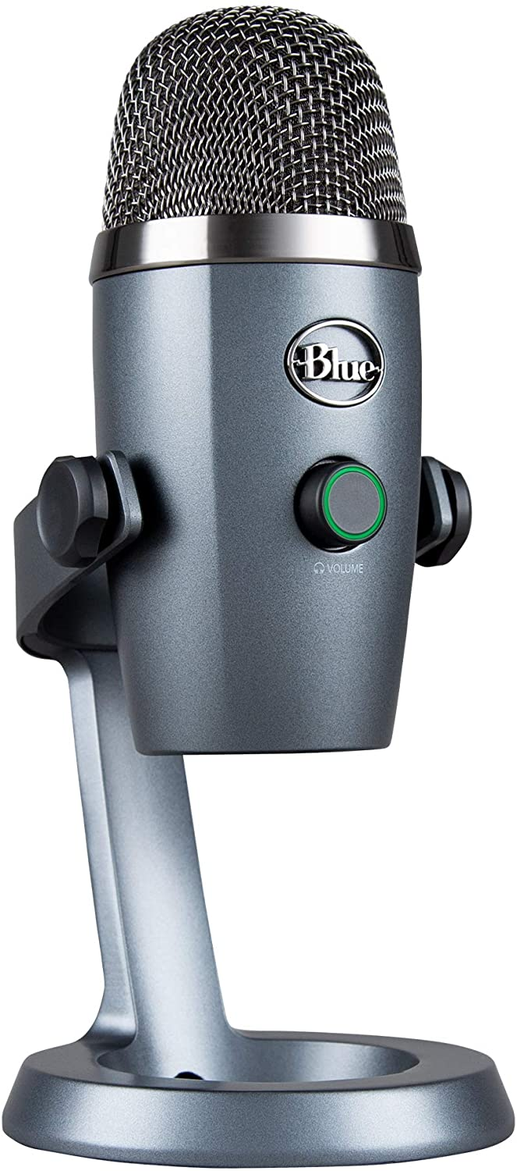
Equipment: Microphone:
Good quality audio
  XLR input cables are best
  Improves clarity for patient
Headphones
  Use wireless if possible
  Allows for improved ability to be away from computer, demonstrate movement/exercise
Notes:
Amazon also has many options Local music stores also a good option. Want to have a good audio experience for patient. Wireless headphones allow improved movement.

Slide 21
Equipment: Backdrop
Sound Baffle
  Improved sound for patient
    Reduces echo
  Creates plain backdrop
  Can improve lighting
Notes:
Available online for 200 dollars. If not using a backdrop make sure that background is professional. If doing telehealth in a busy room this will help isolate outside noise.

Slide 22
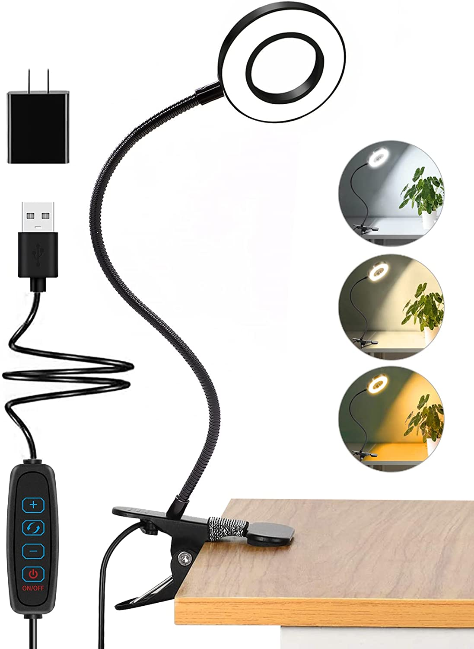
Equipment: Lighting
Light source
  Critical for patient to properly see demonstration/instructions
LED is best
  Cheap to find
Avoid any bright light shining into screen
  Close/open window blinds as needed

Slide 23
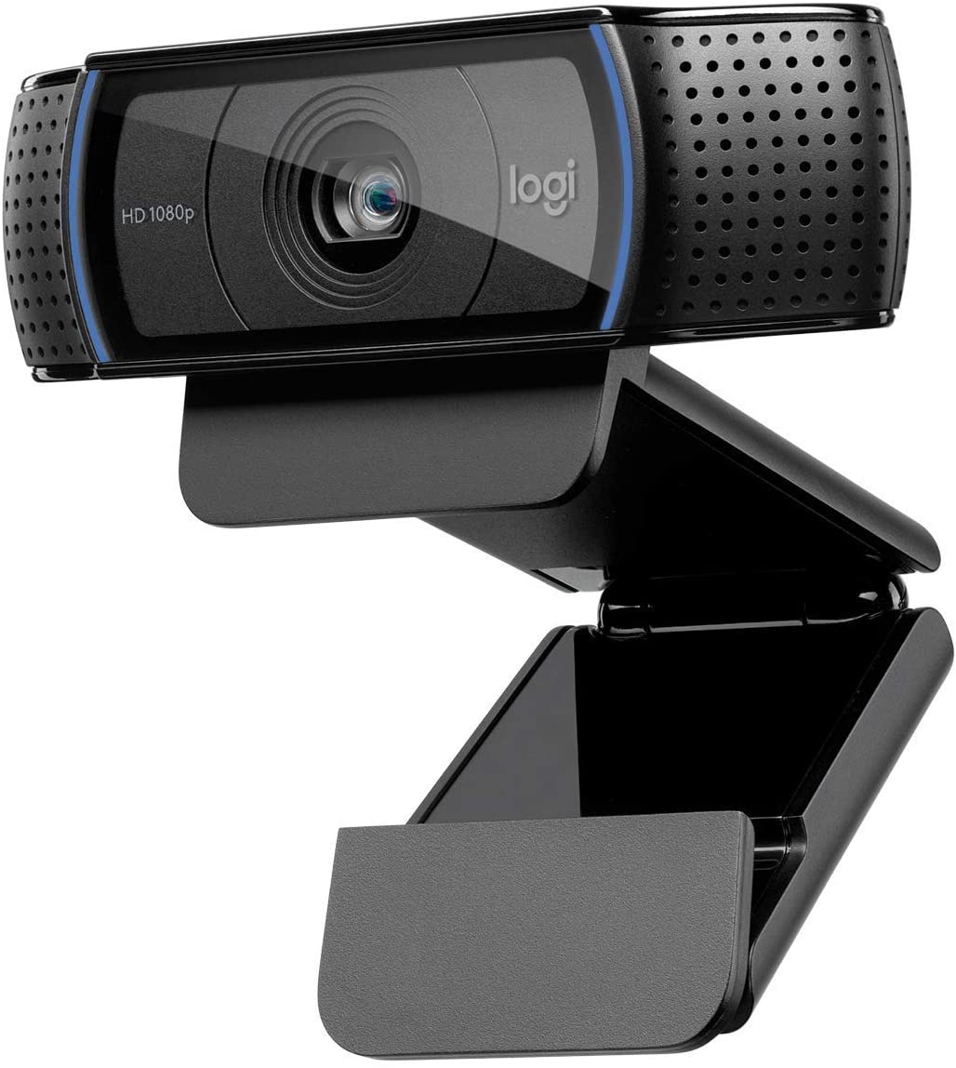
Equipment:
Camera:
Camera
  Amazon is a good choice for HD camera
  Audio quality can be an issue
  External mic sometimes needed
  Camera that autofocuses is helpful
  If using your phone use a tripod for improved adjustability and stability
Notes:
Look at verified purchases on amazon. Some cameras can have bad integrated sounds, getting external mic will increase quality. Good camera for 200-300. You can get a 4K camera but may take up too much bandwidth, wont work well with poor connection. HD camera is fine

Slide 24
Patient Profile:
Who can participate in Telehealth PT?
  pediatric to geriatric.
  Pre and post operative care
  chronic pain management
  musculoskeletal conditions
    Neck/back pain
    Multiple joint pain
    Pre and post event/activity rehab
  fall risk
  balance (including vestibular)

Slide 25
Systematic Review:
The utility of physiotherapy assessments delivered by telehealth: A systematic review
  Journal of Global Health
  December 2021
  39 studies included
    Most studies showed high level of patient satisfaction
    But given choice the preferred in clinic PT
    PT assessments appear valid and reliable for specific assessment types in limited populations (Zischke et al, 2021)
Notes:
Zische et al. Performing physiotherapy assessments using synchronous forms of telehealth appears valid and reliable for specific assessment types in limited populations. Further research is needed

Slide 26
Patient Statisfaction
Patient Satisfaction for Telehealth Physical Therapy Services was Comparable to that of In-Person Services during the COVID-19 Pandemic
  Study done in 2021
  No difference in patient satisfaction between in clinic and telehealth PT.
Notes:
More research in needed. Studay done by Euannuci et al.

Slide 27
Case
42 y/o female with new onset of low back pain with no clear MOI. Intermittent pain, N/T down LLE. Denies prior back surgery. Hx of LBP throughout the years. Works at a desk, long hours at computer, moderate commute distance home. Sx seem to worsen with sitting, improve with activity. Occasional exercise. Fair nutrition. Poor sleep. Has seen referring provider prior to PT. Has not tried PT. No other current treatments for back pain.

Slide 28
Evaluation:
Mackenzie Method
  Biopsychosocial model for musculoskeletal pain
  Emphasis on patient education, empowerment and self management
  Effective for acute, sub acute and chronic conditions for the spine and extremities
  Focus on active treatments vs passive
    Encouraged to treat self
    Repeated and sustained movements
Mechanical Subgroups
  3 subgroups or syndromes
  1. Derangement
    Mechanical obstruction to movement in the joint
  2. Dysfunction
    Mechanical loading of structurally impaired tissues
  3. Postural
    Prolonged overload of tissues
  4. Other conditions
    Stenosis, hip dysfunction, SIJ dysfunction, LBP with pregnancy, chronic pain, post surgical, trauma and mechanically unresponsive radiculopathy
Notes:
Derangement Group:
This is the more common and known syndrome
Inconsistency and change is the major characteristic of this syndrome
Symptoms may be local, referred, radicular or a combination, the symptoms could also move from side to side or proximal to distal.
Symptoms can be constant or intermittent and could vary through the day
The onset can be sudden, with no known cause, or gradual over time
The symptoms can be influenced by postures or normal daily activities
Directional preference is a hallmark of derangement syndrome, which a specific repeated movement or sustained position causes a relevant improvement in symptoms.
Treatments involve specific movements that cause the pain to decrease, centralize and/or abolish.^{[12]}
^{Dysfunction}
refers to pain which is a result of mechanical deformation of structurally impaired tissues like scar tissue or adhered or adaptively shortened tissue.
The symptoms must be present for 8-12 weeks, this time allowed the tissues to deform
The pain is always intermittent and arises at the end range of a restricted movement.
The treatment includes: repeated movements in the direction of the dysfunction or in the direction that reproduces the pain. The aim is to remodel that tissue, which limits the movement, through exercises so that it becomes pain-free over time^{[12]}.
Postural
Refers to pain which occurs due to a mechanical deformation of normal soft tissue from prolonged end range loading of periarticular structures.
The pain arises during static positioning of the spine: for example sustained slouched sitting.
The pain disappears when the patient is moved out of the static position.
There is no pain with performing movement or activity.
The treatment includes: patient education, correction of the posture by improving posture by restoring lumbar lordosis, avoiding provocative postures and avoid prolonged tensile stress on normal structure

Slide 29
Evaluation
Mackenzie method (cont)
Majority of back pain patients fall into the derangement group
Subjective/Hx
  Hx of sx, surgeries, prior injuries, MOI
  Current level of sx, duration of sx, aggravating and easing activities
  How they feel in the morning
  Symptom irritability vs psychological irritability
  Avoid painful positions, don’t throw gas on the fire
  Exercise, nutrition, sleep
Objective
  AROM
  Flex, ext, B SB, B rotation
  Repeated motions
    Flexion, extension
  Up to 70% of patients have a change in sx with positional/movement adjustments
  Looking for decrease in pain, centralization of paresthesia

Slide 30
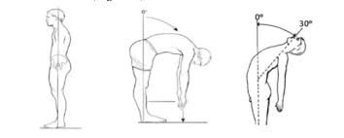
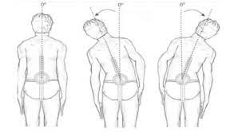
AROM

Slide 31
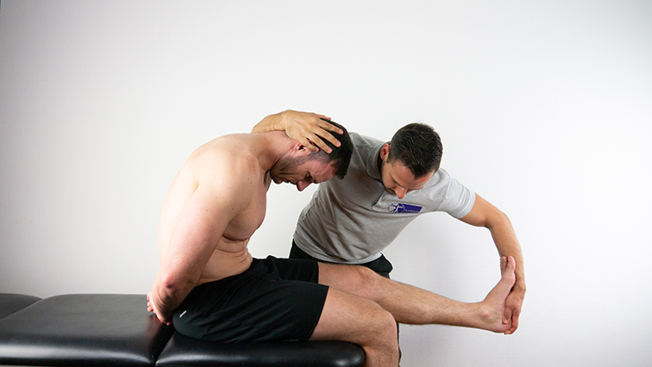
Evaluation
Strength
  Functional strength against gravity
  BUE,trunk,BLE
    Can't do formal MMT over telehealth
Neural tension
    Slump, SLR, seated slouch w/w/o DF
Functional Assessment
    Squat, sit to stand, heel walk, toe walk, SL balance
Functional Outcome Measure
    ODI, PSFS
https://www.physiotutors.com/wiki/slump-test/
Notes:
SFMA 10 key motions to assess mobility cervical flexion,ext,rotation, ER, IR rotatiaon, trunk flexion, extension, rotation, SL stance, squat

Slide 32
Selective Functional Movement Assessment
SFMA
  10 key movements
  Great quick screen
  Dysfunction can be broken down further
  Looking at quality of movement and if painful
Notes:
Look at Dysfunctional non painful, dysfunctional painful, Functional painful, functional non painful
Good at identifying if patient is having a joint/tissue condition or if it is more of a stability, motor control disorder.

Slide 33
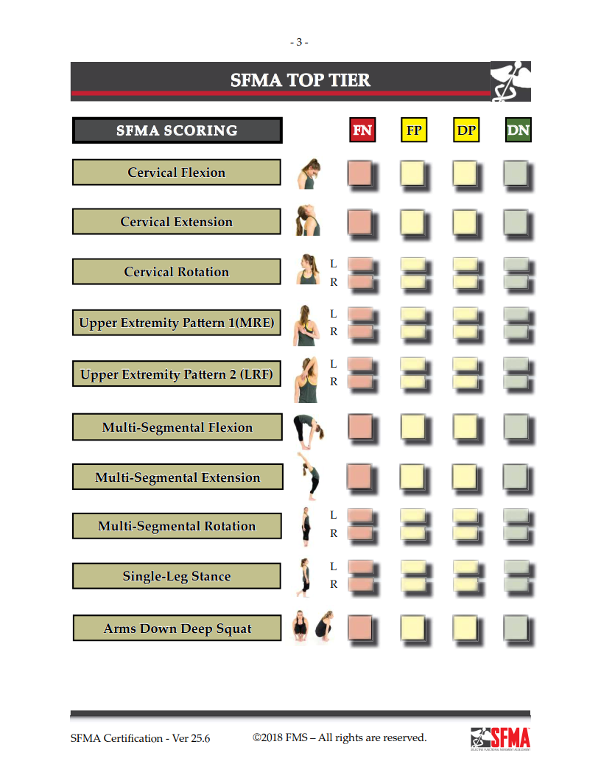
SFMA

Slide 34
Treatment:
Exercise
  Focus on repeated and/or sustained positions that improve sx
  Prescribe extension or flexion-based program
Exercise Type
  Pick something patient is agreeable to perform
HEP should be no more than 3-4 exercises
  Research shows that compliance decreases with too many exercises
  Introduce exercise snacking
Notes:
Important to discuss with patient what they like and don’t like in regards to exercise. People are busier than ever with long work days, family and home duties and exercise needs to be quick, easy and doable. If they do not like a certain thing they definitely wont do it. Exercise snacking can increase compliance and make the HEP much more doable and less overwhelming.

Slide 35
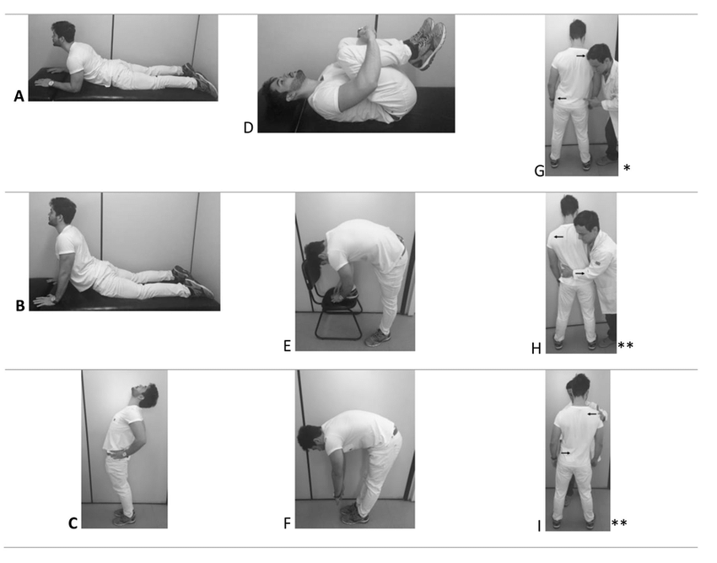
Exercises
https://www.researchgate.net/figure/Principles-of-Treatment-of-the-McKenzie-Method_fig2_327019762

Slide 36
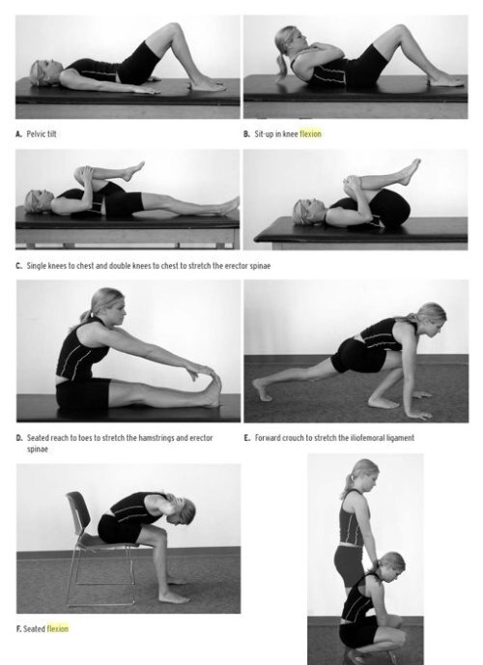
Flexion Based Exercises
https://www.v2mshop.com/?product_id=217563053_33
Notes:
Can be modified to do at desk. Can be done standing, sitting, laying down, whatever is most convenient for the patient.

Slide 37
Assessment/
Plan:
Test and Re-test
  Reassess ROM, neural tension, functional movement
Functional outcome measure
  Reassess initial measure used
Plan
  Clear POC, including heal times, importance of good compliance with PT and HEP to progress towards goals.
  Leave time for questions
  Encourage a hybrid model of PT
  In clinic and telehealth mix
Notes:
Encourage a hybrid model if possible, seeing the patient in person is beneficial if possible. Allows for more in-depth examination and treatment.
Share retest data with patient to help sell the benefit of PT, activity and to show progress in patient care. Sometimes patients don’t realize how much they have improved. Shoulder pain example

Slide 38
Working From Home
Working from home
  Increased neck, back and other musculoskeletal pain
  Increase in poor ergonomics
    Working from couch etc.
  Decreased activity
    Gyms closed
  Increased sedentary lifestyle
    Screen time increase
Notes:
Overall patients reported increased sitting, decreased activity, increased snacking. Quarantine 15

Slide 39
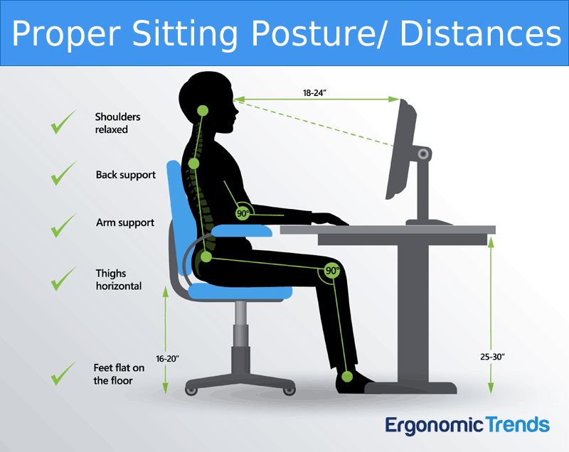
Workstation Ergonomics
Keep your monitor at eye level and place your keyboard close to your body.
Sit in a chair with back support to avoid slumping
Hips and knees should be at approximately 90 degrees
Make sure your feet are firmly planted on the ground, or use a footstool if your feet don’t reach the ground
If possible, use a desk that can be converted to a standing desk to lessen the strain on your spine
Keep your muscles loose by taking standing or walking breaks every 30-45 minutes
When possible, give your eyes a rest by looking away from your computer every 20 minutes and focusing on a distant object
https://ergonomictrends.com/creating-perfect-ergonomic-workspace-ultimate-guide/
Notes:
Here are some quick tips to help make talking on the phone comfortable:
Avoid tilting your head or holding a phone between your ear and shoulder
Use a headset or headphones when possible to keep your head in a neutral position.
Use a speakerphone when able to avoid tilting your neck
Here are some quick tips to improve your posture while texting:
Try to keep your phone screen at eye level to avoid bending your neck
Keep your neck relaxed and avoid shrugging your shoulders
Use your index finger to prevent overuse of your thumb

Slide 40
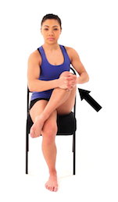
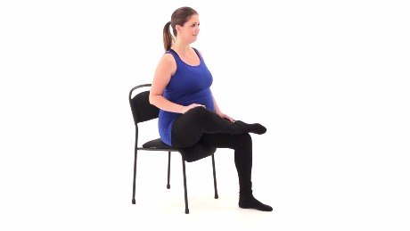
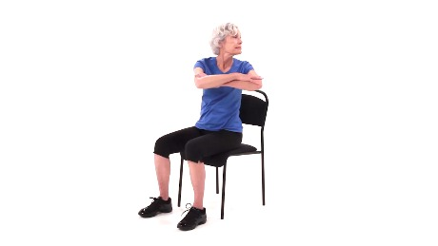
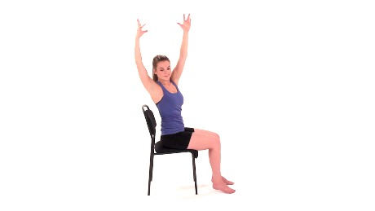
Posture/mobility Exercises
https://www.medbridgeeducation.com/patient_care/programs/create
Notes:
Encourage taking a break every 2 hours, more if possible, get up and move. Even just for 5 minutes.

Slide 41
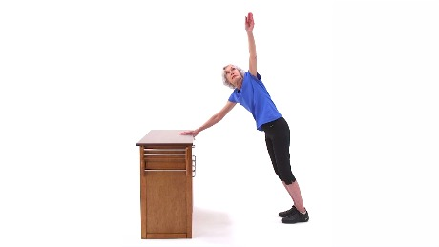
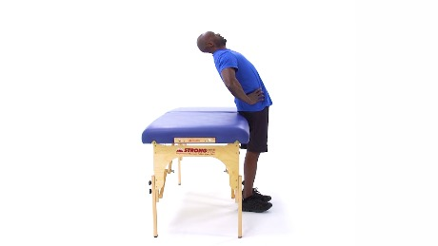
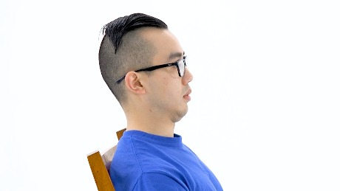
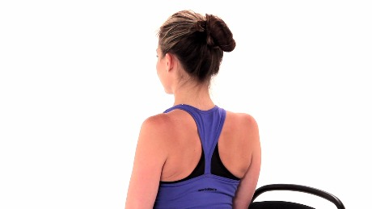
Posture/Mobility Exercises
https://www.medbridgeeducation.com/patient_care/programs/create

Slide 42
Telehealth: In clinic vs.Refer
In clinic
  need hands on tx
  multiple visits without improvement
  Technology challenges
Refer back to PCP
  Trauma
  Red flags
  when in doubt refer out
  Not improving/change in status
Notes:
Encourage a hybrid model, mix of in clinic and out

Slide 43
Summary
Telehealth is a valuable but underused tool in PT
The PT compact has made PT more accessible to underserved patients and rural populations
It is important to always check state and individual payer rules regarding telehealth because it seems rules and laws are always changing
Many conditions are appropriate, some are not, differential diagnosis and clinical judgment are critical
LBP is very common, about 85% of Americans will experience it at some point.
The Mackenzie Protocol is an effective evaluation and treatment method to address LBP over telehealth.
Movement is medicine

Slide 44

Questions

Slide 45
References
PT Compact. Accessed April 8th, 2022 https://ptcompact.org/
Crawford C. 6 Reasons to Consider Telehealth Physical Therapy. August 13th, 2021. Accessed April 8th, 2022. https://www.choosept.com/health-tips/6-reasons-telehealth-physical-therapy
Implementing Telehealth Into Your Practice. APTA. December 22nd, 2020. Accessed April 24th, 2022 https://www.apta.org/your-practice/practice-models-and-settings/telehealth-practice/implementing
HHS.gov. Accessed April 29th, 2022. https://www.telehealth.hhs.gov/providers/
A Guide to Providing Treatment via Telehealth for PTs and PTAs in Washington. Accessed May 2nd, 2022. https://aptawa.org/misc/washingtontelehealth
Telemedicine. Medicaid.gov. Accessed April 24th, 2022. https://www.medicaid.gov/medicaid/benefits/telemedicine/index.html
Tourwe J. McKenzie Method. Accessed May 3rd, 2022. https://www.physio-pedia.com/McKenzie_Method
Rhea P. Telehealth use is waning but not all is lost. June 29th, 2021. Accessed May 4th, 2022. https://www.emarketer.com/content/telehealth-use-waning-not-all-lost-here-s-how-telehealth-vendors-hold-onto-their-new-customers
Telemedicine Use. April 20th, 2022. Accessed May 4th, 2022. https://www.cdc.gov/nchs/covid19/pulse/telemedicine-use.htm
State Telehealth Laws and Reimbursement Policies Report, Fall 2021. October 2021. Accessed May 4th, 2022. https://www.cchpca.org/resources/state-telehealth-laws-and-reimbursement-policies-report-fall-2021/
McKenzie Institute. The McKenzie Method-An Overview. Accessed May 6th, 2022. https://www.mckenzieinstituteusa.org/method-providers.cfm
Telehealth Use in Rural Healthcare July 1st, 2021. Accessed May 6th, 2022. https://www.ruralhealthinfo.org/topics/telehealth
1. Eannucci EF, Hazel K, Grundstein MJ, Nguyen JT, Gallegro J. Patient Satisfaction for Telehealth Physical Therapy Services was Comparable to that of In-Person Services during the COVID-19 Pandemic. HSS Journal®. 2020;16(1_suppl):10-16. doi:10.1007/s11420-020-09800-5
Zischke, C., Simas, V., Hing, W., Milne, N., Spittle, A., & Pope, R. (2021). The utility of physiotherapy assessments delivered by telehealth: A systematic review. Journal of global health, 11, 04072. https://doi.org/10.7189/jogh.11.04072

