Slide 1
HEADER
Hepatitis B (HBV):
The Basics
Karla Thornton, MD, MPH
Professor, Division of Infectious Diseases
Senior Associate Director, Project ECHO
kthornton@salud.unm.edu

Slide 2
Conflicts of Interest Disclosure Statement
I have no conflicts of interest to disclose.

Slide 3
Learning Objectives
  Describe the modes of transmission for HBV
  Identify appropriate baseline serologies for HBV
  Correctly interpret serologic tests for HBV
  Identify who should be offered treatment for HBV
  Recognize the current recommended medications for HBV treatment
  Identify who should be offered HBV vaccination

Slide 4
Question # 1
Globally, what is the most common mode of hepatitis B transmission?
Blood transfusion
Perinatal transmission
Injection drug use
Sexual contact

Slide 5
Question # 2
What is the most likely route of transmission of hepatitis B infection in a 23-year-old male who was born in the United States?
A. Vertical (perinatal) transmission
B. Blood transfusion
C. Accidental needle stick
D. Sexual transmission

Slide 6
Question # 3
Hepatitis B virus is the leading cause of liver cancer worldwide.
A. True
B. False

Slide 7
Virus | Hepatitis A | Hepatitis B | Hepatitis C | Hepatitis D | Hepatitis E
Genome | RNA | DNA | RNA | RNA | RNA
U. S. Annual Incidence 2019 | 37,700 | 20,700 | 57,500 | ? | ?
Prevalence (estimated) | N/A | 1.59 million | 2.4 million | Uncommon | N/A
Transmission | Fecal-oral | Permucosal/ Percutaneous | Percutaneous/Permucosal | Permucosal/ Percutaneous | Fecal-oral
Mean Incubation | 28 days | 120 days | 45 days | ? | 30 days
Symptomatic Acute Infection | Increases with age | Increases with age | 20-30% | ? | Increases with age; High mortality in pregnancy
Potential for Chronic Infection | None | 6-10% of Adults >90% of infants | 75-85% | ? | None
Vaccine | Yes | Yes | No | No | No

Slide 8
Hepatitis B (HBV)
DNA virus - viral DNA integrates into the host
Transmission – sexual, MTC, blood-blood
Progression to chronic infection depends on age
  90% perinatal
  50% children
  5% adults
Risk of progression to cirrhosis, liver failure, HCC

Slide 9
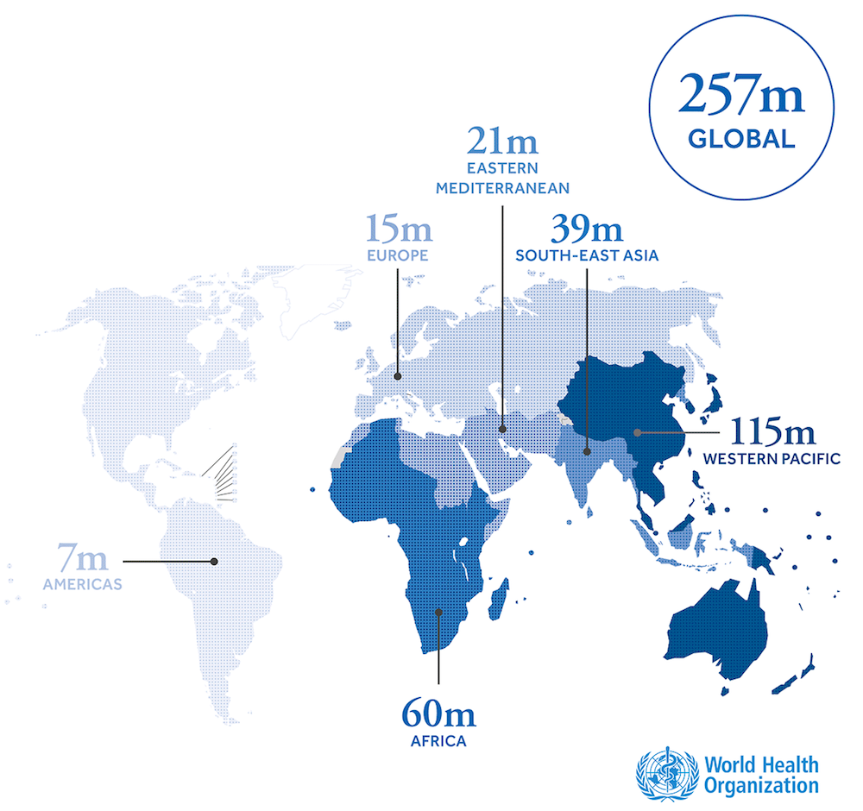
Hepatitis B: Global Burden
https://www.hepatitisb.uw.edu/

Slide 10
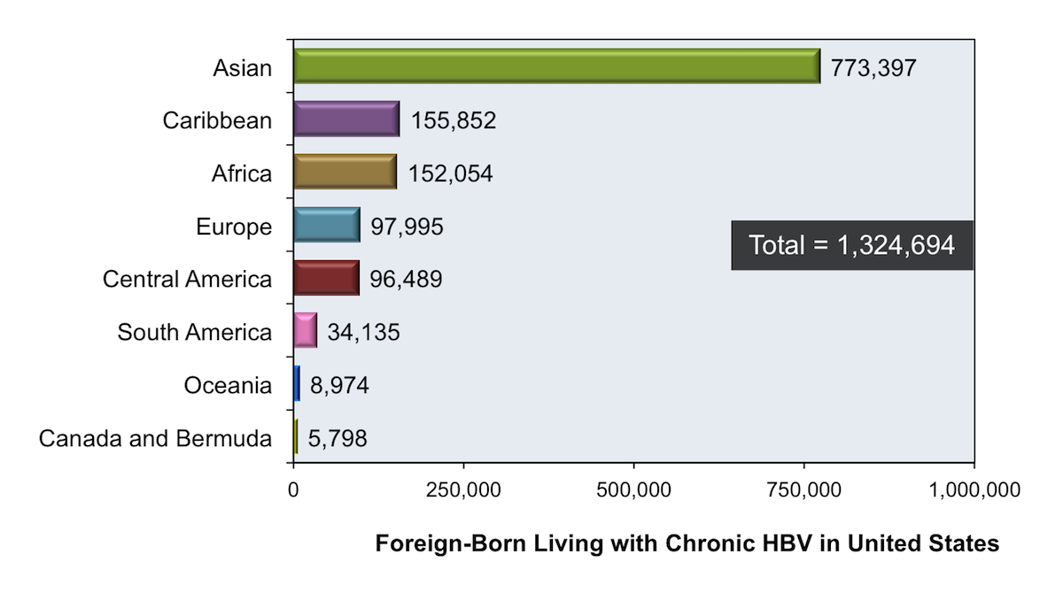
HBV in the U.S.
https://www.hepatitisb.uw.edu/accessed 2/14/22
Kowdley KV, et al. Prevalence of chronic hepatitis B among foreign-born persons living in the U.S.by country of origin. Hepatology. 2012;56:422-33.

Slide 11

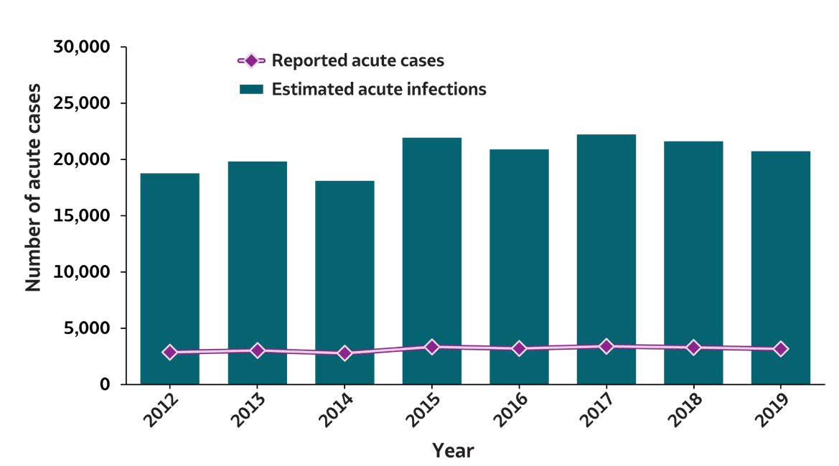
2019 VIRAL HEPATITIS
SURVEILLANCE REPORT
Figure 2.1. Number of reported acute hepatitis B virus infection cases and estimated infections* — United States, 2012–2019
Acute Hepatitis B | 2012 | 2013 | 2014 | 2015 | 2016 | 2017 | 2018 | 2019
Reported acute cases | 2,895 | 3,050 | 2,791 | 3,370 | 3,218 | 3,409 | 3,322 | 3,192
Estimated acute infections | 18,800 | 19,800 | 18,100 | 21,900 | 20,900 | 22,200 | 21,600 | 20,700
Source: CDC, National Notifiable Diseases Surveillance System.
* The number of estimated viral hepatitis infections was determined by multiplying the number of reported cases that met the classification criteria for a confirmed case by a factor that adjusted for underascertainment and underreporting. The 95% bootstrap confidence intervals for the estimated number of infections are displayed in the Appendix.

Slide 12
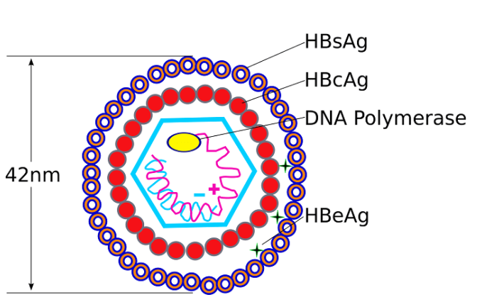
HBV Terminology
Three proteins expressed by HBV
Surface antigen – hallmark of infection
  HBsAg
Core antigen
  HBcAg
Envelope antigen
  HBeAg
https://microbiologyinfo.com/hepatitis-b-virus-structure-epidemiology-symptoms-pathogenesis-diagnosis-treatment-and-vaccines/ Accessed 2_4_22

Slide 13
HBV Terminology
Name | Abbreviation | Interpretation
Hepatitis B Surface Antigen | HBsAg | Indicates active infection. Indicates chronic infection if persistent >6 mos.
Hepatitis B Surface Antibody | anti-HBs | Indicates immunity in persons without HBV exposure.
Hepatitis B Core Antigen | HBcAg | The core protein is inner structure of the virus and encloses the DNA. Cannot be measured in serum.
Hepatitis B Core Antibody | anti-HBc | Indicates exposure. NOT seen in those immune because of vaccine.
Hepatitis B e Antigen | HBeAg | Ongoing replication, higher infectivity.
Hepatitis B e Antibody | anti-HBe | Infection resolving.

Slide 14
HBV Testing

Slide 15
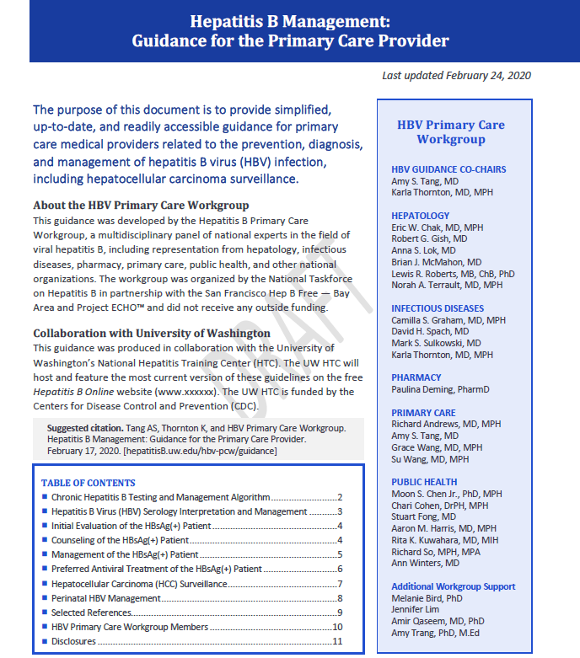
Hepatitis B Management: Guidance for the Primary Care Provider - HBV Primary Care Workgroup - Hepatitis B Online (uw.edu) Accessed 4_1_22

Slide 16
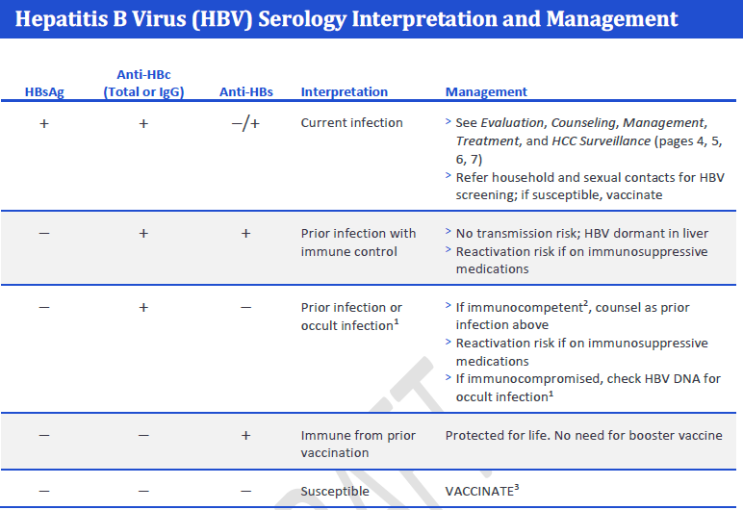

Slide 17
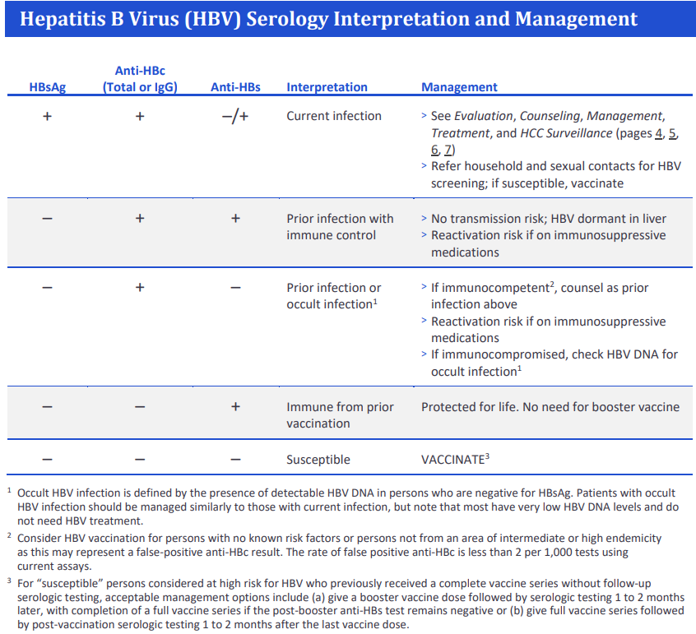

Slide 18
Question # 4
Which is the best test to screen for chronic HBV infection?
Antibody against hepatitis B core antigen (anti-HBc)
Hepatitis B e antigen (HBeAg)
Antibody against hepatitis B surface antigen (anti-HBs)
Hepatitis B surface antigen (HBsAg)

Slide 19
Question #5
A patient has the following labs:
Anti-HBs +
What other labs should you request?
A. anti-HBc, HBeAg
B. HBeAg, HBsAg
C. anti-HBc, HBsAg
D. anti-HBe, HBsAg

Slide 20
Question # 6
A patient has the following labs:
Anti-HBs -
Anti-HBc -
HBsAg -
Should this patient be vaccinated?
A. Yes
B. No

Slide 21
Question # 7
A patient has the following labs:
Anti-HBs –
Anti-HBc +
HBsAg -
Should this patient be vaccinated?
A. Yes
B. No

Slide 22
HBV Treatment
Decision to treat based on HBVDNA level and degree of liver inflammation
Treat all patients with cirrhosis
Treat pregnant women in 3rd trimester at risk of transmission (high viral load)
Current recommended medications
  Tenofovir (TDF or TAF) – nucleotide analogue
  Entecavir - nucleoside analogue
HBV is not curable (with current medications) but is controllable with improved patient outcomes

Slide 23
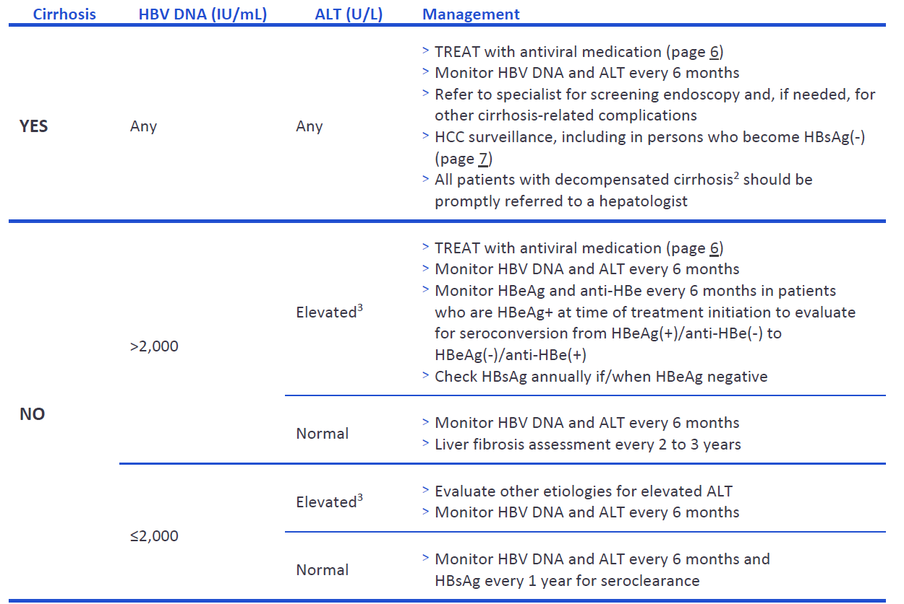
Management of the HBsAg (+) Patient
Elevated ALT defined as >25 U/L in females and >35 U/L in males that is persistent for at least 3 to 6 months.

Slide 24
HBV Vaccination

Slide 25
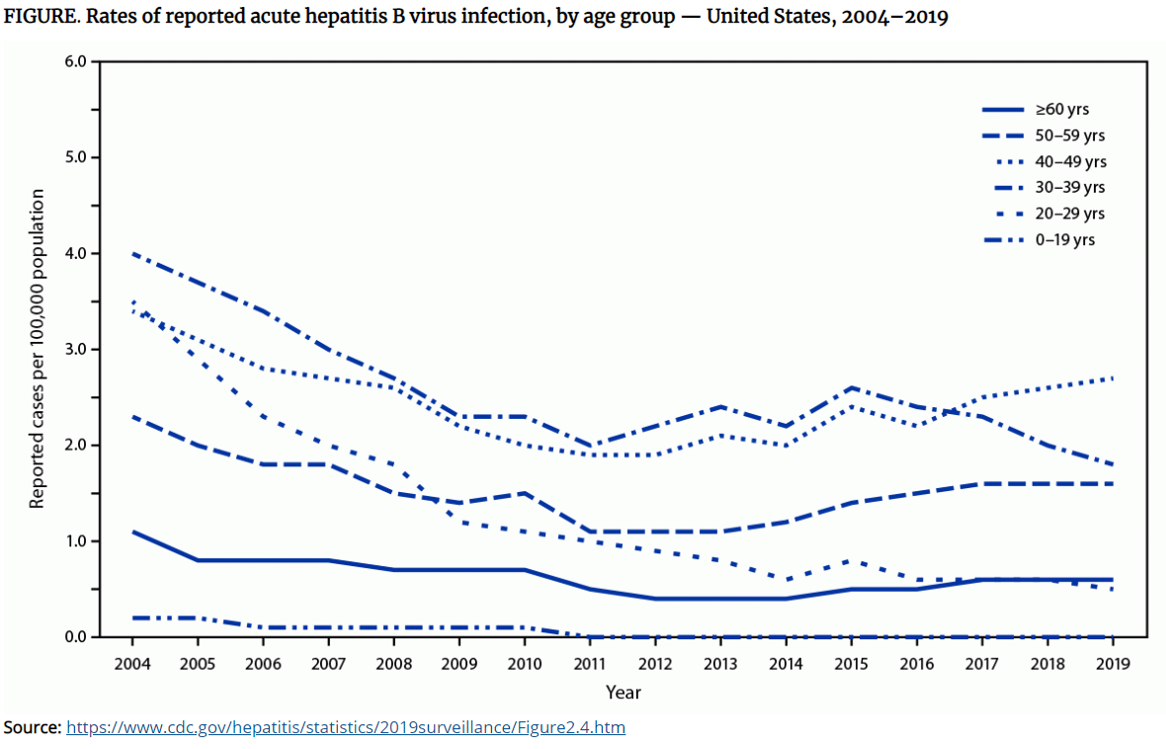
Acute HBV

Slide 26
Universal HBV Vaccination in Adults Aged 19–59 Years: Updated Recommendations of the Advisory Committee on Immunization Practices - 4/1/22
All infants
Persons aged < 19 years
Adults aged 19-59 years
Adults aged ≥ 60 years with risk factors for hepatitis B
Weng MK, Doshani M, Khan MA, et al. Universal Hepatitis B Vaccination in Adults Aged 19–59 Years: Updated Recommendations of the Advisory Committee on Immunization Practices — United States, 2022. MMWR Morb Mortal Wkly Rep 2022;71:477–483. DOI: http://dx.doi.org/10.15585/mmwr.mm7113a1

Slide 27
HBV Vaccination:
Adults aged ≥60 years with risk factors
Persons at risk for infection by sexual exposure
  Sex partners of persons testing positive for HBsAg
  Sexually active persons who are not in a long-term, mutually monogamous relationship (e.g., persons with more than one sex partner during the previous 6 months)
  Persons seeking evaluation or treatment for a sexually transmitted infection
  Men who have sex with men
Persons at risk for infection by percutaneous or mucosal exposure to blood
  Persons with current or recent injection drug use
  Household contacts of persons testing positive for HBsAg
  Residents and staff members of facilities for persons with developmental disabilities
  Health care and public safety personnel with reasonably anticipated risk for exposure to blood or blood-contaminated body fluids
  Persons on maintenance dialysis, including in-center or home hemodialysis and peritoneal dialysis, and persons who are predialysis
  Persons with diabetes at the discretion of the treating clinician
Others
  International travelers to countries with high or intermediate levels of endemic HBV (HBsAg prevalence of ≥2%)
  Persons with hepatitis C virus infection
  Persons with chronic liver disease
  Persons with HIV infection
  Persons who are incarcerated

Slide 28
Key Points
HBV is a major global health problem
HBsAg indicates active HBV infection
HBcAb indicates exposure to HBV
HBV can be prevented by vaccination
Universal HBV vaccine is recommended at birth and for all people ≤ 59 years of age
HBV is not curable (with current medications) but is controllable

Slide 29
Resources and Slide Sources
https://www.cdc.gov/hepatitis/
https://www.cdc.gov/hepatitis/resources/professionals/training/serology/training.htm
https://www.hepatitisb.uw.edu/
Hepatitis B Management: Guidance for the Primary Care Provider - HBV Primary Care Workgroup - Hepatitis B Online (uw.edu)

Slide 30
Questions?

