Slide 1
An Overview of Patient Assessments
DSM V
ASAM Criteria
Opioid Withdrawal Scales
Advancing Pharmacist Roles in Substance Use Disorder ECHO 4/5/2022
Nicole Larsen BSN, RN
LCDR Teresa Grund R.Ph, BCPS. BCPP

Slide 2
No conflicts of interest No financial disclosures

Slide 3
Objectives
Identify 3 criteria in the DSM V for diagnosing an Opioid Use Disorder
Identify 3 dimensions from the ASAM criteria
Identify mild, moderate, and severe opioid withdrawal based on the Clinical Opioid Withdrawal Scale (COWS)
Identify the mild, moderate, and severe opioid withdrawal based on the Subjective Opioid Withdrawal Scale (SOWS)

Slide 4
Tools for assessing Opioid Use Disorders
Clinical Opioid Withdrawal Scale
Brief
Clinician
Subjective Opioid Withdrawal Scale
Brief
Patient
American Society of Addiction Medicine Criteria
Least intensive treatment service
Objective standards
DSM V Criteria
Diagnostic
Clinician

Slide 5
DSM V Criteria for Diagnosing Substance Use Disorders
Hazardous use
Social or interpersonal problems related to use
Neglected major roles to use
Withdrawal
Tolerance
Repeated attempts to control use or quit
Used larger amounts/longer
Much time spent using
Physical or psychological problems related to use
Activities given up to use
Craving
Notes:
Hazardous use: You have used the substance in ways that are dangerous to yourself and/or others, i.e., overdosed, driven while under the influence, or blacked out.
Social or interpersonal problems related to use: Substance use has caused relationship problems or conflicts with others.
Neglected major roles to use: You have failed to meet your responsibilities at work, school, or home because of substance use.
Withdrawal: When you stop using the substance, you experience withdrawal symptoms.
Tolerance: You have built up a tolerance to the substance so that you have to use more to get the same effect.
Used larger amounts/longer: You have started to use larger amounts or use the substance for longer amounts of time.
Repeated attempts to control use or quit: You've tried to cut back or quit entirely,but haven't been successful.
Much time spent using: You spend a lot of your time using the substance.
Physical or psychological problems related to use: Your substance use has led to physical health problems, such as liver damage or lung cancer, or psychological issues, such as depression or anxiety.
Activities given up to use: You have skipped activities or stopped doing activities you once enjoyed in order to use the substance.
Craving: You have experienced cravings for the substance.

Slide 6
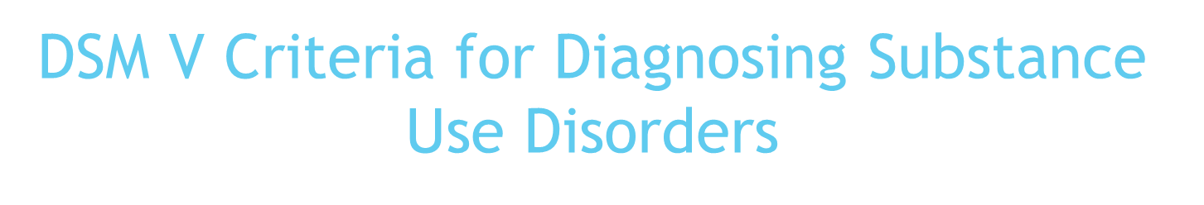
Two or more of these criteria within a 12-month period
Two or three of the criteria = mild substance use disorder
Four to five= moderate substance use disorder
Six or more criteria= severe substance use disorder

Slide 7
Guiding Principles of The ASAM Criteria
Consider the whole person.
Individualize treatment times.
Design treatment for the specific patient.
Reconceptualize the definition of “addiction.”
Provide a spectrum of services
“Failure” is not a treatment prerequisite.
Notes:
Rather than basing treatment decisions around a single element or
Diagnosis, The ASAM Criteria takes a “multidimensional” approach, meaning it
recognizes the many different areas of life that make up who a person is and how these life areas, or
“dimensions,” contain different risks and needs, as well as strengths and resources. A patient’s risks,
needs, strengths and resources provide the basis for creating a treatment plan.
The ASAM Criteria recognizes that effective treatment
cannot take a one-size-fits-all approach. Every individual’s treatment plan is based on his or her
unique needs, and therefore may be different, or require a variety of types or intensities of care.
Individualize treatment times. Some programs use the same treatment timeline for all of their patients (such as putting everyone in a “28-day program”). The ASAM Criteria views treatment length as a unique factor—one that depends on the individual’s progress and changing needs.
Some providers look at a patient’s history to see if he or she has first “failed” out of less-intense services before approving a more intense type of care (such as a residential program or hospital stay). The ASAM Criteria does not see “failures” from treatment as an appropriate way to approve the correct level of care.
Although five broad levels of service are described in The ASAM
Criteria, these levels represent benchmarks along a single continuum of care. These levels are linked
to one another, and patients can move among and between them based on their current needs
In 2011, ASAM proposed a definition of
“addiction” designed to be consistent with both clinical wisdom and the latest research discoveries.
Short Version
Addiction is a primary, chronic disease of brain reward, motivation, memory and related circuitry. Dysfunction in these circuits leads to characteristic biological, psychological, social and spiritual manifestations. This is reflected in an individual pathologically pursuing reward and/or relief by substance use and other behaviors. Addiction is characterized by inability to consistently abstain, impairment in behavioral control, craving, diminished recognition of significant problems with one’s behaviors and interpersonal relationships, and a dysfunctional emotional response. Like other chronic diseases, addiction often involves cycles of relapse and remission. Without treatment or engagement in recovery activities, addiction is progressive and can result in disability or premature death

Slide 8
Using the Criteria to Make Decisions About Care
Assessing
Identifying
Providing/ Evaluating
Notes:
These are steps to work through when discussing
what type of care to offer—and fund—for
an individual. Following this decisional
flow helps ensure that treatment is being
effectively managed, and that patients receive
the appropriate intensity of care.
Nest we’ll look at what happens
in each step.
Keeping in mind The patient is an active
member throughout the process.

Slide 9
Assessing
WHAT DOES THE PATIENT WANT? WHY NOW?
DOES THE PATIENT HAVE ANY IMMEDIATE NEEDS?
ASSESS RISKS, NEEDS, AND STRENGTHS IN ALL LIFE AREAS
IDENTIFY ANY DIAGNOSES
Notes:
WHAT DOES THE PATIENT WANT? WHY NOW?
Recovery
Not to feel withdrawal
DOES THE PATIENT HAVE ANY IMMEDIATE NEEDS?
Homeless
Abuse
SI
Medical needs
ASSESS RISKS, NEEDS, AND STRENGTHS IN ALL LIFE AREAS
Good support
Employment
IDENTIFY ANY DIAGNOSES
Dual diagnosis

Slide 10
Dimension 1: Acute Intoxication and/or Withdrawal Potential
Dimension 2: Biomedical Conditions/Complications
Dimension 4: Readiness to Change
Dimension 5: Relapse/Continued Use/Continued Problem Potential
Dimension 6: Recovery Environment
Dimension 3: Emotional/Behavioral /Cognitive Conditions and Complications
Notes:
Dimension 1: Acute Intoxication
and/or Withdrawal Potential
This life area explores past and
current experiences of substance use
and withdrawal.
Dimension 2: Biomedical
Conditions/Complications
In this life area, the patients
physical health, medical problems
and physical activity and nutrition.
3: Emotional/Behavioral/
Cognitive Conditions and Complications
This life area helps explore the
thoughts, emotions and any mental health issues the patient has
Dimension 4: Readiness to Change
This life area identifies what
motivates the patient and their readiness and
interest in changing.
Dimension 5: Relapse/Continued Use/
Continued Problem Potential
This life area addresses concerns related to continued
substance use, mental health or a relapse.
Dimension 6: Recovery
Environment
This life area explores the patient’s living
situation and the people, places and
things that are important to them.

Slide 11
Identifying
IDENTIFY THE SEVERITY AND LEVEL OF FUNCTIONING
IDENTIFY WHICH LIFE AREAS ARE CURRENTLY MOST IMPORTANT
CHOOSE A SPECIFIC FOCUS AND TARGET FOR EACH PRIORITY LIFE AREA
WHAT SPECIFIC SERVICES ARE NEEDED FOR EACH LIFE AREA?
DETERMINE TREATMENT PRIORITIES
Notes:
Once the information about a patient’s wants, immediate needs, and different life
areas has been gathered; We move into the second phase of
the decision-making process. This phase helps us identify what issues are of the
highest severity, and of the highest priority, to address in treatment.
clinical knowledge and training help to determine which issues and which life areas pose the biggest challenges.
The ASAM Criteria helps them rank these areas and choose which ones to target
during treatment. From here, teams can work with the
patient to figure out the specific services needed, and what goals to set. No
services are recommended that do not refer back to the patient’s needs and goals.

Slide 12
Providing/Evaluating
IDENTIFY THE INTENSITY OF SERVICES NEEDED FOR EACH LIFE AREA
IDENTIFY WHERE THESE SERVICES CAN BE PROVIDED, IN THE LEAST INTENSIVE BUT SAFE LEVEL OF CARE
WHAT IS THE PROGRESS OF TREATMENT?
Notes:
The final phase of The ASAM Criteria treatment process takes the assessment
information, and the identified priorities and services, and establishes what
intensity of services should be provided

Slide 13
Identify priorities
Identify services
Establishes what intensity
Notes:
In other words, this is where teams
decide how much (and how often) treatment is needed.
Patients may require weekly, daily, or even hourly services (which might require
a residential program or hospital stay). Again, this intensity is determined by
a patient’s unique, individual needs, and provided in the least intensive, but
safe treatment setting. Once this has been done, the final step is to track the
progress of treatment, including any recommendations for discharge, transfer, or
continuing service

Slide 14
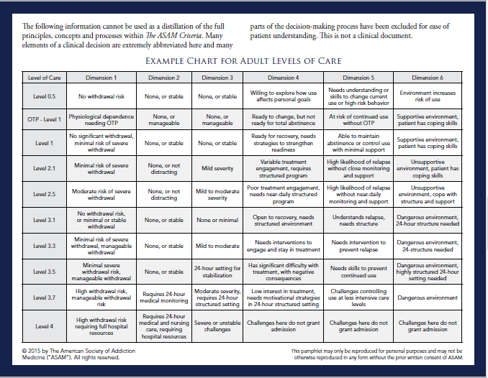
Notes:
Dimension 1: Acute Intoxication
and/or Withdrawal Potential
Patient presented in severe withdrawal
Dimension 2: Biomedical
Conditions/Complications
Uncontrolled diabetes due to noncompliance
3: Emotional/Behavioral/
Cognitive Conditions and Complications
Denies SI, Scores 12 on PHQ9 is noncompliant with SSRI
Dimension 4: Readiness to Change
Self seeking services
Dimension 5: Relapse/Continued Use/
Continued Problem Potential
If I don’t get help now I am going to leave here and use.
Dimension 6: Recovery
Environment
SO is not a user and is very supportive of me seeking care

Slide 15
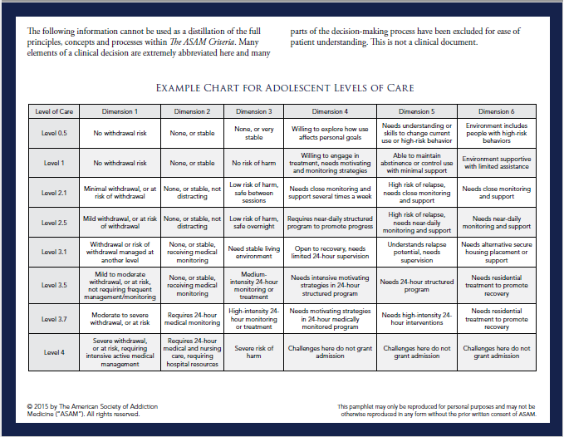

Slide 16
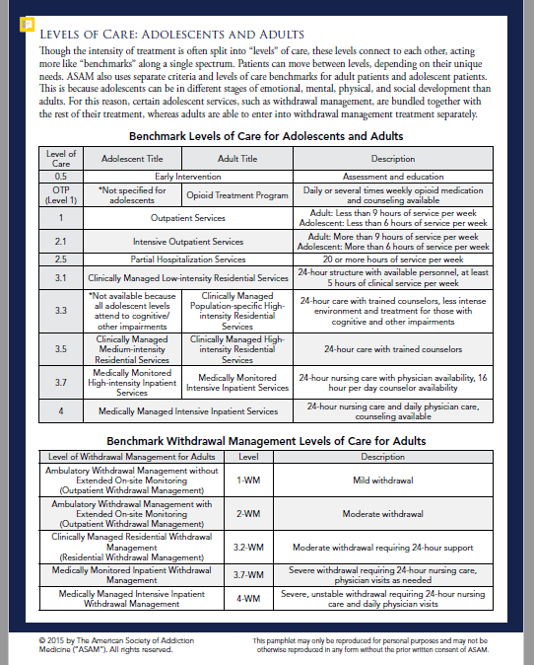
Notes:
This chart shows the amount and type of care a patient will receive from this level of care. Level one which was the level our patient fell into should receive less than 9 hours of service per week. Now we can see the patient is appropriate for outpatient Medication assisted treatment, we will now move onto if and when the patient can be started on medications.

Slide 17
Clinical and Subjective Opioid Withdrawal Scales
Notes:
Next, I am going to turn it over to Nikki who is going to give us and overview of the clinical and Subjective opioid withdrawal scales.

Slide 18
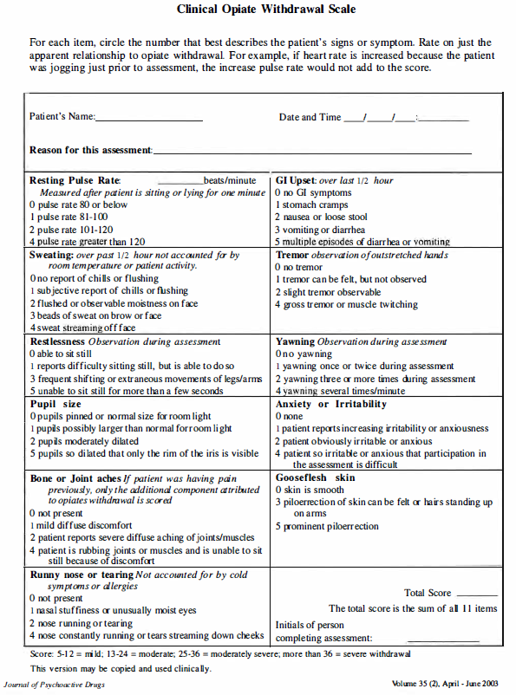
Clinical Opioid Withdrawal Scale

Slide 19
COWS Scoring
Score:
5- 1 2 = mild
13-24 = moderate
25-36 = moderately severe
> 36 = severe

Slide 20
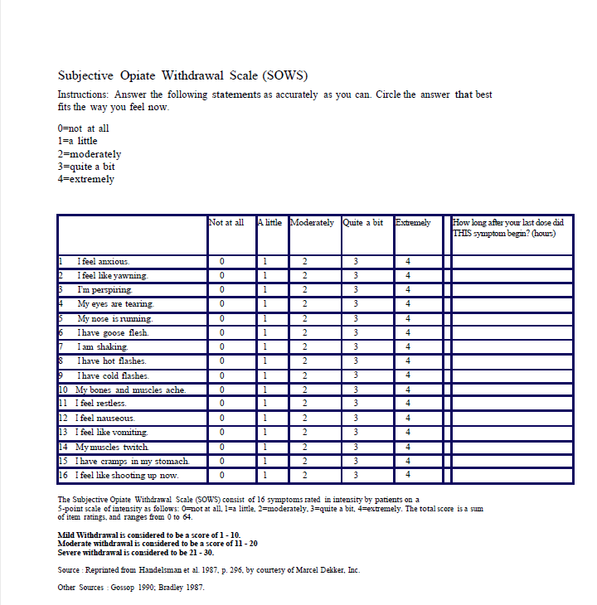
Subjective Opioid Withdrawal Scale

Slide 21
SOWS Scoring
The Subjective Opiate Withdrawal Scale (SOWS) consist of 16 symptoms rated in intensity by patients on a
5-point scale of intensity as follows:
0=not at all
1=a little
2=moderately
3=quite a bit
4=extremely.
The total score is a sum of item ratings, and ranges from 0 to 64.
Mild Withdrawal is considered to be a score of 1 - 10.
Moderate withdrawal is considered to be a score of 11 - 20
Severe withdrawal is considered to be 21 - 30.

Slide 22

Questions

Slide 23
References:
https://dsm-psychiatryonline-org.proxy.library.vcu.edu/doi/full/10.1176/appi.books.9780890425787.x16_Substance_Related_Disorders
https://www.verywellmind.com/what-are-the-official-criteria-for-addiction-22493
https://elearning.asam.org/products/the-asam-fundamentals-of-addiction-medicine-40-hour-cme-program-online
https://nida.nih.gov/sites/default/files/ClinicalOpiateWithdrawalScale.pdf
https://www.asam.org/docs/default-source/education-docs/sows_8-28-2017.pdf

