Slide 1
Abuse of People with Dementia
Laura Mosqueda, M.D.
Professor of Family Medicine and Geriatrics
Director, National Center on Elder Abuse

Slide 2
The Person with dementia:
May be unable to recognize abuse
May be unable to report abuse
May not be believed

Slide 3
Prevalence: Abuse of People with Dementia
60%
62%
52%
52%
48%
42%
2006
2008
2009
2010
2011
2014
Vandeweerd C, Paveja GJ. Verbal mistreatment in older adults:a look at persons with Alzheimer's disease and their caregivers in the state of Florida. J Elder Abuse Negl. 2005.
Cooper C, Manela M, Katona C, Livingston G. Screening for elder abuse in dementia in the LASER-AD study: Prevalence, correlates and validation of instruments. J Ger Psych. 2008
Selwood A, Cooper C, Owens C, Blanchard M, Livingston G. What would help me stop abusing? The family carer’s perspective. Int Psychoger. 2009
Cooper C, Selwood A, Blanchard M, Walker Z, Blizard R, Livingston G. Abuse of people with dementia by family carers: representative cross sectional survey. BMJ. 2010.
Yan E, Kwok T. Abuse of older Chinese with dementia by family caregivers: an inquiry into the role of caregiver burden. Int J Geriatr Psychiatry. 2011
Yan E. Abuse of older persons with dementia by family caregivers: Results of a 6-month prospective study in Hong Kong. Int J Ger Psych. 2014.
Notes:
2005 60% psychologically abused, C. Vandeweerd, Journal of Elder Abuse and Neglect
2006 52% abused or neglected, C. Cooney, International Journal of Geriatric Psychiatry
2009 34% abused, C. Cooper, BMJ
2010 47% Wiglesworth
2011 62% abused, E. Yan, International Journal of Geriatric Psychiatry
2014 27.9 – 62.3% psychologically abused, X. Dong, Health Affairs
https://www.ncbi.nlm.nih.gov/pubmed/19164392

Slide 4
Symptom Categories and Susceptibilities
Cognitive (e.g. memory, language, visual spatial, mathematics)
Psychiatric (e.g. depression, psychosis, agitation, personality change)
Motor (e.g. gait, balance, swallowing)
Function (e.g. financial management, meal preparation, transportation, medication management)

Slide 5
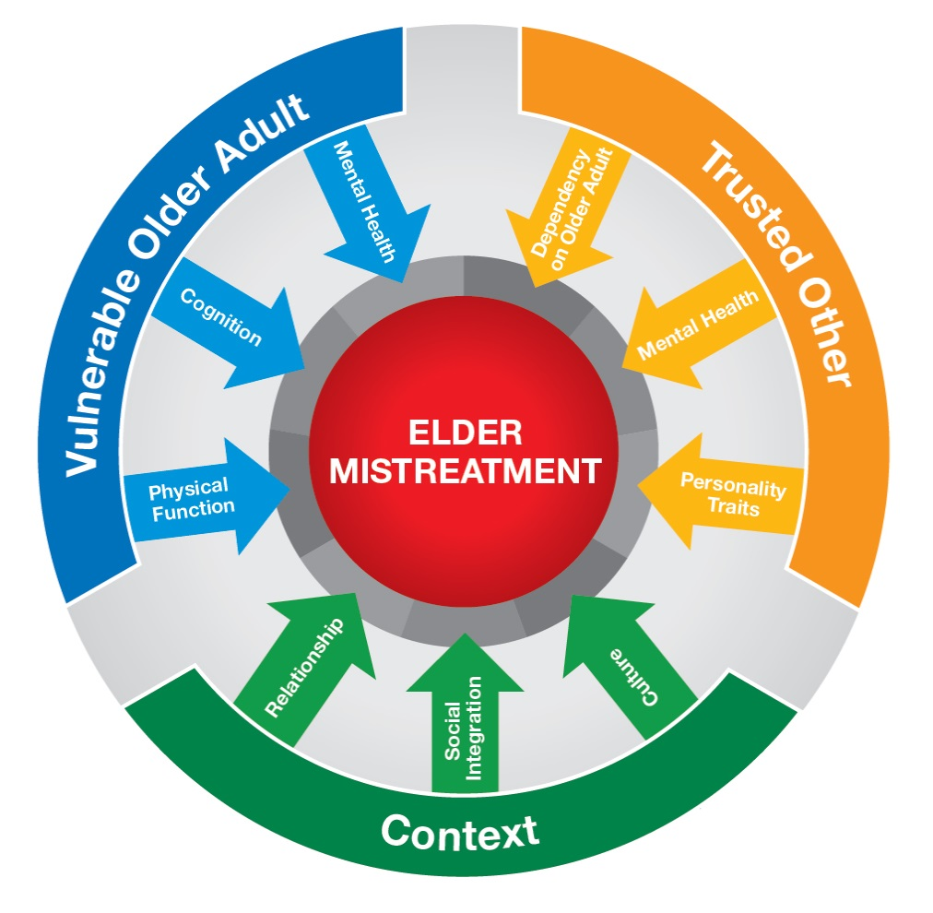
Abuse Intervention-Prevention Model (AIM)
Mosqueda L, Burnight K, Gironda MW, Moore AA, Robinson J, Olsen B. The Abuse Intervention Model (AIM): A pragmatic approach to intervention for elder mistreatment. J Am Geriatr Soc. 2016.

Slide 6
Vulnerable Older Adult
Trusted Other
Context

Slide 7
Vulnerable Older Adult
- Impaired Physical Function: Dementia limiting ADLS
- Impaired Cognition: Dementia causing resistance to care
Trusted Other
- Mental Illness: depression and anxiety
- Impaired Physical Function: Osteoarthritis limiting caregiving
Context
- Low-Quality Relationship: Strained family relationship
- Social Isolation: Limited social contact
- Cultural Norms: Wife does not manage finances

Slide 8
High Risk Caregiving Situations
Caregivers with inadequately treated mental health and/or substance abuse problems
Caregivers who feel stressed/burdened
Care recipient who is physically combative and/or verbally abusive

Slide 9
Observations
Interaction of the alleged victim and perpetrator
Behavioral indicators of state of mind
    Withdrawal
    Fear
    Confusion
Notes:
The observations of the relationship and conversation between the vicitm and the caregiver can be very important clues to what’s happening in the home.
Interaction: Watch to see if the caregiver always answers for the patient. Is the cargiverer rough with the patient. Does the caregiver yell at the patinet?

Slide 10
Pink Flags
Implausible/vague explanations
Delay in seeking care
Unexplained injuries
Inconsistent stories
Sudden change in behavior
Notes:
1. Remember the history of the injury so when doing the physical exam you can decide if the injury is consistent with the history
2. Remember that if people have an inflicted injury they’ll often let it go further at home than normal and hope it gets better by itself, or the perp of the injury won’t let the victim seek care.
3. Remember it’s not usually a one time thing
4. Remember since it’s not an accident no one can keep they’re stories straight!

Slide 11
Preventing abusive actions
All of us have the potential to “take out” our stress on the folks we are caring for
  Yelling/Belittling
  Getting physical
It doesn’t mean you’re a bad person… it usually means that you’re overwhelmed
It’s ok to acknowledge when you are overwhelmed and ask for help

Slide 12
Patient & Family Education
Promoting skills
Fostering physical and mental activities
Avoiding unnecessary challenges to the person – never argue “facts”
Recognizing role of stress
Focusing on the person, not the disease
“Dementia Reconsidered,” Tom Kitwood, 1997

Slide 13
Setting the Stage
Establish rapport
Establish privacy
Establish safe environment
Normalize the questions
Be empathetic
Don’t assume

Slide 14
ASK
Patients
  Are you afraid of anybody?
  Has anyone hurt you?
  Has anybody touched you in a way that made you scared or nervous?
Caregivers
  How are you doing with all this stress?
  Have you ever hit your mom, or are you worried that you might?

Slide 15
Prevention and Early Detection
Identify high-risk situations
  Elder with dementia: aggressive, dependent
  Caregiver: untreated mental health problem, drug/alcohol dependency, overwhelmed, burdened/stressed
Ask and listen
Intervene and help
Follow up
Reassure

Slide 16
Compassion for everyone
Comfort
Meaning
Love
Identity
Inclusion
Joy

Slide 17



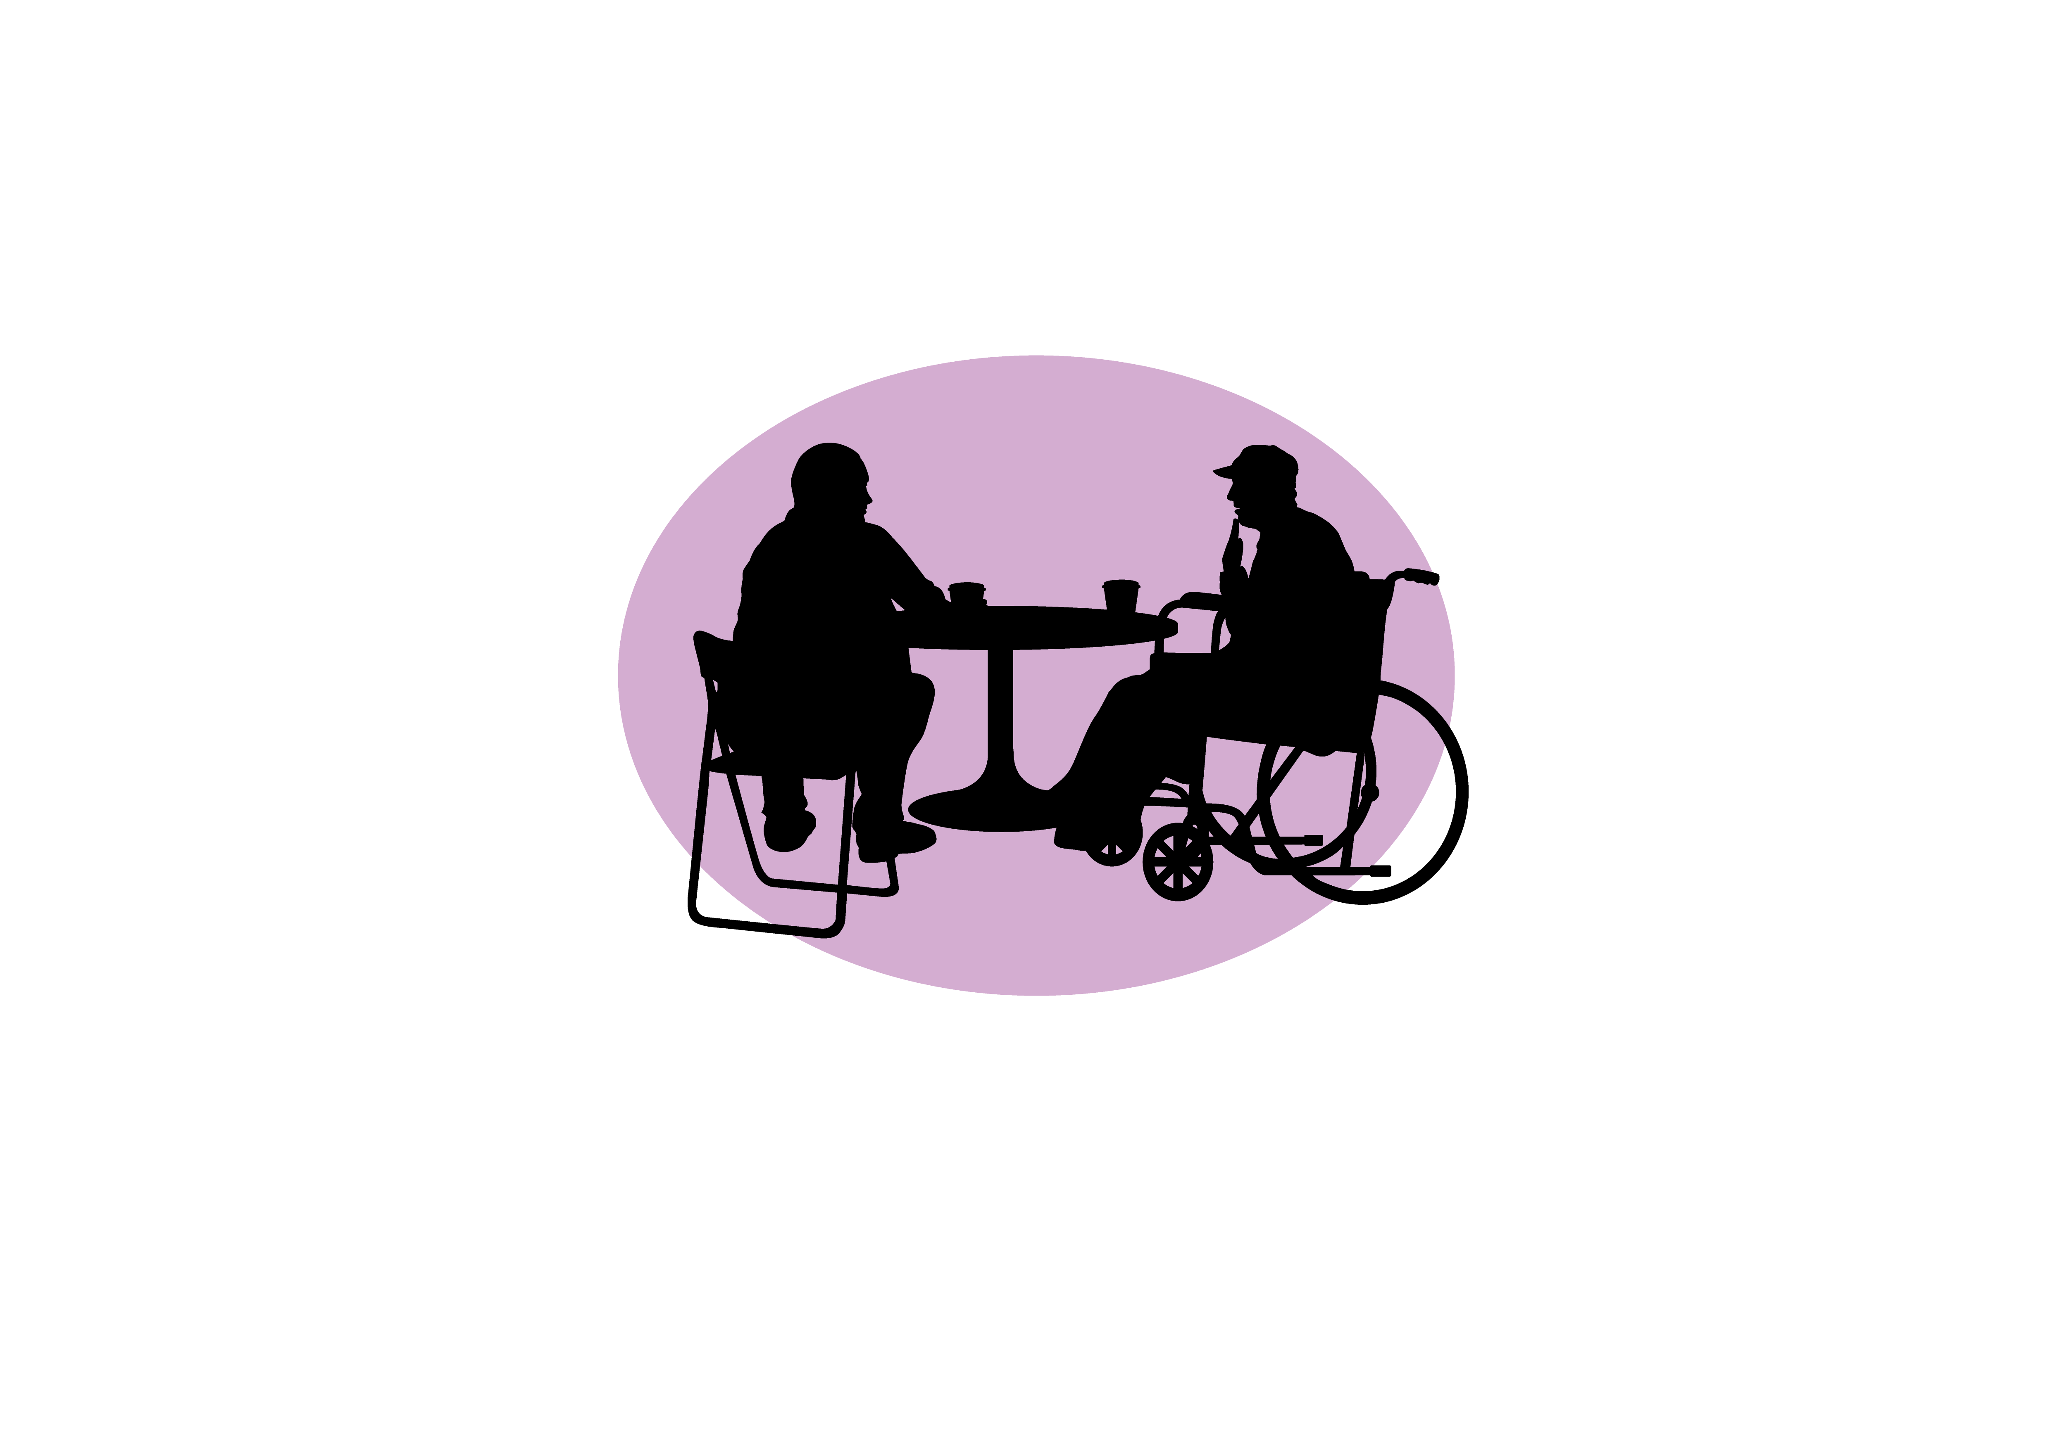

The National Center on Elder Abuse strives to improve the national response to elder abuse, neglect, and exploitation.
We provide education, share the latest in research and national policy, and promote best practices in the field and in our communities.

Slide 18
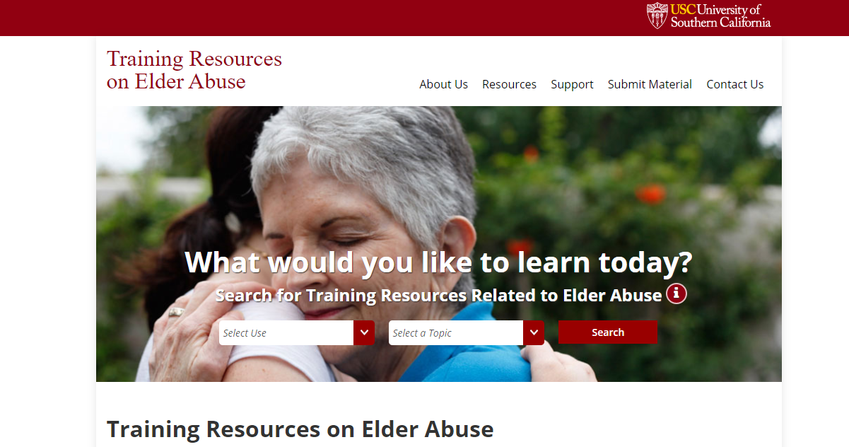
TRAINING RESOURCES ON ELDER ABUSE (TREA)

