Slide 1

A Pharmacist’s Role within Substance Use Disorder (SUD) Treatment and Recovery CAPT Ted Hall, PharmD DHHS/USPHS/IHS Advanced Practice Pharmacist II Clinical Psychiatric Pharmacist Prescriber Ho-Chunk Nation Health Department

Slide 2
Presentation Overview
Discuss various roles a pharmacist is able to serve in SUD treatment and recovery.
Discuss barriers and opportunities implementing SUD services or expanding existing services.
Illustrate the critical importance of evidence-based patient-centered integrative team approach for SUD treatment and recovery.

Slide 3
Disclaimer
The opinions and conclusions expressed today are those of the author and do not necessarily represent the views of the Department of Health and Human Services, US Public Health Service, the Indian Health Service or the Ho-Chunk Nation.
No financial disclosures to report.

Slide 4
Common Barriers & Potential Solutions
Barriers
Solutions
Overwhelming- unsure where to start
Tribal leadership support
Health Department leadership support
Medical staff hesitancy and support
Pharmacy leadership hesitancy and support
Pharmacy staffing limitations
Community resistance
Substance use stigma
Medication assisted treatment (MAT) stigma and resistance
Individual patient beliefs and perceptions
Education
Communication
Collaboration
Integrative teams
Patient centered
“Start slow and grow (together)”
Build on successes
Apply lessons learned

Slide 5
Pharmacist’s Roles
Medication subject matter experts
Case management
Maintain coordinated care plan between healthcare team (medical providers, nurses, behavioral health clinicians, peer recovery specialists, registered dieticians, specialists) and the individual patient
Medical provider support
Patient advocacy
Community and Health Department Education
Reduce stigma, influence and/or develop policy and processes, develop and implement integration, and much more!
Direct interventions
Medication selection recommendations
Naloxone prescribing and dispensing
Collaborative Practice Agreement (CPA) as physician extenders
Patient education and compliance monitoring/enhancement
Motivational interviewing for psychodynamic interventions
Support and augment behavioral health services

Slide 6
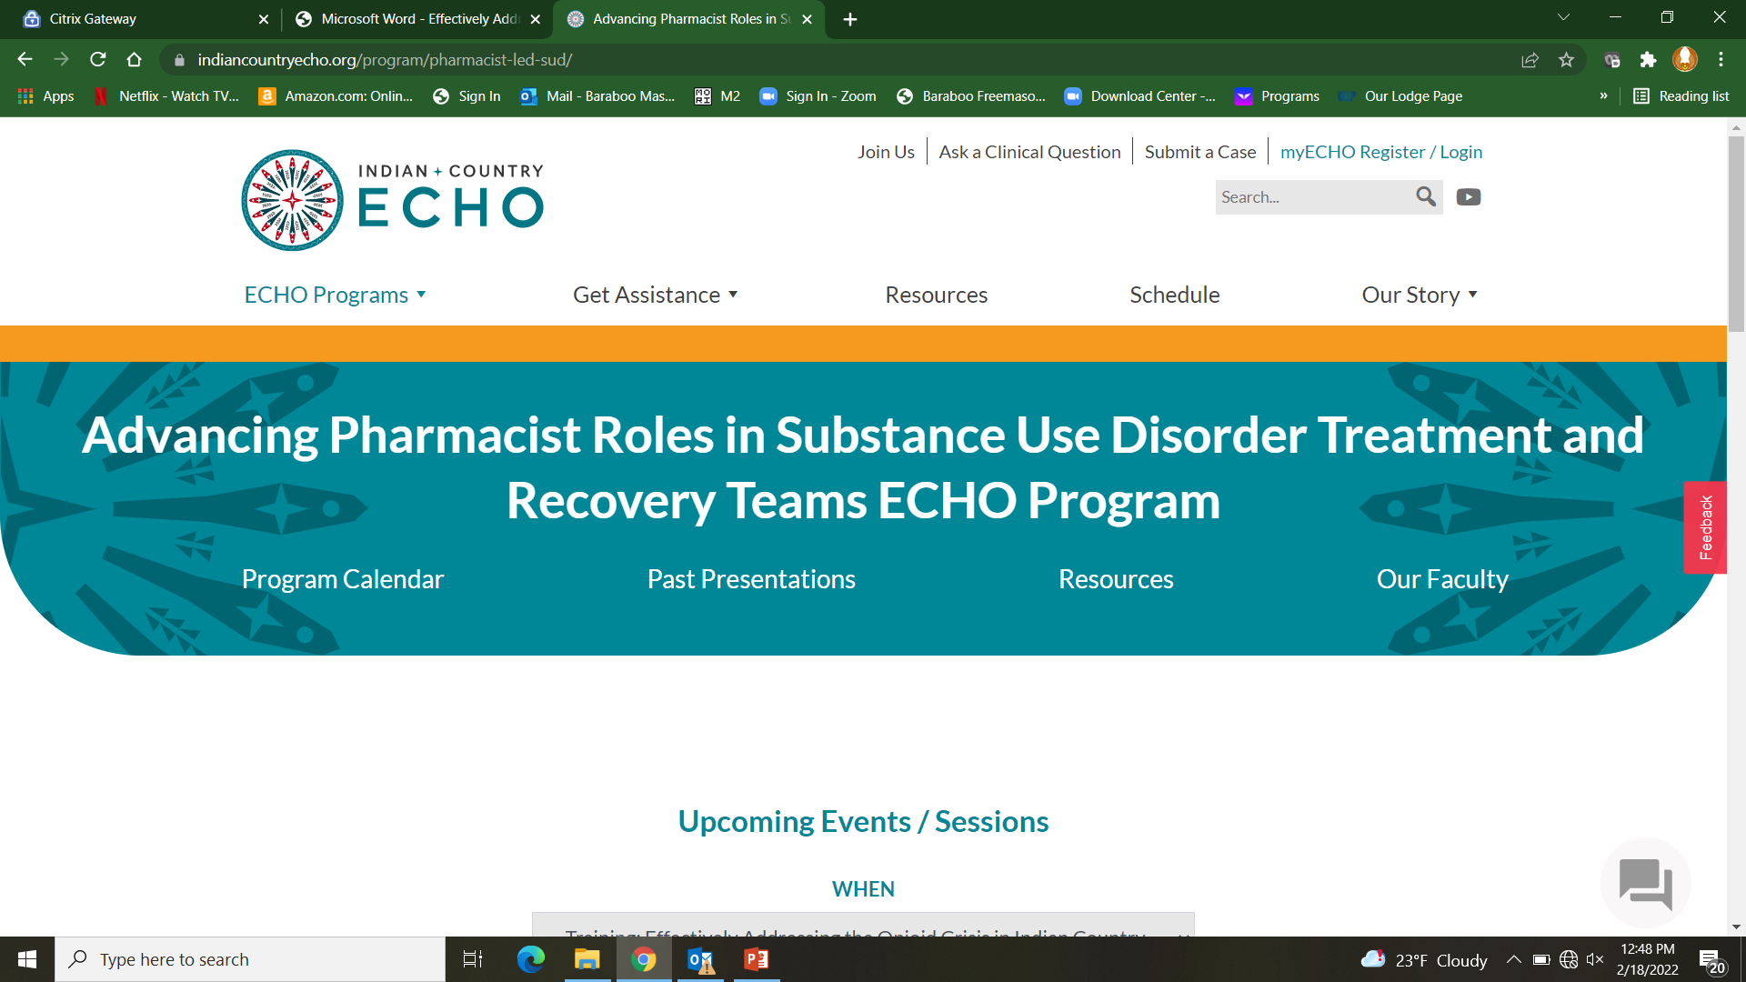
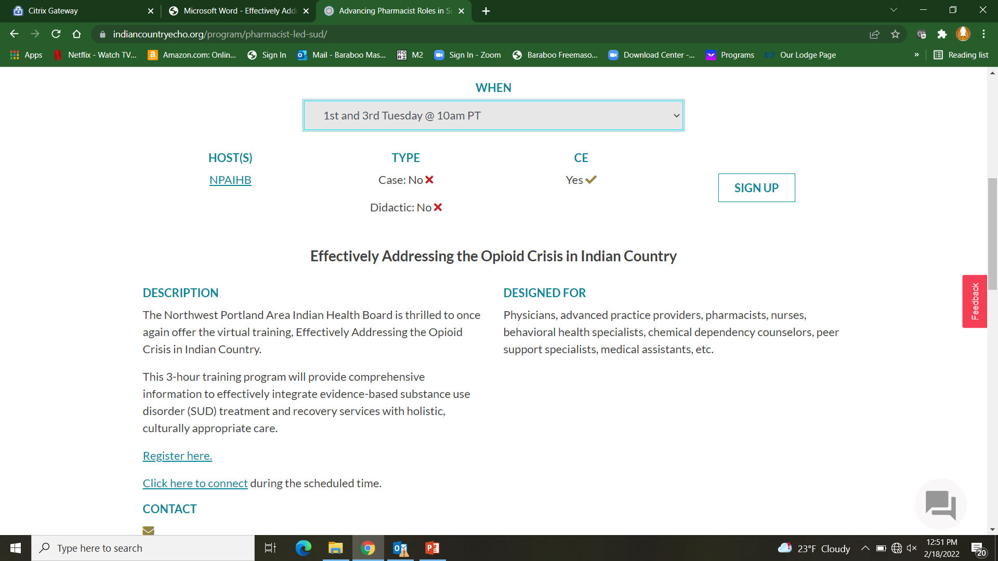
Training and Education:
3-hour training program will provide comprehensive information to effectively integrate evidence-based substance use disorder (SUD) treatment and recovery services with holistic, culturally appropriate care
Designated for physicians, advanced practice providers, pharmacists, nurses, behavioral health specialists, chemical dependency counselors, peer support specialists, medical assistants, etc.
CME Opportunity
Accreditation: In support of improving patient care, IHS Clinical Support Center is jointly accredited by the Accreditation Council for Continuing Medical Education (ACCME), the Accreditation Council for Pharmacy Education (ACPE), and the American Nurses Credentialing Center (ANCC), to provide continuing education for the healthcare team.
Pharmacists: Each virtual clinic session will provide 1 hour of Application-type continuing pharmacy education credit. Pharmacy CPE credits will be delivered via the CPE Monitor system.
https://www.indiancountryecho.org/program/pharmacist-led-sud/

Slide 7
Training and Education:
Format is a didactic and case presentation followed by audience and faculty recommendations.
Cases can be individual patient or systems based
Provides written recommendations for the case presenter’s team for treatment or program enhancements.
Case submission forms are available on website to be presented by pharmacist for training certificate eligibility
Entire team is encouraged to participate and/or co-present.
Opportunity to view recordings of past didactic presentations
https://www.indiancountryecho.org/program/pharmacist-led-sud/

Slide 8
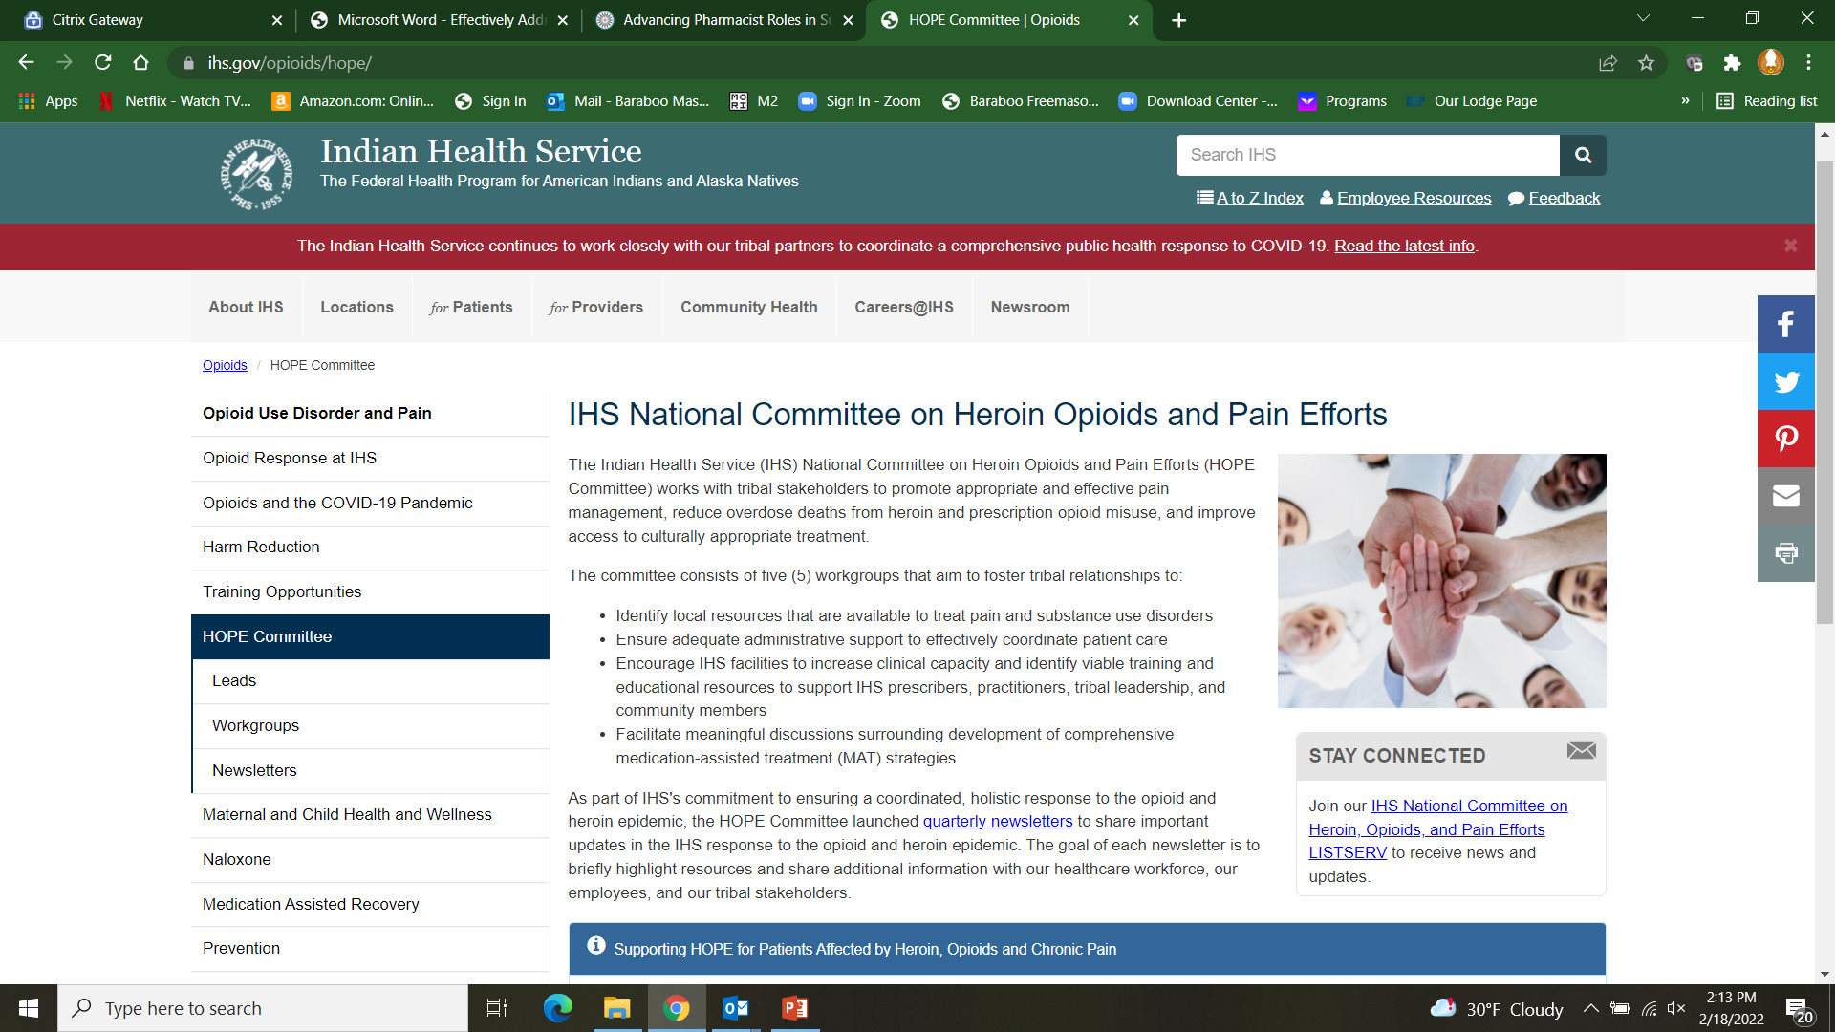
IHS Resources
https://www.ihs.gov/opioids/hope/
Notes:
The Indian Health Service (IHS) National Committee on Heroin Opioids and Pain Efforts (HOPE Committee) works with tribal stakeholders to promote appropriate and effective pain management, reduce overdose deaths from heroin and prescription opioid misuse, and improve access to culturally appropriate treatment.
The committee consists of five (5) workgroups that aim to foster tribal relationships to:
Identify local resources that are available to treat pain and substance use disorders
Ensure adequate administrative support to effectively coordinate patient care
Encourage IHS facilities to increase clinical capacity and identify viable training and educational resources to support IHS prescribers, practitioners, tribal leadership, and community members
Facilitate meaningful discussions surrounding development of comprehensive medication-assisted treatment (MAT) strategies

Slide 9
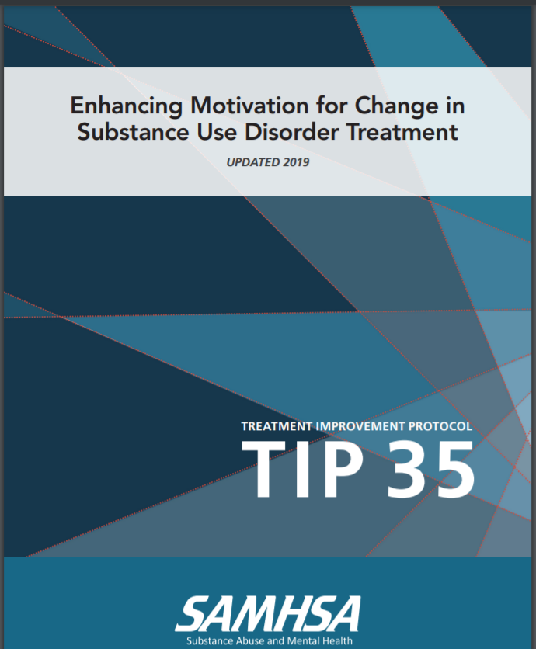
Evidence-Based Motivational Interview Intervention
MI helps develop a therapeutic alliance
MI is a form of non-pharmacological treatment
Helps the individual overcome ambivalence or resistance
Client-centered
https://store.samhsa.gov/sites/default/files/d7/priv/tip35_final_508_compliant_-_02252020_0.pdf

Slide 10
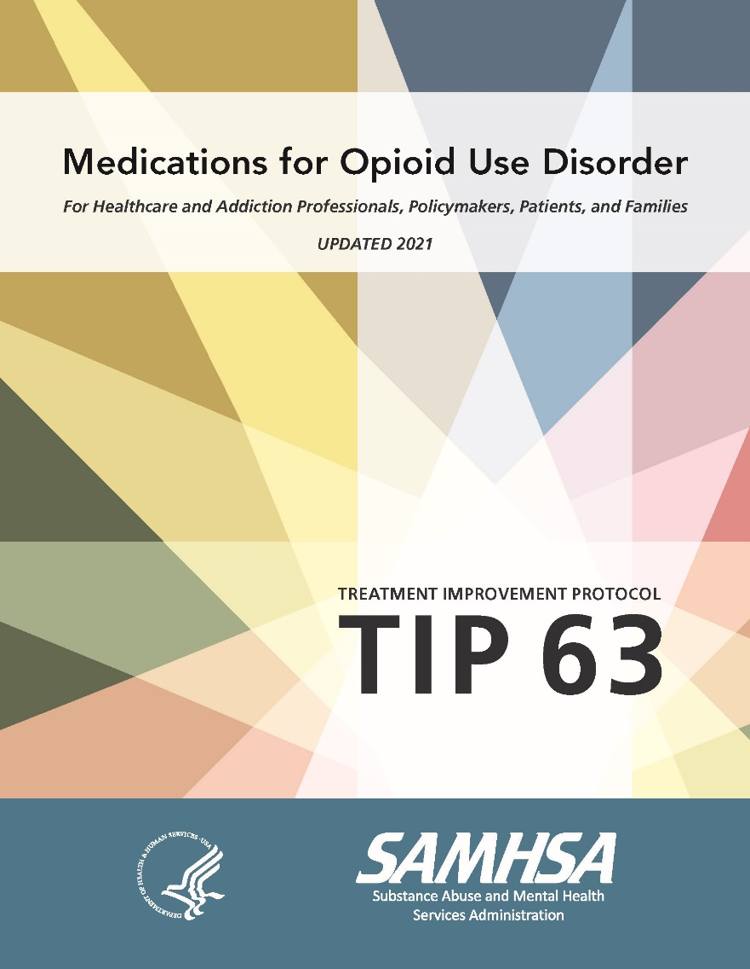
SAMHSA Medications for Opioid Use Disorder Treatment
Evidence Based resource for treatment
This Treatment Improvement Protocol (TIP) reviews the use of the three Food and Drug Administration (FDA)-approved medications used to treat OUD—methadone, naltrexone, and buprenorphine—and the other strategies and services needed to support recovery for people with OUD. This is a revision.
https://store.samhsa.gov/product/TIP-63-Medications-for-Opioid-Use-Disorder-Full-Document/PEP21-02-01-002

Slide 11


Contact Information
CAPT Ted L. Hall, PharmD
Ho-Chunk Nation Health Dept.
S2845 White Eagle Road
Baraboo, WI 53913
(O) 608-355-1240 ext. 35582
(C) 608-301-5390
Ted.Hall@ho-chunk.com

