Slide 1
THE CASE:
35 y/o male presents to the ED…..

Slide 2
CC
abd pain/cramping
pus & blood when urinates
HPI
5 days ago, believed he had food poisoning c intermittent abd cramping, bloating, distention, vomiting
Today vomited x 4, undigested food, not keeping anything down, no hematemesis
Formed BM today, no diarrhea
6 days ago had 1 day of fever, none since
Dysuria at initiation of urinary stream, pus from urethral opening of penis
2 months ago had lapchole at another hospital, with subsequent wound infection
Denies F S C cough ST dyspnea CP

Slide 3
PMH Meth/ETOH abuse (last use few months ago)
Rectal abscess
+ COVD boosted +flu IZ
Meds/Allergies none/NKDA
ROS neg x for HPI
PE
Vs 97.8 90 22 98% RA 101/68
HEENT L eye injected o/w nl
LAN very large NT L>R inguinal LAN (2 cm), no cerv or ax LAN
Resp nl
CV nl
Abd BS decrease, NT ND
GU uncirc male ”chancre-like” painless 1 cm ulcerative lesion, on a clear base with indurated borders at distal foreskin, no noted urethral discharge, testes/ NT no edema/masses Perianal: no lesions
Skin No rash or trauma
Neuro nl

Slide 4
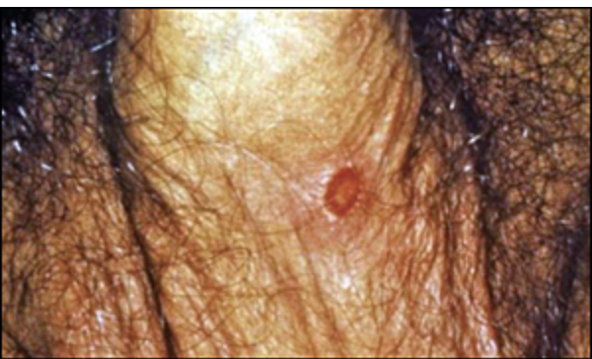

Slide 5
Labs WBC 13 Hgb/Hct/plts nl 73% N 77 segs 10 monos no bands
CMP/lipase nl
UA 1.024 prot 100 RBC 241 WBC 2394 epi 4 bact none
Urine tox + cannabinoids, meth, amph
Hepatitis screen nl
COV neg
Bedside HIV 4th Gen Ag/AB neg
Antitreponemal AB+
CT abd/pelvis
Multiple retroperitoneal and B inguinal adenopathy (diff includes infectious, inflammatory vs malignant adenopathy. “CCR.”
Hepatomegaly, s/p chole.

Slide 6
A/P
Abd pain/N/V/ leukocytosis- gastroenteritis-Rx IVF ondansetron, improving
2. Inguinal/RP lymphadenopathy-pt states lymph nodes were much bigger and have begun to resolve-infectious vs malignant-
? HIV
f/u LAN bx if no improvement after abx, treating STI’s
3. Pyuria/Purulent penile discharge-concern for CT/NG/trich given syphilis as below, will Rx for both
multiple female sexual partners
Rx IM Ceftriaxone 1 Gm x 1 in ED
Rx Doxycycline 100mg PO BID x 7 days
HIV AB pending

Slide 7
4. Primary syphilis- penile lesion c/w resolving chancre
Rx Bicillin 2.4 million units IM in ED
RPR pending
5. PSA + MJ, meth by snorting, denies IVDU
ED course:
ID consultation rec hospitalization and above Rx. Seen by hospitalist, rec blood cx, HIV RNA, but left AMA “to meet his girl coming in from out of town” after above meds and before these rec tests could be drawn.

Slide 8
Labs resulted after ED visit:
Urine Cx neg
HIV AB neg
CT/GC + CT/+GC
RPR reactive, 1:64

