Slide 1

COVID-19 Update
Jorge Mera, MD, FACP
Whitney Essex, APRN

Slide 2
Outline
Status of Omicron in the US
Testing
Return to work recommendations for HCP
Treatment Guidelines

Slide 3
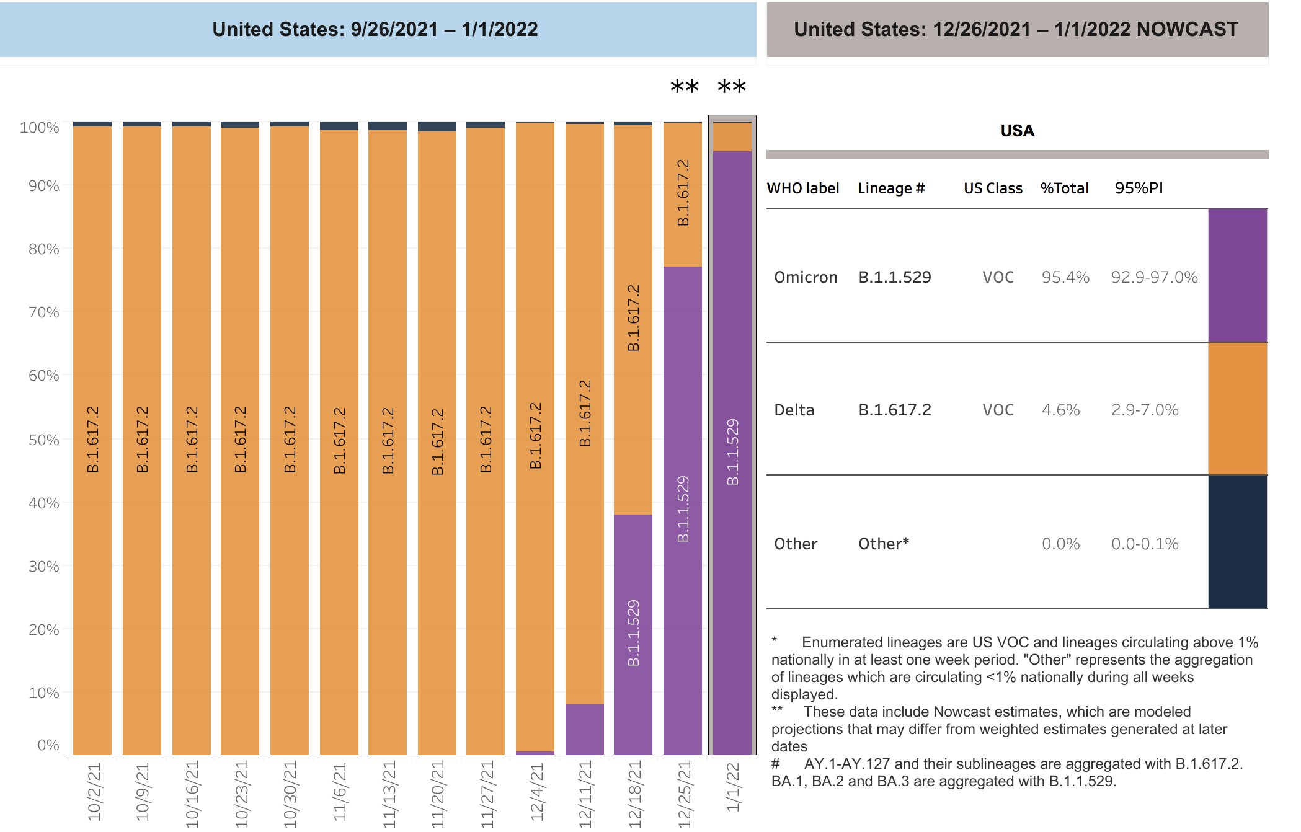

Slide 4
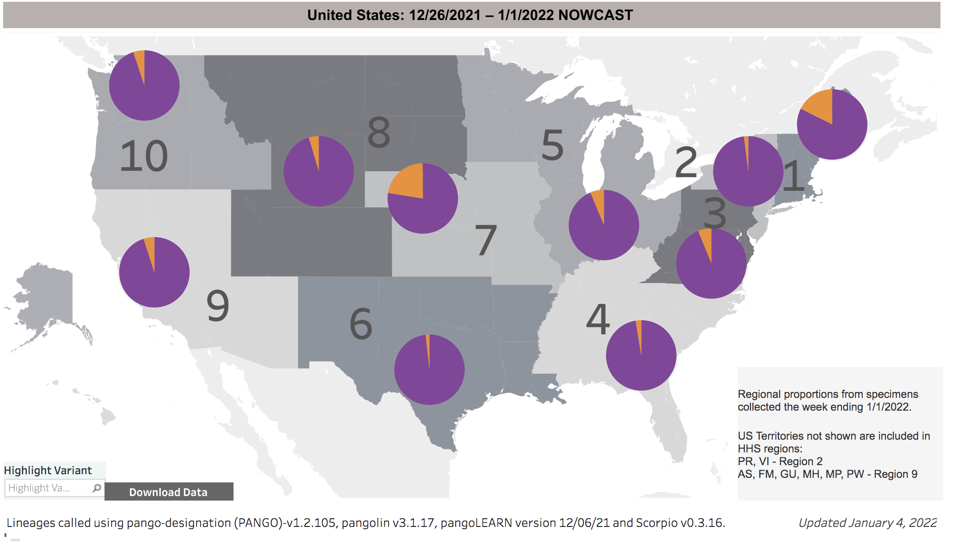

Slide 5
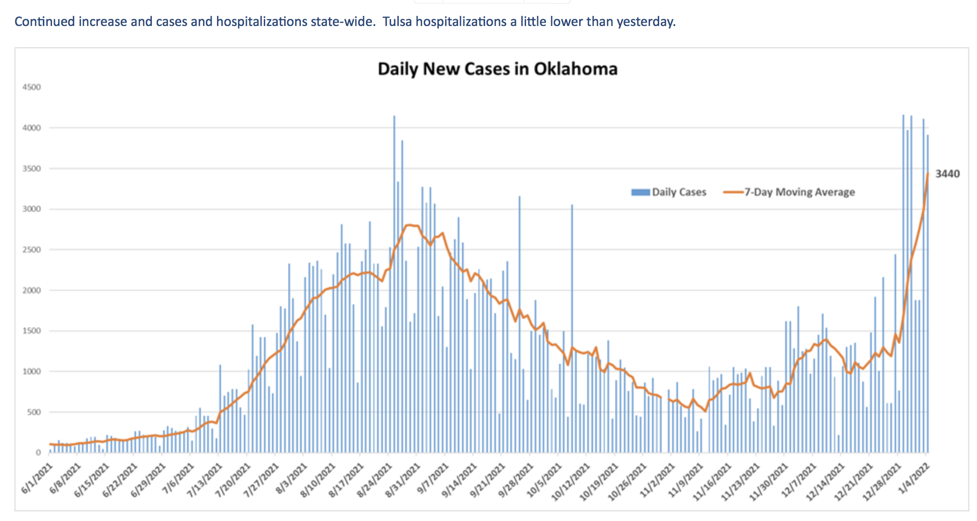

Slide 6
CDC: What We know About OMICRON
Spread
Will spread more easily than the original SARS-CoV-2 virus and how easily Omicron spreads compared to Delta remains unknown.
Severe Illness
More data is needed
Vaccines
Current vaccines are expected to protect against severe illness, hospitalizations, and deaths due to infection with the Omicron variant.
Breakthrough infections in people who are fully vaccinated are likely to occur.
Remain effective at preventing severe illness, hospitalizations, and death.
Treatments
Based on the changed genetic make-up of Omicron, some treatments are likely to remain effective while others may be less effective.
CDC expects that anyone with Omicron infection can spread the virus to others, even if they are vaccinated or don’t have symptoms.
https://www.cdc.gov/coronavirus/2019-ncov/variants/omicron-variant.html

Slide 7
IDSA Guidelines on the Diagnosis of COVID-19: Antigen Testing
SARS-COV-2 EUA Antigen testing: Clinical performance
Rapid Ag tests have high specificity and low to modest sensitivity compared to reference NAAT methods.
Antigen test sensitivity is dependent on viral load, with differences between symptomatic and asymptomatic individuals and the time of testing
Rapid RT-PCR or laboratory-based NAAT remain the diagnostic methods of choice for diagnosing SARS-CoV-2 infection.
When molecular testing is not readily available or is logistically infeasible, Ag testing can help identify some individuals with SARS-CoV-2 infection
The overall quality of available evidence supporting use of Ag testing was graded as very low to moderate.
For symptomatic individuals suspected of having COVID-19, using standard NAAT (either rapid RT-PCR or laboratory-based NAAT) over rapid Ag tests
If NAAT is not available or results are expected to be delayed beyond 2 – 3 days, rapid Ag testing could be considered
For optimal performance, Ag tests should be used within seven days of symptom onset
If clinical suspicion for COVID-19 remains high, negative Ag results should be confirmed by standard NAAT
Infectiousness of an individual cannot be determined based on Ag testing or NAAT results
Data on the clinical performance is limited to single, one-time testing versus NAAT as the reference standard.
NAAT: Nucleic Acid Amplification Test
https://www.idsociety.org/practice-guideline/covid-19-guideline-treatment-and-management/#

Slide 8
IDSA Guidelines on the Diagnosis of COVID-19: Recommendation 7: Rapid Isothermal NAATs
Suggests using either rapid RT-PCR or standard laboratory-based NAATs over rapid isothermal NAATs in symptomatic individuals suspected of having COVID-19
Rapid NAAT was defined as assays generating results in approximately one hour or less of instrument run time
Rapid isothermal NAAT is an acceptable testing option when rapid RT-PCR or standard laboratory-based NAAT is not readily available.
But a negative test result from an individual with a high clinical suspicion for SARS-CoV-2 infection, or anyone in a moderate (10%) or high prevalence (40%) population should be confirmed by standard NAAT or a rapid RT-PCR test when testing is available, and the results will affect patient management.
Compared to a single standard NAAT or composite reference standard when available.
Rapid RT-PCR tests had a pooled sensitivity of 97% (95% CI: 94-99) with specificity 96% (95% CI: 94-98)
Rapid isothermal NAAT (primarily Abbott ID NOW) had a sensitivity of 70% (95% CI: 56-81) with specificity 99% (95% CI, 97-99)
https://www.idsociety.org/practice-guideline/covid-19-guideline-treatment-and-management/#

Slide 9
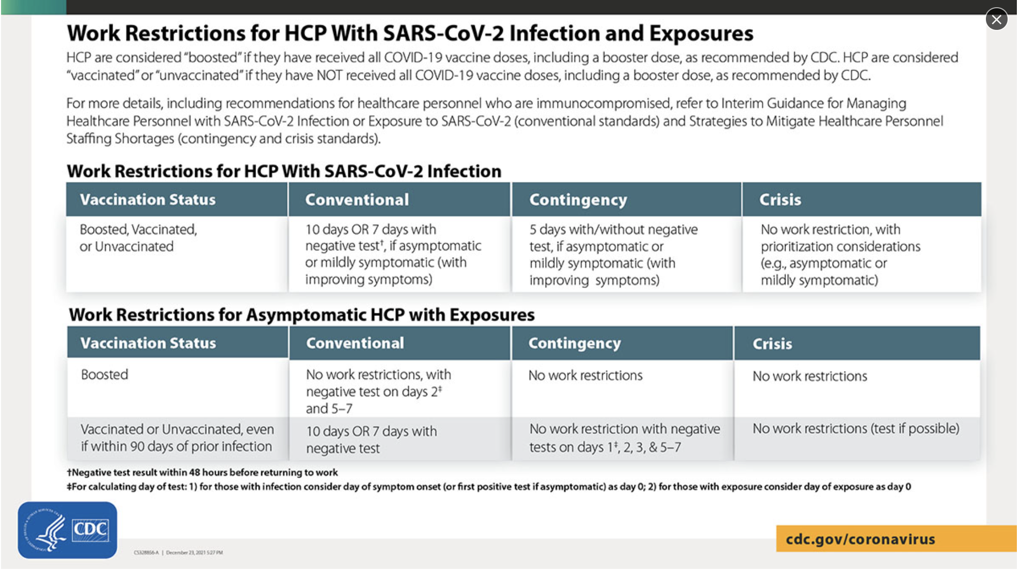

Slide 10
Return to Work Criteria for HCP with SARS-CoV-2 Infection
HCP with mild to moderate illness who are not moderately to severely immunocompromised:
At least 7 days if a negative antigen or NAAT is obtained within 48 hours prior to returning to work (or 10 days if testing is not performed or if a positive test at day 5-7) have passed since symptoms first appeared, and
At least 24 hours have passed since last fever without the use of fever-reducing medications, and
Symptoms (e.g., cough, shortness of breath) have improved.
HCP who were asymptomatic throughout their infection and are not moderately to severely immunocompromised
At least 7 days if a negative antigen or NAAT is obtained within 48 hours prior to returning to work (or 10 days if testing is not performed or a positive test at day 5-7) have passed since the date of their first positive viral test.
https://www.cdc.gov/coronavirus/2019-ncov/hcp/guidance-risk-assesment-hcp.html

Slide 11
Return to Work Criteria for HCP with SARS-CoV-2 Infection
HCP with severe to critical illness and are not moderately to severely immunocompromised:
In general, when 20 days have passed since symptoms first appeared, and
At least 24 hours have passed since last fever without the use of fever-reducing medications, and
Symptoms (e.g., cough, shortness of breath) have improved.
The test-based strategy as described for moderately to severely immunocompromised HCP below can be used to inform the duration of isolation.
HCP who are moderately to severely immunocompromised may produce replication-competent virus > 20 days after symptom onset
Use of a test-based strategy and consultation with an ID specialist or other expert and an occupational health specialist is recommended to determine when these HCP may return to work.
The criteria for the test-based strategy are:
Resolution of fever without the use of fever-reducing medications, and
Improvement in symptoms (e.g., cough, shortness of breath), and
Results are negative from at least two consecutive respiratory specimens collected ≥24 hours apart (total of two negative specimens) using an Ag test or NAAT.
HCP who are not symptomatic:
Results are negative from at least two consecutive respiratory specimens collected ≥24 hours apart (total of two negative specimens) using an Ag test or NAAT.
HCP who are symptomatic:
https://www.cdc.gov/coronavirus/2019-ncov/hcp/guidance-risk-assesment-hcp.html

Slide 12
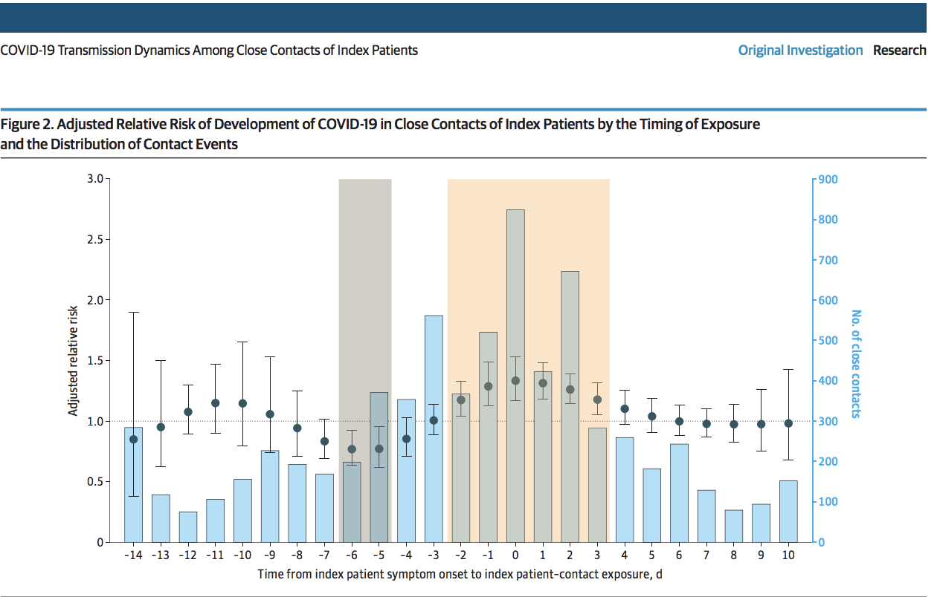
COVID-19 Transmission Dynamics Among Close Contacts of Index Patients
JAMA Intern Med. 2021;181(10):1343-1350. doi:10.1001/jamainternmed.2021.4686 Published online August 23, 2021.

Slide 13
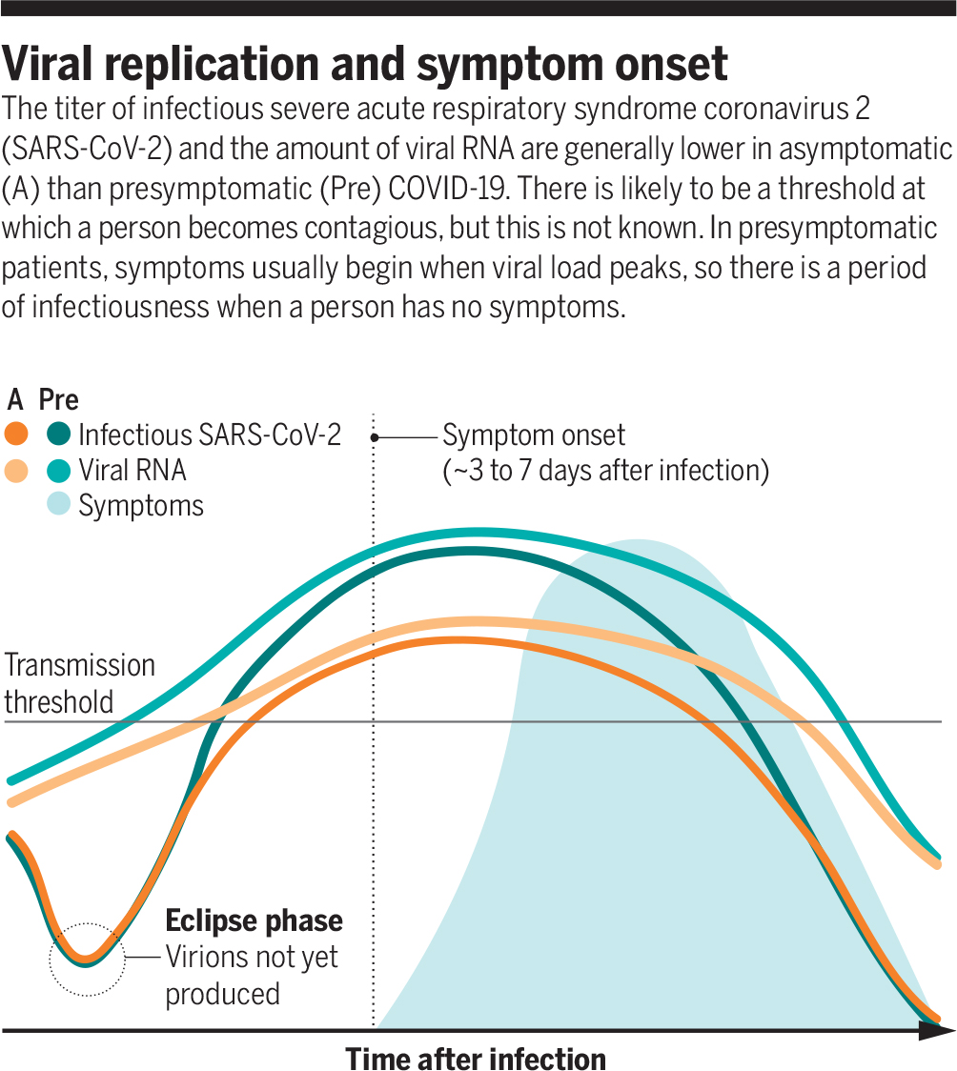

Viral replication and symptom onset
Angela L. Rasmussen, and Saskia V. Popescu Science 2021;371:1206-1207
Copyright © 2021 The Authors, some rights reserved; exclusive licensee American Association for the Advancement of Science. No claim to original U.S. Government Works
Notes:
Viral replication and symptom onset The titer of infectious severe acute respiratory syndrome coronavirus 2 (SARS-CoV-2) and the amount of viral RNA are generally lower in asymptomatic (A) than presymptomatic (Pre) COVID-19. There is likely to be a threshold at which a person becomes contagious, but this is not known. In presymptomatic patients, symptoms usually begin when viral load peaks, so there is a period of infectiousness when a person has no symptoms.

Slide 14
NIH Guidelines recommendations for nonhospitalized patients with mild to moderate COVID-19 who are at high risk of disease progression (listed in order of preference)
Nirmatrelvir 300 mg/ritonavir 100 mg, orally (Paxlovid). AIIa
Has significant and complex drug-drug interactions, primarily due to the ritonavir component.
Sotrovimab 500 mg IV AIIa
Initiated ASAP within 5 days of symptom onset, orally twice daily in those aged ≥12 years and weighing ≥40 kg.
Initiate ASAP within 10 days of symptom onset, , single IV infusion for those aged ≥12 years and weighing ≥40 kg, in areas with a high prevalence of Omicron
Patients should be observed for at least 1 hour after infusion.
Remdesivir 100 mg IV BIIa
Initiate ASAP within 7 days of symptom onset. Remdesivir IV, 200 mg on Day 1, 100 mg daily on Days 2 and 3. for those aged ≥12 years and weighing ≥40 kg
NIH recommends 1 hour of observation, but this was not required in the clinical trial
Outpatient treatment would be an off-label indication.
Carefully review the patient’s concomitant medications, including OTC medications and herbal supplements.
COVID-19 Treatment Guidelines Panel. Coronavirus Disease 2019 (COVID-19) Treatment Guidelines. National Institutes of Health.
Available at https://www.covid19treatmentguidelines.nih.gov/. Accessed [01/02/2021].

Slide 15
NIH Guidelines recommendations for nonhospitalized patients with mild to moderate COVID-19 who are at high risk of disease progression (listed in order of preference)
Bamlanivimab plus etesevimab or casirivimab plus imdevimab can be used only if:
Initiate ASAP within 5 days of symptom onset on those aged ≥18 years
Not recommended for use in pregnant patients (concerns about fetal toxicity observed during animal studies).
There are no data on the use of molnupiravir in patients who have received COVID-19 vaccines, and the risk-to-benefit ratio is likely to be less favorable because of the lower efficacy of this drug.
The Delta VOC represents a significant proportion of infections in the region and other options are not available/contraindicated
Patients understand that this treatment would be ineffective if they are infected with the Omicron VOC
Molnupiravir 800 mg, orally, ONLY when none of the above options can be used CIIa
Not authorized for persons < 18 years of age due to potential bone and cartilage toxicity
COVID-19 Treatment Guidelines Panel. Coronavirus Disease 2019 (COVID-19) Treatment Guidelines. National Institutes of Health.
Available at https://www.covid19treatmentguidelines.nih.gov/. Accessed [01/02/2021].

Slide 16
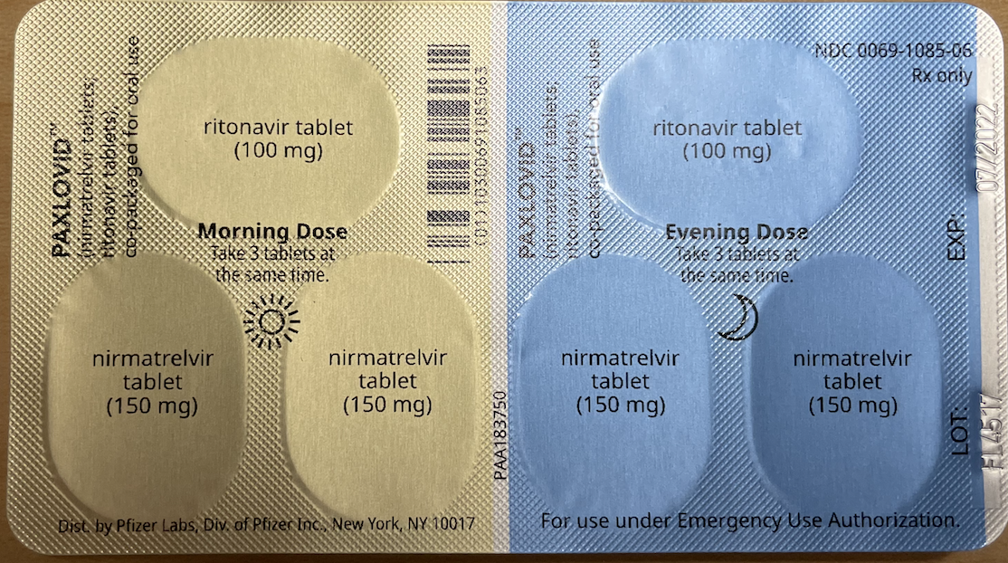
Nirmatrelvir 300 mg/ritonavir 100 mg, orally (Paxlovid).
Reduced the risk of hospitalization/death by 88%
Initiate ASAP within 5 days of symptom onset
Orally twice daily in those aged ≥12 years and weighing ≥40 kg.
Has significant/complex drug-drug interactions
Needs dose adjustment with GFR < 60mL
Only one Nirmatrelvir tablet and one ritonavir tablet
Contraindicated if GFR is < 30 mL
May cause nausea and vomiting (Ritonavir)

Slide 17
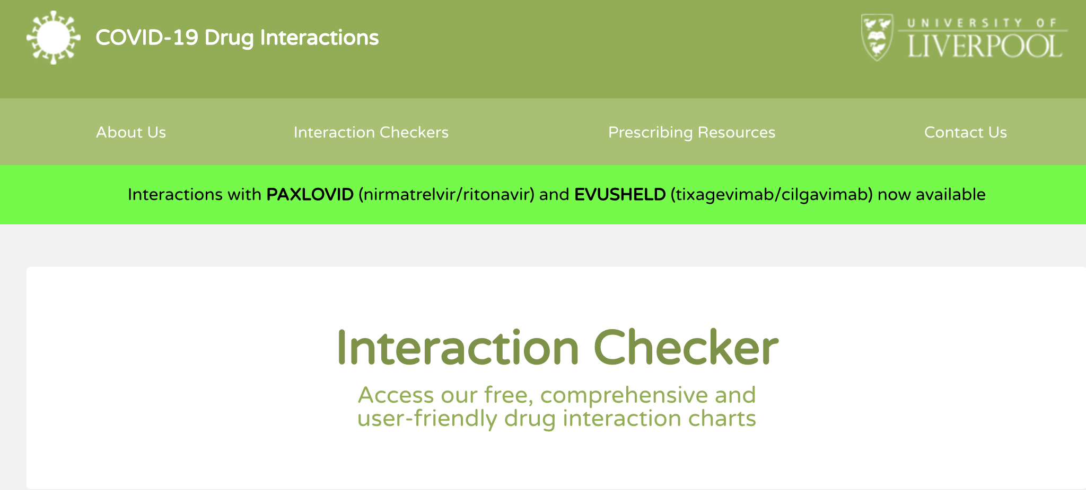
Medications That Are Contraindicated or Should Not Be Co-administered With Ritonavir-Boosted Nirmatrelvir (Paxlovid)
Prescribe an alternative COVID-19 therapy for patients who are receiving any of the medications listed. |  | If the patient is receiving any of these medications, withhold the medication if clinically appropriate or use an alternative concomitant medication or COVID-19 therapy.ª
Amiodarone Apalutamide Bosentan Carbamazepine Cisapride Clopidogrel Clozapine Colchicine in patients with renal and/or hepatic impairment Disopyramide Dofetilide Dronedarone Eplerenone Ergot derivatives FlecainideFlibanserin Glecaprevir/pibrentasvir Ivabradine | Lumateperone Lurasidone Mexiletine Phenobarbital Phenytoin Pimozide Propafenone Quinidine Ranolazine Rifampin Rifapentine Rivaroxaban Sildenafil for pulmonary hypertension St. John’s wort Tadalafil for pulmonary hypertension Ticagrelor Vorapaxar | Alfuzosin Alprazolam Atorvastatin Avanafil Clonazepam Codeine Cyclosporine^{b} Diazepam Everolimus^{b} Fentanyl Hydrocodone Lomitapide Lovastatin Meperidine (pethidine) Midazolam (oral) Oxycodone | Piroxicam Propoxyphene Rosuvastatin Salmeterol Sildenafil for erectile dysfunction Silodosin Simvastatin Sirolimus^{b} Suvorexant Tacrolimus^{b} Tadalafil for erectile dysfunction Tamsulosin Tramadol Triazolam Vardenafil
ª Expert consultation may be considered. In some cases, dose reduction of the concomitant medication may be an appropriate management strategy
^{b} Before prescribing ritonavir-boosted nirmatrelvir (Paxlovid) for a patient receiving this immunosuppressant, the patient’s specialist provider(s) should be consulted, given the significant drug-drug interaction potential between ritonavir and the narrow therapeutic index agent and because close monitoring may not be feasible.

Slide 18
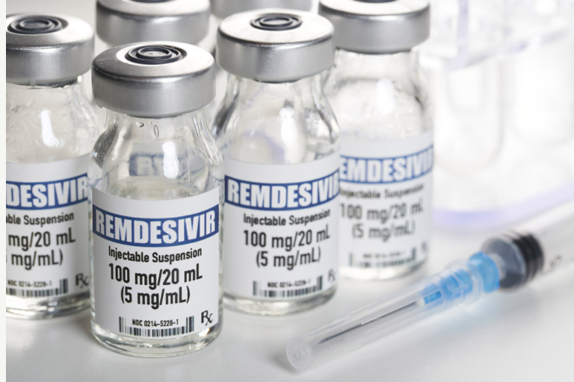
Remdesivir
Effective in outpatients who do not require hospitalization
87% reduction in hospitalization and death when given within 7 days of symptom onset
200 mg on day 1 and 100 mg on day 2 and 3
FDA approved for hospitalized patients only
IV treatment: 30-minute infusion
Contraindicated in patients with:
GFR < 30
Decompensated cirrhosis

Slide 19
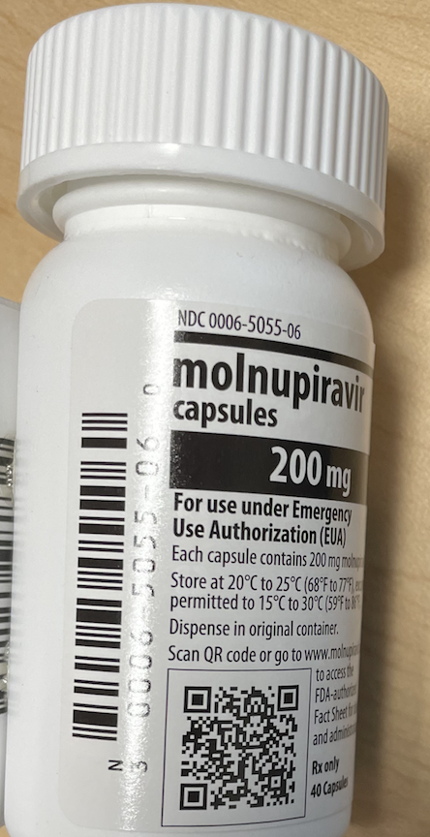
Molnupiravir
Efficacy in reducing hospitalization ~ 30%
ASAP within 5 days of symptom onset
800mg twice a day
Only for patients aged ≥18 years
Not recommended for use in pregnant patients
Discretion in female patients with childbearing potential

Slide 20
Patient Prioritization for Outpatient Anti-SARS-CoV-2 Therapies or Preventive Strategies When There Are Logistical or Supply Constraints Last Updated: December 23, 2021
Tier | Risk Group
1 | Immunocompromised individuals not expected to mount an adequate immune response to COVID-19 vaccination or SARS-CoV-2 infection due to their underlying conditions, regardless of vaccine status; or Unvaccinated individuals at the highest risk of severe disease (anyone aged ≥75 years or anyone aged ≥65 years with additional risk factors).
2 | Unvaccinated individuals at risk of severe disease not included in Tier 1 (anyone aged ≥65 years or anyone aged <65 years with clinical risk factors)
3 | Vaccinated individuals at risk of severe disease (anyone aged ≥65 years or anyone aged <65 with clinical risk factors) Note: Vaccinated individuals who have not received a COVID-19 vaccine booster dose are likely at higher risk for severe disease; patients in this situation within this tier should be prioritized for treatment.
4 | Vaccinated individuals at risk of severe disease (anyone aged ≥65 years or anyone aged <65 with clinical risk factors) Note: Vaccinated individuals who have not received a COVID-19 vaccine booster dose are likely at higher risk for severe disease; patients in this situation within this tier should be prioritized for treatment.
COVID-19 Treatment Guidelines Panel. Coronavirus Disease 2019 (COVID-19) Treatment Guidelines. National Institutes of Health.
Available at https://www.covid19treatmentguidelines.nih.gov/. Accessed [01/02/2021].

Slide 21
Immunocompromising Conditions
Patients who are within 1 year of receiving B-cell depleting therapies
Patients receiving Bruton tyrosine kinase inhibitors
Chimeric antigen receptor T cell recipients
Post-hematopoietic cell transplant recipients
Patients with hematologic malignancies who are on active therapy
Lung transplant recipients
Patients who are within 1 year of receiving a solid-organ transplant (other than lung transplant)
Solid-organ transplant recipients
Patients with severe combined immunodeficiencies
Patients with untreated HIV
(e.g., rituximab, ocrelizumab, ofatumumab, alemtuzumab)
Who have chronic graft versus host disease or who are taking immunosuppressive medications for another indication
With recent treatment for acute rejection with T or B cell depleting agents
Who have a CD4 T lymphocyte cell count <50 cells/mm³
If these anti-SARS-CoV-2 agents cannot be provided to all moderately to severely immunocompromised individuals because of logistical constraints or supply limitations
Prioritize for those who are least likely to mount an adequate response to COVID-19 vaccination or SARS-CoV-2 infection and who are at risk for severe outcomes, including (but not limited to) patients on the list
If supplies are extremely limited,
Prioritize those who are more severely immunocompromised (see list) and
Who also have additional risk factors for severe disease for the outpatient therapies.
COVID-19 Treatment Guidelines Panel. Coronavirus Disease 2019 (COVID-19) Treatment Guidelines. National Institutes of Health.
Available at https://www.covid19treatmentguidelines.nih.gov/. Accessed [01/02/2021].

Slide 22
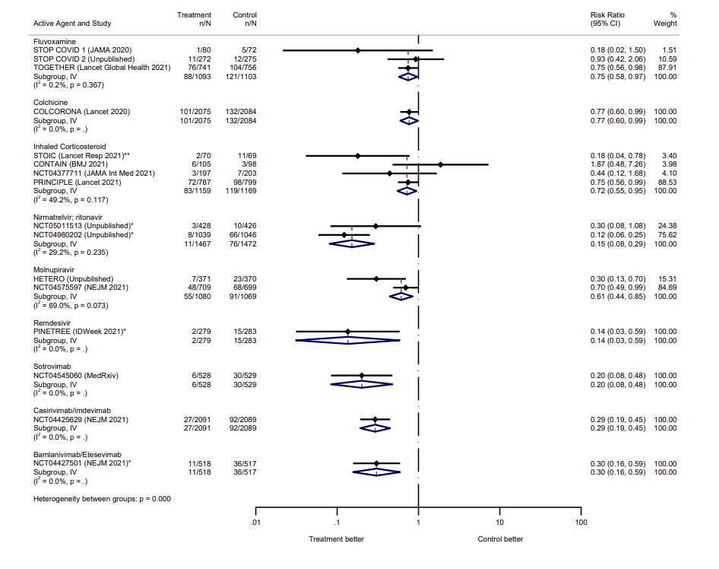
Outpatient therapies for COVID-19: How do we choose?
medRxiv preprint doi: https://doi.org/10.1101/2021.12.17.21268007
Have FDA EUA
Have FDA EUA

Slide 23
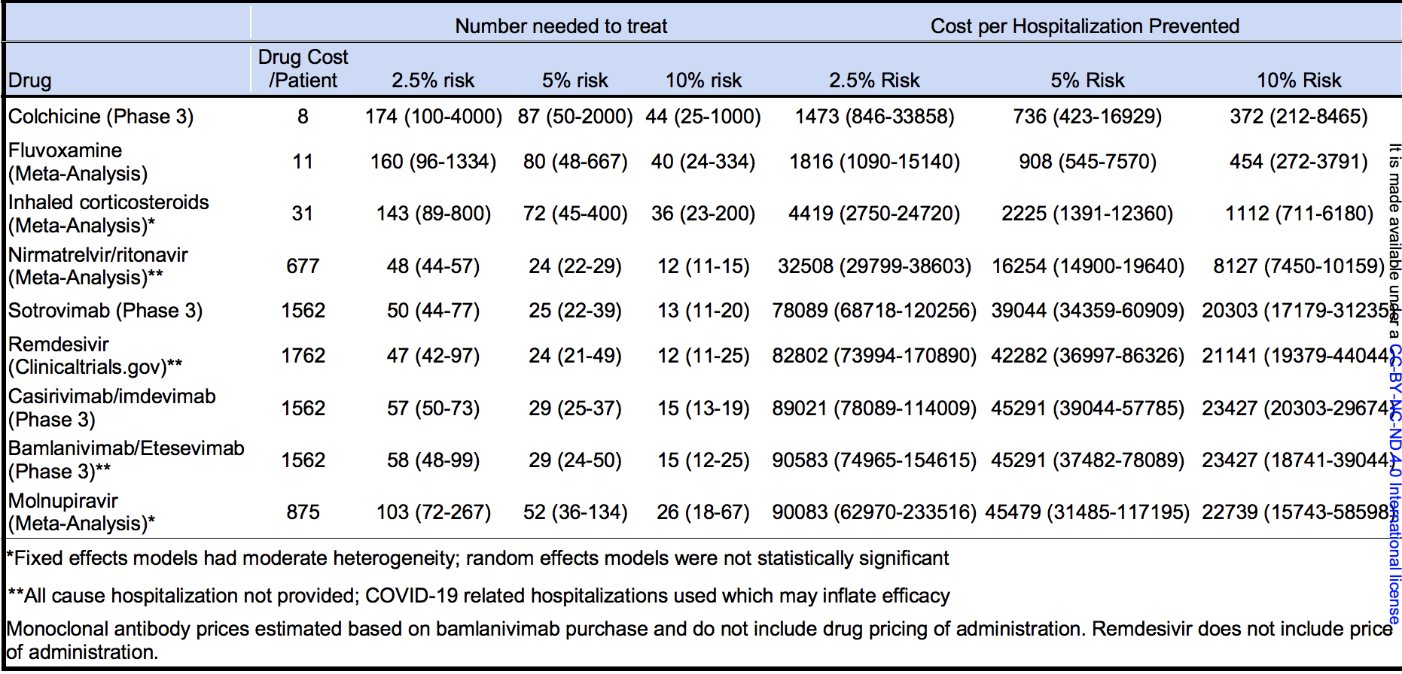
Table 2 -Number Needed to Treat and Costs per Hospitalization Prevented
medRxiv preprint doi: https://doi.org/10.1101/2021.12.17.21268007

Slide 24



