Slide 1

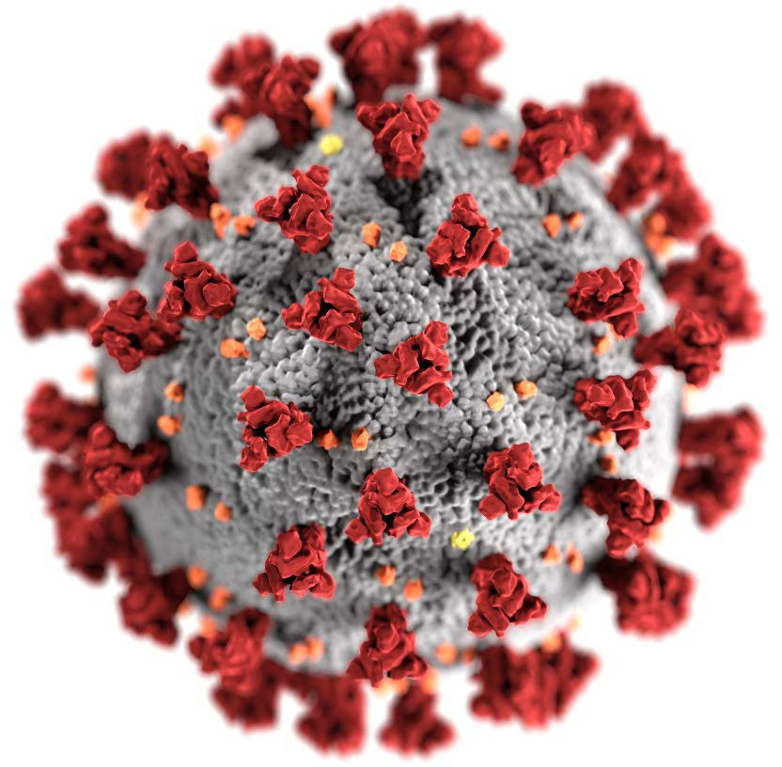

mRNA COVID-19
Vaccine-Associated Myocarditis
Matthew Oster, MD, MPH
CDC COVID-19 Vaccine Task Force
cdc.gov/coronavirus

Slide 2
Disclaimer
The findings and conclusions in this report are those of the author and do not necessarily represent the official position of the Centers for Disease Control and Prevention (CDC)
Mention of a product or company name is for identification purposes only and does not constitute endorsement by CDC

Slide 3
Outline
Cases of myocarditis after COVID-19 vaccine
Comparing types of myocarditis
3-6 month outcomes of myocarditis

Slide 4
Vaccine Adverse Event Reporting System (VAERS):
Reporting rates (per 1 million doses administered) of myocarditis among males after mRNA COVID-19 vaccines, 7-day risk period (N=797)*
 | Pfizer |  | Moderna
 | (Males) |  | (Males)
Ages | Dose 1 | Dose 2 | Dose 1 | Dose 2
12-15 | 4.2 | 39.9
16-17 | 5.7 | 69.1
18-24 | 2.3 | 36.8 | 6.1 | 38.5
25-29 | 1.3 | 10.8 | 3.4 | 17.2
30-39 | 0.5 | 5.2 | 2.3 | 6.7
40-49 | 0.3 | 2.0 | 0.2 | 2.9
50-64 | 0.2 | 0.3 | 0.5 | 0.6
65+ | 0.2 | 0.1 | 0.1 | 0.3
169,740,953 doses of mRNA vaccine administered to males (dose 1 and dose 2) *
Reporting rates exceed background incidence**
Highest % is among males aged 16-17 years:
0.007%
* As of Oct 6, 2021; 797 of 935 reports after doses 1 and 2 of mRNA vaccines occurred during Days 0–6 after vaccination among males; reports verified to meet case definition by provider interview or medical record review
** An estimated 1–10 cases of myocarditis per 100,000 person years occurs among people in the United States, regardless of vaccination status; adjusted for the 7-day risk period, this estimated background is 0.2 to 1.9 per 1 million person 7-day risk period
4

Slide 5
Vaccine Adverse Event Reporting System (VAERS):
Reporting rates (per 1 million doses administered) of myocarditis among females after mRNA COVID-19 vaccines, 7-day risk period (N=138)*
 | Pfizer |  | Moderna
 | (Females) |  | (Females)
Ages | Dose 1 | Dose 2 | Dose 1 | Dose 2
12-15 | 0.4 | 3.9
16-17 | 0.0 | 7.9
18-24 | 0.2 | 2.5 | 0.6 | 5.3
25-29 | 0.2 | 1.2 | 0.4 | 5.7
30-39 | 0.6 | 0.7 | 0.5 | 0.4
40-49 | 0.1 | 1.1 | 0.2 | 1.4
50-64 | 0.3 | 0.5 | 0.5 | 0.4
65+ | 0.1 | 0.3 | 0.0 | 0.3
193,215,313 doses of mRNA vaccine administered to females (dose 1 and dose 2)*
Reporting rates exceed background incidence**
* As of Oct 6, 2021; 138 of 935 reports after doses 1 and 2 of mRNA vaccines occurred during Days 0–6 after vaccination among females; reports verified to meet case definition by provider interview or medical record review
** An estimated 1–10 cases of myocarditis per 100,000 person years occurs among people in the United States, regardless of vaccination status; adjusted for the 7-day risk period, this estimated background is 0.2 to 1.9 per 1 million person 7-day risk period
5

Slide 6
Care and outcomes of preliminary myocarditis cases reported to VAERS after COVID-19 vaccination in persons aged <29 years (N=1,640)
(data thru Oct 6, 2021)
1,640 total preliminary reports
877 met CDC case definition* of myocarditis
637 under review
Of 877 meeting case definition:
829 were hospitalized
789 discharged
‒ 607/789 (77%) known to have recovered from symptoms at time of report
19 still hospitalized (5 in ICU)
21 with unknown disposition
34 were not hospitalized (seen in emergency room, urgent care, outpatient clinic, not specified)
6
* Definition available from Gargano JW, Wallace M, Hadler SC, et al. Use of mRNA COVID-19 Vaccine After Reports of Myocarditis Among Vaccine Recipients: Update from the Advisory Committee on Immunization Practices — United States, June 2021. MMWR Morb Mortal Wkly Rep 2021;70:977–982.
https://www.cdc.gov/mmwr/volumes/70/wr/pdfs/mm7027e2-H.pdf

Slide 7
Vaccine Safety Datalink Confirmed Myocarditis/Pericarditis, among persons aged 12-17 years (Pfizer-BioNTech only) in the 0-7 and 0-21 Day Risk Interval by Dose
Compared with Outcome Events in Vaccinated Comparators on the Same Calendar Days
 |  |  |  | Analysis
Risk Interval | Dose | Events in Risk Interval | Events in Comparison Interval¹ | Adjusted Rate Ratio^{2,3} | 95% Confidence Interval | 2-Sided P-value | Excess Cases in Risk Period per 1 Million Doses
Days 0-21 | Both Doses | 30 | 0 | very high | 5.68 - ∞ | <0.001 | 29.6
 | Dose 1 | 2 | 0 | very high | 0.31 - ∞ | 0.198 | 3.8
 | Dose 2 | 24 | 0 | very high | 9.09 - ∞ | <0.001 | 56.7
Days 0-7 | Both Doses | 27 | 0 | very high | 16.88 - ∞ | <0.001 | 25.9
 | Dose 1 | 0 | 0 | NE | NE | NE | NE
 | Dose 2 | 23 | 0 | very high | 28.83 - ∞ | <0.001 | 54.0
NE= not estimable; indicates that vaccine effect cannot be estimated.
¹Comparison interval is 22–42 days after either dose.
²Adjusted for VSD site, 5-year age group, sex, race/ethnicity, and calendar date.
³The focus should be on the lower bound of the confidence interval.
7

Slide 8

Comparing types of myocarditis
“Classic” Myocarditis
COVID-19 Related Myocarditis
COVID-19
Vaccine-Related Myocarditis
MIS-C
Myocarditis

Slide 9
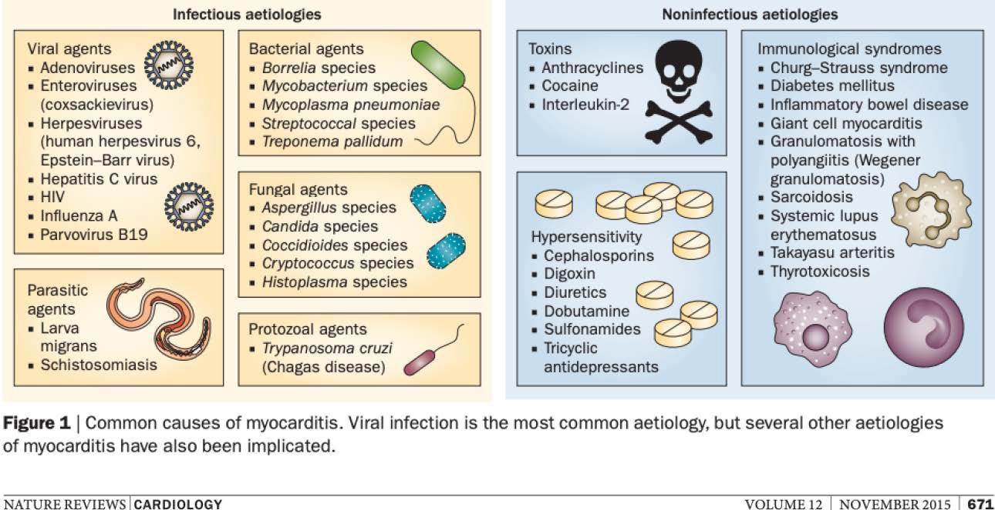
Causes of “classic” myocarditis

Slide 10
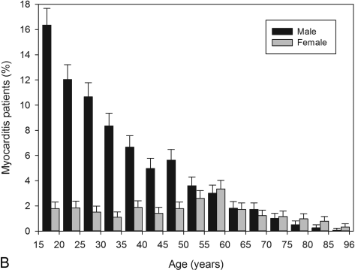
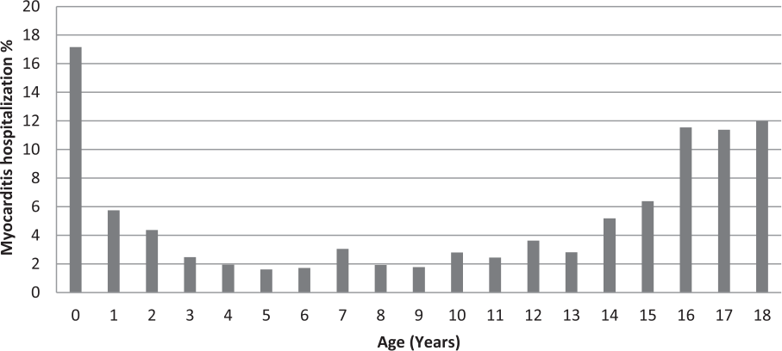
Epidemiology of myocarditis in pre-COVID era
Children
Annual incidence 0.8 per 100,000
In persons aged 15-18 years, 1.8 per 100,000 in 2015-2016
66% male
Median length of stay 6.1 days
Adults
Gradual decrease in incidence with age
76% male
Vasudeva et al. American J Cardiology. 2021.
Kyto et al. Heart. 2013.

Slide 11
Outcomes of “Classic” Myocarditis in Children
Mortality: 4-7% during acute illness
Heart Transplant: 4-9%
Ghelani et al. Circ Cardiovasc Qual Outcomes. 2012 Butts et al. Pediatric Cardiology. 2017
Sachdeva et al. Am J Cardiol.2015

Slide 12
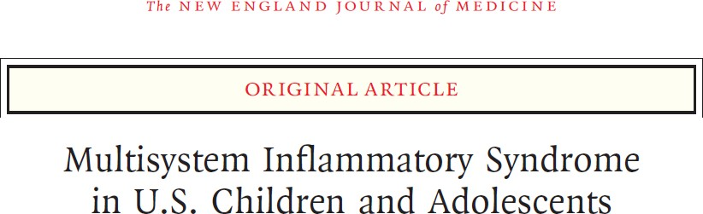
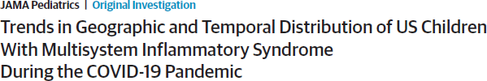
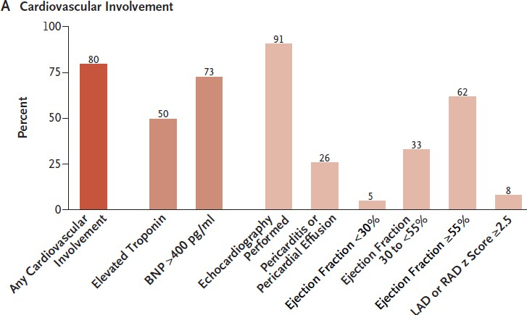
MIS-C Myocarditis
Belay et al. 2021
Feldstein et al. 2020

Slide 13

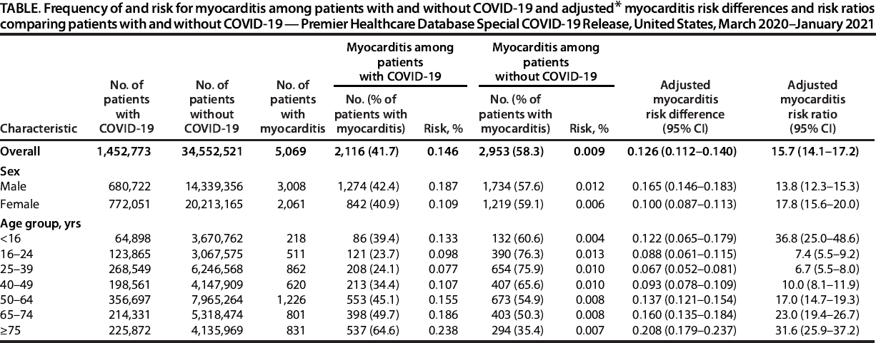
COVID-19 Myocarditis
Boehmer et al. 2021

Slide 14
COVID-19 Myocarditis
Boehmer et al. 2021

Slide 15


COVID-19 Myocarditis
Pediatric inpatient admissions
 | Myocarditis Diagnosed (%) | Myocarditis NOT Diagnosed (%)
COVID-19 (without MIS-C) | 78 (0.02%) | 356,721 (99.98%)
MIS-C | 203 (8.10%) | 2303 (91.90%)
 | Myocarditis Diagnosed (%) | Myocarditis NOT Diagnosed (%)
COVID-19 (without MIS-C) | 20 (0.08%) | 24,144 (99.92%)
MIS-C | 172 (9.04%) | 1730 (90.96%)
https://www.epic.com/software#Cosmos
https://www.childrenshospitals.org/phis

Slide 16

Comparing Types of Myocarditis
Patel et al. 2021

Slide 17
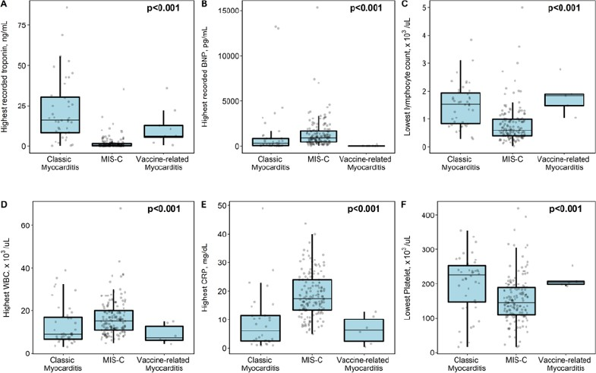
Troponin
BNP
Lymphocytes
C-reactive protein
White blood cells
Platelets
Patel et al. 2021

Slide 18
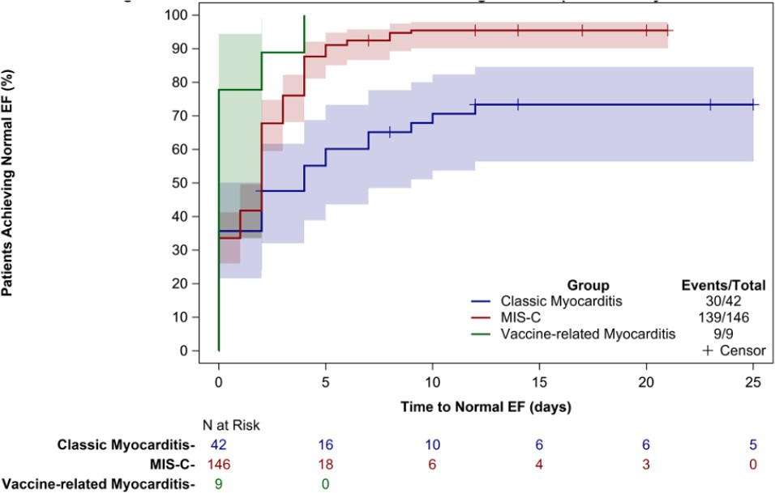
Comparing Types of Myocarditis:
Time to Normal Ejection Fraction (EF) by Echocardiogram
Patel et al. 2021

Slide 19
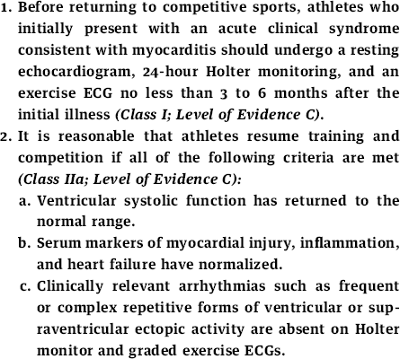
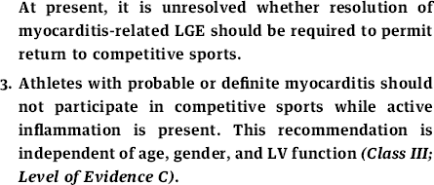
3-6 month outcomes
Risk of sudden death pre-COVID
5-10% of sudden death in adolescents and young adults attributable to myocarditis (typically not previously diagnosed)
2015 Guidelines from American Heart Association and American College of Cardiology
Maron et al. JACC. 2015 Burns et al. J Peds X. 2020.

Slide 20
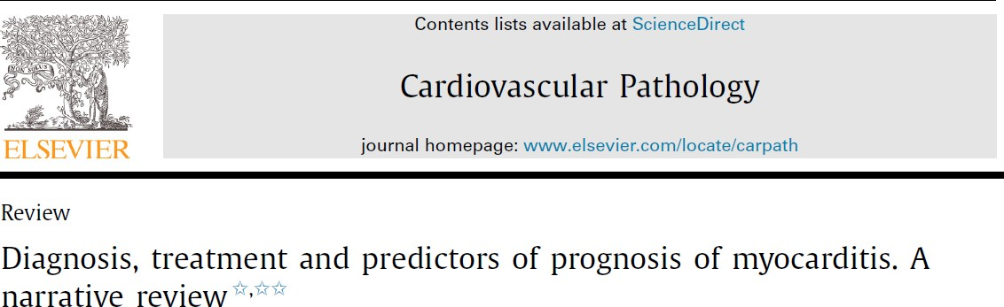
Pre-COVID Myocarditis Outcomes
Picarillo et al. 2021

Slide 21
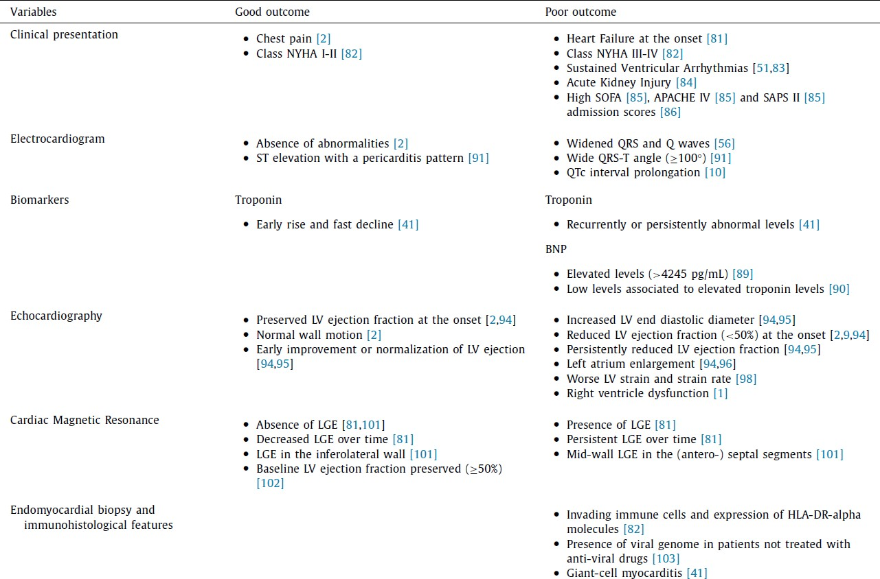
Picarillo et al. 2021

Slide 22
Picarillo et al. 2021

Slide 23
LGE=Late gadolinium enhancement
Picarillo et al. 2021

Slide 24
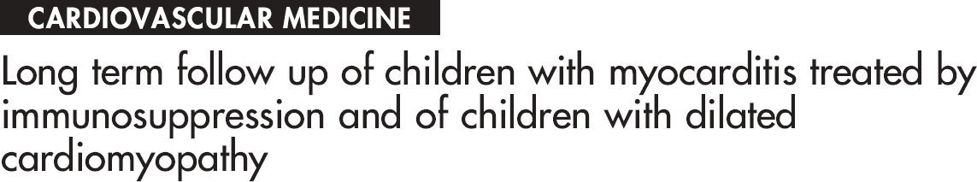
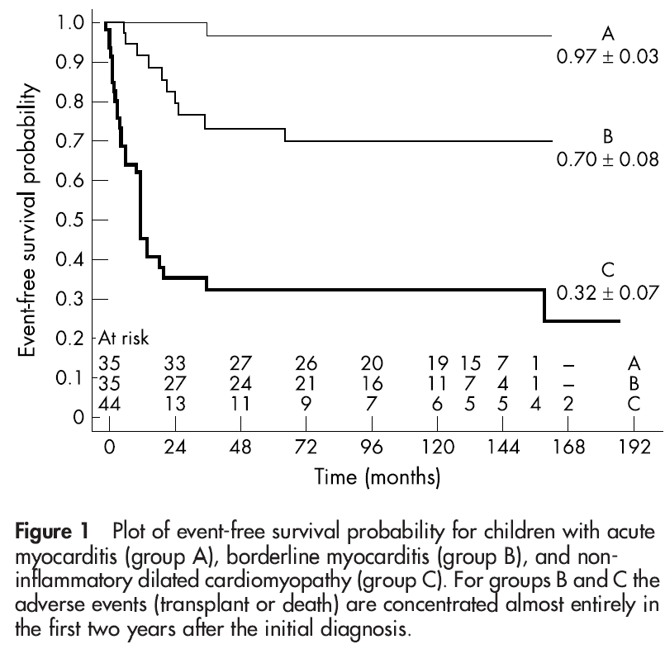
Pre-COVID Myocarditis Outcomes
Acute Myocarditis
Borderline Myocarditis
Non-inflammatory dilated cardiomyopathy
Giulia Gagliardi et al. Heart 2004

Slide 25
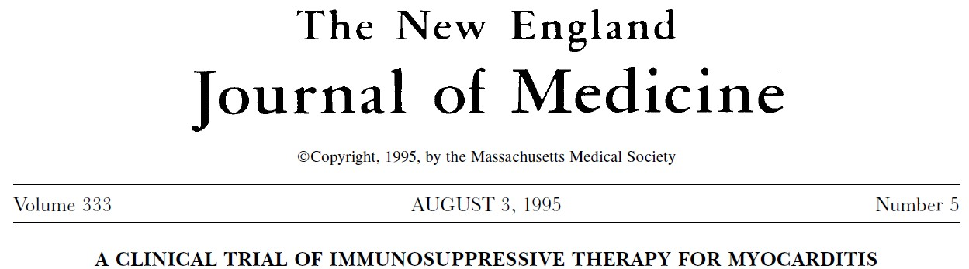
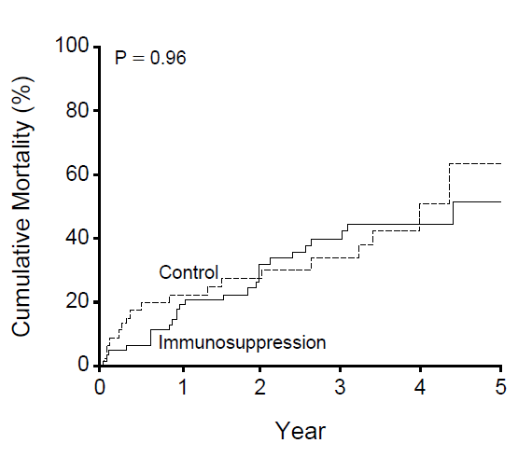

Pre-COVID Myocarditis Outcomes
Adults mean age 42 years
N=111 total
Mason et al. 1995

Slide 26
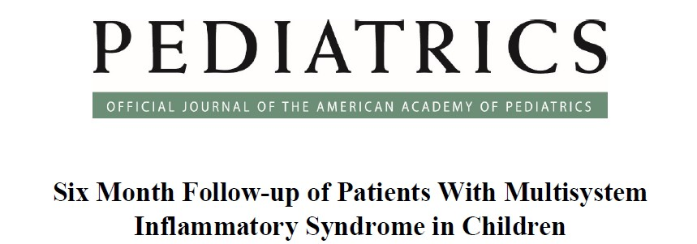
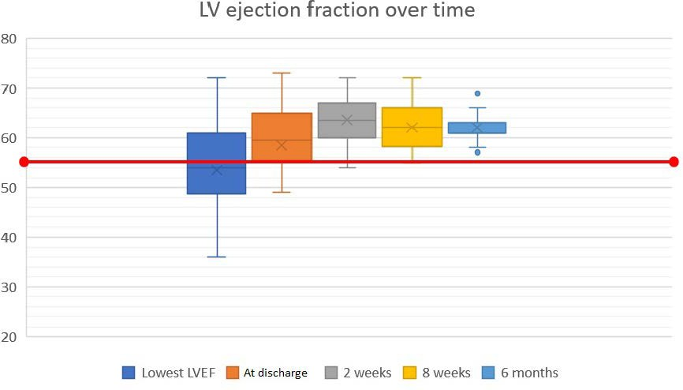
3-6 Month Outcomes
Normal ejection fraction
50 children
Median age 8.5 years
Capone et al. 2021

Slide 27
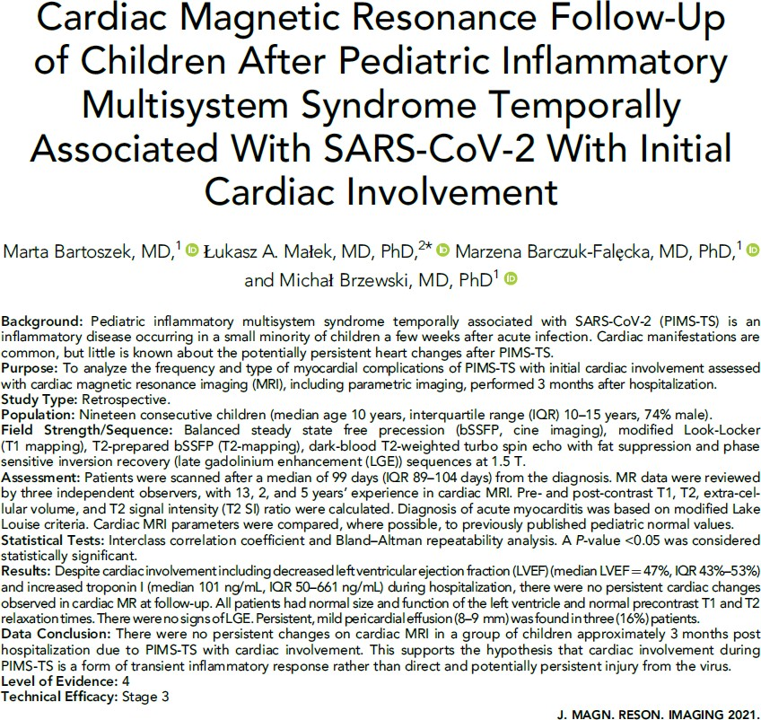
3-6 Month Outcomes

Slide 28
3-6 Month Outcomes
“…there were no persistent cardiac changes observed in cardiac MR at follow-up”

Slide 29
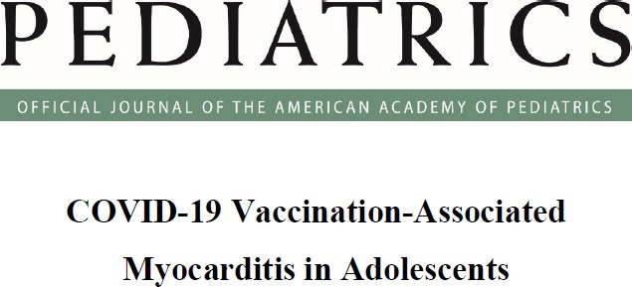
3-6 Month Outcomes
54 patients
Mean age 15.6 years, 92% male
Follow up mean 35 days since vaccination
7 (13%) with persistent symptoms
Echocardiogram: All normal
ECG: 80% normal
Troponin: 24/27 normal, 3/27 borderline
MRI: Follow-up obtained in 2 (at 66 and 71 days)
Improvement in myocardial edema
Persistence of Late Gadolinium Enhancement (improved in 1 patient)
Jain et al. 2021

Slide 30
Vaccine Safety Datalink Preliminary Data Confirmed myocarditis/pericarditis 0-21 days after any dose of an mRNA Vaccine: 3-month Follow-up Chart Review
As of October 9, 2021, chart reviews have been completed for 47 cases that were time-eligible for 3-month follow-up review
Of these, 37 had at least 1 follow-up visit at least 7 days since the initial encounter
These 37 cases were reviewed to obtain information regarding
symptoms and diagnostic evaluation at most recent follow-up visit
any additional doses of COVID-19 vaccine since initial encounter
recovery status for
ongoing symptoms
medication
exercise restrictions
30

Slide 31
Vaccine Safety Datalink Confirmed Myocarditis/pericarditis 0-21 Days after Any Dose of mRNA Vaccine by Age Group/Product: 3 month follow-up review of Cases with at least 1 follow-up visit
since initial episode
 | 12-17 Year-Olds (Pfizer) N=10* | 18-39 Year-Olds (Pfizer) N=12 | 18-39 Years-Olds (Moderna) N=15
Time from symptom onset to most recent follow-up visit (median, range) | 75 days (13 – 111 days) | 72 days (16 – 179 days) | 47 days (9 – 150 days)
Follow-up visit at least 3 months since initial encounter | 3 (30%) | 5 (42%) | 6 (40%)
Additional vaccine doses since initial review | 0 | 0 | 1 (Janssen)
No new or worsening symptoms noted | 5 (50%) | 9 (75%) | 12 (80%)
Any new or worsening symptom | 5 (50%) | 3 (25%) | 3 (20%)
Chest pain/pressure/discomfort | 3 | 2 | 3
Shortness of breath/pain with breathing | 2 | 1 | 1
Palpitations | 3 | 0 | 1
Fatigue | 1 | 1 | 1
Elevated heart rate | 0 | 1 | 1
Other (orthostatic hypotension, dizziness, etc.) | 2 | 1 | 0
Troponin levels obtained | 9 (90%) | 6 (50%) | 7 (47%)
Abnormal troponin level | 2 | 3 | 4
ECG completed | 7 (70%) | 8 (67%) | 6 (40%)
Abnormal findings | 3 | 3 | 5
Echocardiogram completed | 8 (80%) | 3 (25%) | 6 (40%)
Abnormal findings | 1 | 0 | 2
Cardiac MRI completed | 1 (10%) | 0 | 0
Abnormal findings | 0 | NA | NA
31
* 4 of these cases had been in the ICU at their initial encounter.

Slide 32
Vaccine Safety Datalink Confirmed Myocarditis/pericarditis 0-21 Days after Any Dose of mRNA Vaccine by Age Group/Product: 3 month follow-up review of Cases with at least 1 follow-up visit since initial episode
3-month chart review status | 12-17 Year- Olds (Pfizer) N=10 | 18-39 Year- Olds (Pfizer) N=12 | 18-39 Year- Olds (Moderna) N=15
Current Status (not mutually exclusive)
Recovered, no medication, exercise restriction or symptoms | 3 (30%) | 6 (50%) | 8 (53%)
Still symptomatic | 4 (40%) | 5 (42%) | 2 (13%)
Still on medication (primarily NSAIDS, Colchicine) | 0 (0%) | 3 (25%) | 6 (40%)
Still on exercise/physical activity restrictions | 5 (50%) | 2 (17%) | 0 (0%)
32

Slide 33
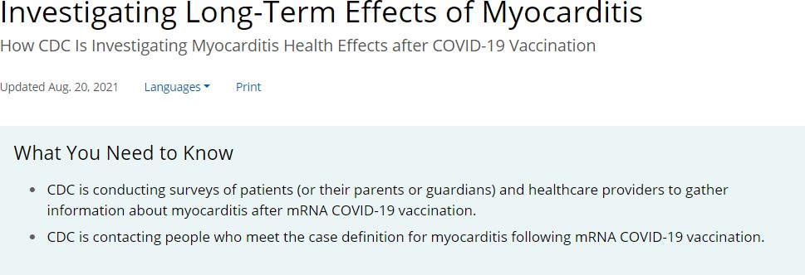
3-6 Month Outcomes
https://www.cdc.gov/coronavirus/2019-ncov/vaccines/safety/myo-outcomes.html

Slide 34
CDC enhanced surveillance for myocarditis outcomes after mRNA COVID-19 vaccination in VAERS case reports
Purpose: Assess functional status and clinical outcomes among individuals reported to have developed myocarditis after mRNA COVID-19 vaccination
Methods: A two-component survey conducted at least 90 days after the onset of myocarditis symptoms
Patient survey: Ascertains functional status, clinical symptoms, quality of life, and need for medication or other medical treatment
Healthcare provider (e.g., cardiologist): Gather data on cardiac health and functional status
Status: Data collection phase
https://www.cdc.gov/coronavirus/2019-ncov/vaccines/safety/myo-outcomes.html
34

Slide 35
CDC enhanced surveillance for myocarditis outcomes after mRNA COVID-19 vaccination in VAERS case reports
As of August 2021, VAERS had received 826 reports of myocarditis or myopericarditis after COVID-19 vaccination that met case definition
To date, around 680 patients have reached 90 days post-myocarditis diagnosis
Of these, 282 (41%) have received at least one phone call
‒ Of the 282 patients who have received a call, 168 (60%) completed the survey and 67 (24%) were unreachable or declined to participate
Of the 168 patients surveyed, 132 (79%) provided cardiologist or healthcare provider contact information
Of the 132 cardiologist or healthcare providers, 26 have completed the survey
Remaining 106 in the process of being contacted
https://www.cdc.gov/coronavirus/2019-ncov/vaccines/safety/myo-outcomes.html
35

Slide 36
Summary
Myocarditis is a rare but important adverse event following COVID-19 vaccination
Not all myocarditis is the same
Early follow-up results of COVID-19 vaccine-associated myocarditis sparse
Ongoing follow-up in progress

Slide 37




Thank you!
Acknowledgments:
CDC COVID-19 Vaccine Task Force, Vaccine Safety Team
Clinical Immunization Safety Assessment Project
Tom Shimabukuro, John Su, CDC Vaccine Task Force
Nicola Klein, Vaccine Safety Datalink
Sam Butler, EPIC
Matt Hall and Cary Thurm, Children’s Hospital Association
For more information, contact CDC 1-800-CDC-INFO (232-4636)
TTY: 1-888-232-6348 www.cdc.gov
The findings and conclusions in this report are those of the authors and do not necessarily represent the official position of the Centers for Disease Control and Prevention.

