Slide 1

Benefits-Risks of Pfizer-BioNTech COVID-19 Vaccine for Ages 5 to 11 Years
Hong Yang, Ph.D.
Senior Advisor for Benefit-Risk Assessment Office of Biostatistics and Epidemiology Center for Biologics Evaluation and Research
FDA VRBPAC, October 26, 2021
1

Slide 2
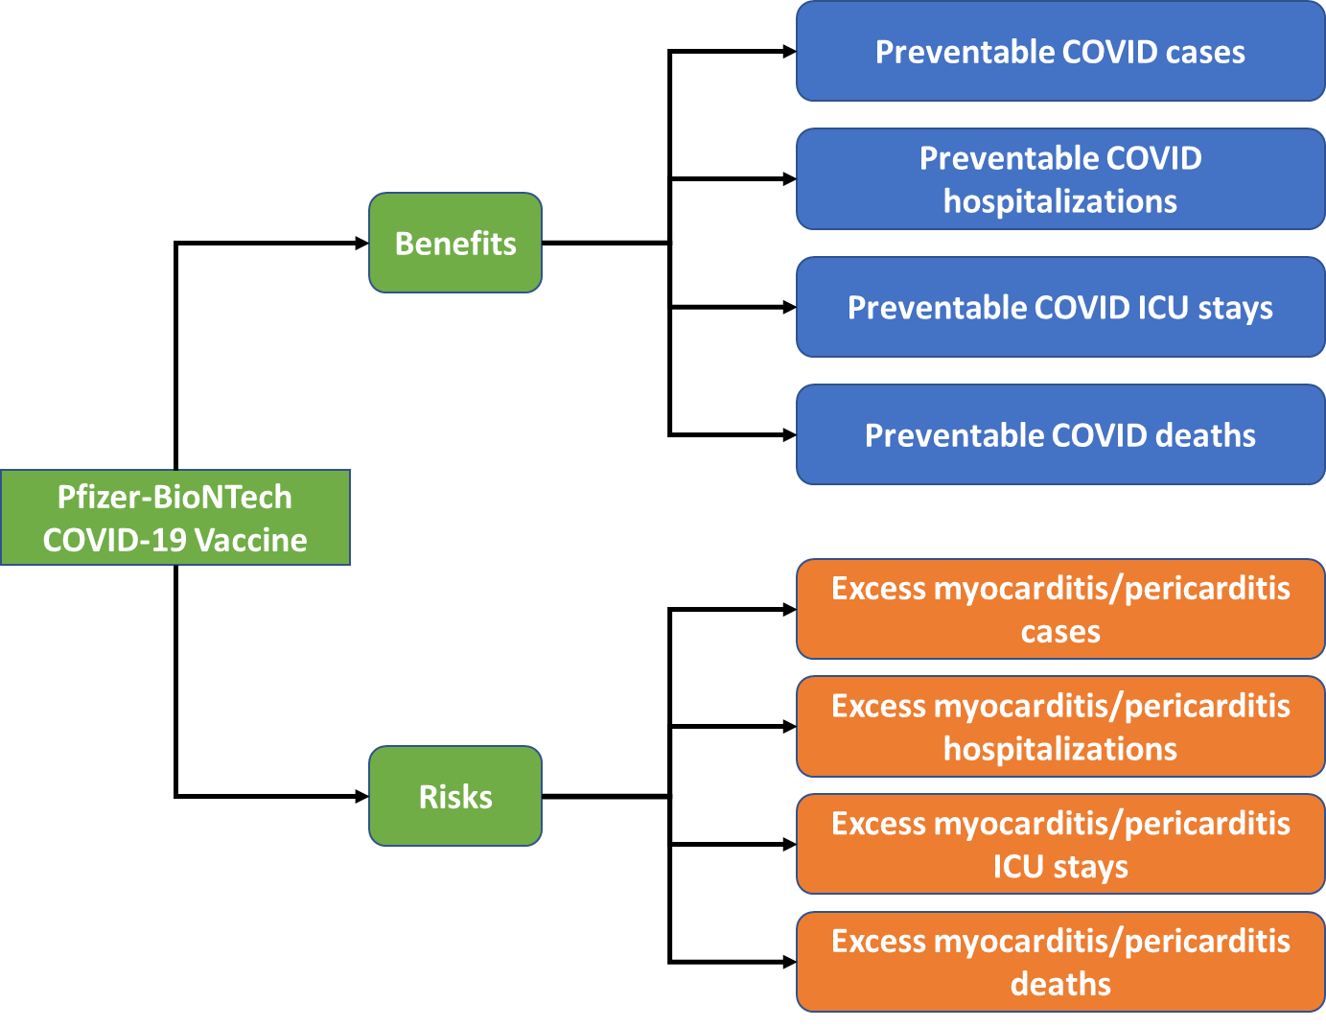
Benefits and Risks Per 1 Million Fully- Vaccinated
(Ages 5 to 11 years/male, female and all sexes)
2

Slide 3
Assumptions and Model Inputs - Scenario 1 (Base)
General assumptions
Duration of vaccine protection: 6 months post 2nd dose (constant vaccine efficacy)
Stable COVID-19 pandemic for 6-month period (constant incidence rates for COVID-19 cases, hospitalizations, ICU stays and deaths)
Benefits COVID-19 related incidence rates: Case: the week of September 11, 2021 from CDC Hospitalization: average of four weeks prior to September 11, 2021 from COVID NET¹ ICU stay and death: historical average rates among those hospitalized from COVID NET¹ Vaccine efficacy: 70% against case and 80% against hospitalization, ages 20-64 years (Pfizer vaccine efficacy study²) | Risks Incidence of excess myocarditis/pericarditis: OPTUM data for ages 12-15 years through July 10 Rate of hospitalization and ICU stay due to vaccine related myocarditis for ages 12-17 years: from Vaccine Safety Datalink (VSD)³ Hospitalization: 87% ICU stay: 32% Myocarditis death rate: zero
¹COVID NET https://www.cdc.gov/coronavirus/2019-ncov/covid-data/covid-net/purpose-methods.html
²CDC vaccine effectivness study: https://www.cdc.gov/vaccines/acip/meetings/downloads/slides-2021-09-22/04-COVID-Link-Gelles-508.pdf
³ACIP Meeting August 30, 2021: https://www.cdc.gov/vaccines/acip/meetings/downloads/slides-2021-08-30/04-COVID-Klein-508.pdf
3

Slide 4
Key Uncertainties & Alternative Model Scenarios
COVID-19 incidence rates
  Uncertainty in pandemic
    Scenario 2 (Recent COVID-19 Peak Incidence): incidences of cases & hospitalizations are 20% and 30% higher than incidences the week of September 11, 2021
    Scenario 3 (The Lowest COVID-19 Incidence): incidences of cases & hospitalizations are 5% and 10% of the incidences the week of September 11, 2021
COVID-19 death rate
  Reported death rate by CDC Data Tracker is about 3x higher than the rate from COVID NET
    Scenario 5 (Higher COVID-19 Death Rate): death rate from CDC Data Tracker
4

Slide 5
Key Uncertainties & Alternative Model Scenarios (continued)
Vaccine efficacy
  A sponsor’s supportive efficacy analysis¹ suggests 90.7% efficacy against infection among ages 5-11 years (data accrued through Oct. 8, 2021)
    Scenario 4 (Higher Vaccine Efficacy): 90% against case and 100% against hospitalization
Incidence of excess myocarditis cases
  The rate for ages 12-17 years is applied to ages 5-11 years for whom the data is not available
  large variation on the incidence of excess myocarditis cases among different data sources (such as OPTUM, VSD and VAERS)
    Scenario 6 (Lower Excess Myocarditis Rate): rate of excess myocarditis cases is 50% lower than that for ages 12-17 years from OPTUM
¹Pfizer's Vaccines and Related Biological Products Advisory Committee Briefing Document on BNT162B2 Retrieved from
https://www.fda.gov/media/153409/download on October 24, 2021
5

Slide 6
Benefit Risk Assessment Results

Slide 7
Scenario 1 (Base)
COVID incidences the week of September 11, 2021
Vaccine efficacy 70% against case and 80% against hospitalization
Rate of excess myocarditis: OPTUM data for ages 12-15 years

Slide 8
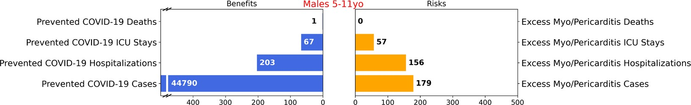
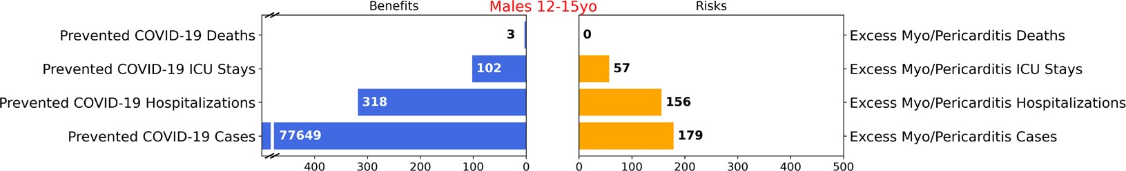
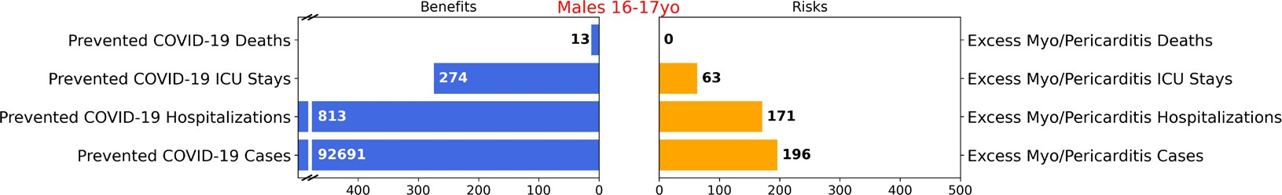
MALES (Cases Per Million)
Note:
Median hospitalization length of stay is 6 days for COVID and 1 day for vaccine related myocarditis

Slide 9
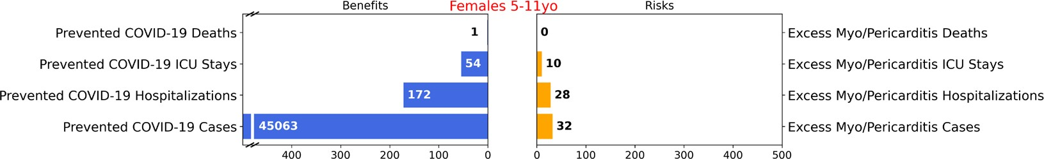
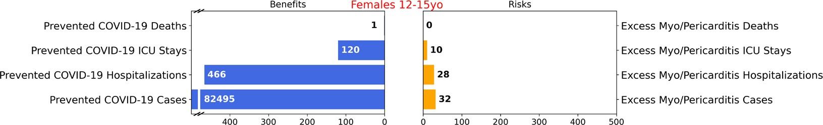
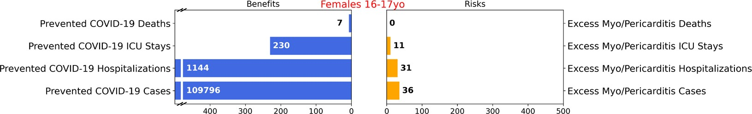
FEMALES (Cases Per Million)

Slide 10
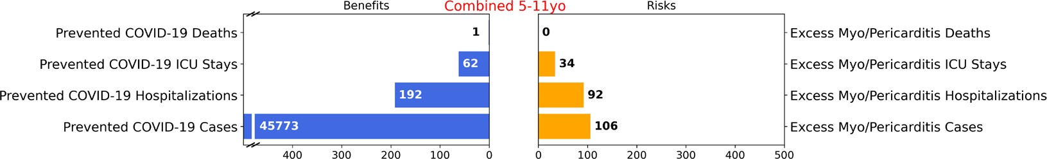
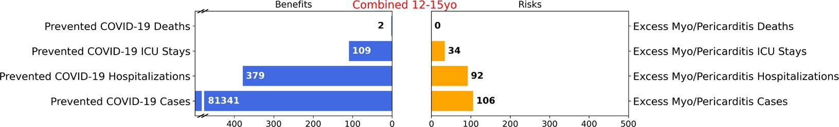
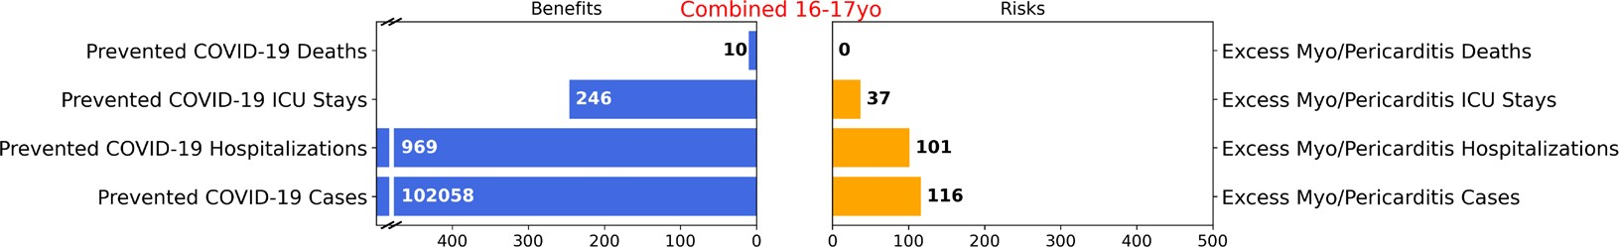
MALES AND FEMALES (Cases Per Million)

Slide 11
Scenario 2 (Recent COVID-19 Peak Incidence)
COVID cases are 20% and Hospitalizations are 30% higher than the week September 11, 2021

Slide 12
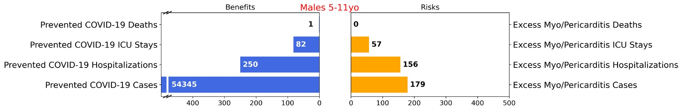
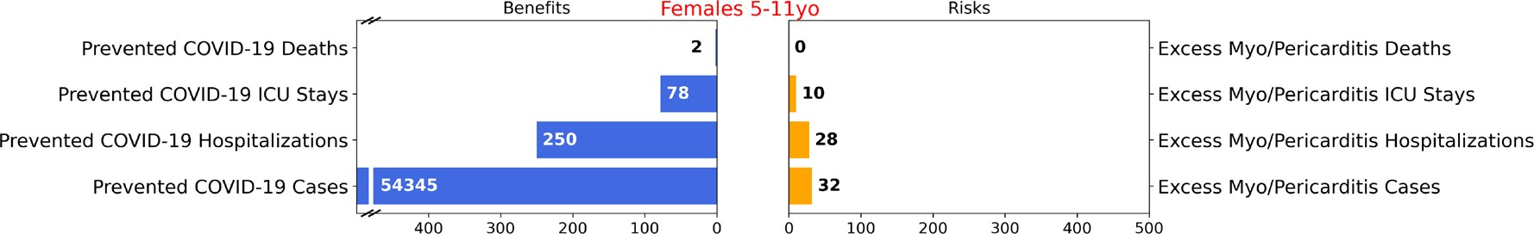
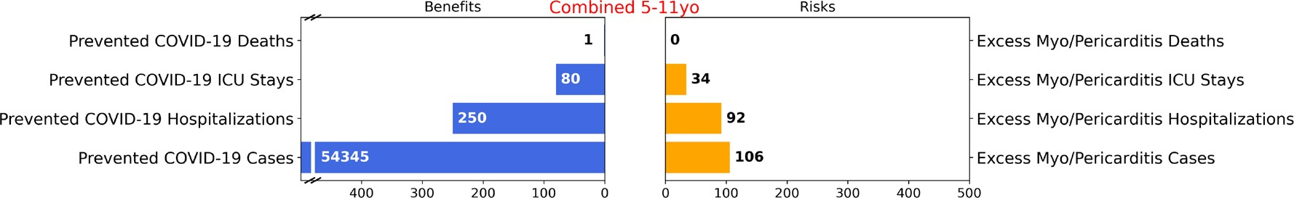
Scenario 2: Cases Per 1 Million Fully- Vaccinated

Slide 13
Scenario 3 (The Lowest COVID-19 Incidence)
COVID cases are 5% and Hospitalizations are 10% of September 11, 2021

Slide 14
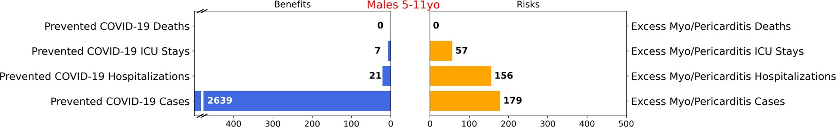
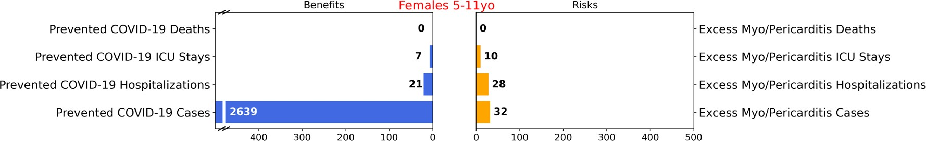
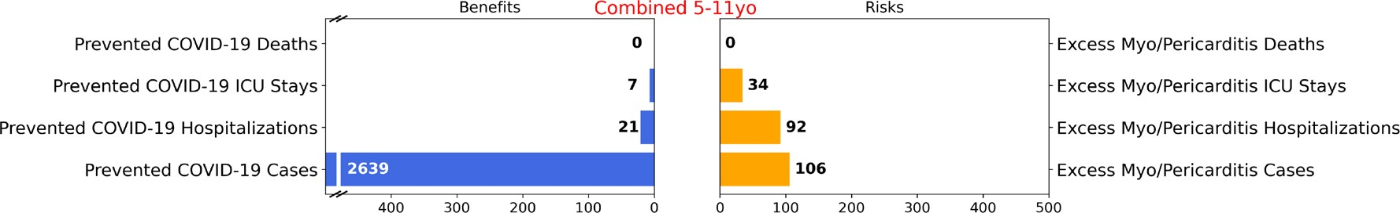
Scenario 3: Cases Per 1 Million Fully- Vaccinated

Slide 15
Scenario 4 (Higher Vaccine Efficacy)
Vaccine efficacy of 90% against case and 100% against hospitalization

Slide 16
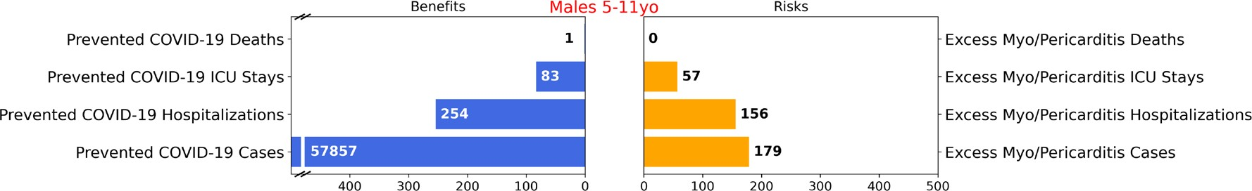


Scenario 4: Cases Per 1 Million Fully- Vaccinated

Slide 17
Scenario 5 (Higher COVID Death Rate)
COVID-19 death rate from CDC Data Tracker

Slide 18


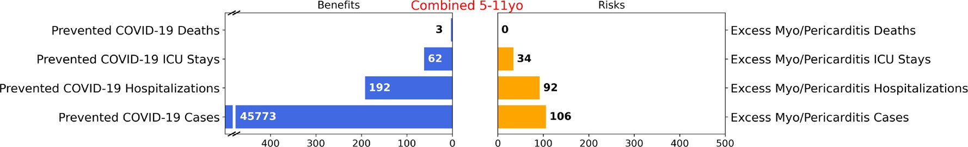
Scenario 5: Cases Per 1 Million Fully- Vaccinated

Slide 19
Scenario 6 (Lower Excess Myocarditis Rate)
50% lower myocarditis case rate compared to data for ages 12-17 years from OPTUM

Slide 20


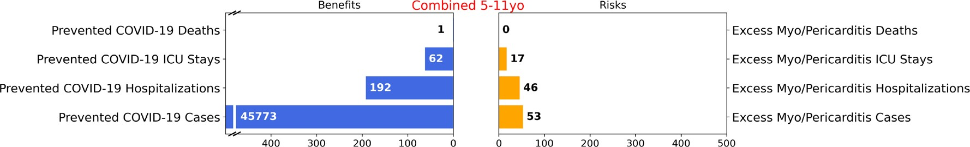
Scenario 6: Cases Per 1 Million Fully- Vaccinated

Slide 21
Major Limitations
Model assumption about constant incidence rate generates great uncertainty on the estimate of benefits.
Vaccine efficacy may change due to new emerging variants of virus
Hospitalizations and ICU stays from COVID-19 and myocarditis are not equivalent and cannot directly compared
The benefit of reducing COVID related multisystem inflammatory syndrome in children may not be fully captured by preventable
hospitalizations, ICU stays and deaths due to COVID-19
This BR risk assessment does not consider potential long-term adverse effects due to either COVID-19 or myocarditis
This BR assessment does not include secondary benefits (reducing COVID-19 disease transmission) and risks

Slide 22
Conclusions
For Scenarios 1 (Base), 2 (Recent COVID-19 Peak Incidence), 4 (Higher Vaccine Efficacy), 5 (Higher COVID-19 Death Rate), and 6 (Lower Excess Myocarditis Rate) the model predicts that benefits of the Pfizer-BioNTech COVID-19 Vaccine 2-dose primary series clearly outweigh the risks for ages 5-11 years.
For Scenario 3 (The Lowest COVID-19 Incidence), the model predicts more excess hospitalizations and ICU stays due to vaccine-related myocarditis/pericarditis compared to prevented hospitalizations and ICU stays due to COVID-19 in males and in both sexes combined.
Considering the different implications and length of stay for COVID-19 hospitalization versus hospitalization for vaccine-associated myocarditis/pericarditis, and benefits related to prevention of cases of COVID-19 with significant morbidity, the overall benefits of the vaccine may still outweigh the risks under this lowest incidence scenario.
If the myocarditis/pericarditis risk in this age group is lower than the conservative assumption used in the model, the benefit-risk balance would be even more favorable. ₂₂

Slide 23
Acknowledgements
Drs. Patrick Funk, Osman Yogurtcu and Richard Forshee for contribution to benefit-risk assessment
Vaccine Task Force at the Centers for Disease Control and Prevention shared initial benefit-risk assessment model and data on COVID-19 pandemic
Acumen and OPTUM Team provided myocarditis case data
Drs. Leslie Ball, Sairah Thommi, Doran Fink and many other CBER colleagues provided inputs to this analysis
23

