Slide 1
Why vaccinate children for COVID-19?
Presented by: Dr. Thomas Weiser, Dr. Allison Empey, Tyanne Conner, MS
Date: 11/16/21

Slide 2
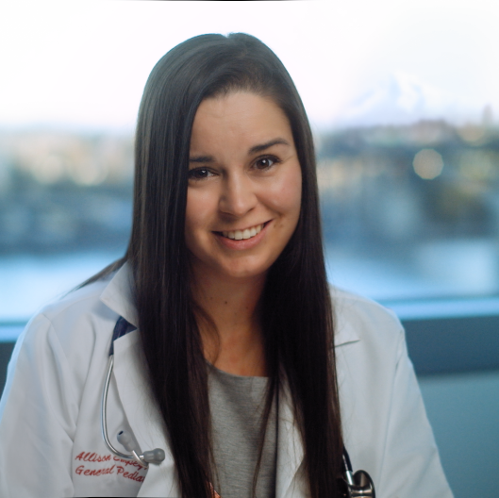


Meet the team
Allison Empey, MD
CAPT Thomas Weiser, MD, MPH
Tyanne Conner, MS
Pediatrician, OHSU
Confederated Tribes of Grand Ronde
Medical Epidemiologist
Portland Area IHS assigned to NPAIHB
Native Boost Coordinator, NPAIHB
tconner@npaihb.org
Notes:
[use for 3 presenters, hosts or contact]

Slide 3

Agenda
Introductions
Ask your questions
Answers to other questions
Tips for talking to others about vaccines
Notes:
[Agenda or table of contents]

Slide 4

How did CDC decide to recommend COVID-19 vaccines for children?

Slide 5
CDC/ACIP Process
Are children at risk of COVID-19 ?
YES!
Children are at least as likely to be infected with SARS-CoV-2 as adults
Over 1.9 million reported cases in children;
It’s likely 1/3 of children 5-11 have antibodies (already were infected)
Infections in children less likely to be reported than adults because may have mild or or no symptoms
Source: CDC ACIP Meeting 11/2/21
Notes:
[section / title at top left should be SHORT to fit the space]

Slide 6
CDC/ACIP Process
But do children get really sick from COVID-19?
Children 5-11 years of age are at risk of severe illness from COVID-19
More than 8,300 COVID-19 related hospitalizations as of mid-October
This number is similar to hospitalizations for flu before the pandemic
As with flu, COVID-19 hospitalizations are serious;
  94 deaths have been reported in this age group since pandemic began
  About 1/3 of hospitalized children 5–11 years require ICU admission
  Multi-system Inflammatory Syndrome-Children (MIS-C) most frequent among children 5–11 years with 2,316 cases reported
  Post-COVID conditions have also been reported in children
Source: CDC ACIP Meeting 11/2/21
Notes:
[section / title at top left should be SHORT to fit the space]

Slide 7
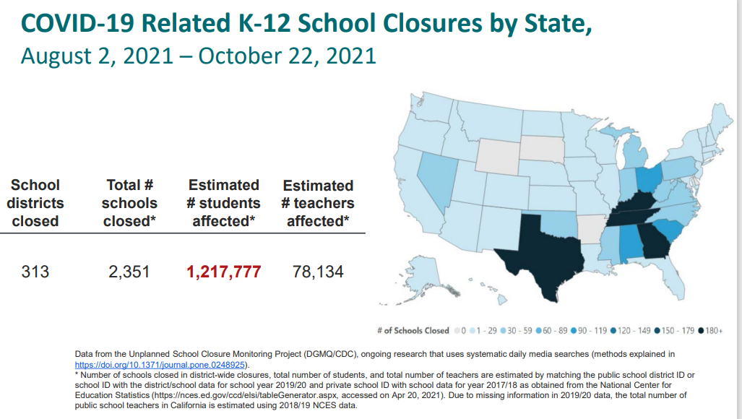
CDC/ACIP Process
Can children spread COVID-19?
YES! Young and school aged children may spread COVID-19 in household, school, and childcare settings
Source: CDC ACIP Meeting 11/2/21
Notes:
This is likely an underestimate of spread, as some classrooms may close (not whole schools), as happened in the Beaverton School District

Slide 8
CDC/ACIP Process
Is the COVID vaccine safe for my child?
YES!
There were no deaths and no Serious Adverse Events (SAE) linked to the vaccine
SAEs are regularly documented during testing of any vaccine
SAEs in the initial enrollment group(median follow-up 3.3 months)
  1 child who received the vaccine (n=1518) had a limb fracture and 1 child in the placebo group (n=750) had abdominal pain and pancreatitis
SAEs in the Safety Expansion Group (median follow-up 2.4 weeks)
  3 SAES in the vaccine group (n=1591): infective arthritis, ingestion of a penny and epiphysial fracture; none in the placebo (n=788)
Source: CDC ACIP Meeting 11/2/21
Notes:
[section / title at top left should be SHORT to fit the space]

Slide 9
CDC/ACIP Process
What short-term side effects should I expect for my child?
Local reactions included: redness, swelling, pain at the injection site; systemic reactions included: fever, nausea/vomiting, headache, fatigue, chills, new or worsened muscle pain, new or worsened joint pain.
2.7% of children in the vaccine arm and 1.1% in the placebo arm had local or systemic reactions that were severe or higher; 1 child in the vaccine arm had fever >40.0°C
  Reactions were most common after Dose 2
  Pain at injection site, fatigue and headache were seen the most
Source: CDC ACIP Meeting 11/2/21
Notes:
[section / title at top left should be SHORT to fit the space]

Slide 10
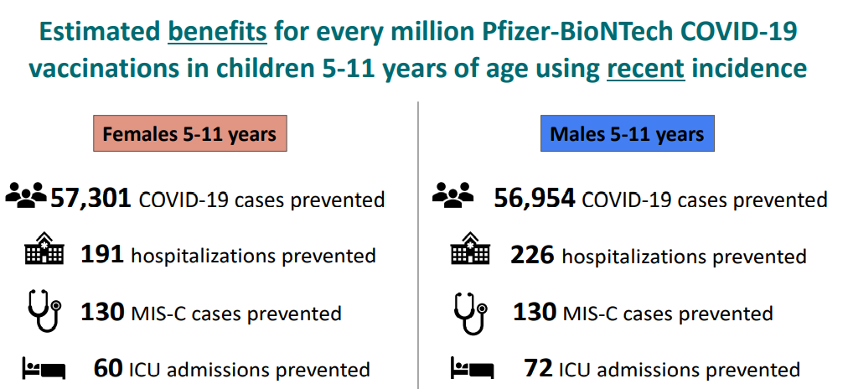
CDC/ACIP Process
What about the risk of heart problems like myocarditis?
Assumptions: Benefits accrue over 180 days (6 months);
VE against symptomatic COVID-19: 90%; VE against hospitalization: 95%;
All data are from the week ending on 9/11/2021
Source: CDC ACIP Meeting 11/2/21
Notes:
[section / title at top left should be SHORT to fit the space]

Slide 11
CDC/ACIP Process
How well does this vaccine work?
Pfizer-BioNTech COVID-19 vaccine testing in children aged 5–11years
Randomized 2:1 vaccine to placebo (median follow-up time: 3.3 months)
Vaccine efficacy against symptomatic lab-confirmed COVID-19 was 90.9% (95% CI: 68.3%, 98.3%)
  3 cases in the vaccine arm (N=1461; surveillance time: 369 person-years)
  16 cases in the placebo arm (N=714; surveillance time: 179-person-years)
Antibody response was similar to that seen in 16–25-year-olds
Source: CDC ACIP Meeting 11/2/21
Notes:
[section / title at top left should be SHORT to fit the space]

Slide 12
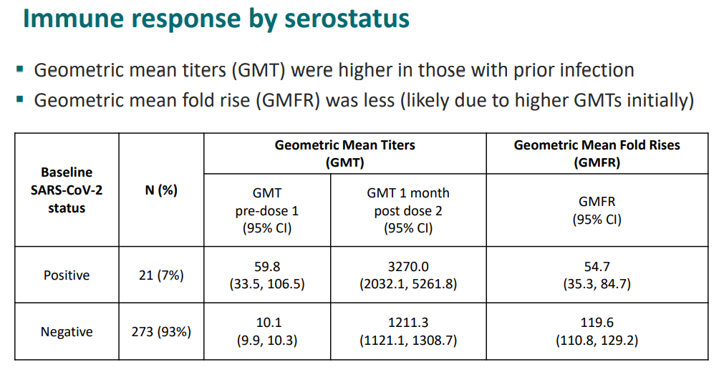
CDC/ACIP Process
What if my child already had COVID-19?
Source: CDC ACIP Meeting 11/2/21
Notes:
[section / title at top left should be SHORT to fit the space]

Slide 13
CDC/ACIP Process
What if my child already had COVID-19? Is it still worth getting the vaccine?
Yes!
Data from Phase 3 Clinical Trial
~9% of children had antibodies against SARS-CoV-2 at baseline
Post-vaccination antibodies were higher in those with antibodies at baseline
Rates of local and systemic reactions, and adverse events, were lower in children who had antibodies at baseline
Data from U.S. Studies
Approximately 38% of children aged 5–11 years have antibodies for SARS-CoV-2
Prior infection can result in protection against infection but not 100%
Children more likely to have asymptomatic infection compared to adults
Source: CDC ACIP Meeting 11/2/21
Notes:
And asymptomatic infection can result in lower antibody levels than seen in those who develop severe disease

Slide 14
Covid-19 vaccines
What are the benefits and risks if my child already had COVID-19?
Benefits of Vaccination
Risks of COVID-19
No concerns identified in safety surveillance with seropositive adolescents and adults
Vaccine recommendations that require serologic testing place unnecessary barriers
Limited data to estimate impact of vaccination of seropositive children, but risks minimal
Overall, the balance of benefits and risks favorable for vaccination of all children
Delta-wave surges of pediatric COVID-19 hospitalizations occurred even with sero-prevalence ~38%, suggesting this alone is not sufficient to provide broad protection
Limited data on rates of reinfection in children
MIS-C typically occurs after asymptomatic or mild infection; post-COVID conditions can also occur after mild infection
It is not entirely known yet what long term or long lasting problem COVID-19 may contribute to
Source: CDC ACIP Meeting 11/2/21
Notes:
[section / title at top left should be SHORT to fit the space]

Slide 15


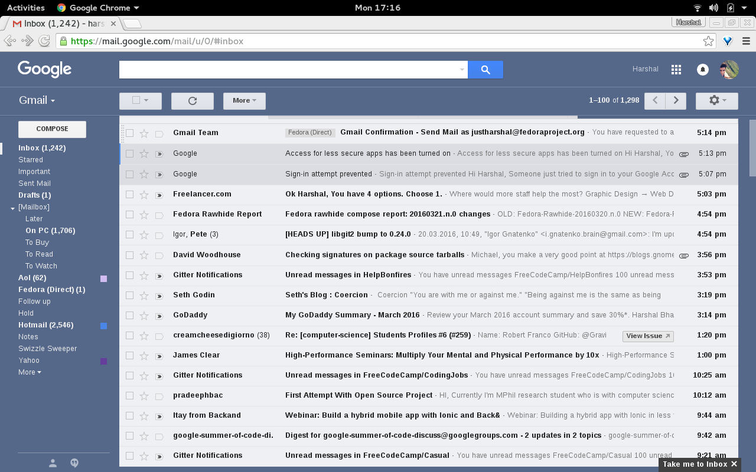

Will the vaccine change my DNA?
RNA vaccines are like an emailed recipe
This Photo by Unknown Author is licensed under CC BY-SA
This Photo by Unknown Author is licensed under CC BY

Slide 16
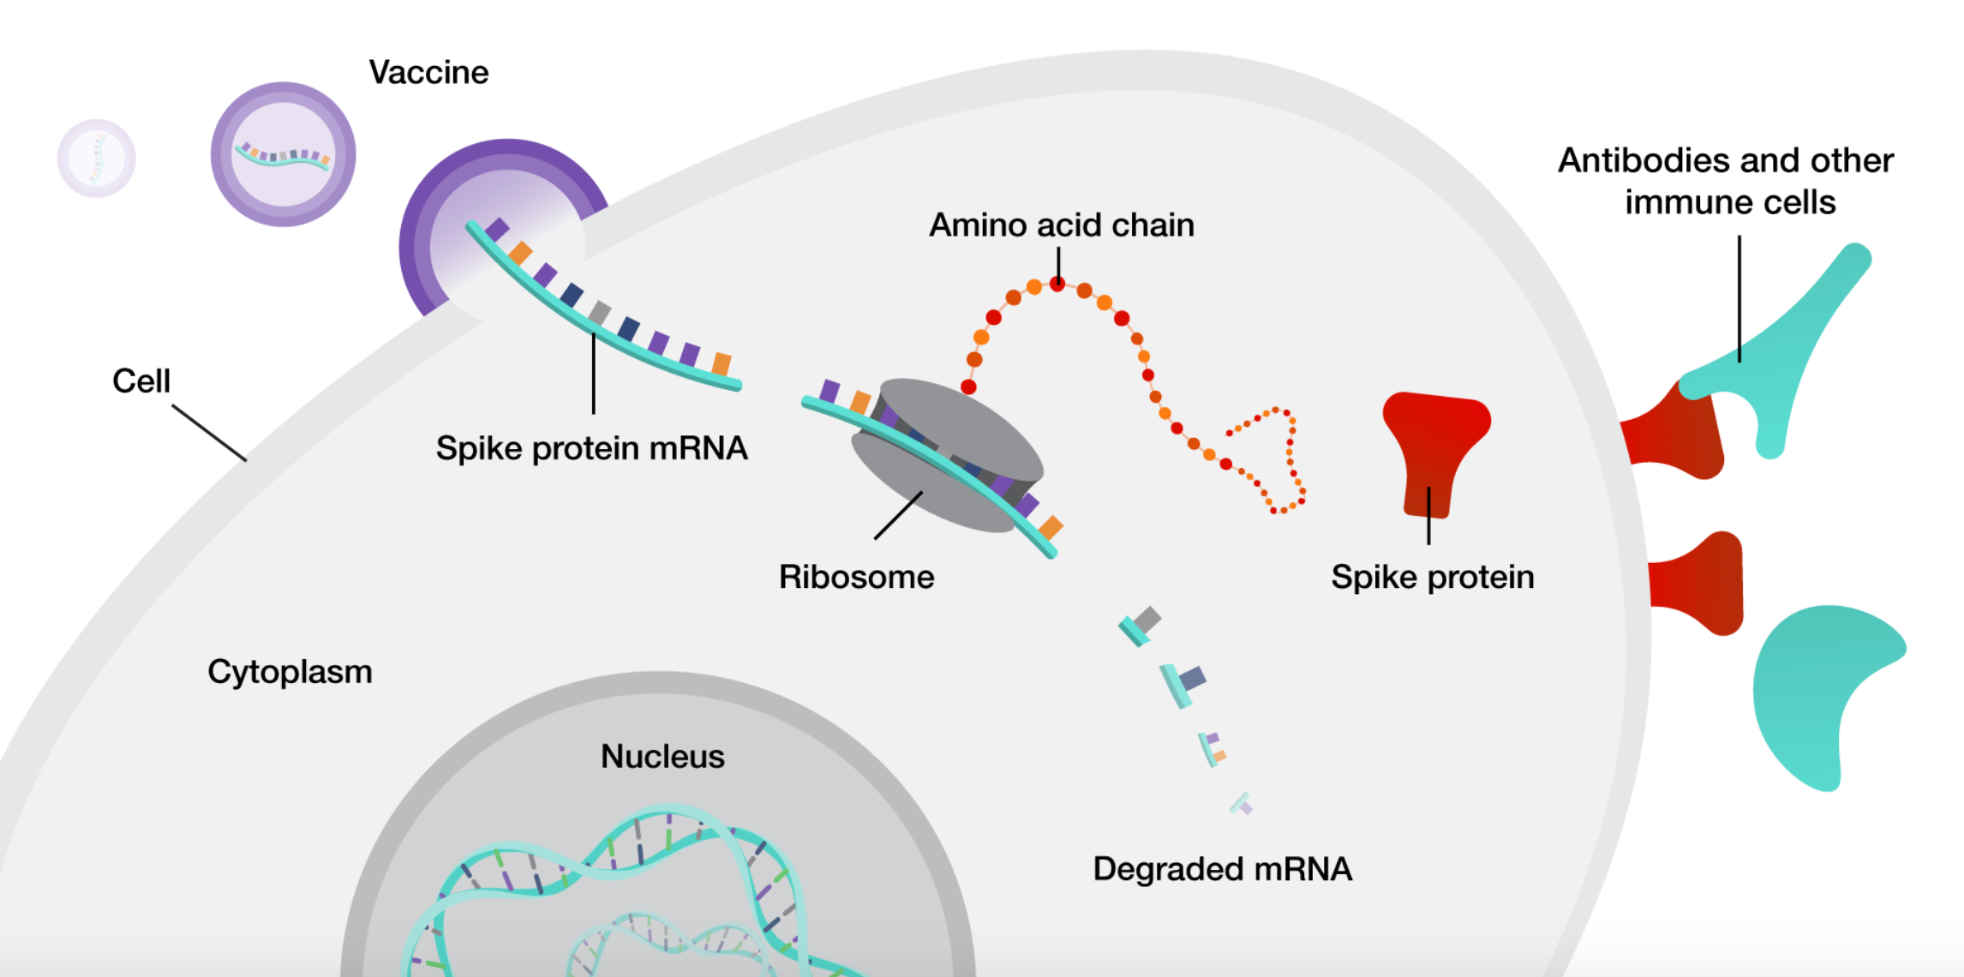

Slide 17
Covid-19 vaccines
Is the Pfizer vaccine the same for school aged kids (5-11) as the vaccine for those12 years and older?
No, the vaccine for ages 5-11 is a smaller dose than the ones for 12 years of age and up
It is about 1/3 of the dose for ages 5-11

Slide 18
Can the vaccine affect fertility?
Covid-19 vaccines
There is currently no evidence that any vaccines, including COVID-19 vaccines, cause fertility problems (problems trying to get pregnant) in women or men.
There is currently no evidence that antibodies made following COVID-19 vaccination or that vaccine ingredients would cause any problems with becoming pregnant now or in the future.
Notes:
In a recent in vitro fertilization (a type of fertility treatment) study, researchers compared pregnancy success rates among three groups of women.
Women with:
Antibodies from having been vaccinated against COVID-19
Antibodies from having a recent infection with the virus that causes COVID-19
No antibodies from either having a recent infection with the virus that causes COVID-19 or from having been vaccinated against COVID-19
The study found no differences in pregnancy success rates among the three groups.¹¹

Slide 19
Covid-19 vaccines
Can my child get other childhood vaccines with or near the Pfizer vaccine?
Yes!
Your child can receive childhood vaccines with the Pfizer vaccine
It is very important to keep up to date on childhood vaccines

Slide 20
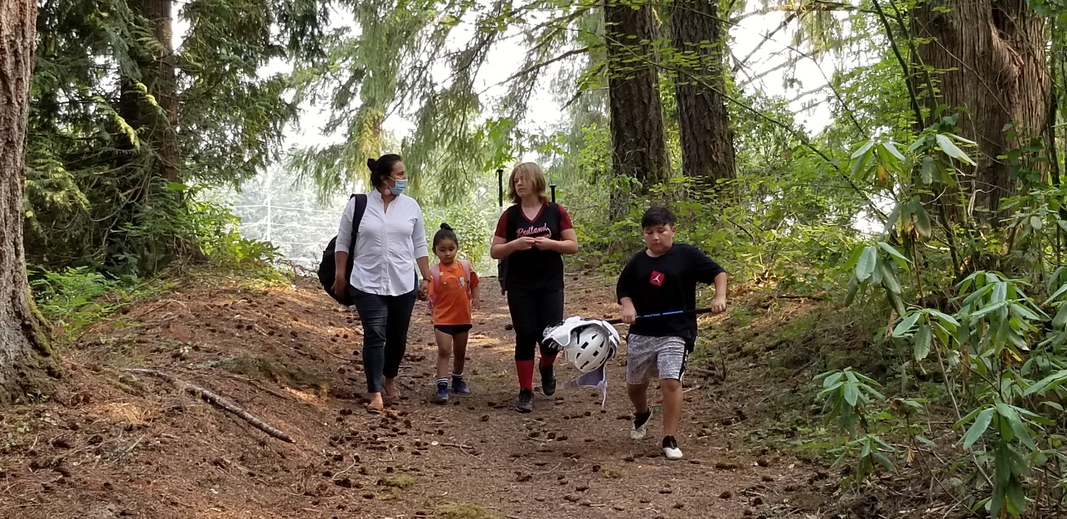
How to talk to Friends and Family
I want to get a vaccine for my child, but how do I talk to my family who don’t?
Listen with empathy
Ask Open-ended questions
Ask permission to share information
Help them find their “Why”
Help make their vaccination happen
https://www.cdc.gov/coronavirus/2019-ncov/vaccines/talk-about-vaccines.html
Notes:
Listen with empathy to understand the root of their concerns. Don’t judge.
Instead of yes/no questions, ask open ended questions such as “What have you seen or heard about the vaccine recently? How does that make you feel?” Again, don’t judge.
Instead of offering unsolicited information, ask if it’s ok to share information. Share quick, accurate answers to common questions. You can also point them to CDC or other reputable resources.
You can share the reasons you got vaccinated and help them find their why. After addressing concerns about “why not”, ask them the reasons why vaccination would be good. Is it to protect themselves and family? Get back to activities they love? Find out what is important to them.

Slide 21
Covid-19 vaccines for children resources
Where do I find more information I can trust?
COVID-19 Vaccination of Minors
U.S. COVID-19 Vaccine Product Information – Official CDC guidance for clinicians on each of the authorized COVID-19 vaccines.
Key Things to Know about COVID-19 Vaccines – Official CDC guidance that can be shared with parents and practice staff on the effectiveness and safety of COVID-19 vaccines, as well as how they’re developed and approved by the FDA.
Myocarditis and Pericarditis Following mRNA COVID-19 Vaccination – These reports are rare, given the hundreds of millions of vaccine doses administered, and have been reported after mRNA COVID-19 vaccination, particularly in adolescents and young adults.
COVID-19 Vaccine: What Pediatricians Can Do Nowexternal icon (American Academy of Pediatrics)
About the COVID-19 Vaccine: Frequently Asked Questionsexternal icon (American Academy of Pediatrics)
The Science Behind COVID-19 Vaccines: Parent FAQsexternal icon (HealthyChildren.org)
Notes:
[section / title at top left should be SHORT to fit the space]

Slide 22


Contact us
Tyanne Conner, Native Boost Coordinator, NPAIHB
tconner@npaihb.org
Please fill out the survey if you would like to participate in a focus group on the topic:
https://www.surveymonkey.com/r/COVIDVaccineforChildrenQuestions

Slide 23

Thank You

